Slide 1
ASTR 535
Observational Techniques
Instruments / Detectors
Introduction

Slide 2
Instruments
What comprises an “instrument”?
Detector
Auxiliary optics, e.g.
modifying shape of focal plane
modifying image quality
changing scale
…
Elements for spectral filtering, e.g.
Filters
Dispersing elements

Slide 3
General considerations for optics
Location of optics: near focal plane vs near pupil
Near focal plane won’t affect image quality
Throughput : transmission and reflection
Refractive vs reflective optics
achromats

Slide 4
Instrument example: field flattener
As previously noted, a typical telescope will have a curved focal plane (field curvature)
With a flat detector, focus cannot be achieved across the entire field
Can use a field flattener, near the focal plane, to shift the focus to a plane
As optic is near focal plane, neglible aberrations are introduced
Often built into detector dewar window

Slide 6
ASTR 535
Observational Techniques
Instruments / Detectors
Focal plane and pupil reimagers

Slide 7
Learning objectives
Understand why one might want a focal plane reimager
Understand the basic design and know the terminology collimator, camera lens, and field lens
Be able to determine how a reimager changes the scale, depending on the focal ratio of the camera lens
Understand why one might want to also reimage the pupil
Understand how a basic coronagraph works

Slide 8
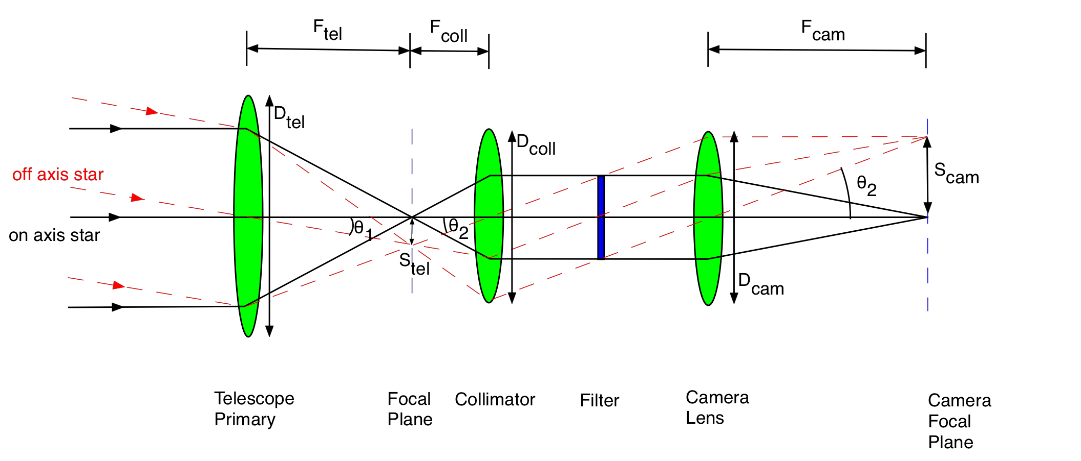
Focal plane reimagers
Motivation
Change plate scale
Focal reducer : demagnifies
Focal expander : magnifies
Access a collimated beam
Access a pupil
Basic simple design
Collimate light
Refocus at different focal ratio
$m= \frac{fcamera}{f collimator}$ $feff=Fcamera D$
Note light coming in on and off axis
This is a focal expander

Slide 9
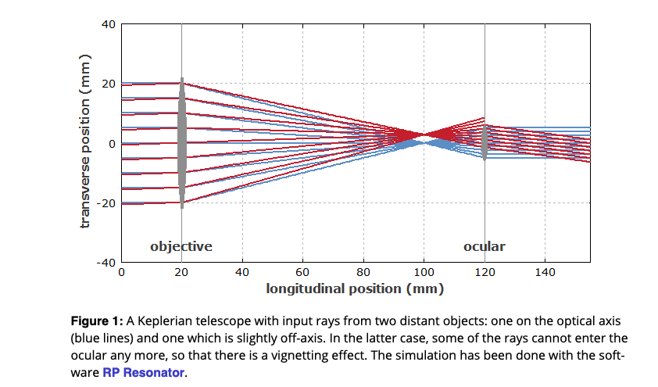
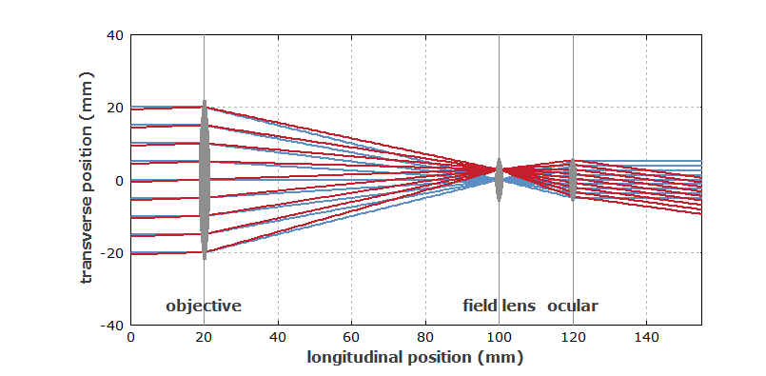
Pupil reimagers
https://www.rp-photonics.com/field_lenses.html
Motivations
Minimize size of optics
Adaptive optics
Coronagraphs
IR instruments and cold pupil stops
Implementation: field lens

Slide 10
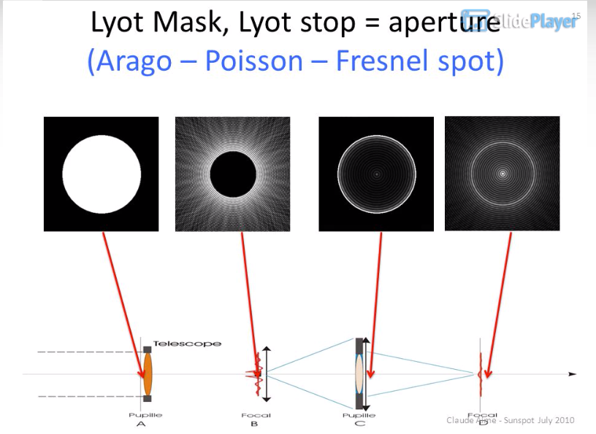
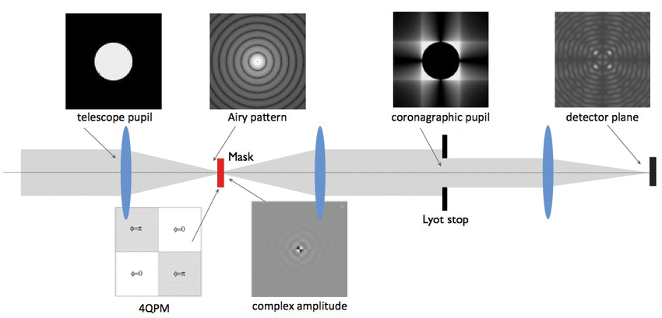
Coronograph
Used to image faint sources near bright ones
Basic design
Focal plane mask to remove core of bright source (but diffraction wings remain)
Pupil plane mask to remove wings

Slide 11
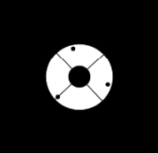
IR cold stop
In IR, everything is glowing, including telescope and mirrors
Can’t block the part of the mirror that is reflecting light from the object, but can block the part that isn’t
But have to block it with something that isn’t emitting, i.e. something cold
→Most IR instruments are cryogenic with a cold pupil stop to block thermal emission from the secondary

Slide 12
Adaptive optics
In an AO system, pupil is imaged onto a deformable mirror, which corrects “aberration” from seeing in real-time
More later!

Slide 14
ASTR 535
Observational Techniques
Instruments / Detectors
Filters

Slide 15
Learning objectives
Understand basic terminology of filters and basic filter types
Understand implications of how interference filters work on their bandpasses

Slide 16
Filters
classification by width: no standard definition, but roughly:
Broad-band : > 1000 A
Medium-band : 100-1000 A
Narrow band : < 100 A
Classification by type
Colored glass
Interference filters

Slide 17
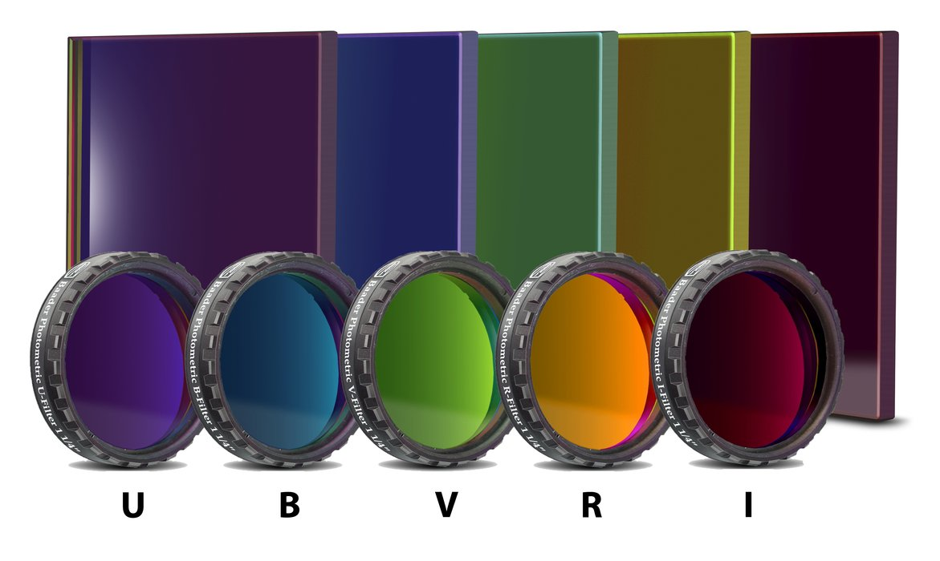
Colored glass filters
Work due to absorption/transmission of various pigments
Wide variety of glasses have been developed (e.g., Schott, Hoya, etc.)
Bandpasses constructed by different combinations of glasses, e.g from Bessell 1979:

Slide 18
Interference filters
Uses partially reflective dielectric coatings to set up interference
Constructive interference occurs at
mλ = 2nd cosθ
Achieve desired bandpass by adjusting n and d, amount of reflection, use multiple layers
Allows for highly customized bandpasses, with sharp cutoffs
Note also antireflection coatings
Ordered: r I u g z

Slide 19
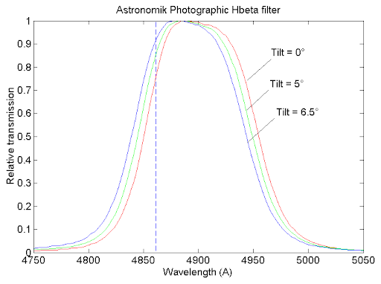
Interference filter bandpasses
mλ = 2nd cosθ
→ bandpass depends on angle of incidence (AOI)
Implication:
Interference filter in collimated beam
Angle of incidence corresponds to field angle!
Filter bandpass shifts with field angle
Interference filter in converging beam
All field angles have range of angles of incidence
Filter bandpass broadens compared to zero AOI
Spectrodon calculator

Slide 21
ASTR 535
Observational Techniques
Instruments / Detectors
Fabry-Perot interferometers

Slide 22
Learning objectives
Know the principles of how a Fabry-Perot interferometer works and how they are used in astronomy

Slide 23
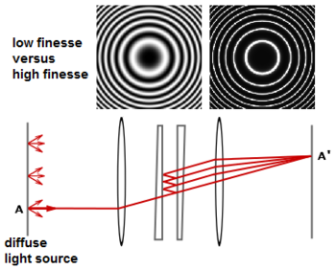
Imaging spectroscopy: Fabry-Perot interferometer
the etalon: a tunable interference filter
Tuned by changing index of refraction (pressure), tilt
Location of etalon in collimated beam
Implication: different bandpass at different field angle

Slide 24
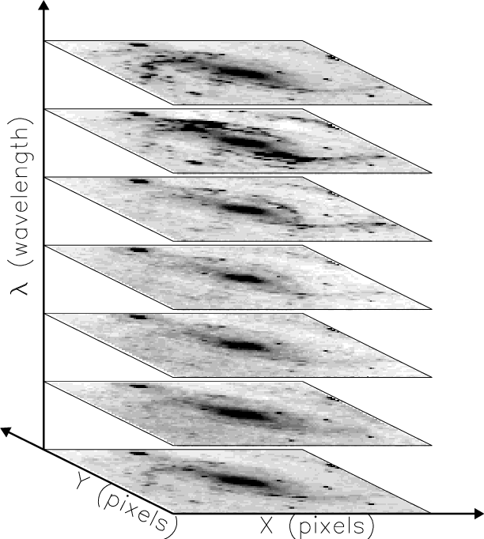
Fabry-Perot data cubes
Take stack of images, scanning through etalon spacings
Constant wavelength is a paraboloid through the stack
Analysis can be complex, depends on stable conditions
Usually done in narrow bandpass, e.g. for kinematics, but there are some etalons at lower spectral resolution

Slide 26
ASTR 535
Observational Techniques
Instruments / Detectors
Dispersing spectrographs

Slide 27
Learning objectives
Understand the basic principles of how a dispersive spectrograph works
Understand the basic functions of the slit, collimator, dispersing element, and camera lens
Be able to draw a spectrograph schematic and draw rays of different wavelengths through the system
Understand the terms dispersion and resolution, and know what they depend on

Slide 28
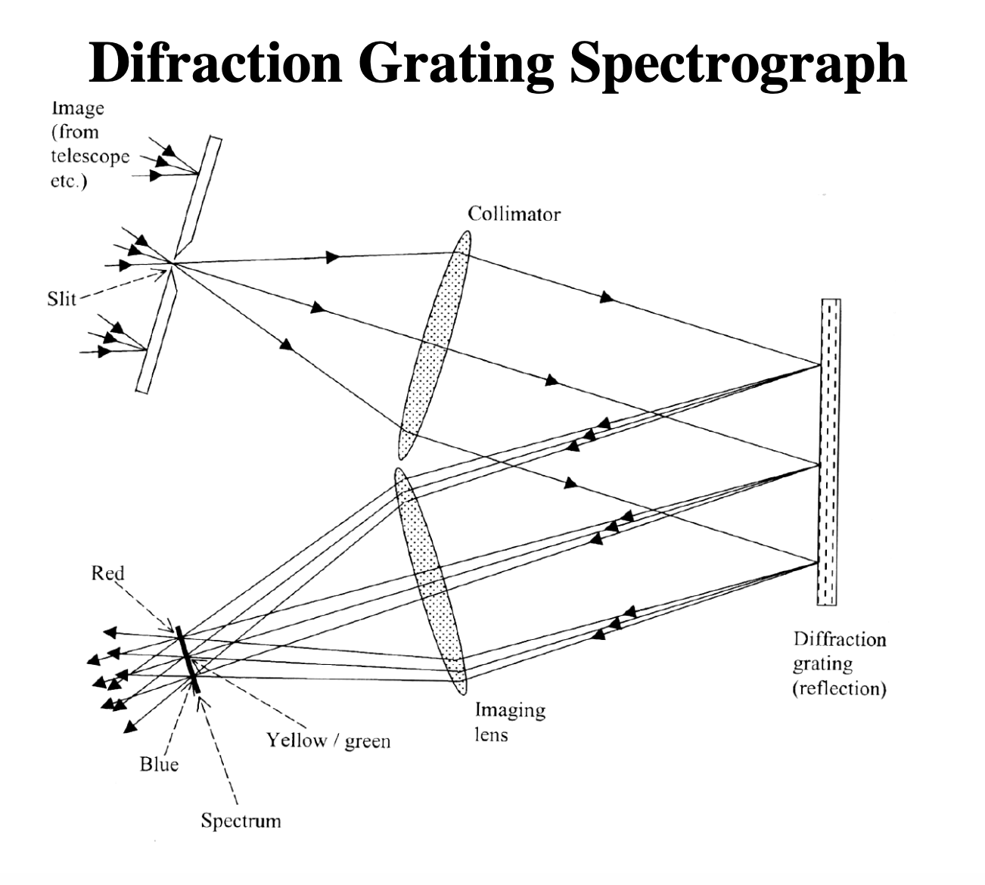
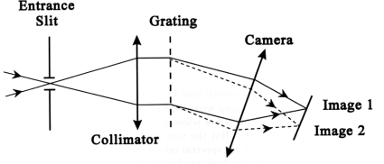
Dispersing spectrographs
Basic design
Focal plan reimager, with a dispersing element
Dispersing elements:
Diffraction grating: transmission or reflection
Prism

Slide 29
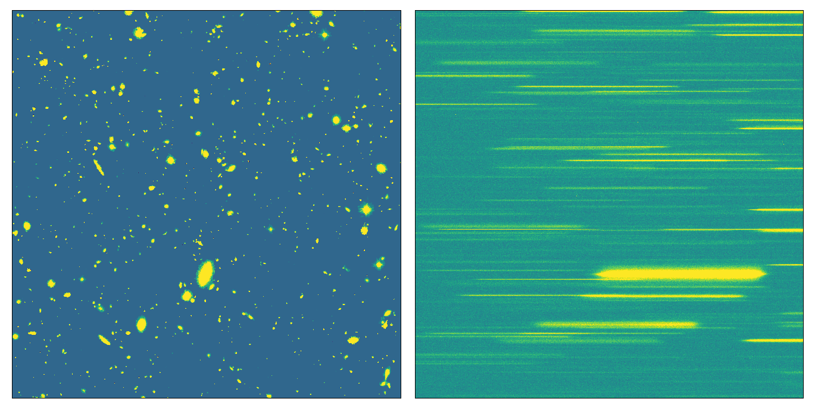
Spectrographs
Consider spectrograph as an imager with dispersion
Note potential confusion of sources!
Slit spectrograph

Slide 30
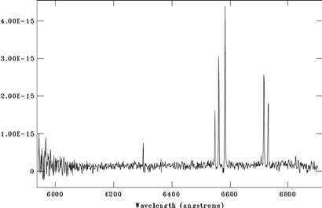
Spectrographs
Consider spectrograph as an imager with dispersion

Slide 31
Important user characterization of a spectrograph
Three important characteristics:
Dispersion: how much light is spread as a function of wavelength
Resolution: how well can you resolve different wavelengths
Throughput: how much light is recorded

Slide 32
_{Dispersion}
Dispersion gives the amount that the light is dispersed
Angular dispersion (angle per wavelength, e.g. radians/A), d𝜃/d𝜆
Linear dispersion (distance in focal plane per wavelength e.g. mm/A), dx/d𝜆
Astronomers typically call the inverse linear dispersion the dispersion (wavelength per distance, e.g. A/mm or A/pixel)
“high” dispersion means light is more spread out, i.e. less A/pixel
Angular dispersion depends on the nature and details of the dispersing element
Linear dispersion depends on the dispersing element, but also on the focal length of the camera lens (since that sets the “scale”)
$\frac{dx}{dλ}=fcamera \frac{dθ}{dλ}$

Slide 33
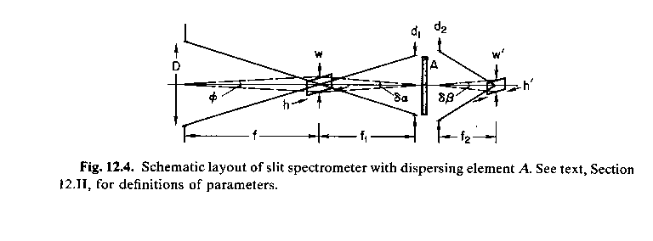
Resolution
Schroeder, Astronomical Optics
Resolution describes how well one can separate features at different wavelengths
Alternatively, how broad is a monochromatic feature
Recall, a spectrograph is an imager with a dispersive element
A monochromatic source looks like the source
Width of a monochromatic feature is given by the size of the source
Without a slit, depends on the seeing
With a slit, depends on the width of the slit
$$h^{′}= \frac{f2}{f1} h$$
$$w′=r \frac{f2}{f1} w$$
where r is the anamorphic magnification, which is a magnification result from the dispersing element in the direction of dispersion
$$δλ=w^{′}\frac{dλ}{dx}=rw \frac{f2}{f1}$$

Slide 34
Descriptions of resolution
Schroeder, Astronomical Optics
Resolution can be described in several ways
$δλ:$ width of a monochromatic source, related to physical slit width by magnification of spectrograph (including anamorphic magnification)
$δλ=w^{′}\frac{dλ}{dx}=rw \frac{f2}{f1}$
Dimensionless resolution: $R= \frac{λ}{δλ}$ = $\frac{λf1}{rwf2}\frac{dx}{dλ}$
Resolution may be a function of wavelength depending on the dispersing element
If $δλ$ is constant with $λ$, then R won’t be, and vice versa

Slide 35
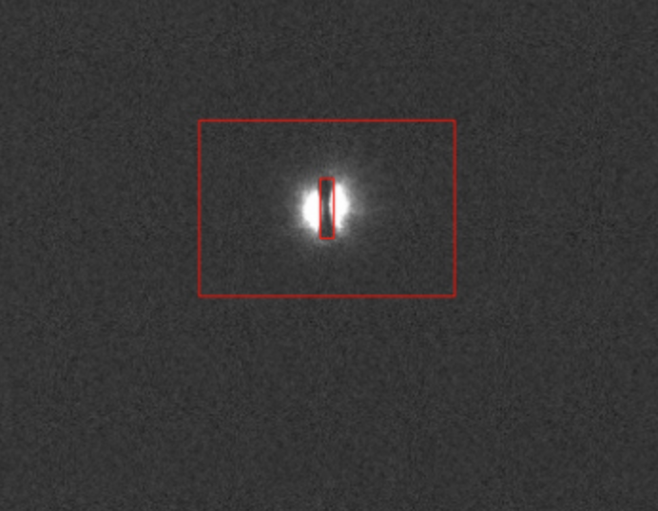
Throughput
Throughput gives amount of light through spectrograph
one factor is the nature of the dispersing elements, but also the transmission of the optics, which are often more complicated than the simple picture!
The narrower the slit, the lower the throughput: tradeoff between resolution and throughput
Typically slit is set around the width of seeing disk, so that resolution doesn’t vary between exposures
For spectrophotometry, a wider slit is often used
Remember differential refraction, where throughput may be a function of wavelength if the slit is not aligned with the parallactic angle!

Slide 37
ASTR 535
Observational Techniques
Instruments / Detectors
Types of astronomical spectrographs

Slide 38
Learning objectives
Understand different types of astronomical spectrographs:
Slitles spectroscopy
Long-slit spectroscopy
Slitlet spectroscopy
Fiber-fed spectroscopy
Integral field spectroscopy
Echelle spectrograph

Slide 39
Slitless spectroscopy
Yields spectra of all objects in field
Implications for overlap : generally used for very low dispersion, so that each object produces a relatively “short” spectrum
Often implemented using a “grism”
Historically, implemented with objective prism spectroscopy
Implication for sky background

Slide 40
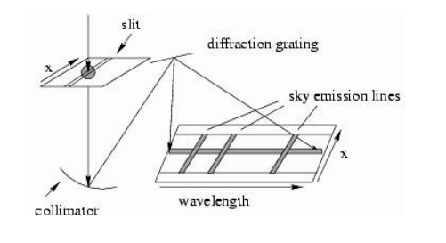
Long slit spectra
To avoid overlapping spectra, add an entrance slit to the spectrograph
Produces spectra along a line in the sky

Slide 41
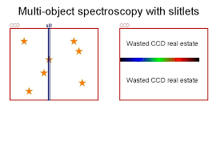
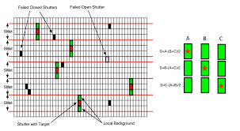
Spectroscopy with slitlets
Long slit spectrograph gives spectra along a line
For many projects, objects won’t lie along a line
Can observe more objects using slitlets
Note possible implication for wavelength coverage
Slit mask needs to be constructed for each field in advance
JWST is pioneering a “programmable” slit mask

Slide 42
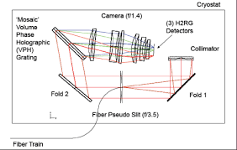
Multiobject spectroscopy with fibers
Alternatively, if objects don’t fall along the line, line them up!
Use optical fibers to take objects from different parts of the field and “line them up” along a slit of a spectrograph, or let the fiber ends themselves make up a “pseudo-slit”
Again, fibers need to be positioned for a specific field
SDSS APOGEE spectrograph

Slide 43
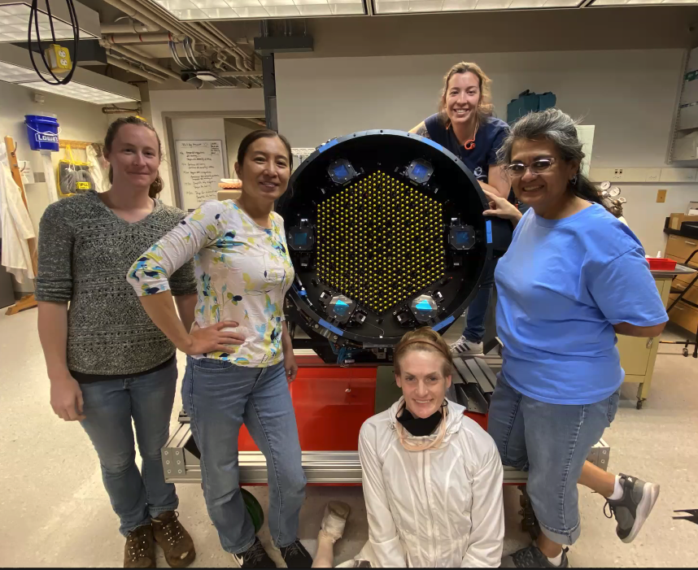
Robotic fiber positioners

Slide 44
Integral field (3D) spectroscopy
For an extended object, ideal would be to get spectra at all location in the object, not just along a line → integral field spectroscopy
Several implementations:
Lenslets
Fibers
Image slicer
https://www.dur.ac.uk/cfai/spectroscopy/introductiontointegralfieldspectroscopy/

Slide 45
Echelle spectrograph
If you want to work at high dispersion/resolution, and also cover a large wavelength region, you have a problem, as you would need a very wide detector
An alternative way to achieve this is to use an echelle spectrograph, which uses a diffraction grating operating at high order to generate a series of spectra covering different wavelength ranges, and then cross-disperses these with a second dispersing element to put them onto a detector
With an echelle, all of the detector is used for a single object!

Slide 47
ASTR 535
Observational Techniques
Instruments / Detectors
Dispersing elements

Slide 48
Learning objectives
Understand the basics of how prisms and diffraction gratings work
Understand the grating equation and how dispersion depends on order and groove/line spacing
Understand grating orders and order overlap, and how it is handled
Understand how an echelle spectrograph works
Understand some basics of factors that affect grating efficiency

Slide 49
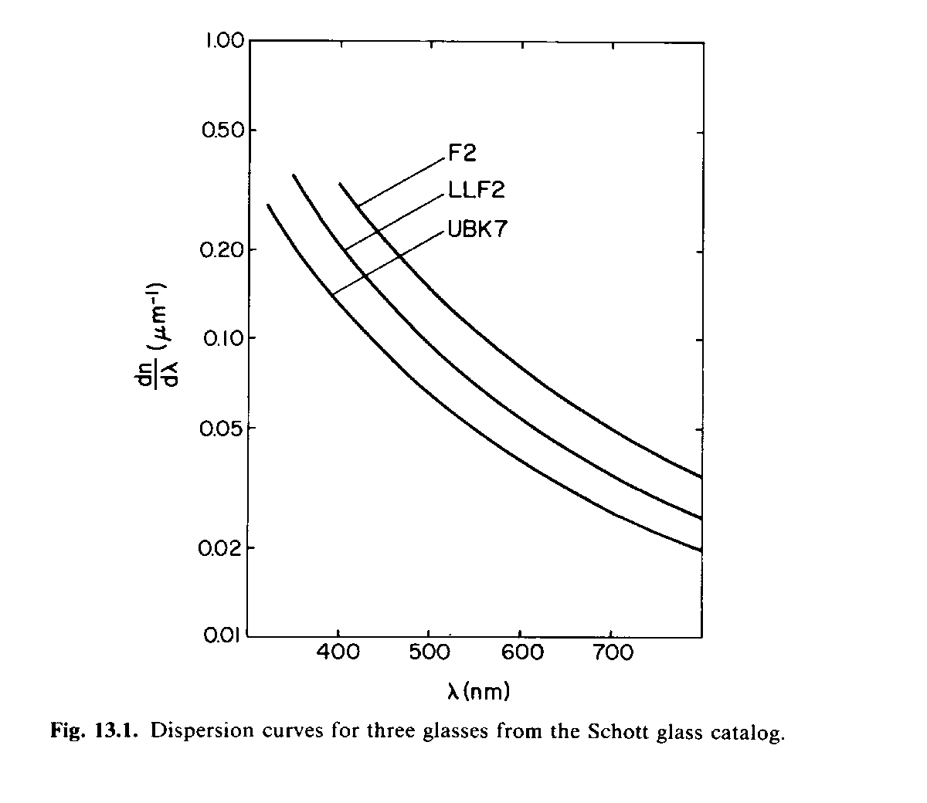
Dispersing elements : prism
Prisms disperse light because index of refraction of glasses is a function of wavelength
$$\frac{dθ}{dλ}= \frac{t}{d}\frac{dn}{dλ}$$
where t is base length, and d is input beam diameter
Generally relatively low resolution compared to gratings
Used, e.g., for objective prism spectroscopy and for cross dispersing in echelle spectrograph; also in grisms
PASP 129,976
Schroeder, Astronomica Optics

Slide 50
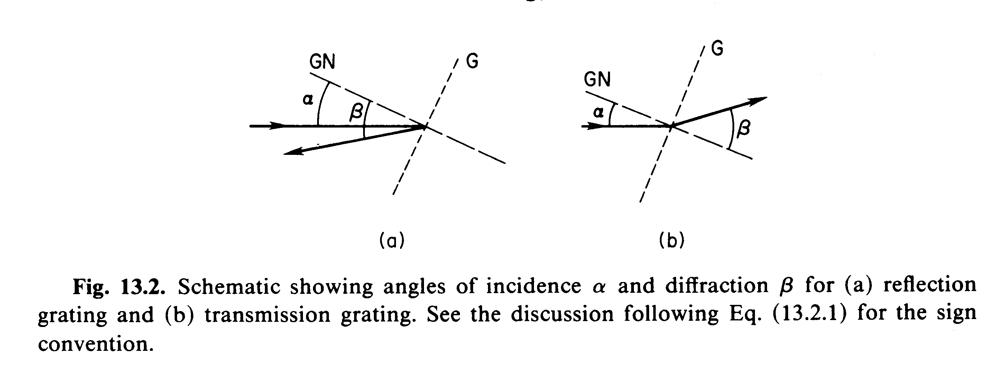
Diffraction gratings
multi-slit interference (note this is not spectrograph slit!)
Simplest: alternating grooves (lines) spaced by 𝜎, either reflective or transmissive
Grating equation: constructive interference:
$mλ= σ(\sin{β+\sin{α}}$ )
dispersion: $\frac{dβ}{dλ}=\frac{m}{σcosβ}$ more dispersion at higher order
$\frac{dβ}{dλ}=\frac{\sin{β+\sin{α}}}{λcosβ}$ more dispersion at higher 𝛼 and 𝛽 (echelle)
Typical gratings have groove densities between 300 and 1200 lines/mm
At given configuration, more lines/mm (smaller spacing) gives higher dispersion and resolution, proportional to lines/mm
Schroeder, Astronomica Optics

Slide 51
Orders and order overlap
Light from different orders can fall at same location
$mλ′=\left(m+1\right)λ$
$$λ^{′}−λ= \frac{λ}{m}$$
more overlap at higher orders
Use order-blocking filter (common for low order) or cross-dispersion (common for high order)

Slide 52
Echelle spectroscopy
Echelle spectrographs work at multiple high orders and cross disperse
Note that light of a given wavelength can appear in multiple orders

Slide 53
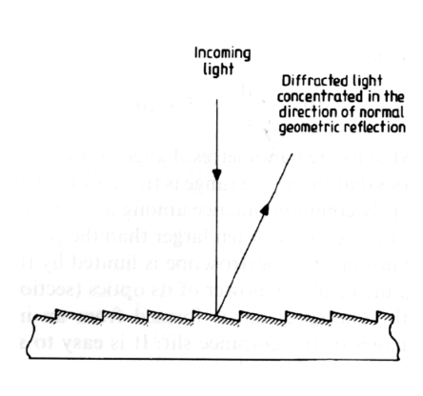
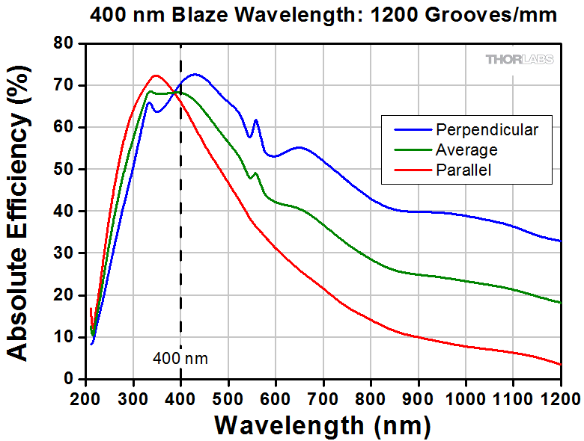
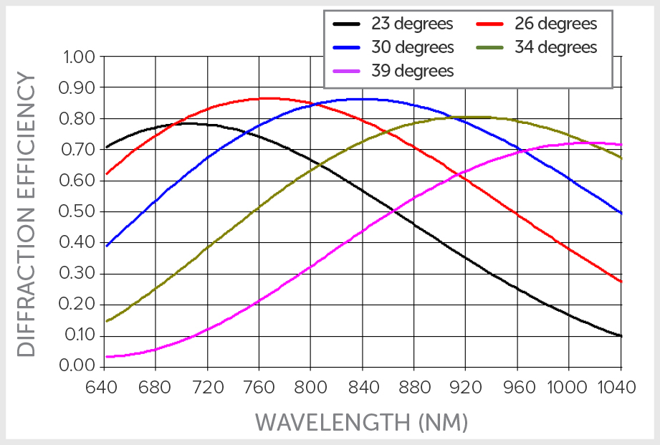
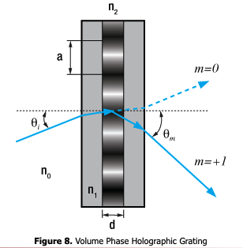
Grating throughput/efficiency
Gratings can be constructed to direct light into particular orders by “blazing” the grating, i.e. tilting the reflective facets (also removes need for dark areas in between)
Typical grating efficiency around 50-70 percent
New technology called volume phase holographic (VPH) gratings allows higher throughput in a transmission grating
Varies index of refraction on very small scales
conventional
VPH

Slide 55
ASTR 535
Observational Techniques
Instruments / Detectors
More spectrographs

Slide 56
Learning objectives
Recognize connection between spectrograph resolution and ability to get velocity information
Be aware of some possibilities for non-dispersive spectroscopy

Slide 57
Resolution and capability
Resolution can be described by the dimensionless resolution
$R= \frac{λ}{δλ}$
Typical dispersive spectrographs have resolution between R=1000 (low dispersions), R=30000 (typical echelles) and R=100,000 (high precision RVs)!
Note that this is closely related to the velocity resolution, since
$\frac{δλ}{λ}$ = $\frac{v}{c}$ = $\frac{1}{R}$
R= 1000 → $δv$= 300 km/s
R=100000 --> $δv$= 3 km/s
an astrophysical velocity width (e.g. velocity dispersion) might be measurable down to 0.1-0.5 of the spectrograph resolution
An astrophysical velocity centroid (e.g., radial velocity) might be measurable to 0.01-0.1 of the spectrograph resolution, and even better if multiple features are being measured

Slide 58
Non-dispersive spectroscopy
We’ve described multiple types of spectrographs that use dispersing elements
We’ve also described the Fabry-Perot interferometer, which provide spectroscopic capability through a tunable filter
It’s also possible to get spectroscopic information through interferometry, i.e. combining light from an object to produce fringes, since interference is a function of wavelength
Fourier transform spectrograph: splits beam into two parts, changes path length of one arm and records interference pattern (essentially a Michaelson interferometer)
Record fringe pattern as a function of path spacing, use it to recover spectrum
FTS can provide very high resolution, typically for very bright sources
Mach–Zehnder interferometer, e.g. JIVE
Schroeder, Astronomical Optics

Slide 60
ASTR 535
Observational Techniques
Instruments / Detectors
Detectors

Slide 61
Learning objectives
Understand the basic principles of detectors
Understand the difference between photon counting and photon collecting devices
Understand terminology used to describe detector characteristics: quantum efficiency, detector resolution, readout noise, pattern noise, dark current, linearity

Slide 62
Detectors
Basic types:
Photographic
Chemical reactions to light
Photoelectric detectors
Photoelectric effect: photons have energy E=h$ν=\frac{hc}{λ}$ that can excite electrons in a material
Wavelength sensitivity depends on photosensitive material : minimum excitation energy and cross-section
Two general classes:
Photon counters
Photon collectors

Slide 63
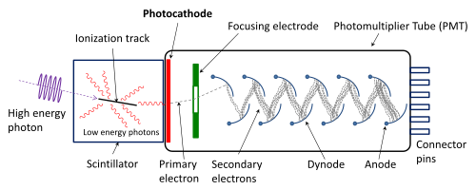
Photon counters
Photons make “events” that are counted in real time
Photomultipliers
Avalanche photo diodes (APD)
Photon counting arrays
Multi-anode microchannel arrays (MAMAs)
Since an event is counted after amplification there is no associated readout noise
Can time-tag photons

Slide 64
Photon collectors
photons generate photoelectrons, which are collected and subsequently read
Different materials:
Si (optical to about 1 micron)
HgCdTe, InSb, PtSi, used in near IR
Different readout electronics: CCD, CMOS, IR multiplexer

Slide 65
Detector characteristics
Quantum efficiency : fraction of incident photons that are detected
Photographic ~1%
Photon counter: tens of percents
Photon collectors: 50-90 %
Of course, QE is a function of wavelength
Increasing QE is equivalent to increasing telescope aperture!

Slide 66
Detector characteristics
Size / resolution elements
Physical size related to maximum field-of view
With reimaging optics, number of spatial resolution elements, i.e. number of pixels, is more relevant
Modern detectors have many megapixels, typical in astronomy 1024x1024, 2048x2048, 4096x4096, typically smaller in the near-IR than in the optical
Commercial detectors have even more, but not all are available for astronomical applications, i.e. high sensitivity and low noise
Arrays of detectors possible, typically with some gap, e.g. DECAM
A common figure of merit for surveys is
discovery efficiency = size * QE

Slide 67
Detector characteristics
KOSMOS bias frames
Readout effects
Readout noise : random, Gaussian noise introduced in the readout process: typically few electrons rms
Pattern noise :
Non-random, i.e. spatially correlated noise that is sometime present in detector/signal chains (e.g. with 60 Hz pattern)
Fixed pattern noise is pattern noise that is repeatable in time, i.e. potentially correctable, e.g. with bias frames
Much pattern noise is not fixed pattern noise!
Photon counting devices aren’t subject to readout noise!

Slide 68
Detector characteristics
Dark current : electrons generated from thermal excitation (not photoelectrons)
Larger at higher temperatures
Larger for detectors with lower excitation energy (i.e. IR detectors)
Mitigated by cooling detectors
Most optical detectors cooled cryogenically to somewhere between -120 and -70 C, typically with LN2 (-196 C)
IR detectors cooled more, e.g. liquid He (4K!)
Lower cost detectors cooled thermoelectrically, typical amateur camera cools to 30-50 C below ambient → still significant dark current, e.g. TMO
Dark current can be corrected by dark frames, but note that calibration frames have both Poisson and readout noise

Slide 69
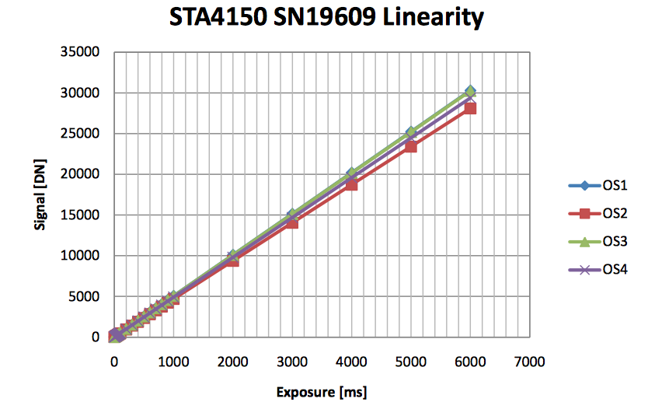
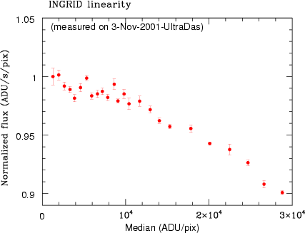
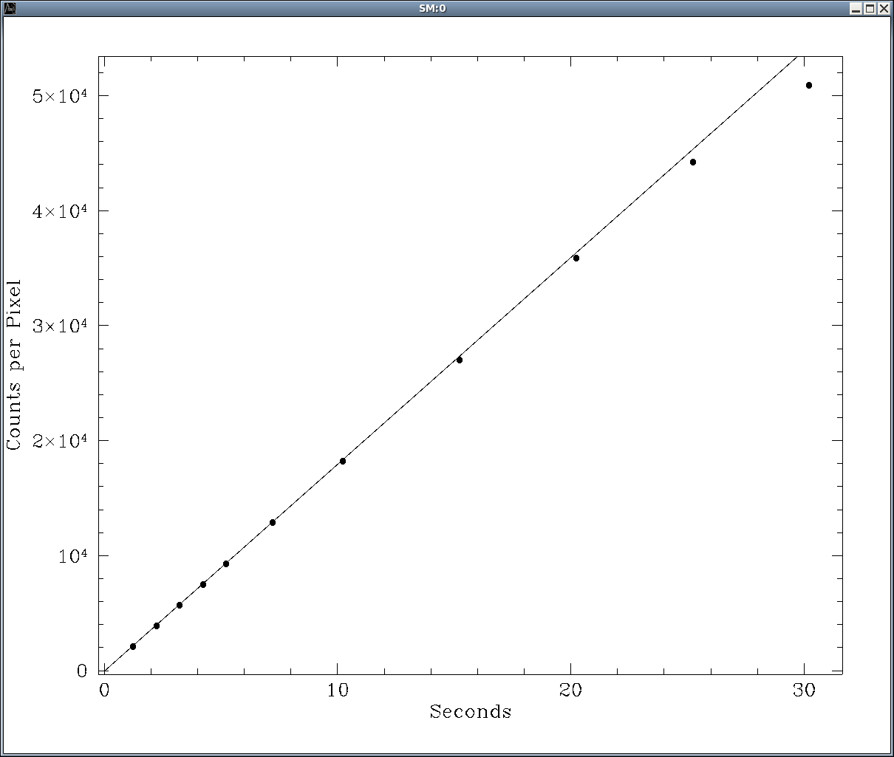
Detector characteristics
DIS
ARCTIC
Linearity : relation between input photons and output photoelectrons
Slope is QE
Linear detector means slope is independent of count level
Full well : maximum number of photoelectrons in device
A/D saturation: maximum count level, determined by number of bits in A/D
TSPEC

Slide 70
Other detector characteristics
Defects, e.g. bad pixels, bad columns, etc.
Modulation transfer function
fringing
Readout speed
Saturation behavior
Hysteresis
reciprocity

Slide 72
ASTR 535
Observational Techniques
Instruments / Detectors
Digitization

Slide 73
Digitization
Although we talk about detectors collecting individual photoelectrons, the electronics that sense this produce analog output (voltages)
This is converted to a data number (DN) by a device called an analog-to-digital (A/D) converter
A/D converters work by comparing the input voltage to a series of reference voltages and setting bits depending on the comparison
The range of numbers that can come out of an A/D converter depends on how many reference voltages there are:
12-bits : 0-4095 (2**12)
16-bits : 0-65535
18-bits: 0-262143

Slide 74
Dynamic range
Ratio of brightest to faintest things you can measure in a single exposure
Certainly limited by A/D
Additionally limited by readout noise - at low levels your measurement is limited by noise
At high level, may be limited by non-linearity, if detector goes nonlinear before A/D saturation

Slide 75
Gain
Digital detector signal chains usually introduce an electronic “gain”: a multiplicative constant that modifies the signal coming from the detector before the signal is digitized
Because of this, the data numbers do not directly give the number of detected photons (each of which generates an electron)
Instead
N(electrons) = GC
where C is the number of counts (DN) and G is the “gain” in “units” of electrons/DN (all dimensionless), even though an electronics person would call this the ”inverse gain”
Knowing the gain is critically important, because the Poisson statistics is determined from the number of detected photons, not the DN value

Slide 76
Gain and Poisson noise
N(electrons) = GC
So the noise in electrons is:
𝜎 (electrons ) = $\sqrt{Nelectrons}$ = $\sqrt{GC}$
Usually, however, people don’t convert images to units of electrons (although some do!)
In units of counts:
C = $\frac{Nelectrons}{G}$
So
𝜎 (counts) = $\frac{σelectrons}{G}$ = $\sqrt{\frac{C}{G}}$
Note that S/N doesn’t change if you were to change the gain, because the number of counts would change as well!

Slide 77
Determining the gain and readout noise
Covered previously!
As a reminder these are determined from the measurement of noise properties:
For gain, take difference of two images at a high light level, determine the variance, and compare with mean level to determin gain
𝜎 (counts in difference image) = $\sqrt{\frac{2C}{G}}$
$G=\frac{2C}{σ2}$
Difference images are used to avoid variance from difference in pixel sensitivities
For readout noise, take difference of two images at zero light level (biases), determine the variance:
𝜎 (counts in difference image) = $\sqrt{\frac{2σrn2}{G2}}$
More comprehensive test determines variance at a range of light level: tests understanding of noise model and help to detect nonlinearities

Slide 79
ASTR 535
Observational Techniques
Instruments / Detectors
Optical detectors

Slide 80
Learning objectives
Understand the basics of how CCDs work
Under the concept of charge transfer efficiency
Learn about electron multiplying CCDS
Learn about CMOS detectors and how they compare with CCDs

Slide 81
Optical photon collectors
Generally use silicon as the photosensitive material
Si band-gap leads to cutoff wavelength ~1.1 microns

Slide 82
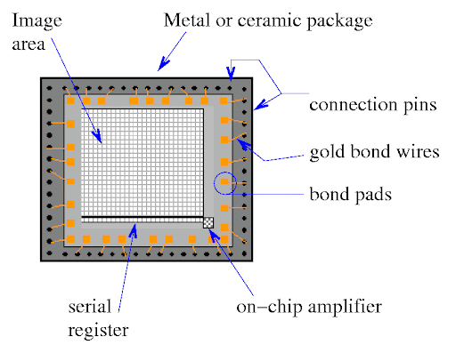
Charge Coupled Devices (CCDs)
Readout method
Charge transfer issues
Charge transfer efficiency (CTE)
CTE must be very close to unity, e.g.
.999**2048=.128 !
.9999**2048 = 0.815
.99999**2048 = .9797
Note issue of CTE degradataion in space environment
Deferred charge and preflash
binning

Slide 83
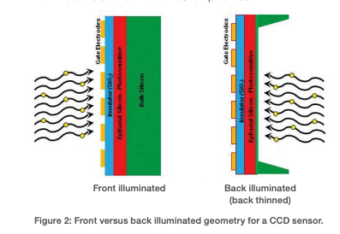
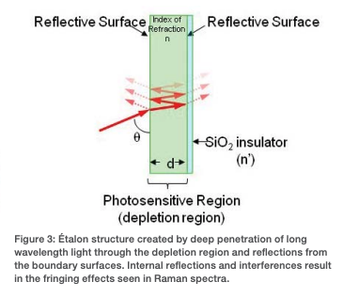
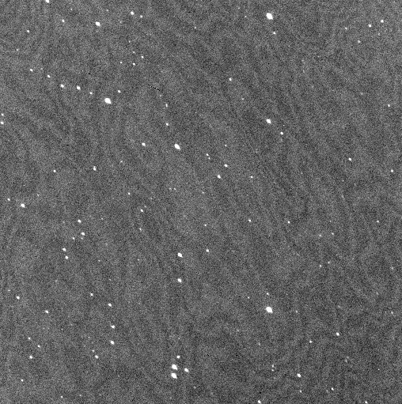
CCD QE
Front side vs back side illumination
Fringing
Spectrograph fringing (DIS)
Imaging fringing

Slide 84
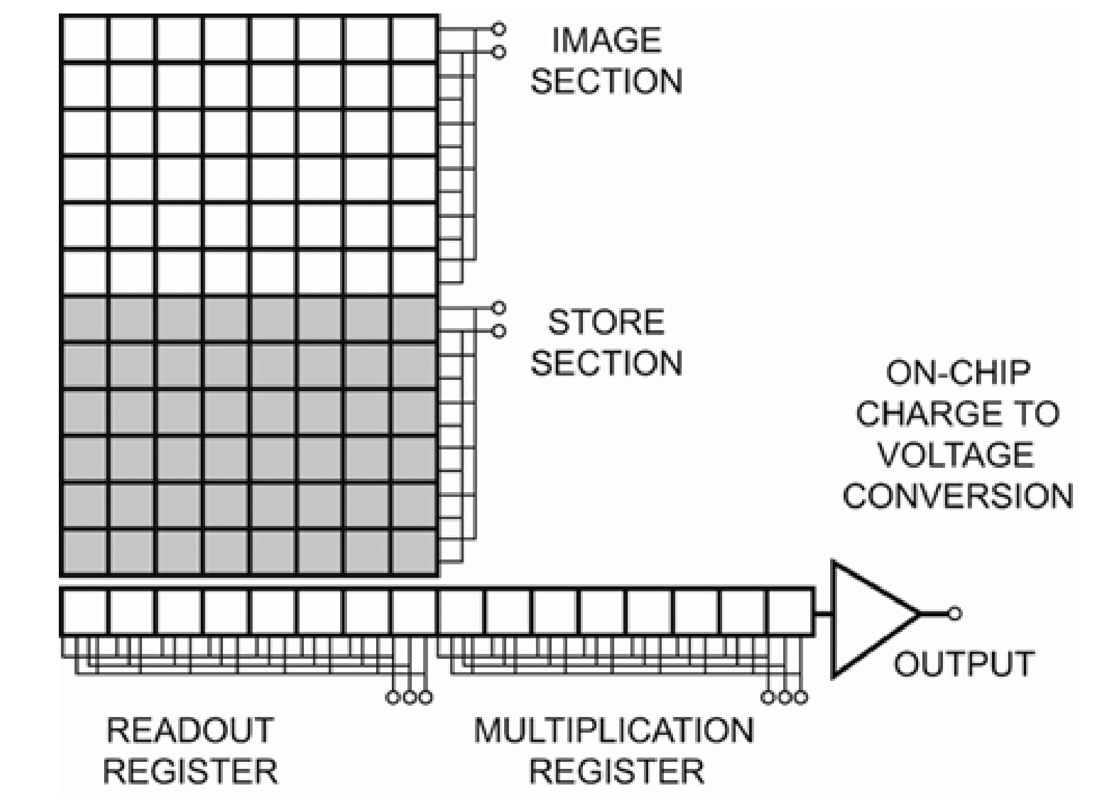
Electron multiplying CCDs (EMCCDs)
Electronics includes an extra “multiplication”, allowing readout noise to be negligible, i.e. approximating a photon counting device
Possible negative factors
Extra noise factor at higher count rates
Smaller dynamic range
https://andor.oxinst.com/learning/view/article/electron-multiplying-ccd-cameras

Slide 85
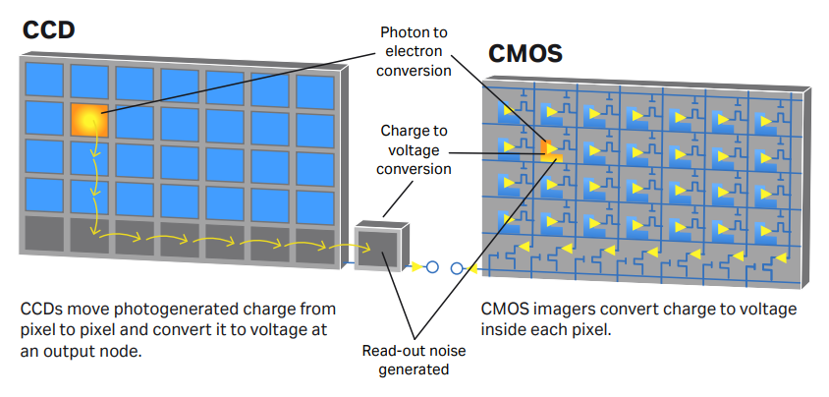
CMOS detectors
Complementary metal oxide semiconductor
Readout method
Readout speed
CCDs trade speed for readout noise
CMOS much faster
Pros/cons vs CCDs
Dynamic range (A/D)
cost
https://andor.oxinst.com/learning/view/article/comparing-scmos

Slide 87
ASTR 535
Observational Techniques
Instruments / Detectors
IR detectors

Slide 88
Learning objectives
Learn about typical materials used for detection of near-IR photons
Understand how the readout of near-IR detectors is different from that of optical detectors: non-destructive readout, resets, and KTC noise
Understand readout modes of near-IR detectors: doubly correlated sampling, Fowler sampling, up-the-ramp sampling

Slide 89
IR detectors
Materials
HgCdTe (“mercury-cadmium-telluride, mer-cad-tel”) to 2.5 micron (can be tuned to lower)
InSb (“indium antimonide”, “insby”): to 5 microns
Photosensitive material is linked to readout material (the “multiplexer”)

Slide 90
IR detector readout
IR multiplexers can be read without affecting the accumulated photoelectrons: ”non-destructive” readout
Readout noise typically larger than than of optical devices
Pixels are “reset” separately
Reset process resets “zero” level, but with some associated noise (“KTC” noise), which is substantial
Accounting for this requires different readout modes than for optical devices

Slide 91
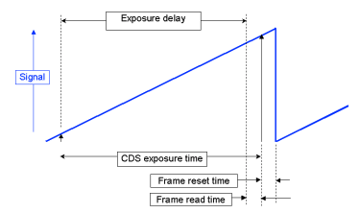
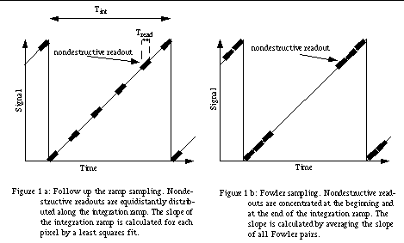
Readout modes
Reducing readout
Doubly correlated sampling: read twice, once after reset, then again after exposure time. Difference the images
Fowler sampling: read multiple times after reset, then multiple times after exposure time
Up the ramp sampling: read continuously and fit slipe

Slide 93
ASTR 535
Observational Techniques
Instruments / Detectors
UV detectors

Slide 94
UV detectors
Because of low background, photon counting devices are often preferred

