Slide 1
ASTR 535 : Observational Techniques
Observing concepts and tools
Time

Slide 2
Learning objectives
Understand the different systems of time: solar time, atomic time, sidereal time
Understand calendars used in astronomy: Gregorian and Julian date

Slide 3
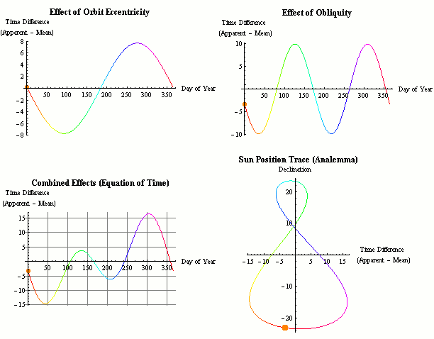
Time: solar time
Solar time : based on the position of the Sun
Split into 24-hour intervals
Local apparent solar time: position of the Sun
But Sun doesn’t move at uniform speed across the sky throughout the year because of tilt of earth’s axis and eccentricity of orbit
Mean solar time tracks a fictitious ”mean Sun” that moves at uniform rate
”equation of time” describes difference between mean and apparent solar time
Local solar time depends on location on earth
Local mean solar time = 0 when anti-Sun crosses meridian (N-S line)
Solar time at Greenwich is called Universal Time
Local solar time = UT + longitude
“legal time” uses time zones
Problem: Earth’s rotation is not perfectly uniform, esp., slowing with time

Slide 4
Time: atomic time and UTC
Atomic time: based on atomic transitions
TAI : International Atomic Time
Coordinated Universal Time (UTC)
Mean solar time occasionally adjusted to match atomic time, with the addition of “leap seconds”

Slide 5
Time : sidereal time
Sidereal time : also measured by Earth’s rotation, but now relative to the stars
Since stars also move in space, sidereal time formally is measured by the position of the vernal equinox (location of mean Sun as it crossed the celestial equator)
Sidereal time also split into 24 hours
Sidereal day is slightly shorter (about 4 minutes, 23h 56m 4s) than solar day, because of Earth’s revolution around the Sun
Over a year those extra minutes amount to one full rotation
At 4 minutes per day, sidereal time drifts with respect to solar time by about 2 hours per month
Stars cross the meridian (line between N and S) at the same sidereal time every day, so the solar time they cross the meridian every day drifts
Local sidereal time = 0 when vernal equinox crosses the meridian
On ~March 21, LST=0 at noon: LST at midnight (standard time) = 12hr
On ~June 21, LST at midnight (standard time) = 18 hr
On ~Sep 21, LST at midnight (standard time) = 0 hr
On ~Dec 21, LST at midnight (standard time) = 6 hr

Slide 6
Calendars and Julian date
Gregorian calendar:
Splits years into months and days
Since one year is not an even multiple of days (~365.25), periodically adds leap days, with complicated formula to account for the value of the fractional part of the length of the year in days
Julian date : just counts days
Julian date (JD): number of days since UT noon, Monday, Jan 1, 4713 BC (note, starts at UT noon!) : 1/1/2021 → JD 2459216
Modified Julian date (MJD) = JD – 2400000.5 (starts at UT midnight)
When giving precise times of astronomical events, may need to account for changing position of Earth with respect to object, and corresponding change in light travel time
Heliocentric Julian Date : Julian date for light arriving at the Sun (not Earth)
Difference from JD depends on location of object, can differ by up up ~8 minutes

Slide 8
ASTR 535 : Observational Techniques
Observing concepts and tools
Coordinate systems

Slide 9
Learning objectives
Understand the different celestial coordinate systems: equatorial, ecliptic, galactic
Understand the different local coordinate systems: alt-az, HA/Dec
Understand the effect of precession, and the meaning of the equinox of coordinates
Understand the effects of motions of astronomical objects: parallax and proper motions and the meaning of the epoch of coordinates

Slide 10
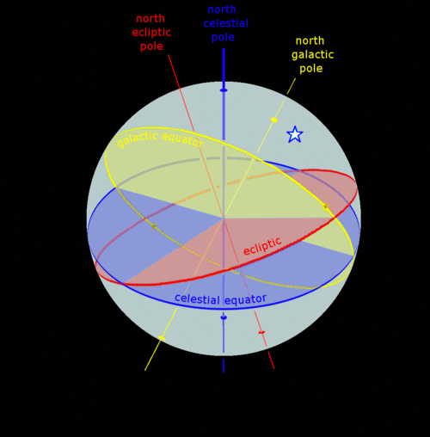
Celestial coordinate systems
Equatorial (RA/Dec) : aligned with Earth’s rotation axis
Declination (== latitude) : 0 at celestial equator, 90 degrees at pole
Right ascension: 0 at location of vernal equinox
Conventionally, RA measured in units of hours (for good reason), but now sometimes measured in degrees (24h = 360 degrees, 1 hr = 15 degrees)
Note when you look at the sky, if N is up, E is to the left!
Ecliptic (𝜆,𝛽): aligned with plane of Earth’s revolution, Sun at 0 ecliptic latitude
Galactic (l,b) : aligned with plane of the Milky Way (galactic latitude = 0), with galactic center at 0 galactic longitude
Can transform from one coordinate system to another using spherical trigonometry

Slide 11
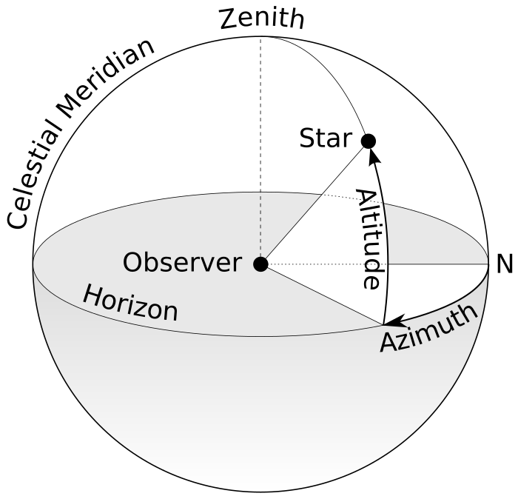
Local coordinate systems
Pole-to-zenith = 90-latitude
Horizon (alt/az) : relative to surface tangent
Equatorial: HA/Dec : relative to Earth’s rotation axis, but fixed in time: hour angle/HA replaces right ascension
HA = 0 is the meridian
HA usually measured in hms, for obvious reasons when one watches stars move across the sky!
Altitude related to declination on the meridian
Declination that passes through zenith is given by the latitude

Slide 12
Precession
Issue with celestial coordinates: Earth’s rotation axis changes direction in time: precession and nutation
Coordinates change through time
Normally, this is “invisible” to the user because we use coordinates at some specified “equinox”, usually J2000.0
Telescope pointing software has to know how to translate these coordinates to actual directions in the sky at any given time, including precession, etc.

Slide 13
Parallax
Stars also change their position because of changing position of Earth as it orbits the Sun: parallax
Generally, << 1 arcsec

Slide 14
Proper motion
Other issue: astronomical objects also physically move through space!
This is called proper motion
Angular motion is larger for objects with larger space velocities and also for closer objects
For objects with measurable proper motion, need to also specify the epoch of the coordinates, i.e. the position (in some specified equinox, e.g. J2000) of the object.
Combined with proper motion, can get the position at any given date of observation
With large automated precision surveys, these things can matter!
GAIA provides proper motions for billions of stars!

Slide 15
Other effects
There are other effects that need to be considered to go from a celestial position to a local position at a given time (i.e., pointing a telescope!)
Aberration of starlight : arises from Earth’s motion
Atmospheric refraction

Slide 16
Astronomical positions
Various catalogs of astronomical objects
SIMBAD : astronomical object database
VizieR : catalogs
NED : extragalactic objects
JPL Horizons : solar system objects (orbital motion very important)
GAIA (!)

Slide 17
Describing orientations in the sky
Orientations of objects in the sky, e.g., the major axis of a galaxy or the orientation of a slit in a spectrograph, are described by the position angle, which is the angle of the object axis from a N-S line, measured counterclockwise (i.e.,going from N through E)
The position angle at any location in the sky of the line from zenith to horizon is called the parallactic angle

Slide 19
ASTR 535 : Observational Techniques
Observing concepts and tools
Observability of astronomical objects

Slide 20
Learning objectives
Understand the basic principles of optimizing observations of objects
Be aware of and familiar with some tools for observation planning

Slide 21
Observability of objects
To observe an astronomical object:
Want it to be above the horizon!
Prefer to observe through as little atmosphere as possible, since increasing atmospheric column increases light losses: stronger effect at shorter wavelengths
Airmass quantifies thickness of atmosphere at a given direction in the sky
Overhead is minimum column: defined as 1 airmass
Note this is a “local” quantity, i.e. airmass at zenith is always 1, even from observatories at different elevations!
As one moves from zenith, airmass ~ 1/cos(Z), where Z is the zenith distance = 90 - altitude

Slide 22
Observability of objects
As objects move across the sky, airmass is minimized when it crosses the meridian, i.e. at HA=0
Relation between HA, RA, and LST:
HA = LST – RA
So, object at a given RA crosses the meridian when LST = RA

Slide 23
When can you best observe objects
Airmass changes with hour angle depending on declination
At the celestial equator, an HA of +/- 3 hours is an airmass of about 2 from mid-latitude observatories
Generally, observers try to observe below an airmass of two
Sometimes, you can’t, e.g. solar system observers of inner planets or comets!
So, from the northern hemisphere, observing window is ~6 hours on the celestial equator, longer at higher declinations, shorter at lower declination

Slide 24
Observation planning
Given list of objects to observe, want to maximize efficiency and data quality
Try to observe all objects as they are crossing meridian, so start by sorting by right ascension and knowing the local sidereal time on the night you are observing
Don’t forget scientific priority!
Objects at higher declination are more forgiving of being observed off of the meridian than those at lower declination
Caveat: alt-az telescopes have a challenge tracking objects near the zenith, so there is often a “dead zone”, e.g. +/- 10 degrees from zenith, so for objects with declination near the latitude of the observatory, may need to avoid the meridian!
Also may want to consider efficiency in terms of slew times: prefer to move shorter distances in the sky
Working by right ascension usually satisfies this
But beware of alt-az telescopes if you have objects with declinations both less than and greater than the latitude, as these can require long azimuth slews!

Slide 25
Observability tools
skycalc/skycalendar : simple text based programs
JSkyCalc :graphical Java program
Python
astropy.coordinates : tools for working with coordinates and transforming between different systems
Astroplan : astropy affiliated package for observation planning
WCSTools : various tools for transformations between coordinate systems, tools for working with coordinates in image files

Slide 27
ASTR 535 : Observational Techniques
Observing concepts and tools
Telescope use and planning

Slide 28
Learning objectives
Understand some of the key things to prepare for before going observing

Slide 29
Overall consideration
At larger research telescopes, telescope time is valuable
Thousands of dollars per night
Often, oversubscription factors of several
Make full, efficient use of the resource
Prepare in advance
Have plan for productive use of all of the time

Slide 30
Telescope and pointing
Learn how telescope is commanded
Object catalogs
Can save time and minimize chances of error, especially late at night
Observation scripts
Critical for some types of observing, e.g., in the infrared
Pointing accuracy and finding charts
How accurately does telescope point
How easy will it be to identify your objects?
Prepare finding charts in advance; understand orientation of images
Tools: SIMBAD, SkyView
Tracking performance and guiding
Sharper images maximize S/N, don’t want them to be degraded by telescope tracking
When guiding is needed, understand how it is done
In some cases, identifying guide stars in advance may be useful, e.g., to adjust pointing

Slide 31
Focus /data inspection
You need to inspect data as it comes in, to ensure you are getting what you expect, and that there are no issues
Can impact observing efficiency: two people help
Tools for inspecting/analyzing images
Are data as expected?
Saturation issues?
Image quality
Focusing a telescope/instrument
Can be achieved by moving instrument, but more common, by moving secondary mirror
Focus run goes through several positions, chooses best (or fits a curve to find the minimum)
Focus provides you a measurement of the seeing, which may affect your plans
Focus can change throughout the night, so continue to monitor image quality

Slide 32
Observation planning and logs
Observation planning
HA = LST – RA
Consider slew times
Consider scientific priorities
Tools: skycalc, astropy-affiliated astroplan
Observing logs
Although you may think you won’t forget details, you probably will
Take notes on everything, especially anything odd/unusual
Note conditions of the sky, including transparency and seeing
While a log spreadsheet giving details of each exposure is nice, often, much of this information is in the image files: it’s the less standard stuff that it’s REALLY important to log!
Set up observing log in advance, e.g. Google Doc

Slide 34
ASTR 535 : Observational Techniques
Observing concepts and tools
Digital imaging and image display

Slide 35
Learning objectives
Understand what digital imaging is, and some of the challenges involved with looking at digital images
Learn about intensity scaling
Learn about some standard image display software

Slide 36
Digital imaging
Quantitative detection of light
Linear detector: number of photons recorded is proportional to number of incident photons
Output of a detector is an array of numbers, often referred to as counts or DN (data numbers)
Individual picture elements: pixels
Potential issues in data visualization / inspection
Larger number of pixels than available on display
Larger dynamic range (intensities) than available on display

Slide 37
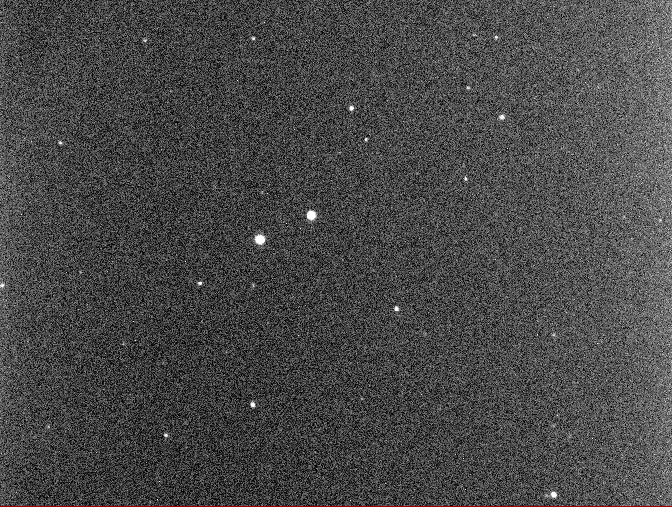
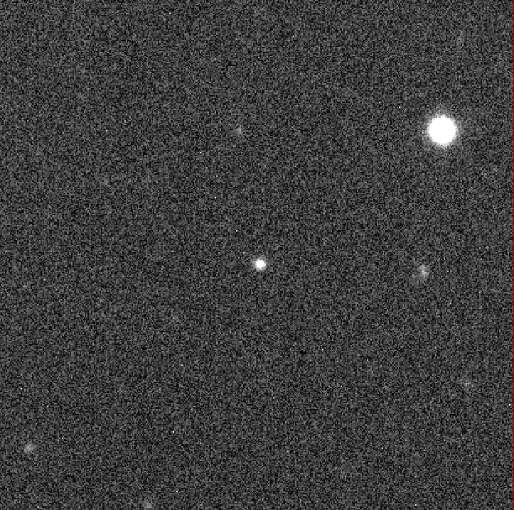

Slide 38
Digital imaging: spatial resolution
Computer display, e.g., laptop 2560x1600, external monitor 1920x1200
Digital cameras
High quality 2048x2048 detectors are widespread
TMO camera: 9600x6422 unbinned, 4800x3211 binned 2x2
Not possible to see every pixel at the same time!
Options:
Zoom
Every Nth pixel
Average NxN pixels
Beware of Moire patterns
Be aware!

Slide 39
Demo

Slide 40
Digital imaging: image display
Dynamic range : ratio of brightest to faintest objects
Typical astronomical signal chains provide 16-bit data, i.e. DN from 0 to 65535
ARC/KOSMOS will have an 18-bit signal chain
Typical graphics card and image display provide 8-bits of intensities, i.e. from 0 to 255, for each of 3 colors (eye may not be able to distinguish any more)
→ Not possible to see all intensity information at the same time

Slide 41
Brightness and contrast
…. 65535
Given limits of display:
Show small range at full intensity resolution, but nothing outside of range (high contrast) (blue lines)
Show large range, but at reduced intensity resolution (low contrast) (red lines)
Some combination (green lines)
If displaying at lower contrast, also choose which part of range to show (brightness)
Brightness (level) and contrast (range)
Contrast: separation between lines
Brightness: location of lines
Alternatively, low and high levels
255
0
0…..

Slide 42
Display parameters
Many software display routines will choose a default intensity scaling, or give you a choice of some algorithms:
Min-max (100%)
Various other percentiles (99% → 50%)
Histogram equalization
Nonlinear display scalings
In many cases, the full dynamic range is not populated
Reasonable scaling: few sigma below sky to more sigma above
Changing scaling requires recalculation and display

Slide 43
Demo

Slide 44
Color maps and pseudo color
Given a scaling to 8-bits, can also associate a color with each one of the intensity levels
Black-and white (greys)
Inverted
Pseudo color: assign various colors to different intensity levels
Quick brightness/contrast adjustment can be done by adjusting the color map, but at some loss of information

Slide 45
Demo

Slide 46
“True” color images
True color images are made by combining images taken at multiple (usually 3) wavelength ranges
Standard color images: red, green, blue
Can encode other bandpasses into a “true” color:
UV, visual, IR
Broadband + narrowband

Slide 47
Other display functions
Blinking images
Annotating images
Interactive display: marking objects
Calculating quantities based on interactively marked objects

Slide 48
Some display tools
SAOimage ds9 : https://sites.google.com/cfa.harvard.edu/saoimageds9
ximtool : https://github.com/iraf-community/x11iraf
gaia : http://star-www.dur.ac.uk/~pdraper/gaia/gaia.html
Python image display
Basic display with matplotlib imshow
More advanced possibilities

Slide 50
ASTR 535 : Observational Techniques
Observing concepts and tools
Digital imaging: file formats

Slide 51
Learning objectives
Understand some basic concepts of how data are stored in files
Understand how FITS files are structured

Slide 52
Storing image data
Image data is just a grid of numbers
In simplest format, one could just provide those numbers
For more compact files, store in binary representation
Need some minimal basic information in addition to a string of bits
How many bits for each pixel
How many pixels per row
For astronomical images, there is a lot of other potentially interesting ancillary information
telescope, coordinates, time, exposure time, etc.
what is on the axes
Instrument information

Slide 53
Flexible Image Transport System (FITS)
Basic FITS image files: contain two pieces: header and image
Header
Set of rows of 80 characters each
”card” name (limited to 8 characters)
“card” value
“card” comment
Must come in multiples of 36 card (2880 bytes); pad with blanks
Image
Binary sequence of data

Slide 54
FITS tables
FITS has been generalized to also allow the storage of “tables”
ASCII and binary tables
Table column names not limited to 8 characters
Mixed data types supported
Some “data” files may be saved as FITS tables rather than FITS images
E.g., spectroscopic data

Slide 55
FITS multi-extension files
Some data may not be limited to a single “image” or a single “table”
Can have multiple “extensions” in a single FITS file
E.g., data, uncertainty, and mask
Each extension is an “HDU” (header-data unit)

Slide 56
Tools for working with FITS files
astropy.io.fits provides a comprehensive set of tools
For tabular data astropy.table provides good tools
Quick demo

Slide 57
Other file formats
ascii (text) files : note astropy.io.ascii
HDF format

Slide 59
ASTR 535 : Observational Techniques
Observing concepts and tools
Digital imaging: gain and readout noise

Slide 60
Learning objectives
Understand the concept of gain and why it is critical for characterizing the noise in your data
Understand how you can measure the gain and readout noise

Slide 61
Gain
Digital detector signal chains usually introduce an electronic “gain”: a multiplicative constant that modifies the signal coming from the detector before the signal is digitized
Because of this, the data numbers do not directly give the number of detected photons (each of which generates an electron)
Instead
N(electrons) = GC
where C is the number of counts (DN) and G is the “gain” in “units” of electrons/DN (all dimensionless), even though an electronics person would call this the ”inverse gain”
Knowing the gain is critically important, because the Poisson statistics is on the number of detected photons, not the DN value

Slide 62
Gain and Poisson noise
N(electrons) = GC
So the noise in electrons is:
𝜎 (electrons ) = $\sqrt{Nelectrons}$ = $\sqrt{GC}$
Usually, however, people don’t convert images to units of electrons (although some do!)
In units of counts:
C = $\frac{Nelectrons}{G}$
So
𝜎 (counts) = $\frac{σelectrons}{G}$ = $\sqrt{\frac{C}{G}}$

Slide 63
Determining the gain
Gain usually must be determined from the noise properties
Simple prescription:
Take two images with high (and similar) light levels
Measure the mean intensity in a region of ~constant intensity from an average of the two images: this measures the signal
Calculate the difference between the two images
Measure the standard deviation in the difference image in a region of ~constant intensity: this measures the noise, but since it comes from two images, it is a factor of $\sqrt{2}$ larger than the noise from a single image
Calculate the gain
𝜎 (counts in difference image) = $\sqrt{\frac{2C}{G}}$
$G=\frac{2C}{σ2}$
This assumes that Poisson statistics is applicable, i.e. that there are no unknown sources of noise (or problems!)
Note that difference in two images is preferred to a region of a single image because the latter might include some variance from difference in pixel-to-pixel response or illumination

Slide 64
Gain: more comprehensive test
𝜎 (counts in difference image) = $\sqrt{\frac{2C}{G}}$
$G=\frac{2C}{σ2}$
For a more comprehensive test, do this at multiple light levels and plot 𝜎² vs C: this should be a straight line with slope given by 2/G

Slide 65
Readout noise
At low light levels, readout noise contributes:
𝜎 (counts) = $\sqrt{\frac{C}{G}+\frac{σrn2}{G2}}=\sqrt{\frac{S+B}{G}+\frac{σrn2}{G2}}$
To measure readout noise:
Take difference of two images with no light (bias frames), i.e. C=0, to determine $σrn2$, once G is known
𝜎 (counts in difference image) = $\sqrt{\frac{2σrn2}{G2}}$
Difference image in case there is some “fixed pattern noise” in bias frames
Can also get from intercept of comprehensive gain test, but this can be susceptible to small uncertainties in measurements
𝜎 (counts in difference image) = $\sqrt{\frac{2C}{G}+\frac{2σrn2}{G2}}$

Slide 67
ASTR 535 : Observational Techniques
Observing concepts and tools
Digital imaging: basic data reduction

Slide 68
Learning objectives
Understand the most basic data reduction steps of bias level subtraction and flat fielding

Slide 69
Basic data reduction
While data reduction may need to include correction for multiple effects, the most basic data reduction of digital images is simple and consists of two steps:
Bias level (overscan) subtraction
Flat fielding
Other things that we will address later:
Bias pattern subtraction
Dark current subtraction
Linearity correction
Shutter shading correction
Fringing subtraction
Spectroscopic data reduction (wavelength and flux calibration)

Slide 70
Bias level (overscan) subtraction
Before digitizing the signal from a detector, the signal electronics will add some level so that, in the presence of noise, there will be no ”negative” signal
This bias level does NOT contribute Poisson noise, so must be subtracted before the correct Poisson uncertainties can be determined
This level, usually called the bias level, may not be perfectly stable in time, so, when possible, should be determined from each image independently
This is usually achieved by adding a “overscan” region to each image, which adds ”virtual” pixels to an image, i.e. data values that are read through the signal chain but without any real pixel input
In CCDs, this generally adds columns to the “real” image
At TMO (CMOS detector), extra rows are added

Slide 71
Overscan
TMO
ARCTIC

Slide 72
Bias level (overscan) subtraction
In simplest form, one determines the mean value in the overscan, and subtracts this from the rest of the image
In more complex cases, the bias level may drift over the course of the readout, so it may be necessary to do a row-by-row subtraction of bias level (or some smoothed version of it)

Slide 73
Flat fielding
Flat fielding corrects for non-uniform throughput across the field-of-view, i.e. at different locations within an image
Variations in throughput can arise from optics (vignetting, non-uniformity of filter, dust, etc.) and/or from variations in sensitivity of the detector in different locations
Flat fielding is critical for comparing intensity at one location to intensity at another
If one compares intensity in one image to another at the same location, then the need for flat fielding is minimized

Slide 74
TMO flat field

Slide 75
Flat fielding
Flat fields are created by observing an object that produces spatially uniform illumination, so that observed variations can be attributed to variations in throughput
Typical sources:
“white spot” on side of dome
Illuminated mirror covers
Twilight sky
No source is perfectly uniform, so deviations from uniformity will be propagated systematically into your images, at whatever level the non-uniformity is
Any noise in your flat field will be propagated systematically into your images, so you generally want to achieve very high S/N in the flat fields
Usually combine multiple images, each one at high S/N

