Slide 1
Intelligent life in the Universe? The end of the class

Slide 2
Assignments this week
Class evaluations for a 100% lab grade, due by weekend!
Canvas post-class assessment: one homework grade, due before final on Wednesday
Canvas homeworks have been opened for inspection
Final next Wednesday, 10:30-12:30
Cumulative
extra emphasis on material since last midterm
CLICKER RETURN !!!

Slide 3
How would you rate the use of clickers in this class, considering helping with understanding material, breaking up the class time, etc.
Really liked using them
Liked them pretty much
Neutral
Didn’t like them too much, but tolerable
Really didn’t like them: no value added

Slide 4
Probability of intelligent life
Want to estimate how many other locations in the Galaxy might have intelligent life
Break the question down into a set of different things that the number depends on

Slide 5
How many bald men are enrolled in NMSU CHEM 101?
Number of NMSU students
Fraction of NMSU students that take CHEM 101
Fraction of NMSU students that are men
Fraction of NMSU men that are bald
Fraction of students that are taking CHEM 101 NOW

Slide 6
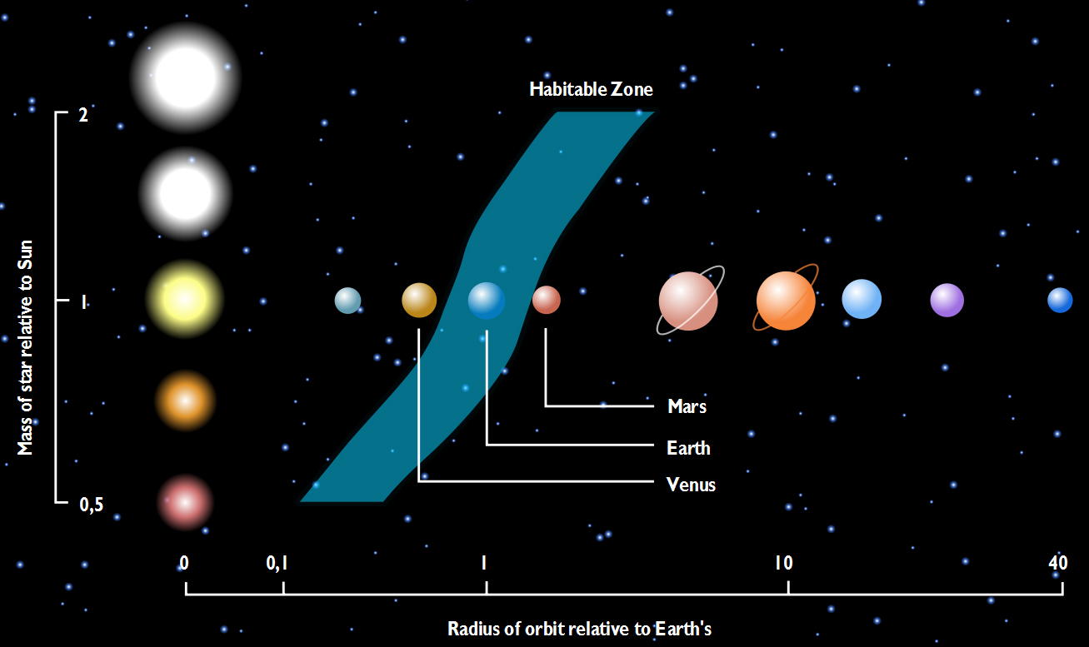
The Drake equation
N_{life} = N_{stars} f_{goodstars} f_{planets} f_{habitable}f_{life} f_{civilization} f_{now}
Number of stars in the galaxy
About 10 billion!
Fraction of “good stars”, around which life could develop
Lifetime longer than 2 billion (?) years
~90%
No big flares
~75%
Fraction of stars with planets: 50% of stars are binaries
Habitable planets….
Fraction with life
Fraction with civilization that could develop interstellar communication
Fraction with civilization NOW
Drake equation doesn’t give us an answer now, but provides a framework for what we need to understand to answer the question
We’re working our way down the list! Current major advances are occuring on the issue of planets and habitable planets!

Slide 7
Finding planets around other stars
Very difficult to see planets around other stars directly
Earth’s atmosphere blurs images of stars so that planets are “buried”
Even without atmosphere, telescopes provide a lower level of blurring because of the properties of how they work (diffraction)
Sophisticated imaging techniques may get around these issues in some cases
Fomalhaut B: a Jupiter mass planet in a large orbit around a nearby A star

Slide 8
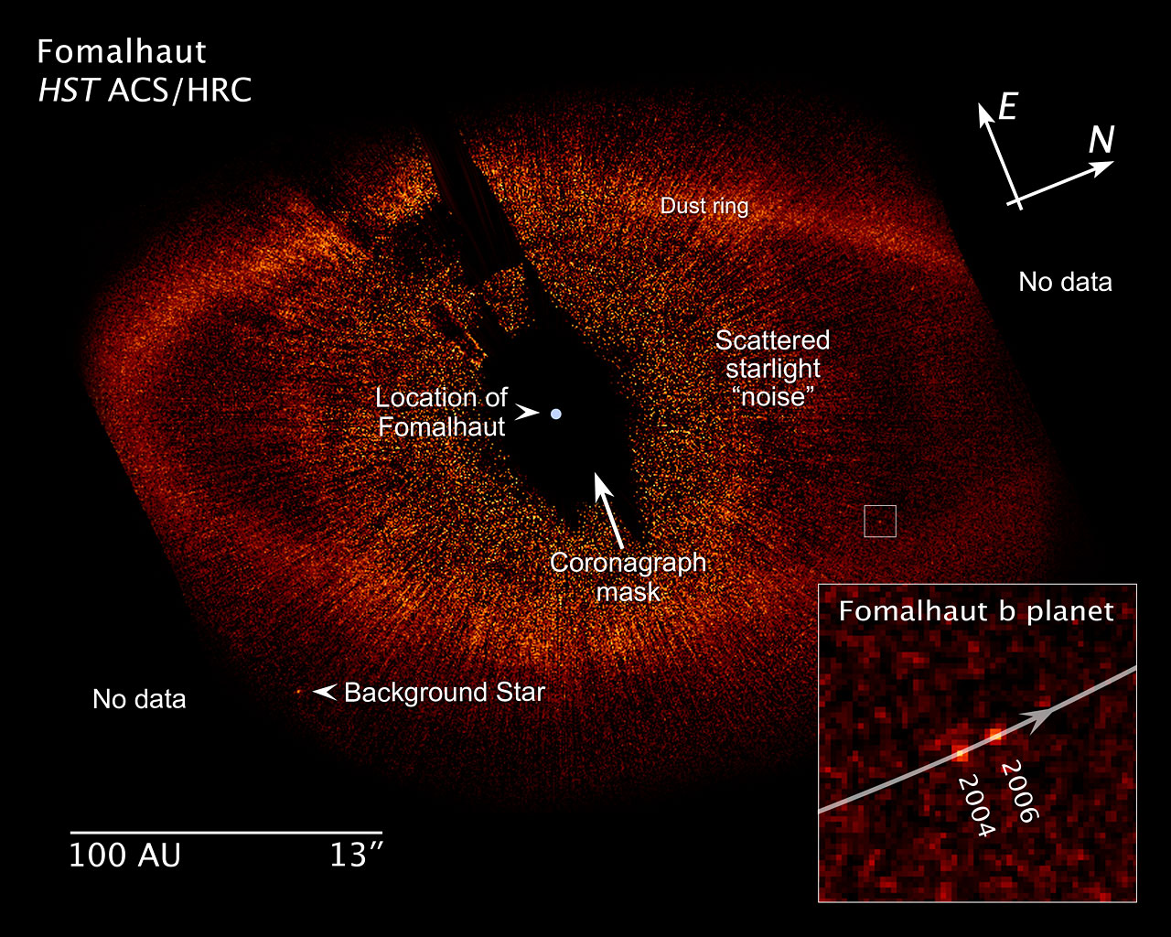

Slide 9
Finding planets indirectly
Despite difficulties of direct detection, we now have discovered hundreds of planets around other stars by indirect detection
Works by understanding gravity and acceleration

Slide 10
If a planet is orbiting a star that is much more massive than the planet
The gravitational pull of the star on the planet is stronger than the pull of the planet on the star
The gravitational pull of the star on the planet is equal to the pull of the planet on the star, but the planet will accelerate more than the star
The gravitational pull of the star on the planet is equal to the pull of the planet on the star, and both the planet and the star will have the same acceleration
The gravitational pull of the star on the planet is equal to the pull of the planet on the star, but the star will accelerate more than the planet

Slide 11
Finding planets indirectly
Gravitation pull of a planet on its parent star cause the star to make a small orbit
Orbit can’t be seen directly
But the motion can be detected by the Doppler shift if it is oriented correctly relative to our line of sight

Slide 12
“Unblurred” view of a star with a planet

Slide 13
Extrasolar planet detections
Lots of planets (>500!) have been detected
With Doppler detections, you can tell something about the mass of the planet from how fast star is moving back and forth, and size of orbit from how long it takes to do a full cycle
Many of the extrasolar systems don’t seem much like ours, but a lot of this may be due to the sensitivity of experiments

Slide 14
Imagine you’re looking at a star that has a planet. At which location will the planet exert a stronger gravitational pull on its parent star, causing it to move faster?
Position A
Position B
Both positions will make the star move at the same speed
Neither position will make the star move at all

Slide 15
Imagine you’re looking at a star that has a planet. If planet B has more mass than planet A (both are at same distance), which planet will exert a stronger gravitational pull on its parent star, causing it to move faster?
Planet A
Planet B
Both planets will make the star move at the same speed
Neither planet will make the star move at all

Slide 16
Extrasolar planet detections
Most extrasolar planets that have been discovered are relatively massive, the mass of Jupiter or larger
Much of this is probably a selection effect
As techniques continue to improve, lower mass planets are being detected!

Slide 17
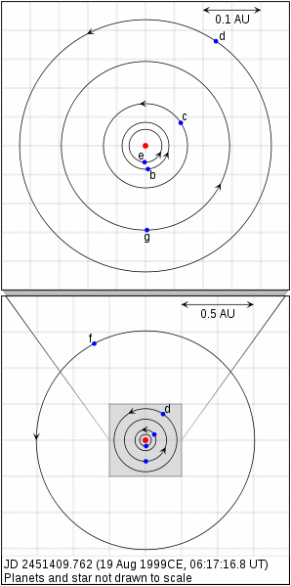
Gliese 581
Multiple planet system with a planet in a habitable zone?
Low mass M star, so habitable planets are close
Seven planets have been suggested!
Gliese 581g has a period of 37 days and is predicted to be in the habitable zone!
Gl 581g is “tidally locked” to star, meaning same side always faces the stars

Slide 18
Another detection methods: transits
There’s another way to detect planets by looking at the parent star, but not from the Doppler shift but by looking at the brightness of the star
If there’s a planet, and the system is “edge-on” to our line of sight, the planet will periodically pass in front of the star
The star will get a tiny bit dimmer when this happens

Slide 19
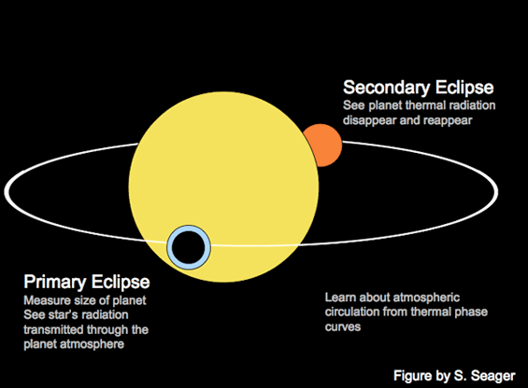

Slide 20
Transits and Kepler mission
Problem: dimming is small, determined by relative size of planet and star
Very small for Earth sized planets!
Has been detected for large planets
Kepler mission is currently searching for Earth-sized planets!

Slide 21
Possibilities from transits
Amount of dimming in a transit tells you the size of the planet
If you make a Doppler detection as well, you get the mass
Combining mass and size, you get the density! Hints about what the planet might be made of….
In principle, during a transit a small bit of light from the star passes through the atmosphere of a planet (if it has one), so you might be able to measure something about atmospheric composition….
Very exciting times for planet discovery: Kepler has thousands of candidates
Unfortunately, Kepler satellite has recently stopped working…..

Slide 22
ASTR110 : Introduction to Astronomy
Astronomy and Science
Astronomy by eye: motions in the Sky
Overview of the Universe
The Physical Basis of Astronomy: Gravity and Light
Interesting questions in Astronomy:
- how do stars work and evolve
- possibilities and searches for life in the Solar System and the Universe

Slide 23
Theme: Process of science
Science is a powerful process for learning about the world
Science is based on observations/data, not opinion or preconceived ideas
Science is a skeptical process, trying to prove ideas wrong
Ideas that survive have very strong support!
Science is important in society

Slide 24
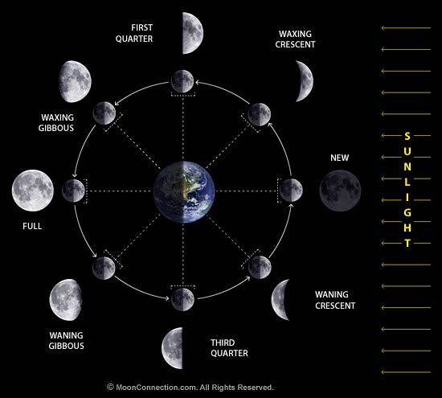
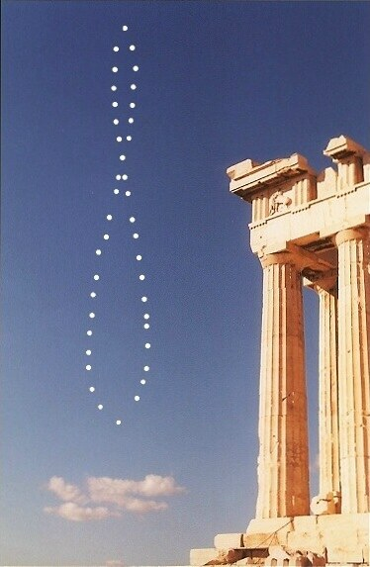
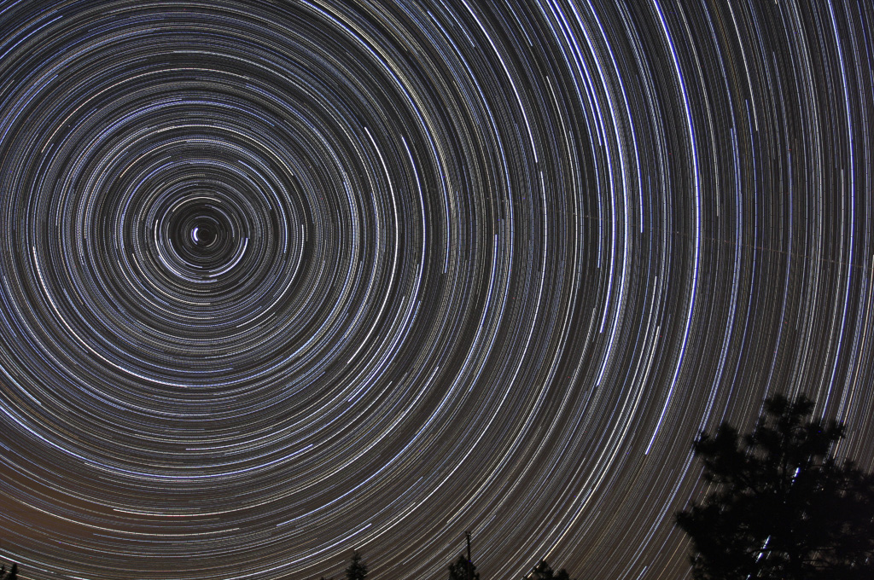
Theme: astronomy in everyday life
Night and day: motions of stars in the sky
Seasons
Phases of the Moon / eclipses
Color of the sky

Slide 25
Theme: Earth’s place in the Universe
Our galactic address: Solar System, Milky Way galaxy, Universe
Earth is not in the center of anything
Sun is not a special star
Contents of the Universe
Planets: different types
Stars: range of properties
Galaxies: range of properties

Slide 26
Theme: physics explains why and lets you learn amazing things
Gravity
Main force in the Universe
Lets you learn about masses of objects
Light
Rich phenomenon of electromagnetic spectrum
Lets you learn about temperatures, compositions, sizes, motions of objects
Energy production
Nuclear reactions: fusion and fission

Slide 27
Theme: a dynamic Universe
Motions in the solar system
Motions in galaxies
An expanding Universe
Stars, stellar evolution and life cycles

Slide 28
Theme: Big questions / unknowns
Dark matter:
what is most of the matter in the Universe made of?
Why do we think it exists?
Dark energy:
what is most of the energy in the Universe coming from?
Why do we think it exists?
Is there other life in the Universe?

Slide 29
More astronomy …. ?
Gen ed classes: ASTR 105 + 110
Viewing a wider world: ASTR 301, 305, 308, 330
Upper level astronomy: ASTR 401, 402
Astronomy minor:
5-6 classes, can include some from other depts
Regular (physics) track
Engineering track
Education track

