Slide 1
The life and death of stars

Slide 2
How do stars work and evolve?
Why do stars shine?
Nuclear reactions
Fusion and fission reactions
How nuclear reactions can create energy
Why is it hard to get fusion nuclear reactions to occur?
Forces inside of atoms
Nuclear reactions in the Sun
Only in core
Energy works its way out
Radiative zone
Convective zone

Slide 3
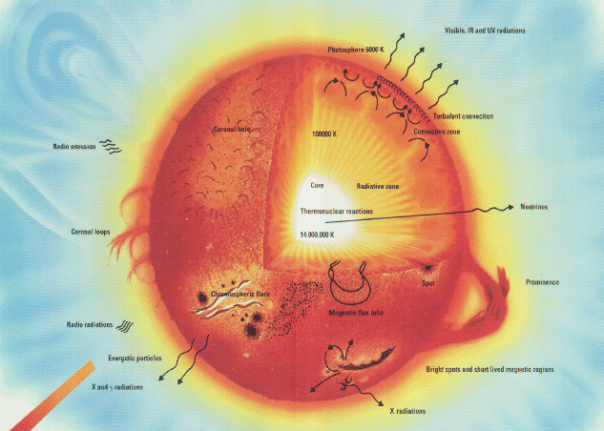
Energy transport in the Sun
Nuclear reactions only happen in the core, and they produce gamma ray light!
How does the energy get out?
In inner parts, by radiation
In outer parts, by convection

Slide 4
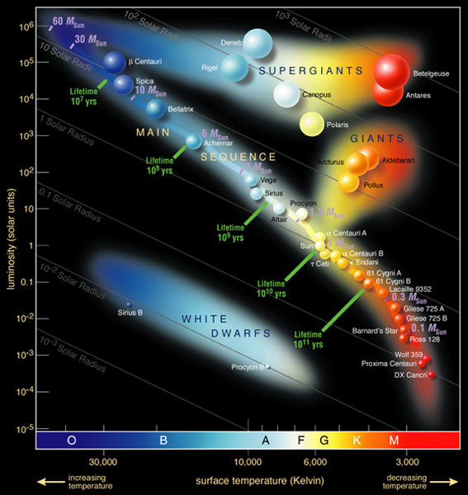
Nuclear reactions: how do we know?
Solar structure
We can do the physics of gas balls, and the observed properties of the Sun (size and temperature) match those expected from physics with nuclear reactions: note “sunquakes”
Other stars
We can do the physics of gas balls for different masses, and find that we expect a relation between mass, temperature, and size for gas balls of different mass
Exactly what is observed in the HR diagram – the Main Sequence!
Direct evidence: neutrinos
In addition to electromagnetic energy, nuclear reactions produce a kind of particle called a neutrino
Interesting thing about these is that the gas in the Sun is transparent to neutrinos
We observe them from Earth!

Slide 5
Nuclear reactions in stars: Sun
Nuclear reaction in the Sun: 4 hydrogen atoms fuse to one helium atom (2 protons + 2 neutrons)
Initial heat to start nuclear reactions come from gravitational energy when Sun forms
Nuclear reactions keep the core hot, which keeps the Sun from collapsing under its own gravity
Hotter gas has higher pressure than cooler gas
Pressure up balances gravity down
Eventually, the hydrogen will run out…. But not for a long time!

Slide 6
The future of the Sun
Eventually, the Sun will run out of its hydrogen in the core
Very center of core is hottest, so it runs out first
It will continue nuclear reactions in a shell, but the outer structure will evolve: the Sun will expand and its outer layers will cool

Slide 7
If the Sun cools and expands, what kind of stars will it become?
A red main sequence star
A blue main sequence star
A red giant
A white dwarf
No clue
GIANTS and SUPERGIANTS are EVOLVED stars

Slide 8
Once the Sun runs out of hydrogen in its core and shell, it is left with a helium core. What do you think might be able to happen next?
It will be impossible to produce any more energy by nuclear reactions
It will be easy to produce more energy by splitting the helium atoms back into hydrogen
It will be possible to produce more energy by splitting the helium atoms back into hydrogen, but it will require the core to get hotter
It will be easy to produce more energy by fusing helium atoms together
It will be possible to produce more energy by fusing helium atoms together, but it will require the core to get hotter

Slide 9
The future of the Sun
Eventually, the Sun will run out of its hydrogen in the core
It will continue nuclear reactions in a shell, but the outer structure will evolve: the Sun will expand into a red giant
Eventually the hydrogen will run out
Not enough enough for helium nuclear reactions: these have stronger electromagnetic repulsion since they have two protons
Without heat source, gravity will cause core to collapse and get hotter
Helium nuclear reactions can occur for a while, but they will run out pretty fast
Sun will end its life as a hot carbon core: a white dwarf
Further collapse and heating is prevented by a different kind of pressure called electron degenerate pressure
Outer layers are shed in what is known as a planetary nebula

Slide 10
Planetary nebulae : remnants of stars like the Sun!

Slide 11
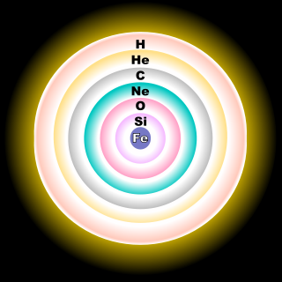
Evolution of other stars
In more massive stars, degenerate electron pressure isn’t sufficient to balance gravitational collapse
Additional nuclear reactions can occur
Carbon to oxygen to neon to magnesium, silicon to sulfur to argon ….. All the way up until iron and nickel.
Iron and nickel can’t have nuclear reactions that produce energy!
Core collapses and results in a giant explosion …. A supernova!

Slide 12
Supernova image gallery
Supernovae explosions are extremely bright: for a couple of weeks, the explosion can be as bright as the combined brightness of billions of stars … i.e an entire galaxy!
More supernovae

Slide 13
Supernovae and life
Supernovae are critical as they release heavy elements – formed in the centers of massive stars -- back into the interstellar medium
These mix with existing material and eventually form into new stars …. And planets … and things on the planets …
Humans are composed of starstuff!

Slide 14
Where do we come from?
When was the oxygen in our bodies assembled into atoms (when were the protons, neutrons, and electrons put together?
Within the past day, e.g. from food you ate
Within the past century, e.g. when you were born
When the Sun and Earth were formed, about 4.5 billion years ago
Before the Sun was formed but after the beginning of the Universe
They have existed since the beginning of the Universe

