Slide 1
How do stars produce energy?
Nuclear reactions

Slide 2
Project due Friday!
Remaining assignments
Labs during last week

Slide 3
Science and Astronomy
Astronomy by Eye: Motions in the Sky
Overview of the Universe
The Physical Basis of Astronomy: Gravity and Light
Summary: “How do we know?”
V. Some interesting questions
How do stars work? What is the eventual fate of the Sun?
Where might we look for life in the Solar System? Life in other locations? What is the probability of other life?

Slide 4
Why do stars shine?
We’ve seen what you can learn about the light (electromagnetic energy) that’s emitted from the surface of stars
We understand that stars shine because they are hot
But what makes them hot? What is the source of the energy?
Nuclear reactions in the cores of stars

Slide 5
Nuclear reactions
What is a nuclear reaction?
Under extreme conditions, atoms of one element can turn into atoms of another element
Nuclear fusion: two smaller atoms join to make a bigger atom
Nuclear fission: one bigger atom splits to form smaller atoms

Slide 6
Why do nuclear reactions produce energy?
Atoms of each element have a mass
For some reactions, the mass of the product element is not equal to the mass of the input elements
If the mass of the product is less than the mass on the input, the extra mass comes out in the form of energy…. And lots of it!
E = mc²

Slide 7
Hydrogen atoms have a mass of of 1.0079 atomic units. Helium atoms have a mass of 4.0026 atomic units. The nuclear reaction: 4 H --> 1 He will
Produce energy, because the mass of the product is less than the mass of the input
Produce energy, because the mass of the product is more than the mass of the input
Require energy, because the mass of the product is less than the mass of the input
Require energy, because the mass of the product is more than the mass of the input
Neither produce nor require energy

Slide 8
What nuclear reactions produce energy?
Generally, fusion of small atoms into a larger one produces energy --> STARS
Fission of large atoms into smaller ones produces energy --> NUCLEAR POWER PLANTS
Elements around iron are the special elements that have the highest binding energy, I.e. you can’t make a nuclear reaction with iron that produces energy

Slide 9
The “curve of binding energy”

Slide 10
What does it take to get fusion nuclear reactions?
Need to understand forces in atoms
Inside atoms
protons have positive electric charge and are found in the nucleus
neutrons have no electric charge and are found in the nucleus
electrons have negative positive charge and are found outside the nucleus
An element is determined by the number of protons it has
To get fusion to occur, you need to merge together two (or more) different nucleii

Slide 11
The electromagnetic force between two protons is about VERY MUCH stronger than the gravitational force between them
Getting nuclear fusion to occur should be
Easy because protons are attracted to each other by the electromagnetic force
Hard because protons are repelled from each other by the electromagnetic force
Easy because protons are attracted to each other by the force of gravity
Hard because protons are repelled from each other by the force of gravity

Slide 12
What does it take for fusion to occur?
For fusion, smaller elements have to combine into a larger one
Elements are determined by their number of protons
Protons have positive electric charge
Positive charges repel each other!
So how do protons stick together in atomic nucleii?
The strong force, which is stronger than the electromagnetic force, but only if protons get very close to one another
How can you get protons close enough?
High energy collisions
Require very fast moving protons --> VERY HIGH TEMPERATURES! Millions of degrees!

Slide 13
Practical application: nuclear power
Nuclear power plants: fission
Pros: no greenhouse gas emissions
Cons: radioactive byproducts, safety, high cost
Nuclear power plants: fusion?
Potentially great source of energy
Hard to confine gas at high enough temperatures!

Slide 14
Nuclear reactions in stars: Sun
Only in the very center of the Sun does it get hot enough for nuclear reactions
Initial heat is generated during formation of the Sun, from gravitational energy
Most abundant element is hydrogen
Easiest nuclear reaction involves hydrogen, because it only has one proton
The Sun’s nuclear reaction: the proton-proton cycle
Overall, through a series of nuclear reactions, four hydrogen atoms fuse into one helium atom, producing energy.
4 hydrogen → 1 helium + energy

Slide 15
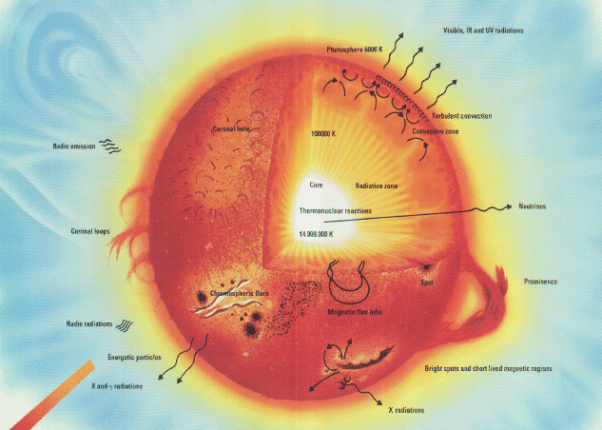
Energy transport in the Sun
Nuclear reactions only happen in the core, and they produce gamma ray light!
How does the energy get out?
In inner parts, by radiation
In outer parts, by convection

Slide 16
Evolution of the Sun
Eventually, the hydrogen will run out…. But not for a long time!
When hydrogen runs out, there will be a helium core. Helium is an element with TWO protons

Slide 17
Once the Sun runs out of hydrogen in its core
It will be impossible to produce any more energy by nuclear reactions
It will be easy to produce more energy by splitting the helium atoms back into hydrogen
It will be possible to produce more energy by splitting the helium atoms back into hydrogen, but it will require the core to get hotter
It will be easy to produce more energy by fusing helium atoms together
It will be possible to produce more energy by fusing helium atoms together, but it will require the core to get hotter

Slide 18
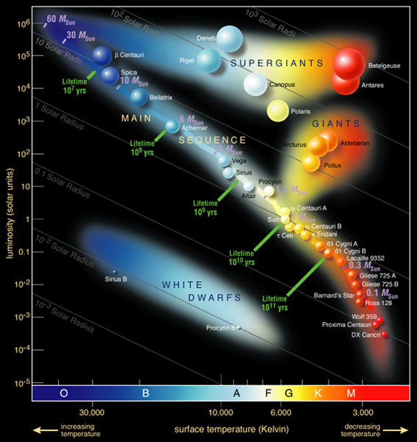
Nuclear reactions: how do we know?
Solar structure
We can do the physics of gas balls, and the observed properties of the Sun match those expected from physics with nuclear reactions: note “sunquakes”
Other stars
We can do the physics of gas balls for different masses, and find that we expect a relation between mass, temperature, and size for gas balls of different mass
Exactly what is observed in the HR diagram!
Direct evidence: neutrinos
In addition to electromagnetic energy, nuclear reactions produce a kind of particle called a neutrino
Interesting thing about these is that the gas in the Sun is transparent to neutrinos
We observe them from Earth!

Slide 19
The future of the Sun
Eventually, the Sun will run out of its hydrogen in the core
It will continue nuclear reactions in a shell, but the outer structure will evolve: the Sun will expand and its outer layers will cool

Slide 20
If the Sun cools and expands, what kind of stars will it become?
A red main sequence star
A blue main sequence star
A red giant
A white dwarf
No clue

Slide 21
The future of the Sun
Eventually, the Sun will run out of its hydrogen in the core
It will continue nuclear reactions in a shell, but the outer structure will evolve: the Sun will expand into a red giant
Eventually the hydrogen will run out
Helium nuclear reactions can occur for a while, but they will run out pretty fast
3 helium → 1 carbon + energy
Carbon core shrinks but stops before it gets hots enough for carbon nuclear reactions
Sun will end its life as a hot carbon core: a white dwarf

