Slide 1
How do stars produce energy?
Nuclear reactions

Slide 2
Project due Friday!
Lab this week
Assignments next week
Measuring radial velocities from light
Doppler shift
Astronomy applications
Light: redshift and blueshift
Sound: pitch changes

Slide 3
Science and Astronomy
Overview of the Universe
Astronomy by Eye: Motions in the Sky
The Physical Basis of Astronomy: Gravity and Light
Summary: “How do we know?”

Slide 4
How can we measure masses of stars?
Studying the continuous spectrum of stars
Studying absorption lines in stars
Studying binary star orbits
Studying the brightnesses of stars
Only by estimation
Watch orbits, measure size of orbits and either period of orbits or speed of the stars, use understanding of gravity to get masses

Slide 5
D
A
B
C
Planets C and D orbit stars A and B, respectively. Both take one year to go around. What can you say about the stars?
Star A is more massive
Star B is more massive
Both stars have the same mass
You can’t tell anything about the relative masses

Slide 6
How can we measure compositions of stars?
Studying the continuous spectrum of stars
Studying absorption lines in stars
Studying binary star orbits
Studying the brightnesses of stars
Only by estimation
Different elements have individual “fingerprints” of absorption or emission lines, look for these to determine composition

Slide 7
How can we measure temperatures of stars without any ambiguity?
Studying the continuous spectrum of stars
Studying absorption lines in stars
Studying binary star orbits
Studying the brightnesses of stars
Only by estimation
Hotter stars will be bluer, cooler stars will be redder. However, there’s a possibility you might get confused by intervening dust between us and the star, which might make it appear redder (like at sunset!). Even in this case, however, absorption lines can tell us the temperature. Note that hot stars generally have few absorption lines (O and B stars)

Slide 8
A
Star A is hotter
Star B is hotter
Stars A and B are same temperature
Can’t tell: they could be the same temperature, with A behind dust
Can’t tell: they could be the same temperature, with B behind dust
B

Slide 9
How can we measure sizes of stars?
Studying the continuous spectrum of stars
Studying absorption lines in stars
Studying binary star orbits
Studying the brightnesses of stars
Only by estimation
Brightness of a star is affected by distance, temperature, and size. If you can independently measure distance and temperature, you can use brightness to infer size.

Slide 10
A
B
You look at a star cluster and see two red stars: one (A) is much brighter than the other (B). What can you conclude?
Star A is hotter than star B
Star A is farther away than star B
Star A is bigger than star B
Star A is smaller than star B
The stars are the same size

Slide 11
Direction of stars motion
To Earth
If you used a spectrum to look at this star and found a pattern of absorption lines that you could recognize, you would find that:
These lines were located at a shorter wavelength (blueshifted) than you would have expected
These lines were located at the same wavelength that you would have observed them at on Earth
These lines were located at a longer wavelength (redshifted) than you would have expected

Slide 12
To Earth
If you used a spectrum to look at this star and found a pattern of absorption lines that you could recognize, you would find that:
These lines were located at a shorter wavelength (blueshifted) than you would have expected
These lines were located at the same wavelength that you would have observed them at on Earth
These lines were located at a longer wavelength (redshifted) than you would have expected
Direction of stars motion

Slide 13
Is this car:
Coming towards you?
Standing still
Moving away from you
Can’t tell
Both coming towards and going away

Slide 14
What number am I thinking of?
1
3
5
7
9

Slide 15
Science and Astronomy
Overview of the Universe
Astronomy by Eye: Motions in the Sky
The Physical Basis of Astronomy: Gravity and Light
Summary: “How do we know?”
V. Some interesting questions
How do stars work? What is the eventual fate of the Sun?
Where might we look for life in the Solar System? Life in other locations? What is the probability of other life?

Slide 16
Why do stars shine?
We’ve seen what you can learn about the light (electromagnetic energy) that’s emitted from the surface of stars
We understand that stars shine because they are hot
But what makes them hot? What is the source of the energy?
Nuclear reactions in the cores of stars

Slide 17
Nuclear reactions
What is a nuclear reaction?
Under extreme conditions, atoms of one element can turn into atoms of another element
Nuclear fusion: two smaller atoms join to make a bigger atom
Nuclear fission: one bigger atom splits to form smaller atoms

Slide 18
Why do nuclear reactions produce energy?
Atoms of each element have a mass
For some reactions, the mass of the product element is not equal to the mass of the input elements
If the mass of the product is less than the mass on the input, the extra mass comes out in the form of energy…. And lots of it!
E = mc²

Slide 19
Hydrogen atoms have a mass of of 1.0079 atomic units. Helium atoms have a mass of 4.0026 atomic units. The nuclear reaction: 4 H --> 1 He will
Produce energy, because the mass of the product is less than the mass of the input
Produce energy, because the mass of the product is more than the mass of the input
Require energy, because the mass of the product is less than the mass of the input
Require energy, because the mass of the product is more than the mass of the input
Neither produce nor require energy

Slide 20
What nuclear reactions produce energy?
Generally, fusion of small atoms into a larger one produces energy --> STARS
Fission of large atoms into smaller ones produces energy --> NUCLEAR POWER PLANTS
Elements around iron are the special elements that have the highest binding energy, I.e. you can’t make a nuclear reaction with iron that produces energy

Slide 21
The “curve of binding energy”

Slide 22
What does it take to get fusion nuclear reactions?
Need to understand forces in atoms
Inside atoms
protons have positive electric charge and are found in the nucleus
neutrons have no electric charge and are found in the nucleus
electrons have negative positive charge and are found outside the nucleus
An element is determined by the number of protons it has
To get fusion to occur, you need to merge together two (or more) different nucleii

Slide 23
The electromagnetic force between two protons is about VERY MUCH stronger than the gravitational force between them
Getting nuclear fusion to occur should be
Easy because protons are attracted to each other by the electromagnetic force
Hard because protons are repelled from each other by the electromagnetic force
Easy because protons are attracted to each other by the force of gravity
Hard because protons are repelled from each other by the force of gravity

Slide 24
What does it take for fusion to occur?
For fusion, smaller elements have to combine into a larger one
Elements are determined by their number of protons
Protons have positive electric charge
Positive charges repel each other!
So how do protons stick together in atomic nucleii?
The strong force, which is stronger than the electromagnetic force, but only if protons get very close to one another
How can you get protons close enough?
High energy collisions
Require very fast moving protons --> VERY HIGH TEMPERATURES! Millions of degrees!

Slide 25
Practical application: nuclear power
Nuclear power plants: fission
Pros: no harmful emissions
Cons: radioactive byproducts, safety, high cost
Nuclear power plants: fusion?
Potentially great source of energy
Hard to confine gas at high enough temperatures!

Slide 26
Nuclear reactions in stars: Sun
Only in the very center of the Sun does it get hot enough for nuclear reactions
Most abundant element is hydrogen
Easiest nuclear reaction involves hydrogen, because it only has one proton
The Sun’s nuclear reaction: the proton-proton cycle
Overall, through a series of nuclear reactions, four hydrogen atoms fuse into one helium atom, producing energy
Eventually, the hydrogen will run out…. But not for a long time!

Slide 27
Once the Sun runs out of hydrogen in its core
It will be impossible to produce any more energy by nuclear reactions
It will be easy to produce more energy by splitting the helium atoms back into hydrogen
It will be possible to produce more energy by splitting the helium atoms back into hydrogen, but it will require the core to get hotter
It will be easy to produce more energy by fusing helium atoms together
It will be possible to produce more energy by fusing helium atoms together, but it will require the core to get hotter

Slide 28
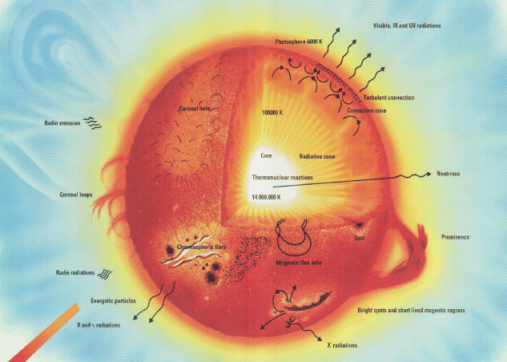
Energy transport in the Sun
Nuclear reactions only happen in the core, and they produce gamma ray light!
How does the energy get out?
In inner parts, by radiation
In outer parts, by convection

Slide 29
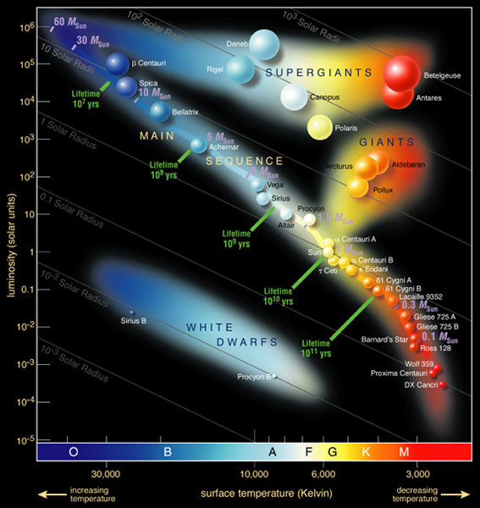
Nuclear reactions: how do we know?
Solar structure
We can do the physics of gas balls, and the observed properties of the Sun match those expected from physics with nuclear reactions
Other stars
We can do the physics of gas balls for different masses, and find that we expect a relation between mass, temperature, and size for gas balls of different mass
Exactly what is observed in the HR diagram!
Direct evidence: neutrinos
In addition to electromagnetic energy, nuclear reactions produce a kind of particle called a neutrino
Interesting thing about these is that the gas in the Sun is transparent to neutrinos
We observe them from Earth!

Slide 30
The future of the Sun
Eventually, the Sun will run out of its hydrogren in the core
It will continue nuclear reactions in a shell, but the outer structure will evolve: the Sun will expand and its outer layers will cool

Slide 31
If the Sun cools and expands, what kind of stars will it become?
A red main sequence star
A blue main sequence star
A red giant
A white dwarf
No clue

Slide 32
The future of the Sun
Eventually, the Sun will run out of its hydrogen in the core
It will continue nuclear reactions in a shell, but the outer structure will evolve: the Sun will expand into a red giant
Eventually the hydrogren will run out
Helium nuclear reactions can occur for a while, but they will run out pretty fast
Sun will end its life as a hot carbon core: a white dwarf

