Slide 1
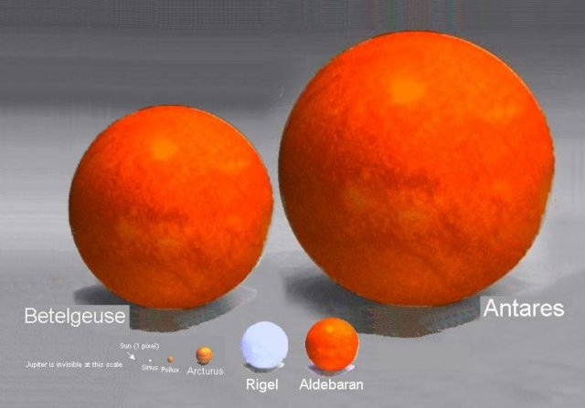
Brightnesses, sizes and motions of stars

Slide 2
Recap
Project: due Friday 11/21
Campus observatory
Information from brightnesses of stars
Brightness depends on: distance, temperature and size
If you know two of these, brightness can be used to give you the third
Using distances (from parallax), temperatures (from spectra), we can infer information about sizes of stars
Stars come in range of sizes, and sizes are correlated with temperature

Slide 3
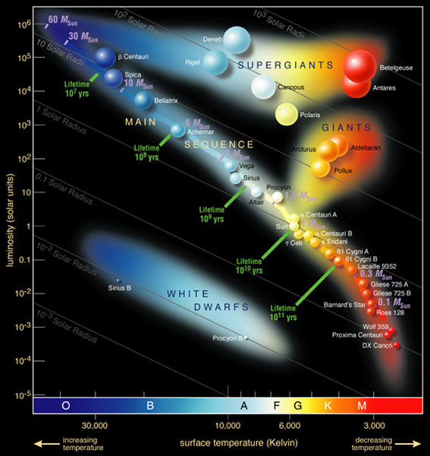
Stellar properties
We’ve learned that stars come in a range of sizes and a range of temperatures
Are they related to each other?
Investigate this using a diagram called a Hertzsprung-Russell (HR) diagram
Plots intrinsic brightness vs. temperature
Most stars found along a line in this diagram --> the main sequence
A few are found in other places: what’s different about these?
Why isn’t there all combinations of temperature and size?
Physics of how stars work

Slide 4
Measuring motions with light
Still one more thing we can learn about from studying light: something about how objects move, even when they’re so far away we don’t see them change position!
The Doppler effect allows you to measure the radial velocity component of an object
Radial velocity is the part of the velocity that is directly towards or away from you

Slide 5
Doppler shift in Astronomy
Expansion of the Universe
Detection of dark matter via spiral galaxy rotation curves
Masses of stars using binary stars
Many others:
Detection of planets around other stars

Slide 6
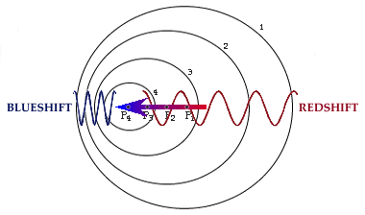
Doppler effect
Doppler effect occurs because light has properties of a wave
If an object is moving as it emits waves, the observed wavelength will be different from the emitted wavelength
The size of the difference depends on how fast the object is moving relative to how fast the wave is moving
For many astronomical objects, shift is quite small
Distinguishing color change from Doppler effect vs color change from temperature or intervening dust: absorption lines!

Slide 7
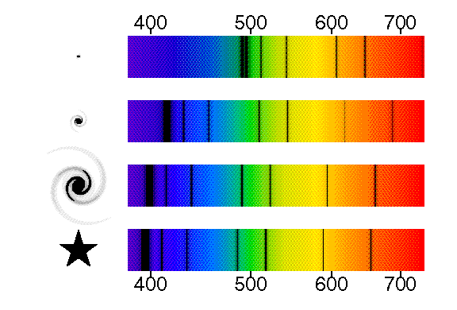
Locate the absorption line in the bottom spectrum located at a wavelength of about 510 nm. Can you find the same line in the top spectrum, and if so, at what wavelength?
A. 510nm
B. 540nm
C. 610nm
D. 640nm
E. can’t find the same line

Slide 8
Which object is moving away at the fastest rate?
A. top
B. second
C. third
D. bottom
E. can’t tell from information given

Slide 9
The top three represent spectra of galaxies. Remembering what we learned about the expansion of the Universe (!), which galaxy is the farthest away?
A) top
B) second
C) third
D) can't tell

Slide 10
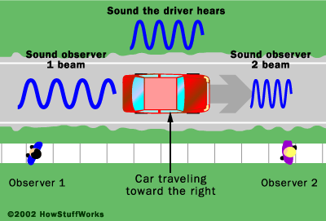
Doppler shift with sound
Doppler effect occurs for any physical phenomenon that involves waves
Sound is an everyday example!
For sound, wavelength of sound wave corresponds to pitch
Pitch of an object moving towards or away from you will sound different than when object is stationary

Slide 11
Radial vs. transverse velocity
Doppler shift is great, but it doesn’t tell us everything about the motion of an object, only the radial component
Sideways/transverse motion is actually harder to detect, because objects are so far away
New satellites are in preparation that will measure sufficiently accurate positions to measure these velocities for millions of stars in our galaxy
Combined total velocities will provide much improved model of motions in the galaxy

Slide 12
Science and Astronomy
Astronomy by Eye: Motions in the Sky
Overview of the Universe
The Physical Basis of Astronomy: Gravity and Light
Summary: “How do we know?”

Slide 13
How can we measure masses of stars?
Studying the continuous spectrum of stars
Studying absorption lines in stars
Studying binary star orbits
Studying the brightnesses of stars
Only by estimation
Watch orbits, measure size of orbits and either period of orbits or speed of the stars, use understanding of gravity to get masses

Slide 14
D
A
B
C
Planets C and D orbit stars A and B, respectively. Both take one year to go around. What can you say about the stars?
Star A is more massive
Star B is more massive
Both stars have the same mass
You can’t tell anything about the relative masses

Slide 15
How can we measure compositions of stars?
Studying the continuous spectrum of stars
Studying absorption lines in stars
Studying binary star orbits
Studying the brightnesses of stars
Only by estimation
Different elements have individual “fingerprints” of absorption or emission lines, look for these to determine composition

Slide 16
How can we measure temperatures of stars without any ambiguity?
Studying the continuous spectrum of stars
Studying absorption lines in stars
Studying binary star orbits
Studying the brightnesses of stars
Only by estimation
Hotter stars will be bluer, cooler stars will be redder. However, there’s a possibility you might get confused by intervening dust between us and the star, which might make it appear redder (like at sunset!). Even in this case, however, absorption lines can tell us the temperature.

Slide 17
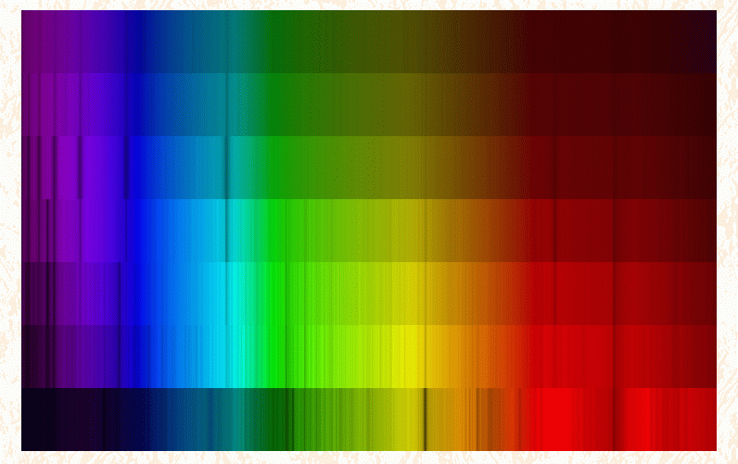
A
Star A is hotter
Star B is hotter
Stars A and B are same temperature
Can’t tell: they could be the same temperature, with A behind dust
Can’t tell: they could be the same temperature, with B behind dust
B

Slide 18
How can we measure sizes of stars?
Studying the continuous spectrum of stars
Studying absorption lines in stars
Studying binary star orbits
Studying the brightnesses of stars
Only by estimation
Brightness of a star is affected by distance, temperature, and size. If you can independently measure distance and temperature, you can use brightness to infer size.

Slide 19
A
B
You look at a star cluster and see two red stars: one (A) is much brighter than the other (B). What can you conclude?
Star A is hotter than star B
Star A is farther away than star B
Star A is bigger than star B
Star A is smaller than star B
The stars are the same size

Slide 20
Direction of stars motion
To Earth
If you used a spectrum to look at this star and found a pattern of absorption lines that you could recognize, you would find that:
These lines were located at a shorter wavelength (blueshifted) than you would have expected
These lines were located at the same wavelength that you would have observed them at on Earth
These lines were located at a longer wavelength (redshifted) than you would have expected

Slide 21
To Earth
If you used a spectrum to look at this star and found a pattern of absorption lines that you could recognize, you would find that:
These lines were located at a shorter wavelength (blueshifted) than you would have expected
These lines were located at the same wavelength that you would have observed them at on Earth
These lines were located at a longer wavelength (redshifted) than you would have expected
Direction of stars motion

Slide 22
Is this car:
Coming towards you?
Standing still
Moving away from you
Can’t tell

Slide 23
What number am I thinking of?
1
3
5
7
9

