Slide 1
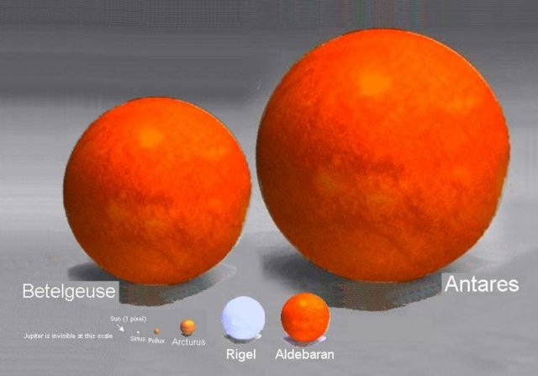
Brightnesses, sizes and motions of stars

Slide 2
Recap
Canvas assignment due Friday
Project: due Friday 11/21
Campus observatory
Emission and absorption lines
Arise from low density gases, where structure of atoms becomes important
Electrons in atoms have discrete (quantized) energy levels, leading to distinct colors that they can emit or absorb
This leads to emission and absorption line specta
Emission from hot gases where electrons are excited to higher energy levels and spontaneously fall to lower levels, emitting light in the process
Absorption from cooler gases in front of continuum source, where discrete colors are absorbed by atoms
From emission and absorption lines, get composition of objects and also their temperature

Slide 3
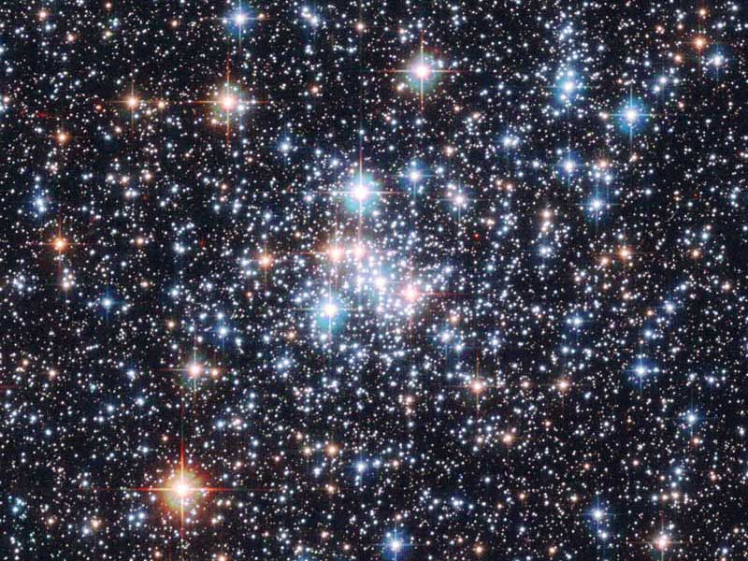
Brightnesses of objects
We’ve talked about spectra of objects and what you can learn from it, but not much about total brightnesses of objects
This is because brightness depends on multiple things
One primary issue is DISTANCE to the object: more distant objects are fainter (inverse square law)
However, one only needs to look at a star cluster to realize this isn’t the whole story

Slide 4
Why do the stars in the cluster have different colors?
A. they are made of different things
B. they have different temperatures
C. they have different amounts of intervening dust
D. they are at different distances

Slide 5
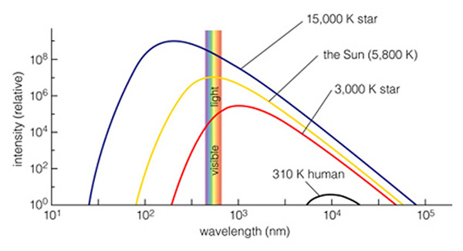
Brightnesses
In fact, brightnesses depend on three things
Distance
Temperature: hotter objects are brighter
Size: bigger objects are brighter

Slide 6
Consider stars A and B (both at the same distance). Which of the following is true?
A) A is brighter
B) B is brighter
C) A and B same brightness
D) can't tell relative brightnesses of A and B from information given

Slide 7
Consider stars B and D (both at the same color/temperature). Which of the following is true?
A) B is brighter
B) D is brighter
C) B and D same brightness
D) can't tell relative brightnesses of B and D from information given

Slide 8
Consider stars A and C. Which of the following is true?
A) A is brighter
B) C is brighter
C) A and C same brightness
D) can't tell relative brightnesses of A and C from information given

Slide 9
Consider stars C and D. Which of the following is true?
A) C is brighter
B) D is brighter
C) C and D are the same brightness
D) can't tell relative brightnesses of C and D from information given

Slide 10
Using brightnesses
Brightness depends on three things: distance, temperature, size
If we can independently measure two of these, we can use brightness to infer the third
Can we measure distances? How?
--> PARALLAX
Can we measure temperatures? How?
--> COLOR / ABSORPTION LINES
--> Use brightnesses to get sizes of stars

Slide 11
Sizes of stars
You can get sizes from brightnesses if you can independently measure distance and temperature
Why can’t you just measure the size of a star directly?
Too far away!

Slide 12
Sizes of stars
What do you find when you measure sizes of stars?
Stars come in a range of sizes
Sun is intermediate in size
Largest stars are huge!
Animation: http://www.youtube.com/watch?v=HEheh1BH34Q

Slide 13
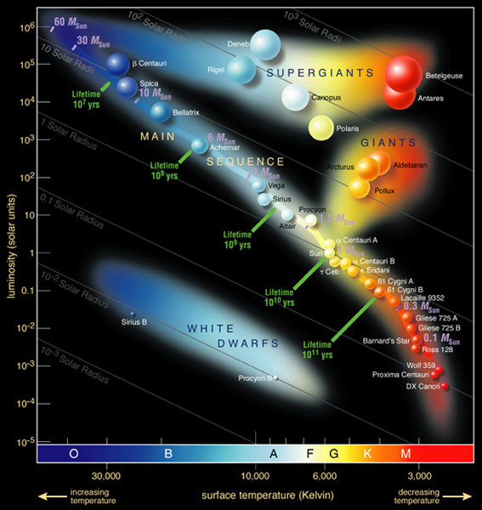
Stellar properties
We’ve learned that stars come in a range of sizes and a range of temperatures
Are they related to each other?
Investigate this using a diagram called a Hertzsprung-Russell (HR) diagram
Plots intrinsic brightness vs. temperature
Most stars found along a line in this diagram --> the main sequence
A few are found in other places: what’s different about these?
Why aren’t there all combination of temperature and size?
Physics of how stars work

Slide 14
Measuring motions with light
Still one more thing we can learn about from studying light: something about how objects move, even when they’re so far away we don’t see them change position!
The Doppler effect allows you to measure the radial velocity component of an object
Radial velocity is the part of the velocity that is directly towards or away from you

Slide 15
Doppler shift in Astronomy
Expansion of the Universe
Detection of dark matter via spiral galaxy rotation curves
Masses of stars using binary stars
Many others:
Detection of planets around other stars

Slide 16
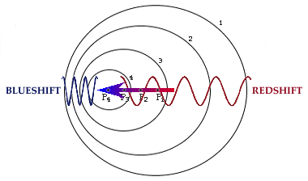
Doppler effect
Doppler effect occurs because light has properties of a wave
If an object is moving as it emits waves, the observed wavelength will be different from the emitted wavelength
The size of the difference depends on how fast the object is moving relative to how fast the wave is moving
For many astronomical objects, shift is quite small
Distinguishing color change from Doppler effect vs color change from temperature or intervening dust: absorption lines!

Slide 17
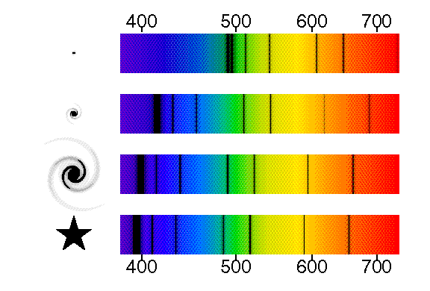
Locate the absorption line in the bottom spectrum located at a wavelength of about 510 nm. Can you find the same line in the top spectrum, and if so, at what wavelength?
A. 510nm
B. 540nm
C. 610nm
D. 640nm
E. can’t find the same line

Slide 18
Which object is moving away at the fastest rate?
A. top
B. second
C. third
D. bottom
E. can’t tell from information given

Slide 19
The top three represent spectra of galaxies. Remembering what we learned about the expansion of the Universe (!), which galaxy is the farthest away?
A) top
B) second
C) third
D) can't tell

Slide 20
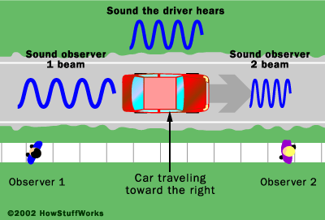
Doppler shift with sound
Doppler effect occurs for any physical phenomenon that involves waves
Sound is an everyday example!
For sound, wavelength of sound wave corresponds to pitch
Pitch of an object moving towards or away from you will sound different than when object is stationary

Slide 21
Radial vs. transverse velocity
Doppler shift is great, but it doesn’t tell us everything about the motion of an object, only the radial component
Sideways/transverse motion is actually harder to detect, because objects are so far away
New satellites are in preparation that will measure sufficiently accurate positions to measure these velocities for millions of stars in our galaxy
Combined total velocities will provide much improved model of motions in the galaxy

Slide 22
Science and Astronomy
Overview of the Universe
Astronomy by Eye: Motions in the Sky
The Physical Basis of Astronomy: Gravity and Light
Summary: “How do we know?”

Slide 23
How can we measure masses of stars?
Studying the continuous spectrum of stars
Studying absorption lines in stars
Studying binary star orbits
Studying the brightnesses of stars
Only by estimation

Slide 24
How can we measure compositions of stars?
Studying the continuous spectrum of stars
Studying absoprtion lines in stars
Studying binary star orbits
Studying the brightnesses of stars
Only by estimation

Slide 25
How can we measure temperatures of stars?
Studying the continuous spectrum of stars
Studying absorption lines in stars
Studying binary star orbits
Studying the brightnesses of stars
Only by estimation

Slide 26
How can we measure sizes of stars?
Studying the continuous spectrum of stars
Studying absorption lines in stars
Studying binary star orbits
Studying the brightnesses of stars
Only by estimation

