Slide 1
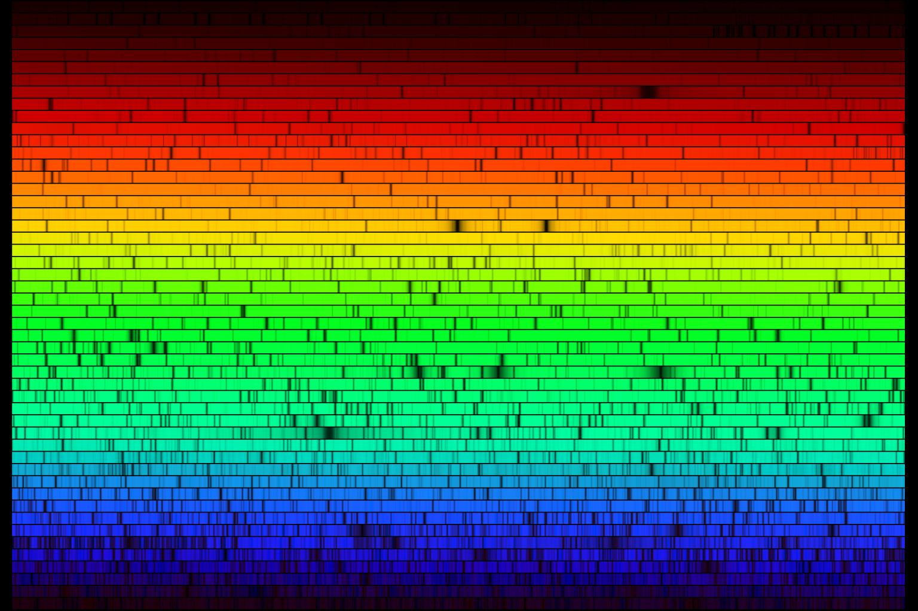
Light:
Thermal Spectra
Emission and Absorption Spectra

Slide 2
Recap
Canvas homework due FRIDAY
Lab this week: the Hertzsprung-Russell diagram (unfortunately, getting here a little ahead of class!)
Project due 11/22: see information from Canvas home page (http://astronomy.nmsu.edu/holtz/a110/project.html)
Continuous emission and colors of objects
  For object that produce continuous thermal emission (dense objects), spectrum is determined entirely by temperature of object
  For stars, their temperatures (thousands of degrees) lead to thermal spectra that make stars appear to have different colors (that our eyes can see): red stars cooler than blue stars
  Intervening material (interstellar mater) between stars and us, however, can scatter blue light preferentially, making stars appear redder
  Similar effect happens to sunlight as it travels through the molecules in the Earth’s atmosphere

Slide 3
Why is the sky blue?
Because it is relatively hot
Because it is relatively cool
Because it is reflecting light from the ocean
Because more blue light from the Sun is scattered by molecules in the Earth’s atmosphere than other colors
Because our eyes see blue light better than other colors

Slide 4
Emission and absorption line spectra
Emission and absorption line spectra occur when low density gases are involved
  Hot low density gases produce emission lines
  Cool low density gases produce absorption lines when found in front of continuous sources
In low density gases, it’s not interactions between atoms that produce light, but, instead, changes within individual atoms

Slide 5
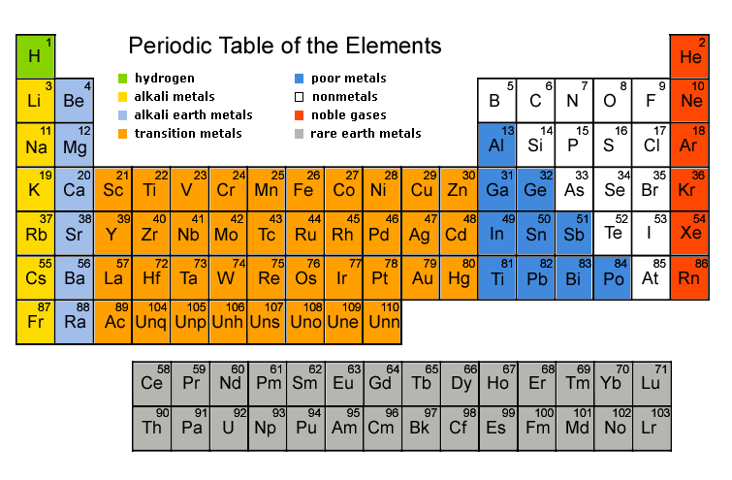
Atoms: brief review
Atoms are made of protons, neutrons, and electrons
  Protons and neutrons found in nucleus
  Electrons found outside of nucleus
Number of protons determine what element the atom is, i.e. what a substance is made of
  Periodic table lists all of the elements, e.g. hydrogen, helium, …. carbon, nitrogen, oxygen…

Slide 6
Light production by individual atoms
Key component of atoms having to do with light production is the electrons
In any given type of atom, electrons are only found in several discrete energy levels
  Energy levels are quantized
  (“Apartment building” model of an atom)
Electrons can move from one energy level to another
  If they go from a higher energy level to a lower one, the extra energy comes out in the form of light!
    What wavelength? The wavelength that corresponds to the exact amount of energy change
    The more the energy change, the shorter wavelength the emitted light
  To go from a lower energy level to a higher one, a atom needs to absorb energy

Slide 7
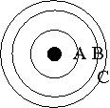
The diagram schematically represents the energy levels of electrons in an atom with larger circles representing electrons of higher energy, and the distance between circles representing the differences in electron energies.
If an electron were to go from orbit C to orbit A:
A. an emission line would be produced
B. an absorption line would be produced
C. a continuous spectrum would be produced
D. a transition from C to A is impossible

Slide 8
If one considered the electron transitions C-to-B and B-to-A,
A) the emission line arising from C-B would be bluer than that from B-to-A
B) the emission line arising from C-B would be redder than that from B-to-A
C) both emission lines would have the same color since they come from the same atom
D) neither transition would result in an emission line

Slide 9
Light production by individual atoms
Left to themselves, electrons will fall to the lowest available energy level
Electrons can move from lower to higher levels in two different ways
  If light of the correct energy is incident on the atom, it can be absorbed and used to move the electron to a higher energy level
  In a hot gas, collisions with other atoms can impart energy and move electrons to higher energy levels

Slide 10
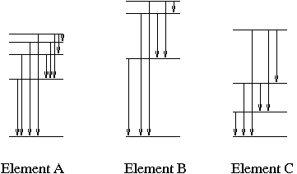
Emission and absorption lines: what can we learn?
Each different type of atom has its own distinct energy levels, and so produces its own distinct pattern of emission or absorption lines, like a fingerprint
  Recognizing the light fingerprint allows us to determine the composition of objects that produce emission or absorption lines, I.e. what they are made of

Slide 11
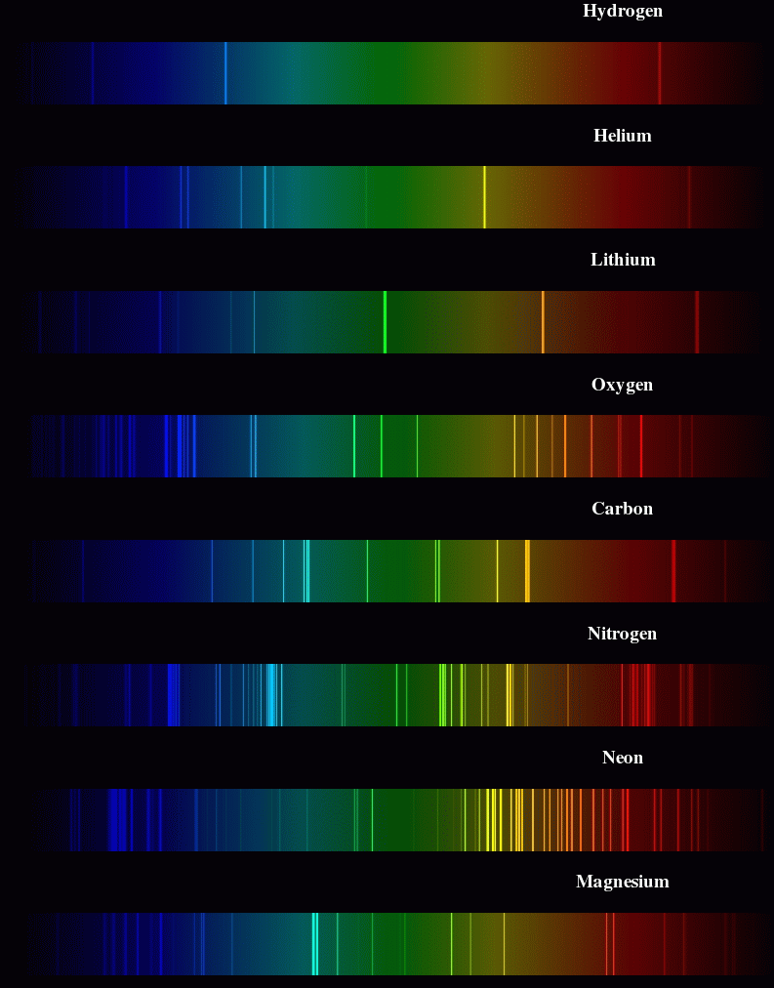

Slide 12
Emission and absorption lines: what can we learn?
Although each atom has allowed energy levels, which ones are populated depends on the temperature of the gas
  Seeing which part of the fingerprint appears allows us to determine the temperature of objects that produce emission or absorption lines

Slide 13
Absorption lines
Electrons can move from lower to higher energy levels, but need to absorb energy to do so
Key point is that they can ONLY absorb light with exactly the right amount of energy that corresponds to an electron energy level transition: all other light passes through
Absorption lines occur in the outer layers of stars: continuous emission from the inner dense portions passes through the stellar atmospheres and a few specific wavelengths are absorbed by the gases there

Slide 14
Astronomical applications: stars
Stars show a range of different patterns of absorption lines
  Analysis shows that the variations are almost all due to variations in temperature of stars
  In fact, most stars appear to have very similar compositions: mostly hydrogen (90%) and helium (9%) and only a bit of everything else!
  Different absorption spectra of stars originally led to spectral classification, and spectral types of stars, which are now understood to be a sequence of stellar temperatures: OBAFGKM (the Sun is a G star)
    Mnemonics 1
    Mnemonics 2

Slide 15
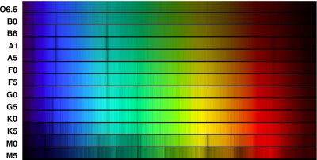

Hotter
O
B
A
F
G
K
M
Cooler
You can see temperature differences both from absorption lines and underlying continuum

Slide 16
You take spectra of two stars, star A and star B, and you see that they have a different pattern of absorption lines. What is the most likely reason?
The stars have different chemical compositions
The stars have different temperatures
One star is being seen through interstellar gas
One star is larger than the other

Slide 17
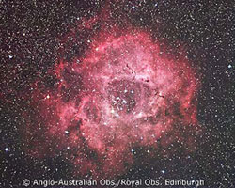
Astronomical applications: hot interstellar gas
Interstellar gas clouds can be heated by nearby stars, especially young hot ones
Atoms are excited by light from the stars and by collisions between atoms
When electrons fall down to lower energy levels, emission lines are produced

Slide 18
Summary: Emission and absorption lines: what can we learn?
Each different type of atom has its own distinct energy levels, and so produces its own distinct pattern of emission or absorption lines, like a fingerprint
  Recognizing the light fingerprint allows us to determine the composition of objects that produce emission or absorption lines, I.e. what they are made of
Although each atom has allowed energy levels, which ones are populated depends on the temperature of the gas
  Seeing which part of the fingerprint appears allows us to determine the temperature of objects that produce emission or absorption lines

Slide 19
Summary: what can we learn from understanding light?
Objects that produce thermal continuous spectra (warm dense objects) --> TEMPERATURE
Objects that produce emission or absorption lines --> COMPOSITION and TEMPERATURE

Slide 20
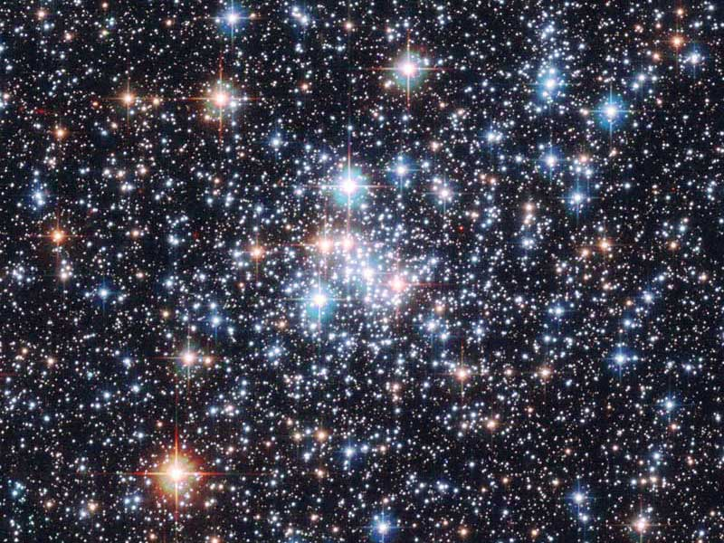
Brightnesses of objects
We’ve talked about spectra of objects and what you can learn from it, but not much about total brightnesses of objects
This is because brightness depends on multiple things
One primary issue is DISTANCE to the object: more distant objects are fainter
However, one only needs to look at a star cluster to realize this isn’t the whole story

Slide 21
Why do the stars in the cluster have different colors?
A. they are made of different things
B. they have different temperatures
C. they have different amounts of intervening dust
D. they are at different distances

Slide 22
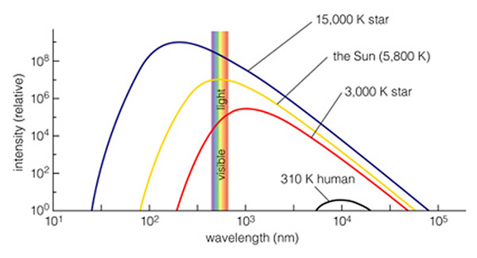
Brightnesses
In fact, brightnesses depend on three things
  Distance
  Temperature: hotter objects are brighter
  Size: bigger objects are brighter

Slide 23
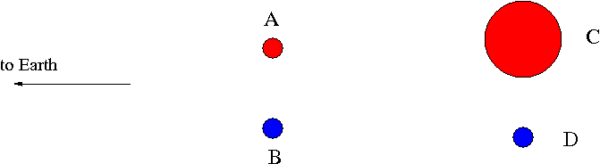
Consider stars A and B (both at the same distance). Which of the following is true?
A) A is brighter
B) B is brighter
C) A and B same brightness
D) can't tell relative brightnesses of A and B from information given

Slide 24
Consider stars B and D (both at the same color/temperature). Which of the following is true?
A) B is brighter
B) D is brighter
C) B and D same brightness
D) can't tell relative brightnesses of B and D from information given

Slide 25
Consider stars A and C. Which of the following is true?
A) A is brighter
B) C is brighter
C) A and C same brightness
D) can't tell relative brightnesses of A and C from information given

Slide 26
Consider stars C and D. Which of the following is true?
A) C is brighter
B) D is brighter
C) C and D are the same brightness
D) can't tell relative brightnesses of C and D from information given

Slide 27
Using brightnesses
Brightness depends on three things: distance, temperature, size
If we can independently measure two of these, we can use brightness to infer the third
Can we measure distances?
  --> PARALLAX
Can we measure temperatures?
  --> COLOR / ABSORPTION LINES
--> Use brightnesses to get sizes of stars

Slide 28
Sizes of stars
You can get sizes from brightnesses if you can independently measure distance and temperature
Why can’t you just measure the size of a star directly?
  Too far away!

Slide 29
Sizes of stars
What do you find when you measure sizes of stars?
  Stars come in a range of sizes
  Sun is intermediate in size
  Largest stars are huge!
Animation: http://www.youtube.com/watch?v=HEheh1BH34Q

