Slide 1
Light: Thermal Spectra Emission and Absorption Spectra

Slide 2
Recap
Campus observatory
Project due 11/22
Continuous emission and colors of objects
Why do dense objects produce continuous emission?
Temperature as a measure of average speed of atoms in a material
For object emitting thermal radiation, spectrum gives you the temperature
Thermal emission we are talking about is sometimes called blackbody emission

Slide 3
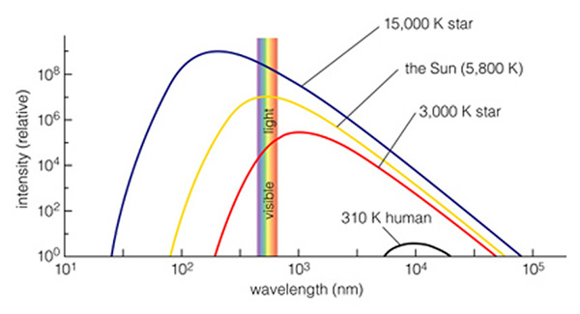
Thermal radiation
Powerful thing about the thermal radiation from dense objects: it ONLY depends on the temperature, nothing else!
Over most of the range of temperatures of stars, thermal radiation means that stars have different colors when looked at in visible light
Remember, relation between color and temperature holds for objects that are glowing from thermal radiation
It’s not true for objects that are reflecting light
For these, color has to do with color of incident light and reflective properties of the material
A blue shirt isn’t hotter than a red one!

Slide 4
Imagine you looked at two stars: star A at 6000 K and star B at 3000 K. You would find:
A. the peak of star A’s spectrum would be at a shorter wavelength than star B and it would be bluer
B. the peak of star A’s spectrum would be at a longer wavelength than star B and it would be redder
C. the peak of star A’s spectrum would be at a shorter wavelength than star B and it would be redder
D. the peak of star A’s spectrum would be at a longer wavelength than star B and it would be bluer
E. the peak of star A’s spectrum would be at a longer wavelength than star B, but they would both appear the same color

Slide 5
The hottest stars can get up to 50000 degrees K. Imagine you looked at two stars: star A at 30000 K and star B at 50000 K. You would find:
A. the peak of star A’s spectrum would be at a shorter wavelength than star B and it would be bluer
B. the peak of star A’s spectrum would be at a longer wavelength than star B and it would be redder
C. the peak of star A’s spectrum would be at a shorter wavelength than star B and it would be redder
D. the peak of star A’s spectrum would be at a longer wavelength than star B and it would be bluer
E. the peak of star A’s spectrum would be at a longer wavelength than star B, but they would both appear the same color

Slide 6
If you look at an object that is producing continuous thermal/blackbody spectrum, what can you likely learn about the object from its spectrum?
A. how much mass it has
B. how big it is
C. how hot it is
D. what it is made of

Slide 7
What can we learn from objects with thermal spectra? And … a problem
Spectra of dense objects only depends on temperature
Different temperatures yield different colors
Observe color --> measure temperature!
Unfortunately, there is another thing that can ALSO affect the color: if light from an object passes through dust clouds in the interstellar medium
Small dust particles can scatter/reflect some of the light out of its path into other directions
Most interstellar dust particles scatter blue light much more efficiently than red light
As a result, stars seen behind interstellar dust clouds will look redder than they really are

Slide 8
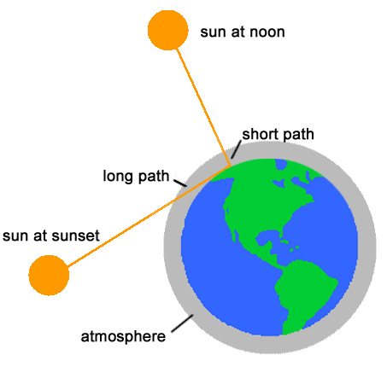
Everyday example: color of the sky
Color of the sky
Light from the Sun travels through empty space between Sun and Earth, but then has to travel through Earth’s atmosphere before getting to surface
Earth’s atmosphere has particles/molecules that scatter light
Not exactly the same as interstellar dust, but also more effective at scattering blue than red
During daytime, only relatively short path of light through atmosphere: only blue wavelengths are scattered

Slide 9
Everyday example: color of sunrise and sunset
At sunrise/sunset, Sun lower in the sky
Light from Sun travels through more of Earth’s atmosphere
Extra passage through particles gives more scattering, not just of blue light, but more of longer wavelengths as well
Sky ends up multicolored
Only the red light from Sun makes it directly to us --> Sun appears redder!

Slide 10
The Moon has essentially no atmosphere. If you were on the moon during the daytime, what color would the sky be?
A. blue
B. red
C. black
D. yellow
E. white

Slide 11
If the Sun were a cooler star than it is, what color do you think the daytime sky would be?
A. blue
B. red
C. black
D. yellow
E. white

Slide 12
A blue star:
Produces ONLY blue light, i.e. no red light at all
Produce light of all colors, but more blue than red
Produces light of all colors, but more red than blue

Slide 13
A blue star
Must be a hot star
Must be a cool star
Could be a hot star, or a cool star seen behind an interstellar dust cloud
Could be a cool star, or a hot star seen behind an interstellar dust cloud

Slide 14
Why is the sky blue?
Because it is relatively hot
Because it is relatively cool
Because it is reflecting light from the ocean
Because more blue light from the Sun is scattered by molecules in the Earth’s atmosphere than other colors
Because our eyes see blue light better than other colors

Slide 15
Emission and absorption line spectra
Emission and absorption line spectra occur when low density gases are involved
Hot low density gases produce emission lines
Cool low density gases produce absorption lines when found in front of continuous sources
In low density gases, it’s not interactions between atoms that produce light, but, instead, changes within individual atoms

Slide 16
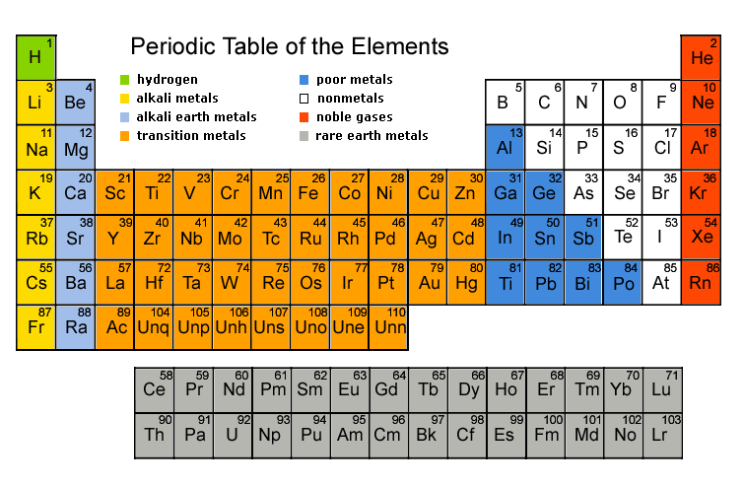
Atoms: brief review
Atoms are made of protons, neutrons, and electrons
Protons and neutrons found in nucleus
Electrons found outside of nucleus
Number of protons determine what element the atom is, i.e. what a substance is made of
Periodic table lists all of the elements, e.g. hydrogen, helium, …. carbon, nitrogen, oxygen…

Slide 17
Light production by individual atoms
Key component of atoms having to do with light production is the electrons
In any given type of atom, electrons are only found in several discrete energy levels
Energy levels are quantized
(“Apartment building” model of an atom)
Electrons can move from one energy level to another
If they go from a higher energy level to a lower one, the extra energy comes out in the form of light!
What wavelength? The wavelength that corresponds to the exact amount of energy change
The more the energy change, the shorter wavelength the emitted light
To go from a lower energy level to a higher one, a atom needs to absorb energy

Slide 18
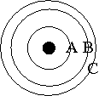
The diagram schematically represents the energy levels of electrons in an atom with larger circles representing electrons of higher energy, and the distance between circles representing the differences in electron energies.
If an electron were to go from orbit C to orbit A:
A. an emission line would be produced
B. an absorption line would be produced
C. a continuous spectrum would be produced
D. a transition from C to A is impossible

Slide 19
If one considered the electron transitions C-to-B and B-to-A,
A) the emission line arising from C-B would be bluer than that from B-to-A
B) the emission line arising from C-B would be redder than that from B-to-A
C) both emission lines would have the same color since they come from the same atom
D) neither transition would result in an emission line

Slide 20
Light production by individual atoms
Left to themselves, electrons will fall to the lowest allowed energy level
Electrons can move from lower to higher levels in two different ways
If light of the correct energy is incident on the atom, it can be absorbed and used to move the electron to a higher energy level
In a hot gas, collisions with other atoms can impart energy and move electrons to higher energy levels

Slide 21
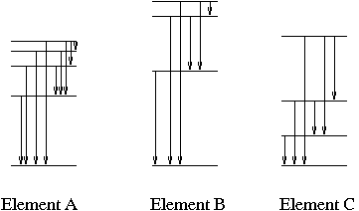
Emission and absorption lines: what can we learn?
Each different type of atom has its own distinct energy levels, and so produces its own distinct pattern of emission or absorption lines, like a fingerprint
Recognizing the light fingerprint allows us to determine the composition of objects that produce emission or absorption lines, I.e. what they are made of

Slide 22
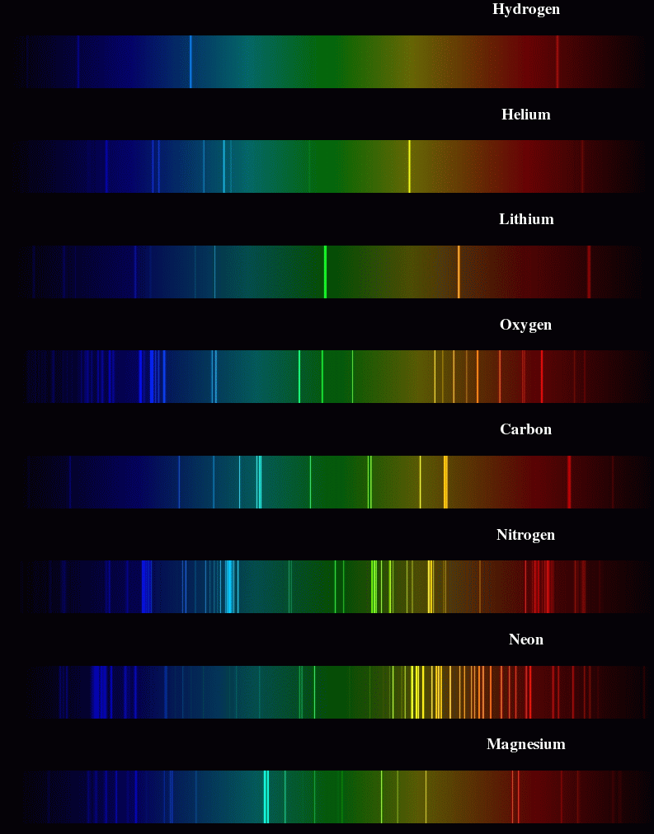

Slide 23
Emission and absorption lines: what can we learn?
Although each atom has allowed energy levels, which ones are populated depends on the temperature of the gas
See which part of the fingerprint appears allows us to determine the temperature of objects that produce emission or absorption lines

Slide 24
Absorption lines
Electrons can move from lower to higher energy levels, but need to absorb energy to do so
Key point is that they can ONLY absorb light with exactly the right amount of energy that corresponds to an electron energy level transition
Absorption lines occur in the outer layers of stars: continuous emission from the inner dense portions passes through the stellar atmospheres and a few specific wavelengths are absorbed by the gases there

Slide 25
Astronomical applications: stars
Stars show a range of different patterns of absorption lines
Analysis shows that the variations are almost all due to variations in temperature of stars
Most stars appear to have very similar compositions: mostly hydrogen (90%) and helium (9%) and only a bit of everything else!
Different absorption spectra of stars originally led to spectral classification, and spectral types of stars, which are now understood to be a sequence of stellar temperatures: OBAFGKM (the Sun is a G star)
Mnemonics 1
Mnemonics 2

Slide 26
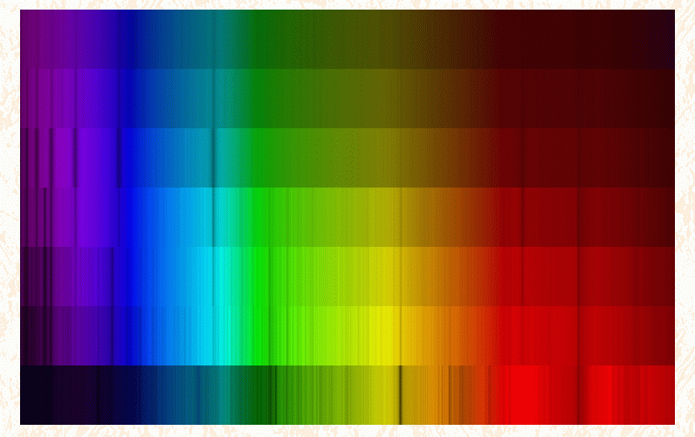
Hotter
O
B
A
F
G
K
M
Cooler
Can see temperature differences both from absorption lines and underlying continuum

Slide 27
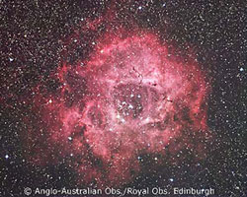
Astronomical applications: hot interstellar gas
Interstellar gas clouds can be heated by nearby stars, especially young hot ones
Atoms are excited by light from the stars and by collisions between atoms
When electrons fall down to lower energy levels, emission lines are produced

Slide 28
Summary: Emission and absorption lines: what can we learn?
Each different type of atom has its own distinct energy levels, and so produces its own distinct pattern of emission or absorption lines, like a fingerprint
Recognizing the light fingerprint allows us to determine the composition of objects that produce emission or absorption lines, I.e. what they are made of
Although each atom has allowed energy levels, which ones are populated depends on the temperature of the gas
Seeing which part of the fingerprint appears allows us to determine the temperature of objects that produce emission or absorption lines

Slide 29
Summary: what can we learn from understanding light?
Objects that produce thermal continuous spectra (warm dense objects) --> TEMPERATURE
Objects that produce emission or absorption lines --> COMPOSITION and TEMPERATURE

Slide 30
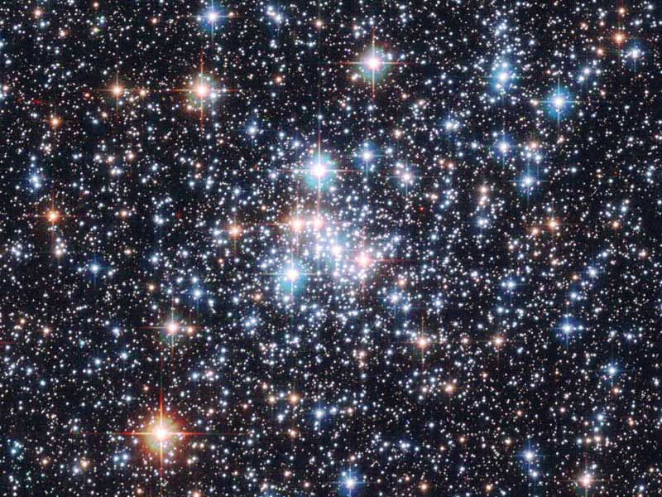
Brightnesses of objects
We’ve talked about spectra of objects and what you can learn from it, but not much about total brightnesses of objects
This is because brightness depends on multiple things
One primary issue is DISTANCE to the object: more distant objects are fainter
However, one only needs to look at a star cluster to realize this isn’t the whole story

Slide 31
Why do the stars in the cluster have different colors?
A. they are made of different things
B. they have different temperatures
C. they have different amounts of intervening dust
D. they are at different distances

Slide 32
Brightnesses
In fact, brightnesses depend on three things
Distance
Temperature: hotter objects are brighter
Size: bigger objects are brighter

Slide 33
Consider stars A and B (both at the same distance). Which of the following is true?
A) A is brighter
B) B is brighter
C) A and B same brightness
D) can't tell relative brightnesses of A and B from information given

Slide 34
Consider stars B and D (both at the same color/temperature). Which of the following is true?
A) B is brighter
B) D is brighter
C) B and D same brightness
D) can't tell relative brightnesses of B and D from information given

Slide 35
Consider stars A and C. Which of the following is true?
A) A is brighter
B) C is brighter
C) A and C same brightness
D) can't tell relative brightnesses of A and C from information given

Slide 36
Consider stars C and D. Which of the following is true?
A) C is brighter
B) D is brighter
C) C and D are the same brightness
D) can't tell relative brightnesses of C and D from information given

Slide 37
Using brightnesses
Brightness depends on three things: distance, temperature, size
If we can independently measure two of these, we can use brightness to infer the third
Can we measure distances?
--> PARALLAX
Can we measure temperatures?
--> COLOR / ABSORPTION LINES
--> Use brightnesses to get sizes of stars

Slide 38
Sizes of stars
You can get sizes from brightnesses if you can independently measure distance and temperature
Why can’t you just measure the size of a star directly?
Too far away!

Slide 39
Sizes of stars
What do you find when you measure sizes of stars?
Stars come in a range of sizes
Sun is intermediate in size
Largest stars are huge!
Animation: http://www.youtube.com/watch?v=HEheh1BH34Q

