Slide 1
Thermal (blackbody) spectra

Slide 2
Recap
No HW this week
Project due 11/22
Light /electromagnetic energy
Wavelength, frequency, energy
Electromagnetic spectrum: X rays, ultraviolet, visible, infrared, microwave, radio waves
spectra
Continuous: dense objects
Emission line: hot low density gases
Absorption line: cooler low density gases in front of a continuous source

Slide 3
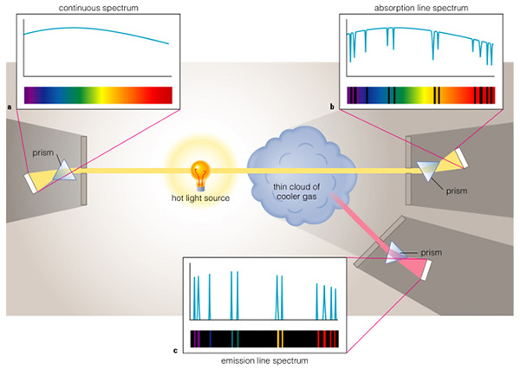

Slide 4
Spectra of astronomical objects
There are astronomical objects that fall into all three categories
Continuous spectra: warm, dense (opaque) objects
Planets without atmospheres
Stars APART FROM their outer layers
Absorption line spectra: cooler gases in front on continuous spectra
Planets with atmospheres
Stars, since outer layers are lower density and transparent
Interstellar gas in between Earth and stars
Emission line spectra
Hot interstellar gas

Slide 5
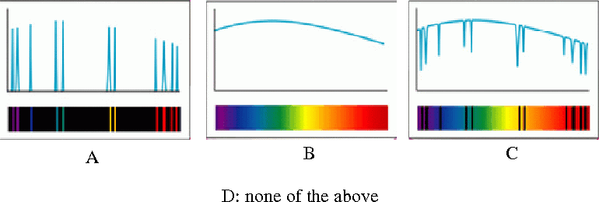
Which of these types would you see if you looked at the Sun?

Slide 6
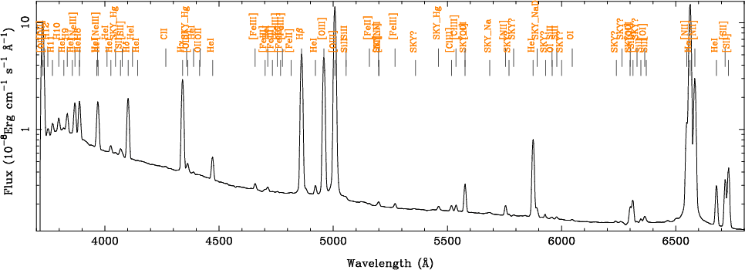
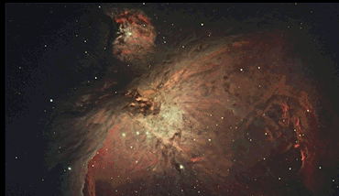
This picture is of some hot interstellar gas. Which type of spectrum do you think it would have if you passed the light through a spectrograph?

Slide 7
Continuous spectra
What can we learn from continuous spectra?
Main application: stars and planets
Stars produce absorption line spectra, but first we will ignore the absorption lines and study the underlying continuous emission

Slide 8
What causes continuous spectra?
Dense objects have lots of atoms that are all moving and interacting
Motion of atoms produce light
Typical speed/energy of atoms depends on the temperature of the object
While there is a “typical” speed/energy, atoms in an object will have a range around this typical value
Range of speeds/energies of atoms give a range of different energy of light --> a continuous spectrum
More light will be produced at the “typical” energy than at other energies

Slide 9
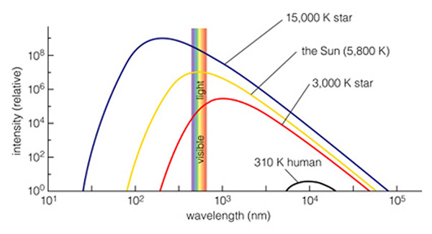
energy
Continuous, thermal emission depends on the temperature of the object
Hotter objects peak at bluer wavelengths
Note that emission is over entire electromagnetic spectrum and peak can be outside of visible light!
Note that light doesn’t have a temperature, the object does!

Slide 10
Temperatures
Astronomers use a temperature scale that is related to motion of atoms
degrees Kelvin
Just like degrees Centigrade but instead of 0 C degree being freezing point of water, 0 K degrees is absolute zero where atoms stop moving
ºK = ºC - 273
No temperatures below zero in degrees K!
Objects with temperatures up to a few hundred degrees glow mostly in the infrared and hardly at all in the visible
Objects with temperatures of thousands of degrees or more glow in the visible. STARS!

Slide 11
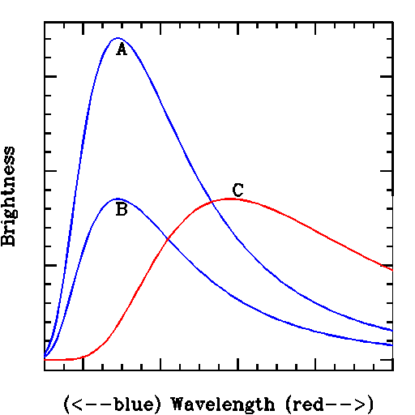
How do objects A and C compare?
A is hotter
C is hotter
They are the same temperature
Can’t tell from information given

Slide 12
Thermal radiation
Powerful thing about the thermal radiation from dense objects: it ONLY depends on the temperature, nothing else!
Over most of the range of temperatures of stars, thermal radiation means that stars have different colors when looked at in visible light
Remember, relation between color and temperature holds for objects that are glowing from thermal radiation
It’s not true for objects that are reflecting light
For these, color has to do with color of incident light and reflective properties of the material
A blue shirt isn’t hotter than a red one!

Slide 13
The hottest stars can get up to 50000 degrees K. Imagine you looked at two stars: star A at 30000 K and star B at 50000 K. You would find:
A. the peak of star A’s spectrum would be at a shorter wavelength than star B and it would be bluer
B. the peak of star A’s spectrum would be at a longer wavelength than star B and it would be redder
C. the peak of star A’s spectrum would be at a shorter wavelength than star B and it would be redder
D. the peak of star A’s spectrum would be at a longer wavelength than star B and it would be bluer
E. the peak of star A’s spectrum would be at a longer wavelength than star B, but they would both appear the same color

Slide 14
If you look at an object that is producing continuous thermal/blackbody spectrum, what can you likely learn about the object from its spectrum?
A. how much mass it has
B. how big it is
C. how hot it is
D. what it is made of

Slide 15
What can we learn from objects with thermal spectra? And … a problem
Spectra of dense objects only depends on temperature
Different temperatures yield different colors
Observe color --> measure temperature!
Unfortunately, there is another thing that can ALSO affect the color: if light from an object passes through dust clouds in the interstellar medium
Small dust particles can scatter/reflect some of the light out of its path into other directions
Most interstellar dust particles scatter blue light much more efficiently than red light
As a result, stars seen behind interstellar dust clouds will look redder than they really are

Slide 16
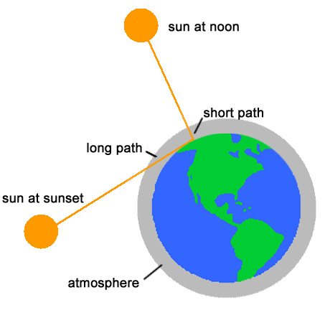
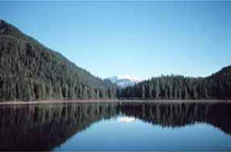
Everyday example: color of the sky
Color of the sky
Light from the Sun travels through empty space between Sun and Earth, but then has to travel through Earth’s atmosphere before getting to surface
Earth atmosphere has particles/molecules that scatter light
Not exactly the same as interstellar dust, but also more effective at scattering blue than red
During daytime, only relatively short path of light through atmosphere: only blue wavelengths are scattered

Slide 17
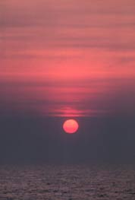
Everyday example: color of sunrise sunset
At sunrise/sunset, Sun lower in the sky
Light from Sun travels through more of Earth’s atmosphere
Extra passage through particles gives more scattering, not just of blue light, but more of longer wavelengths as well
Sky ends up multicolored
Only the red light from Sun makes it directly to us --> Sun appears redder!

Slide 18
The Moon has essentially no atmosphere. If you were on the moon during the daytime, what color would the sky be?
A. blue
B. red
C. black
D. yellow
E. white

Slide 19
If the Sun were a cooler star than it is, what color do you think the daytime sky would be?
A. blue
B. red
C. black
D. yellow
E. white

