Slide 1
Light
Electromagnetic radiation
Electromagnetic spectrum
Spectra

Slide 2
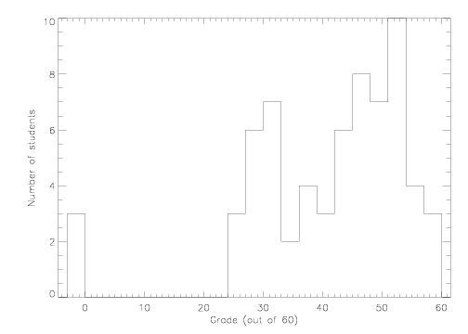
Recap
Midterm
Project: due 11/22
Lab this week: The Power of Light: Understanding Spectroscopy
Masses of galaxies and dark matter
Observational evidence for dark matter: lots of it!
What is it? Don’t know! Probably some new kind of particle
Black holes: probably not dark matter, but still interesting!

Slide 3
Introduction: Astronomy and Science
Astronomy by Eye: Motions in the Sky
Overview of the Universe
The Physical Basis of Astronomy
Gravity and Motion
Light: why do astronomical objects shine and what can we learn about them by studying the light they emit
Interesting questions in astronomy

Slide 4
Light
What is light?
A kind of energy
Electromagnetic energy
Connection between light and the electromagnetic force
Electromagnetic force acts between objects that have electric charge
Acceleration of charged particles produces light
Light incident on charged particles can cause them to accelerate

Slide 5
Characterizing light
Light comes in little packets called photons
Can think of photons as little waves of electromagnetic energy that travel through space
Light waves, like other waves, can be characterized by:
Wavelength: distance between peaks
Speed
Frequency: how often peaks pass a point
Energy: how much work the wave can do

Slide 6
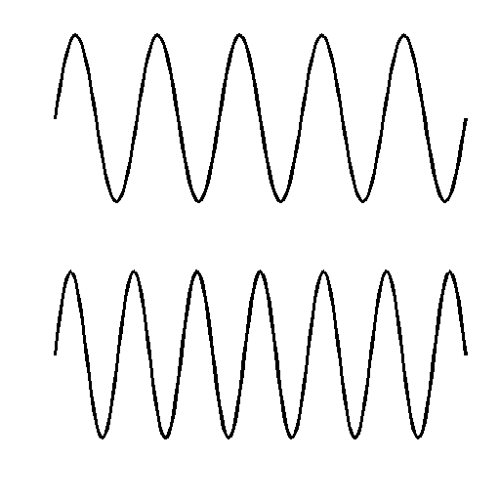
Wave A
Wave B
Both of these waves travel at the same speed. Which of the following statements is true?
A has a longer wavelength and a higher frequency than B
A has a longer wavelength and a lower frequency than B
A has a shorter wavelength and a lower frequency than B
A has a shorter wavelength and a higher frequency than B
A has a longer wavelength, but they both have the same frequency

Slide 7
Light waves
Light waves come in a wide range of different wavelength/frequency/energy
We see different kinds of lights as light of different colors
However, there is also a lot of different kinds of light that we can’t see directly with our eyes at all!
wavelengths of visible light are very short!
For light, wavelength, frequency, and energy are all directly related to each other
Longer wavelengths -> lower frequency -> less energy
Shorter wavelengths -> higher frequency -> more energy

Slide 8
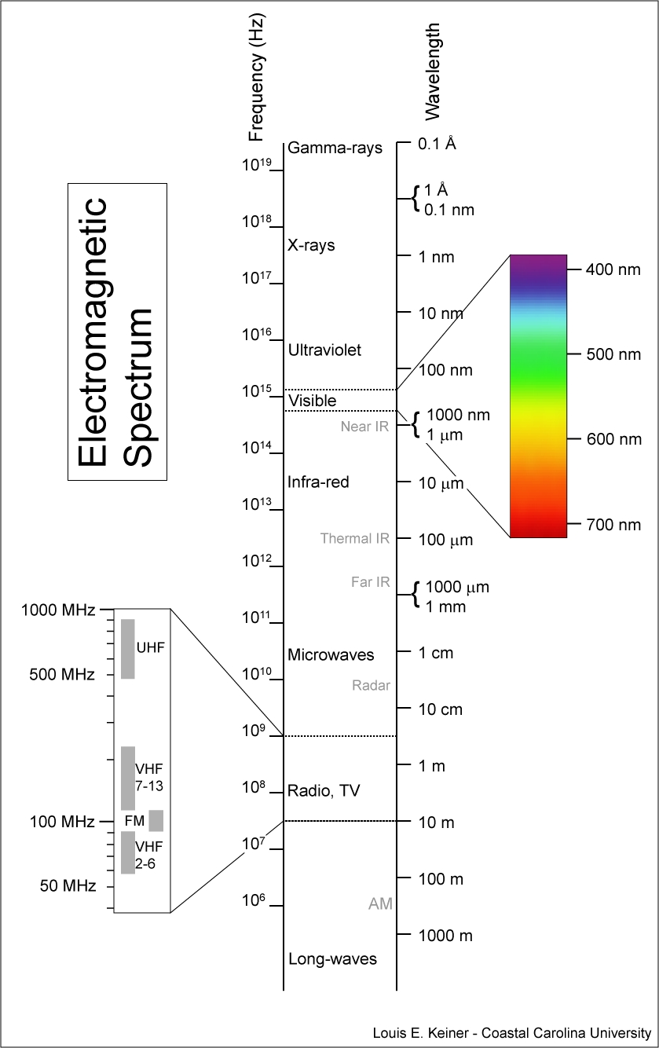
Electromagnetic spectrum
Light of different wavelength/frequency/energy has different names, although they are all basically the same underlying thing
Many are familiar from everyday life!
Entire set of different kinds of light called the electromagnetic spectrum

Slide 9
Which kind of light has the longest wavelength?
A ) X-rays
B) blue light
C) radio waves
D) all have the same wavelength

Slide 10
Which kind of light has the highest frequency?
A ) X-rays
B) blue light
C) radio waves
D) all have the same frequency

Slide 11
Which kind of light has the most energy?
A ) X-rays
B) blue light
C) radio waves
D) all have the same energy

Slide 12
Which kind of light travels the fastest?
A ) X-rays
B) blue light
C) radio waves
D) all have the same speed

Slide 13
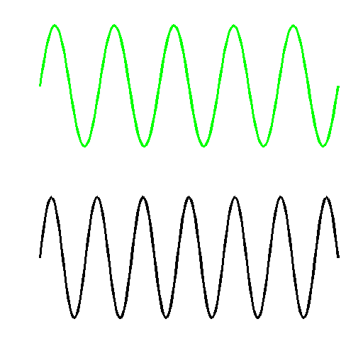
Wave A
Wave B
If wave A represents green light, what is wave B most likely to represent?
X ray light
Blue light
Red light
Infrared light
Radio light

Slide 14
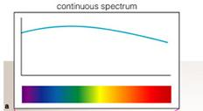
Spectra
Lots of information about objects that emit light can be derived from determining the relative amount of the different wavelengths of light, i.e.. its spectrum
Spectra can be measured using an instrument that sends different wavelengths of light in different directions: a spectrograph
A prism is a simple spectrograph
Several ways of representing spectra:
Show the “rainbow” of colors
Show a graph of the brightness at each color

Slide 15
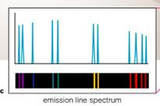
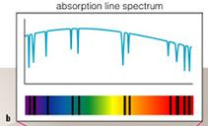
Classes of spectra
When looking at objects that emit light, one finds they fall into three general categories
Continuous spectra: light emitted over a broad range of wavelengths
Emission line spectra: light emitted only at a few distinct wavelengths
Absorption line spectra: light emitted over a broad range of wavelengths, but missing at a few distinct wavelengths

Slide 16
Colors of objects
The color of an object can give a crude representation of its spectrum
In this respect, the eye/brain is a crude spectrograph, as it sees some objects with different spectra as having different colors
If an object gives off more blue than red, we see it as blue
If an objects gives off more red than blue, we see it as red
If an object gives off equal amounts of all of the visible colors, we see it as white
Problem: can’t distinguish between “pure” blue and “more” blue
Problem: eye only sees visible light!

Slide 17
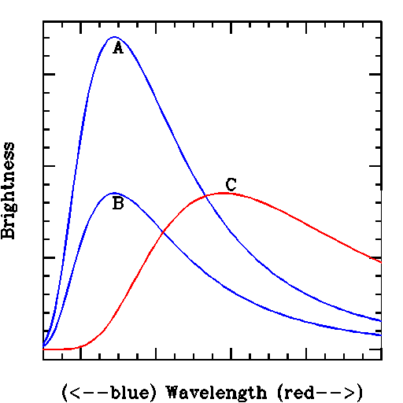
Here are spectra of three different objects
Object C will be
A. bluer than object A
B. redder than object A
C. same color as object A, but brighter
D. same color as object A, but fainter

Slide 18
Object B will be
A. bluer than object A
B. redder than object A
C. same color as object A, but brighter
D. same color as object A, but fainter

Slide 19
Colors of astronomical objects
Our eyes require a fair amount of light to see different colors: for faint objects, it is difficult to see color in an object
For objects that emit light (like astronomical objects), you can measure a color by looking at the object through different filters
A filter is a material that only transmits light of a certain range of colors
For example, a blue filter only lets blue light through, a red filter only lets red light through
With filters, you can quantitatively measure how much light is emitted from different sections of the spectrum

Slide 20
Imagine you look at a white light bulb through a blue filter and a red filter. What will you see?
A. more light through the blue filter
B. more light through the red filter
C. equal light through both filters
D. no light through either filter

Slide 21
Imagine you look at a red light bulb through a blue filter and a red filter. What will you see?
A. more light through the blue filter
B. more light through the red filter
C. equal light through both filters
D. no light through either filter

Slide 22
Imagine you look at a green light bulb through a red filter. What color will it appear?
A. white
B. red
C. green
D. black
E. blue

Slide 23
Classes of spectra: Kirchoff’s laws
The type of emitted spectrum is related to nature of object that is emitting
Continuous spectra: light emitted over a broad range of wavelengths
Produced by warm, dense (opaque) objects
Emission line spectra: light emitted only at a few distinct wavelengths
Produced by hot, low density gasses
Absorption line spectra: light emitted over a broad range of wavelengths, but missing at a few distinct wavelengths
Produced by “cooler” density gases placed in front of continuous sources

Slide 24
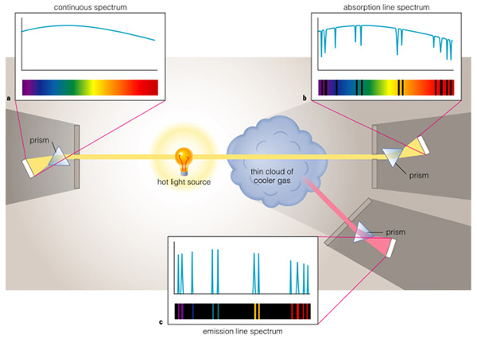

Slide 25
Spectra of astronomical objects
There are astronomical objects that fall into all three categories
Continuous spectra: warm, dense (opaque) objects
Planets without atmospheres
Stars APART FROM their outer layers
Absorption line spectra: cooler gases in front on continuous spectra
Planets with atmospheres
Stars, since outer layers are lower density and transparent
Interstellar gas in between Earth and stars
Emission line spectra
Hot interstellar gas

Slide 26
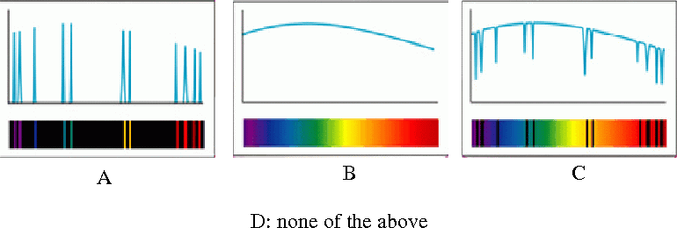
Which of these types would you see if you looked at the Sun?

Slide 27
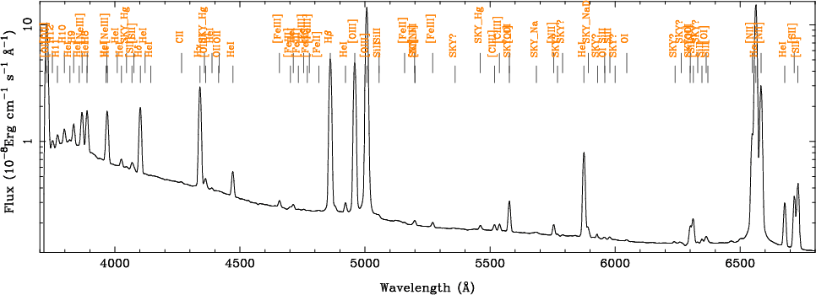
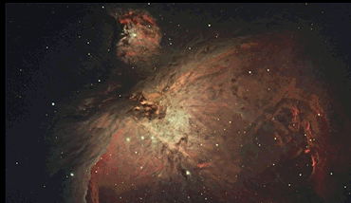
This picture is of some hot interstellar gas. Which type of spectrum do you think it would have if you passed the light through a spectrograph?

Slide 28
Which of these types would you see if you looked at a planet?

Slide 29
To do
Project

