Slide 1
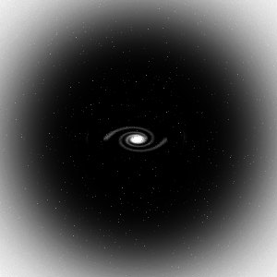
Dark Matter
Masses of Galaxies
Gravity and Light
Black Holes
What is Dark Matter?

Slide 2
Recap
Midterm Friday 11/1: summary review sheet posted
Canvas homework : due Wednesday
Lab this week
Using gravity to measure masses
  To measure mass of an object, look at something that orbits it: measure the period or speed of the orbiting object and the distance it is from the object around which it orbits→ use understanding of gravity to measure mass of the object that is causing the motion
  Masses of planets: orbits of moons or satellites
  Masses of stars: orbits of planets (too hard to see!) or binary star orbits
  Masses of galaxies: orbits of stars

Slide 3
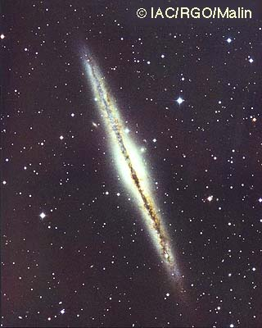
Measuring masses of galaxies
Since there are lots of stars in a galaxy, we can measure the orbital speed at lots of different distances from the center of the galaxy: you can actually measure speed of gas even farther out, beyond the stars
A given object is pulled by all of the mass that exists inside of its orbit
Since most of the light in galaxies is at the center, we expect that most of the mass is at the center, so , once we get out of the central regions, we expect the orbital speeds of stars to decrease as we go farther from the center
But it’s not what we find!

Slide 4
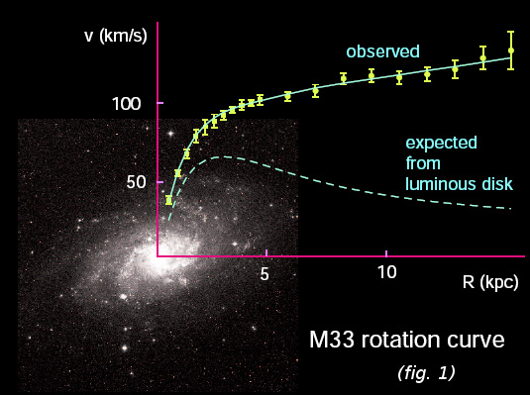
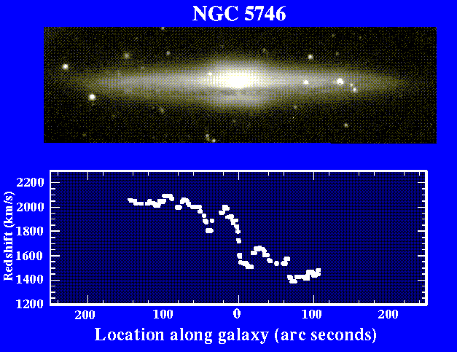

Slide 5
What’s going on?
When we measure orbital speeds of stars (or gas) in galaxies, we find that stars farther out are moving just as fast as stars in the inner regions
Implication, either:
  our understanding of gravity is wrong (but it seems to work perfectly everywhere else!)
  there's a lot of extra matter at large distances from the center of galaxies that provide more pull than we expected based on where we see the light coming from
Most astronomers feel that the latter is more likely, hence we believe that galaxies are filled with some unknown type of dark matter
  The dark matter is NOT just where the stars are, it must fill a much larger volume of space
  How much is there? A LOT. Roughly 90 % of the total mass of galaxies appears to be in dark matter, I.e. there’s a lot more dark matter than there is matter that we can see!

Slide 6
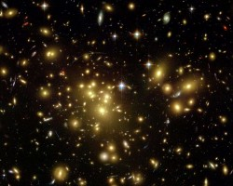
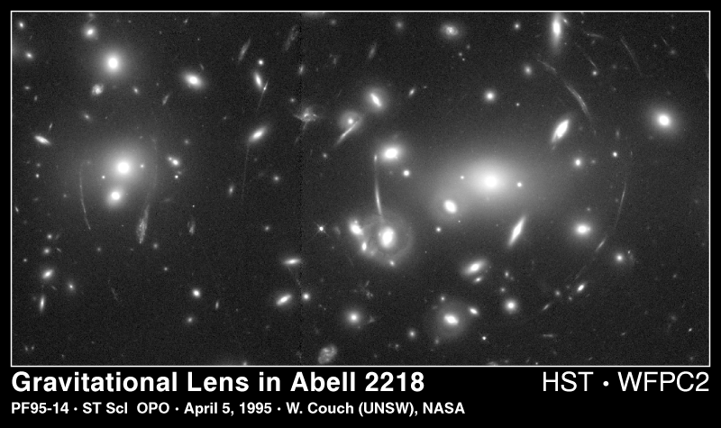
Other evidence for dark matter
Motions of galaxies in galaxy clusters
  Galaxies move faster than expected from observed light --> fast enough so that cluster should come apart, but we see them!
Gravitational lensing
  Modern theory of gravity developed by Einstein, called general relativity
  Gives same results as Newton’s laws under almost all conditions, but generalizes to regions of very strong gravity
  Where gravity is very strong, even light can be affected by gravity
  Predicts the existence of so-called gravitational lenses
All evidence of dark matter suggests the same thing: there is a lot more dark matter than luminous matter!

Slide 7
What is dark matter?
Note that although there’s a lot of dark matter, it’s spread out over a large volume
  Even though there is probably dark matter in the Solar System, there’s not enough to have any impact on motions of planets, etc!
We don't know what the dark matter is, even though we think it dominates the mass of galaxies!
  Need to think of things that have mass but would be hard to see
  Several possibilities

Slide 8

“Failed” stars or planets
When we measure masses of stars, we find there are lots more low mass stars than high mass stars
  Low mass stars are fainter and harder to see
  Maybe there’s a lot of super low mass stars, or free-floating planets?
Problems:
  low mass stars and planets don’t have a lot of mass! Even though there’s more of them, there doesn’t seem to be that many more!
  The very low mass objects would have to be located in a different place than the more massive stars, since the dark matter has to be much more extended to explain the observations!

Slide 9
“Burned out” stars
When stars end their lives, they can leave behind “embers” which gradually fade out. Maybe there are lots of dead stars that make up the dark matter?
Problem:
  Only stars more massive than the Sun have had enough time to live their lives. These stars aren’t all that common, so it doesn’t seem like there’s enough of them
  Again, the dead stars would need to be distributed in space differently than the living stars, hard to imagine how this could be!

Slide 10
Black holes
Einstein’s theory of gravity, general relativity, says that light can be affected by gravity
This leads to the possibility of compact massive objects where gravity at the surface of the object could be strong enough to prevent light from escaping… a black hole!
  Key issue for a black hole is the strength of gravity at it’s “surface”
  You can get strong gravity by either having a lot of mass or a very small object (or both)
  Far away from the black hole, it’s no different than being far away from a normal object that has the same mass

Slide 11
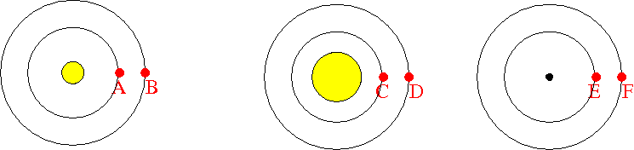
Here's some diagrams of a possible solar system: in all three, the central object has the same mass, but it has different sizes: a small star in the left, a bigger star in the middle, and a black hole in the right. Remember: the force of gravity depends on the masses of the objects and the distance between their centers. All planet have sideways velocity so that they move in circular orbits.
Which planet do you expect to move faster, A or C?
A. Planet A will move faster because the gravitational pull from the star is bigger on planet A
B. Planet C will move faster because the gravitational pull from the star is bigger on planet C
C. Both planets A and C should be moving at the same speed because the gravitational pulls are the same
D. You can't tell from the information given which star will move faster
E. Planets A and C will get pulled into the central stars eventually

Slide 12
Here's some diagrams of a possible solar system: in all three, the central object has the same mass, but it has different sizes: a small star in the left, a bigger star in the middle, and a black hole in the right. Remember: the force of gravity depends on the masses of the objects and the distance between their centers. All planets have sideways velocity so that they travel in circular orbits.
Which planet do you expect to move faster, A or E?
A. Planet A will move faster because the gravitational pull from the star is bigger on planet A
B. Planet E will move faster because the gravitational pull from the star is bigger on planet E
C. Both planets A and E should be moving at the same speed because the gravitational pulls are the same
D. You can't tell from the information given which star will move faster
E. Planet E will get sucked into the black hole!

Slide 13
Black holes (2)
Do black holes even exist for real?
  Almost certainly yes!
  We see some star orbits where we infer a massive companion, but don’t see anything!
  Looking in the center of our galaxy, we see a similar thing
    http://www-xray.ast.cam.ac.uk/xray_introduction/movie2003.gif
    http://www.astro.ucla.edu/~ghezgroup/gc/pictures/orbitsMovie.shtml
Could they be the dark matter?
  Very unlikely!
  Origin of black holes:
    death of very massive stars
    Centers of galaxies
  Neither matches the requirement that dark matter has to exist where stars don’t!

Slide 14
Another kind of matter?
Since nothing else seems to work, another suggestion is that dark matter is made up of some new kind of, yet to be discovered, subatomic particle!
  Not protons, neutrons, electrons, or even any of the other known subatomic particles (muons, kaons, pions, etc.)
  WIMPs: Weakly Interacting Massive Particles
Observations of relative abundance of different kinds of atoms, in conjunction with Big Bang theory, supports the idea that dark matter has to be made of some other kind of subatomic particle
People are doing experiments to try to detect this stuff, since it’s expected to be in the Solar System
  Problem: it doesn’t interact with stuff, that’s why it’s hard to see in the first place! So it’s hard to detect!

Slide 15
What is dark matter?
We don't know what the dark matter is, even though we think it dominates the mass of galaxies!
Several possibilities
  "failed stars", too low mass to shine --> UNLIKELY
  dead stars", faded stars that no longer shine --> UNLIKELY
  Black holes --> UNLIKELY
  Some new sort of undiscovered matter --> MOST LIKELY!
Clearly, we have a lot to learn! But this is a mystery that may be resolved relatively soon!
Note that dark matter is not the same thing as dark energy, which we previously noted when talking about the expansion of the Universe, causing this expansion to accelerate with time

