Slide 1
Orbits and Masses of astronomical objects
Using gravity and orbits to to measure masses
Masses of planets, stars and galaxies
Dark matter

Slide 2
Recap
Midterm next Friday 11/1
Canvas homework : due today and next Wed
Gravity and motion
Orbits
Gravity causing objects to fall around each other
Orbits in the solar system: how did planets get their sideways motion?
Orbits around Earth: free fall and “weightlessness”
Using gravity to measure masses

Slide 3
Masses from gravity
Basic idea is simple: objects orbit because of the pull of gravity.
Strength of pull depends on masses of object and distance between them
Stronger pull means objects orbit faster
Observe orbits, measure
Either period of orbit, or speed of orbiting object
Distance between the objects (size of orbit)
Use gravity, determine the mass of the object!
Mathematically, Newton’s laws give:
(M₁+M₂) = K a³ / P²
which is a generalization of Kepler’s 3rd law

Slide 4
Example: masses of planets
To measure masses of planets, look for objects that go around them ….. moons!
Measure how long it takes to go around and distance between moon and planet
Use understanding of gravity to determine how much mass the planet must have to cause it to orbit at the observed speed!
Example: Moons of Jupiter
http://www.skyandtelescope.com/observing/objects/javascript/jupiter#

Slide 5
Results: masses of planets
Planet | Mass (Units: earth masses)
Mercury | 0.06
Venus | 0.82
Earth | 1.00
Mars | 0.11
Jupiter | 318
Saturn | 95
Uranus | 14.5
Neptune | 17.1
Pluto | 0.003
Look at orbits of moons to measure planetary masses
Mercury and Venus don’t have moons! ---> Use artificial satellites
Discovery of a moon can be very useful!
Review: inner planets have a lot less mass than outer planets ---- and different composition too!

Slide 6
Example: masses of stars
Measure masses of stars by looking for objects that orbit around them
Planets? Actually, very hard to directly see planets around other stars!
Binary stars are useful, but a bit more complicated, since both stars may have comparable mass, so they orbit each other
If you can observe sizes of both orbits, you can get both masses from Newton’s laws!

Slide 7
Orbit simulator
See orbit simulator by PhET Interactive Solutions, University of Colorado
http://phet.colorado.edu/sims/my-solar-system/my-solar-system_en.html
(In simulator, M₁+M₂ = .0048 P² / a³⁾

Slide 8
Result: Masses of stars
Stars come in a range of masses!
Most massive stars about 100 times the mass of the Sun
Least massive stars about 1/10th the mass of the Sun
Sun is in the middle of the range, but there are lots more low mass stars than high mass stars
Open question: what determines allowable masses of stars and relative numbers at each mass?

Slide 9
Multiple orbiting objects
What happens if you have multiple objects that are orbiting, like many planets around a star, or many stars around a galaxy?
If the mass of the central object is much larger than the mass of the orbiting objects, each one orbits independently, without being affected by the others
In detail, the orbits can be very slightly affected by the others: this is how Neptune was discovered!

Slide 10
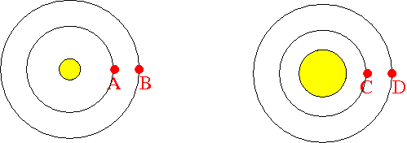
The diagram represents a solar system, with a star in the center and two planets orbiting it. The planets orbit the star because of its gravitational pull. Both planets have the same mass and are much less massive than the star, so the motion of each is dominated by the gravitational pull from the star. Remember: the force of gravity depends on the masses of the objects and the distance between their centers.
Which planet do you expect to move faster, A or B?
A. Planet A will move faster because the gravitational pull from the star is bigger on planet A
B. Planet B will move faster because the gravitational pull from the star is bigger on planet B
C. Both planets A and B should be moving at the same speed because the gravitational pulls are the same, because it's the same star that is doing the pulling
D. You can't tell from the information given which planet will move faster

Slide 11
Imagine you observe the periods of planets A and B and the size of their orbits, and use them, with Newton’s laws, to infer the mass of the star. Which will be true?
A. The orbit of planet A will give a larger mass for the star
B. Both orbits will give the same mass for the star
C. The orbit of planet B will give a larger mass for the star
D. You can’t determine the mass with just the period and the size of the orbit

Slide 12
Here's the same diagram, but on the right let's imagine that the star has been puffed up: it still has the same mass, but it is significantly bigger (i.e., it has a lower density). Remember: the force of gravity depends on the masses of the objects and the distance between their centers.
Which planet do you expect to move faster, A or C?
A. Planet A will move faster because the gravitational pull from the star is bigger on planet A
B. Planet C will move faster because the gravitational pull from the star is bigger on planet C
C. Both planets A and C should be moving at the same speed because the gravitational pulls are the same
D. You can't tell from the information given which planet will move faster

Slide 13
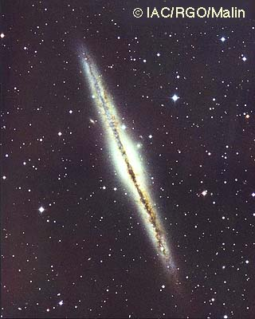
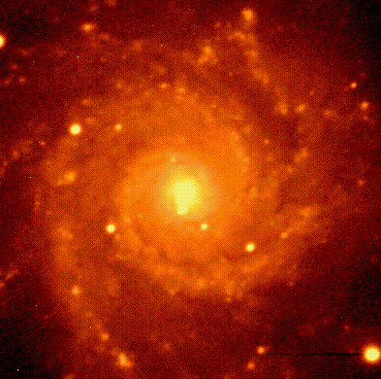
Measuring masses of galaxies
In spiral galaxies, stars orbit around the center of the galaxy
Can use these to measure the mass in the galaxy!
To get the full mass, want to look at stars in the outer regions
Can look at several different distances to check for consistency
Problem: stars take hundreds of millions of years to go around --> hard to measure the period!
Solution: instead of measuring period, measure the speed of the stars
Look at edge-on galaxies
Use the Doppler effect (same thing we talked about for measuring motions of galaxies)

Slide 14
This diagram is supposed to represent a hypothetical galaxy seen edge-on. Consider the force of gravity on the stars shown in the figures ( which you can assume all have the same mass):
A. Star A should be moving faster than star B because it is experiencing a stronger force of gravity
B. Star B should be moving faster than star A because it is experiencing a stronger force of gravity
C. Both stars A and B should be moving at the same speed
D. You can't tell from the information given which star is moving faster

Slide 15
Measuring masses of galaxies
Since there are lots of stars in a galaxy, we can measure the orbital speed at lots of different distances from the center of the galaxy: you can actually measure speed of gas even farther out, beyond the stars
A given object is pulled by all of the mass that exists inside of its orbit
Since most of the light in galaxies is at the center, we expect that most of the mass is at the center, so , once we get out of the central regions, we expect the orbital speeds of stars to decrease as we go farther from the center
But it’s not what we find!

Slide 16
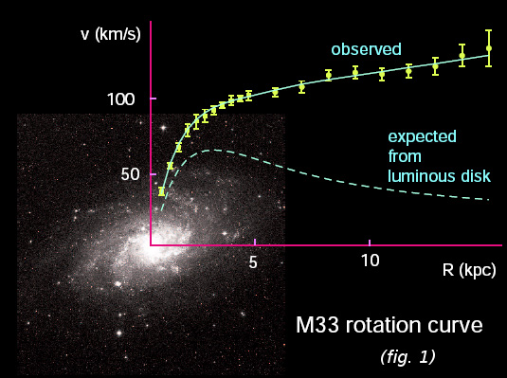
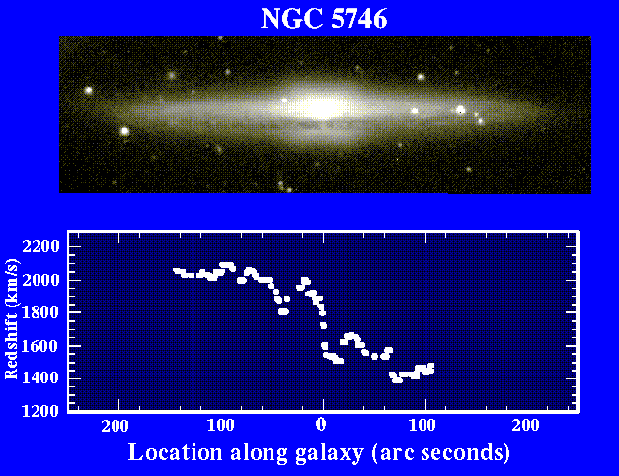

Slide 17
What’s going on?
When we measure orbital speeds of stars (or gas) in galaxies, we find that stars farther out are moving just as fast as stars in the inner regions
Implication, either:
our understanding of gravity is wrong (but it seems to work perfectly everywhere else!)
there's a lot of extra matter at large distances from the center of galaxies that provide more pull than we expected based on where we see the light coming from
Most astronomers feel that the latter is more likely, hence we believe that galaxies are filled with some unknown type of dark matter
The dark matter is NOT just where the stars are, it must fill a much larger volume of space
How much is there? A LOT. Roughly 90 % of the total mass of galaxies appears to be in dark matter, I.e. there’s a lot more dark matter than there is matter that we can see!

Slide 18
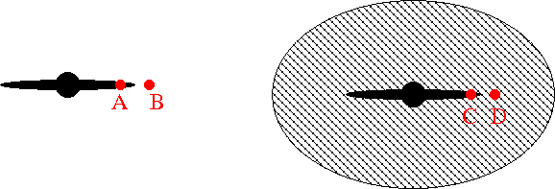
These diagrams are supposed to represent hypothetical galaxies seen edge-on. The left diagram is a diagram without dark matter, while the right diagram shows a galaxy with a dark matter halo. Consider the force of gravity on the stars shown in the figures ( which you can assume all have the same mass):
A. Star A should be moving faster than star B because it is experiencing a stronger force of gravity
B. Star B should be moving faster than star A because it is experiencing a stronger force of gravity
C. Both stars A and B should be moving at the same speed
D. You can't tell from the information given which star is moving faster

Slide 19
The diagrams are supposed to represent hypothetical galaxies seen edge-on. The left diagram is a diagram without dark matter, while the right diagram shows a galaxy with a dark matter halo. Consider the force of gravity on the stars shown in the figures ( which you can assume all have the same mass):
A. Star A should be moving faster than star C because the dark matter will slow star C down
B. Star C should be moving faster than star A because the extra gravity from the dark matter will exert a greater force
C. Both stars A and C should be moving at the same speed, because the dark matter has no effect
D. You can't tell from the information given which star is moving faster

Slide 20
The diagrams are supposed to represent hypothetical galaxies seen edge-on. The left diagram is a diagram without dark matter, while the right diagram shows a galaxy with a dark matter halo. Consider the force of gravity on the stars shown in the figures ( which you can assume all have the same mass):
A. The force of gravity on star C is greater than the force of gravity on star D because it is closer to the center of the galaxy
B. The force of gravity on star D is greater than the force of gravity on star C because more dark matter is pulling on it.
C. It's hard to tell because both statements (A) and (B) are true
D. Star D has to be traveling slower than star C because it is farther away.

Slide 21
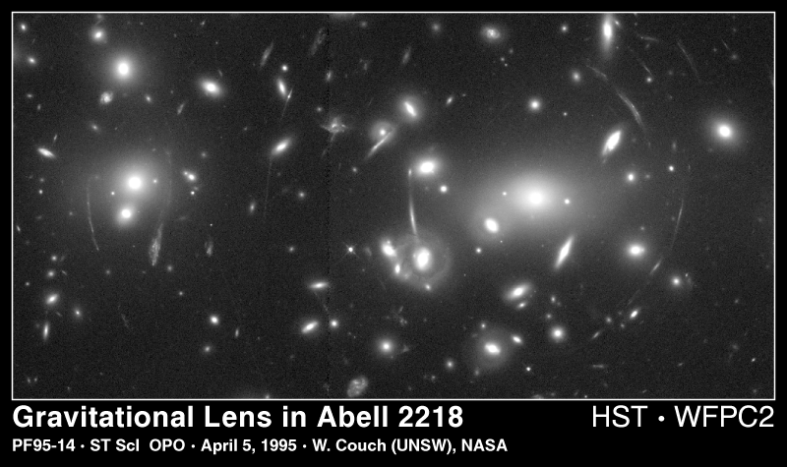
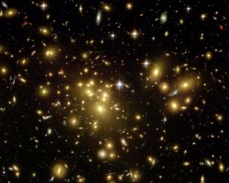
Other evidence for dark matter
Motions of galaxies in galaxy clusters
Galaxies move faster than expected from observed light --> fast enough so that cluster should come apart, but we see them!
Gravitational lensing
Modern theory of gravity developed by Einstein, called general relativity
Gives same results as Newton’s laws under almost all conditions, but generalizes to regions of very strong gravity
Where gravity is very strong, even light can be affected by gravity
Predicts the existence of so-called gravitational lenses
All evidence of dark matter suggests the same thing: there is a lot more dark matter than luminous matter!

Slide 22
What is dark matter?
Note that although there’s a lot of dark matter, it’s spread out over a large volume
Even though there is probably dark matter in the Solar System, there’s not enough to have any impact on motions of planets, etc!
We don't know what the dark matter is, even though we think it dominates the mass of galaxies!
Need to think of things that have mass but would be hard to see
Several possibilities

Slide 23
“Failed” stars or planets
When we measure masses of stars, we find there are lots more low mass stars than high mass stars
Low mass stars are fainter and harder to see
Maybe there’s a lot of super low mass stars, or free-floating planets?
Problems:
low mass stars and planets don’t have a lot of mass! Even though there’s more of them, there doesn’t seem to be that many more!
The very low mass objects would have to be located in a different place than the more massive stars, since the dark matter has to be much more extended to explain the observations!

Slide 24
“Burned out” stars
When stars end their lives, they can leave behind “embers” which gradually fade out. Maybe there are lots of dead stars that make up the dark matter?
Problem:
Only stars more massive than the Sun have had enough time to live their lives. These stars aren’t all that common, so it doesn’t seem like there’s enough of them
Again, the dead stars would need to be distributed in space differently than the living stars, hard to imagine how this could be!

Slide 25
Black holes
Einstein’s theory of gravity, general relativity, says that light can be affected by gravity
This leads to the possibility of compact massive objects where gravity at the surface of the object could be strong enough to prevent light from escaping… a black hole!
Key issue for a black hole is the strength of gravity at it’s “surface”
You can get strong gravity by either having a lot of mass or a very small object (or both)
Far away from the black hole, it’s no different than being far away from a normal object that has the same mass

Slide 26
Here's some diagrams of a possible solar system: in all three, the central object has the same mass, but it has different sizes: a small star in the left, a bigger star in the middle, and a black hole in the right. Remember: the force of gravity depends on the masses of the objects and the distance between their centers
Which planet do you expect to move faster, A or C?
A. Planet A will move faster because the gravitational pull from the star is bigger on planet A
B. Planet C will move faster because the gravitational pull from the star is bigger on planet C
C. Both planets A and C should be moving at the same speed because the gravitational pulls are the same
D. You can't tell from the information given which star will move faster

Slide 27
Here's some diagrams of a possible solar system: in all three, the central object has the same mass, but it has different sizes: a small star in the left, a bigger star in the middle, and a black hole in the right. Remember: the force of gravity depends on the masses of the objects and the distance between their centers
Which planet do you expect to move faster, A or E?
A. Planet A will move faster because the gravitational pull from the star is bigger on planet A
B. Planet E will move faster because the gravitational pull from the star is bigger on planet E
C. Both planets A and E should be moving at the same speed because the gravitational pulls are the same
D. You can't tell from the information given which star will move faster
E. Planet E will get sucked into the black hole!

Slide 28
Black holes (2)
Do black holes even exist for real?
Almost certainly yes!
We see some star orbits where we infer a massive companion, but don’t see anything!
Looking in the center of our galaxy, we see a similar thing
http://www-xray.ast.cam.ac.uk/xray_introduction/movie2003.gif
http://www.astro.ucla.edu/~ghezgroup/gc/pictures/orbitsMovie.shtml
Could they be the dark matter?
Very unlikely!
Origin of black holes:
death of very massive stars
Centers of galaxies
Neither matches the requirement that dark matter has to exist where stars don’t!

Slide 29
Another kind of matter?
Since nothing else seems to work, another suggestion is that dark matter is made up of some new kind of, yet to be discovered, subatomic particle!
Not protons, neutrons, electrons, or even any of the other known subatomic particles (muons, kaons, pions, etc.)
WIMPs: Weakly Interacting Massive Particles
Observations of relative abundance of different kinds of atoms, in conjunction with Big Bang theory, supports the idea that dark matter has to be made of some other kind of subatomic particle
People are doing experiments to try to detect this stuff, since it’s expected to be in the Solar System
Problem: it doesn’t interact with stuff, that’s why it’s hard to see in the first place! So it’s hard to detect!

Slide 30
What is dark matter?
We don't know what the dark matter is, even though we think it dominates the mass of galaxies!
Several possibilities
"failed stars", too low mass to shine --> UNLIKELY
dead stars", faded stars that no longer shine --> UNLIKELY
Black holes --> UNLIKELY
Some new sort of undiscovered matter --> MOST LIKELY!
Clearly, we have a lot to learn! But this is a mystery that may be resolved relatively soon!
Note that dark matter is not the same thing as dark energy, which we previously noted when talking about the expansion of the Universe, causing this expansion to accelerate with time

