Slide 1
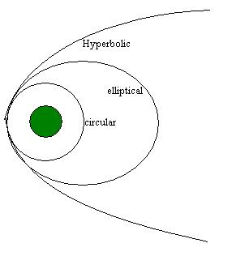
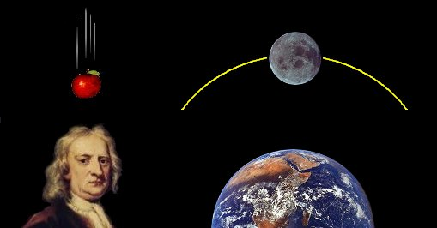
Orbits
Why doesn’t the Earth fall into the Sun?
Using orbits to measure masses

Slide 2
Recap
Midterm 11/1
Canvas homework due FRIDAY this week
Gravity
  Source of our weight
  Weight on other planets
Orbits
  Inertia and sideways motion
  Orbits and Kepler’s laws

Slide 3
Orbits
If gravity is an attractive force between objects, how come the Earth and the other planets aren’t pulled into the Sun?
The key is Newton’s first law, the law of inertia, and the recognition that when objects are formed, they are not always formed standing still!

Slide 4
Orbits
What happens if an object has some initial velocity?
  The law of inertia says an object will continue at the same velocity unless a force acts on it
Key issue is whether an object has sideways, or transverse, velocity, relative to the object that is pulling it
Consider some possibilities

Slide 5
Orbit simulator
See orbit simulator by PhET Interactive Solutions, University of Colorado
http://phet.colorado.edu/sims/my-solar-system/my-solar-system_en.html

Slide 6
Newton’s laws and Kepler’s laws
The mathematics of Newton’s laws can be used to quantitatively determine what motion will take place for an object with transverse velocity
When this is done, one finds that Newton’s laws GIVE Kepler’s laws:
  Orbits are elliptical
  Objects move faster in their elliptical orbits when they are closer to the Sun
  Objects in larger orbits move slower and take longer to go around
Without any other forces, orbits are such that objects return back to where they started, with the same velocity they started it, so it just keeps going!
  Good way to think about orbits: gravity causes objects to fall, but with sideways velocity, they fall around each other rather than towards each other!

Slide 7
Sideways motion of planets
Key to orbits is sideways motion
How did the planets get the sideways motion they need to keep them orbiting the Sun rather than falling into it?
Key is in understanding of how Solar System formed

Slide 8
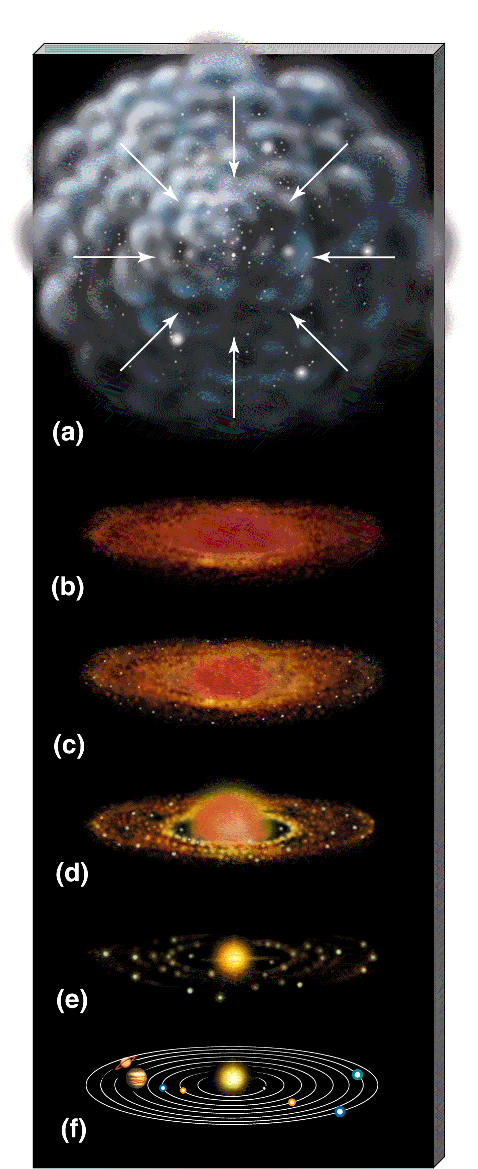
Model of Solar System Formation
Stars and planetary systems form from large, diffuse, interstellar gas clouds
Under certain conditions, these start to contract because of gravity
As objects contract (get smaller), any small amount of spin they might have can get greatly amplified
  Conservation of angular momentum: mass times speed times distance from center stays the same
  Another consequence is that collapsing cloud will flatten
If there’s lots of stuff, objects on non-circular orbits collide, and orbits get circularized
Result: things end up spinning in circular orbits!
Planets form out of material in spinning disk… in roughly circular orbits!

Slide 9
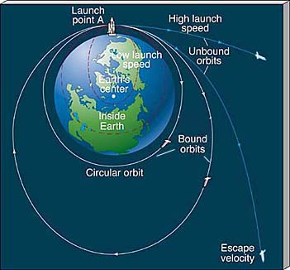
Putting objects into Earth orbit
The same principle is used to put objects in orbit around Earth
  To put an object in orbit, just give it some sideways velocity!
  Don’t need to keep running engines, just give it a sideways start and let the Earth do the rest of the pulling!
  Do need to get above the Earth’s atmosphere so that friction isn’t a big effect

Slide 10
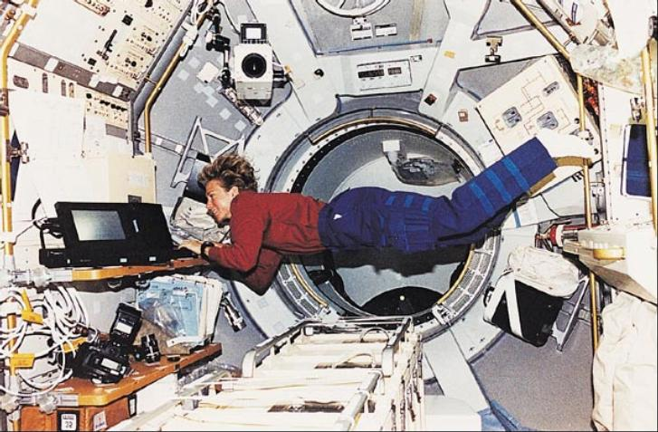
The shuttle orbits about 220 miles above the surface of the Earth. The Earth's radius is about 4000 miles. Given that the force of gravity between two objects (here, the Earth and the shuttle) is given by
force = G M_{earth} m_{shuttle} / d_{Earthcenter-to-shuttle}²
the force of gravity on the shuttle in orbit is
A. much greater than the force of gravity on the surface of the Earth
B. much less than the force of gravity on the surface of the Earth
C. only slightly less than the force of gravity on the surface of the Earth
D. can't tell from information given

Slide 11
Weightlessness and free fall
What is going on? The astronauts clearly experience the force of gravity, why do they appear to be weightless?
Key point is that they are in freefall, they are constantly falling, but because of their sideways motion, are falling around the Earth instead of falling towards it

Slide 12
Using gravity to measure masses
Lots of astronomical objects orbit other ones
  Moons orbit planets
  Planets orbit the Sun
  Binary stars orbit each other
  Stars orbit around centers of galaxies
  Galaxies orbit around each other
By understanding why objects orbit, and observing orbit characteristics, we can learn about the masses of objects

Slide 13
Masses from gravity
Basic idea is simple: objects orbit because of the pull of gravity.
  Strength of pull depends on masses of object and distance between them
  Stronger pull means objects orbit faster
  Observe orbits, measure
    Either period of orbit, or speed of orbiting object
    Distance between the objects (size of orbit)
  Use gravity, determine the mass of the object!
Mathematically, Newton’s laws give:
(M₁+M₂) = K a³ / P²
which is a generalization of Kepler’s 3rd law

Slide 14
Orbit simulator
See orbit simulator by PhET Interactive Solutions, University of Colorado
http://phet.colorado.edu/sims/my-solar-system/my-solar-system_en.html
Let’s measure some masses!
(for simulator, M₁+M₂ = .0048 a³ /P² )

Slide 15
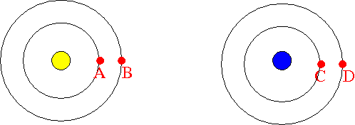
Consider planets around two different stars as shown above. If we observe that planet C takes longer to go around the blue star than planet A takes to go around the yellow star, what can we conclude?
The yellow star must be more massive than the blue star
The blue star must be more massive than the yellow star
This is impossible: both A and C should take the same amount of time to go around
It’s possible, but you can’t tell anything about the mass of the stars
What you infer about the mass of the stars depends on the mass of the planets

Slide 16
Example: masses of planets
To measure masses of planets, look for objects that go around them ….. moons!
Measure how long it takes to go around and distance between moon and planet
Use understanding of gravity to determine how much mass the planet must have to cause it to orbit at the observed speed!
Example: Moons of Jupiter
http://www.skyandtelescope.com/observing/objects/javascript/jupiter#

Slide 17
Results: masses of planets
Planet | Mass (Units: earth masses)
Mercury | 0.06
Venus | 0.82
Earth | 1.00
Mars | 0.11
Jupiter | 318
Saturn | 95
Uranus | 14.5
Neptune | 17.1
Pluto | 0.003
Look at orbits of moons to measure planetary masses
  Mercury and Venus don’t have moons! ---> Use artificial satellites
  Discovery of a moon can be very useful!
Review: inner planets have a lot less mass than outer planets ---- and different composition too!

Slide 18
Example: masses of stars
Measure masses of stars by looking for objects that orbit around them
  Planets? Actually, very hard to directly see planets around other stars!
Binary stars are useful, but a bit more complicated, since both stars may have comparable mass, so they orbit each other
If you can observe sizes of both orbits, you can get both masses from Newton’s laws!

Slide 19
Orbit simulator
See orbit simulator by PhET Interactive Solutions, University of Colorado
http://phet.colorado.edu/sims/my-solar-system/my-solar-system_en.html
(In simulator, M₁+M₂ = .0048 P² / a³⁾

Slide 20
Result: Masses of stars
Stars come in a range of masses!
Most massive stars about 100 times the mass of the Sun
Least massive stars about 1/10th the mass of the Sun
Sun is in the middle of the range, but there are lots more low mass stars than high mass stars
Open question: what determines allowable masses of stars and relative numbers at each mass?

Slide 21
Multiple orbiting objects
What happens if you have multiple objects that are orbiting, like many planets around a star, or many stars around a galaxy?
If the mass of the central object is much larger than the mass of the orbiting objects, each one orbits independently, without being affected by the others
  In detail, the orbits can be very slightly affected by the others: this is how Neptune was discovered!

Slide 22
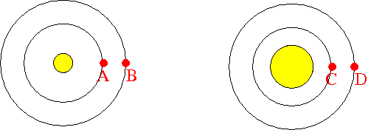
The diagram represents a solar system, with a star in the center and two planets orbiting it. The planets orbit the star because of its gravitational pull. Both planets have the same mass and are much less massive than the star, so the motion of each is dominated by the gravitational pull from the star. Remember: the force of gravity depends on the masses of the objects and the distance between their centers.
Which planet do you expect to move faster, A or B?
A. Planet A will move faster because the gravitational pull from the star is bigger on planet A
B. Planet B will move faster because the gravitational pull from the star is bigger on planet B
C. Both planets A and B should be moving at the same speed because the gravitational pulls are the same, because it's the same star that is doing the pulling
D. You can't tell from the information given which planet will move faster

Slide 23
Imagine you observe the periods of planets A and B and the size of their orbits, and use them, with Newton’s laws, to infer the mass of the star. Which will be true?
A. The orbit of planet A will give a larger mass for the star
B. Both orbits will give the same mass for the star
C. The orbit of planet B will give a larger mass for the star
D. You can’t determine the mass with just the period and the size of the orbit

Slide 24
Here's the same diagram, but on the right let's imagine that the star has been puffed up: it still has the same mass, but it is significantly bigger (i.e., it has a lower density). Remember: the force of gravity depends on the masses of the objects and the distance between their centers.
Which planet do you expect to move faster, A or C?
A. Planet A will move faster because the gravitational pull from the star is bigger on planet A
B. Planet C will move faster because the gravitational pull from the star is bigger on planet C
C. Both planets A and C should be moving at the same speed because the gravitational pulls are the same
D. You can't tell from the information given which planet will move faster

Slide 25
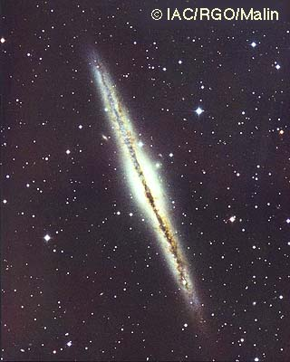
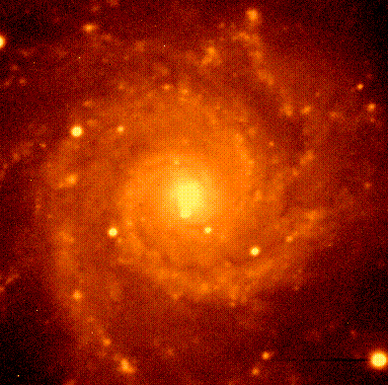
Measuring masses of galaxies
In spiral galaxies, stars orbit around the center of the galaxy
Can use these to measure the mass in the galaxy!
  To get the full mass, want to look at stars in the outer regions
  Can look at several different distances to check for consistency
Problem: stars take hundreds of millions of years to go around --> hard to measure the period!
Solution: instead of measuring period, measure the speed of the stars
  Look at edge-on galaxies
  Use the Doppler effect (same thing we talked about for measuring motions of galaxies)

