Slide 1
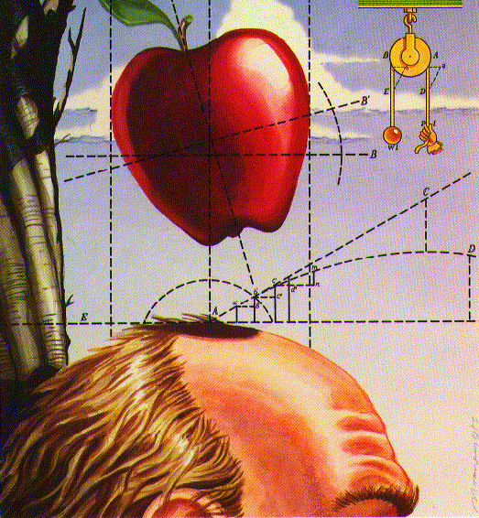
Motion
Why do objects move?
Forces and Gravity

Slide 2
Recap
Second midterm in two week: 11/1
Distances in astronomy
  Measuring distances using brightnesses
    Inverse square law
    Standard candles (e.g., Cepheid variables)
  Units of distance used in astronomy
    Astronomical units, light years, parsecs
  General size scales in astronomy
    Solar system: light minutes to light hours
    Galaxy: light years to tens of thousands of light years
    Galaxies & Universe: millions to billions of light years
Part IV: Physical basis of Astronomy: Gravity and Light

Slide 3
Motion and Newton’s Laws
Terminology:
  Velocity characterizes motion: speed AND direction
  Acceleration: change in velocity, either speed OR direction OR both
Newton’s laws of motion
  Law of inertia: velocity stays the same unless force acts on object
  Force law: if force is applied, object accerates in direction of force, with acceleration proportional to force and inversely proportional to mass

Slide 4
Newton’s laws of motion (3)
Action / reaction law
  For every applied force, a force of equal strength but opposite direction arises
  Explains how many things on Earth move
  Has an important consequence called conservation of momentum
    Momentum is defined as mass times velocity
    When there are no other forces, the total momentum of a a set of objects is unchanged (conserved)
    Principle behind rocket/jet propulsion
    Recoil is another familiar application

Slide 5
If the Sun pulls on the Earth, what does Newton’s 3rd law say about the pull of the Earth on the Sun?
The Earth does not pull on the Sun
The Earth pulls on the Sun but this pull is much weaker than the pull of the Sun on the Earth
The Earth pulls on the Sun with an equal force to that with which the Sun pulls on the Earth
The pull of the Earth on the Sun is stronger than the pull of the Sun on the Earth

Slide 6
Newton’s 2nd law (force law) says that if a force acts on an object, the object accelerates. If the Earth pulls on the Sun with the same force as the Sun pulls on the Earth, then
The acceleration of the Sun must be the same as the acceleration of the Earth
The acceleration of the Sun must be stronger than the acceleration of the Earth, because the Sun is more massive
The acceleration on the Sun must be weaker than the acceleration of Earth, because the Sun is more massive
The acceleration of the Sun must be stronger than the acceleration of the Earth, because the Earth is more massive
The acceleration of the Sun must be weather than the acceleration of the Earth, because the Earth is more massive

Slide 7
Forces in nature
Newton’s laws tell us how objects will move in the presence or absence of forces. But where do forces come from?
So far, only four basic forces have been discovered
  Gravity: force between objects that have mass
  Electromagnetic force: force between objects that have electric charge
  Strong force: force that is important within atomic nucleii
  Weak force: also only important within atoms
Of these forces, only gravity is important for understanding the motion of most astronomical objects

Slide 8
Gravity
Gravity is a force that exists between any objects that have mass
  It is an attractive force (pull between objects). Any object that has mass is attracted towards any other object that has mass.
  If there are lots of objects, the force on an an object is the sum of the force from all of the other objects. Since force has a direction, forces from opposite directions can cancel each other
For a spherical object, the force of gravity from the object at any location depends on the distance from the center of the object.

Slide 9
The strength of gravity
The strength of the gravitational force depends on:
  The mass of the objects: the greater the mass, the stronger the force
  The distance between the objects: the greater the distance, the weaker the force
  Mathematically:
  force = G M m / d²
  where M and m are the masses of the two objects, and d is the distance between them. G is a fixed number that describes how strong gravity is.

Slide 10
Consider the force of gravity between the Sun and the earth. The strength is
force = G M m / d²
Where M is the mass of the Sun, m is the mass of the Earth, and d is the distance between the (center of the) Sun and the (center of the) Earth
If the Sun’s mass were doubled, how would the force of gravity from the Sun on the Earth change?
It would stay the same
It would be half as strong
It would be twice as strong
It would be one quarter as strong
It would be four times stronger.

Slide 11
force = G M m / d²
If BOTH the Sun’s mass AND the Earth’s mass were doubled, how would the force of gravity from the Sun on the Earth change?
It would stay the same
It would be half as strong
It would be twice as strong
It would be one quarter as strong
It would be four times stronger.

Slide 12
force = G M m / d²
If the Sun’s mass was doubled and the Earth’s mass was halved, how would the force of gravity on the Earth change?
It would stay the same
It would be half as strong
It would be twice as strong
It would be one quarter as strong
It would be four times stronger.

Slide 13
force = G M m / d²
If the Earth was moved to a distance of 2 astronomical units, how would the force of gravity between the Earth and the Sun change?
It would stay the same
It would be half as strong
It would be twice as strong
It would be one quarter as strong
It would be four times stronger.

Slide 14
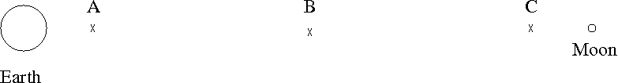
The following picture shows the Earth and Moon (sizes not to scale relative to the distance between them). The Earth is about 100 times more massive than the Moon. The diagram also shows three positions of a hypothetical spaceship.
At which position is the force of gravity from the Moon the strongest?
A. A
B. B
C. C
D. it is the same at all three positions
E. there is no gravity in between the Earth and the Moon

Slide 15
The following picture shows the Earth and Moon (sizes not to scale relative to the distance between them). The Earth is about 100 times more massive than the Moon. The diagram also shows three positions of a hypothetical spaceship.
At which position is the combined force of gravity from the Earth and the Moon closest to zero?
A. A
B. B
C. C
D. it is the same at all three positions
E. there is no location where the combined force could be close to zero

Slide 16
Gravity: example
Gravity is what pulls us down to the ground!
  Even after we hit the ground, gravity keeps pulling us down: the ground pushes back with a different kind of force
This pull of gravity is the source of our weight. Weight is a measure of how strong gravity pulls us
  Weight is different from, although related to, the quantity mass, which is a measure of how much stuff is in an object
    Weight is what would be measured by a spring scale
    Mass is what would be compared by a balance scale
  Since weight is just the force of gravity exerted by the Earth, what does our weight depend on?
    F = G M m / d²
  Our weight (F) depends on our mass (m), the mass of Earth, (M) and the distance between us and the center of Earth (d)

Slide 17
Would you weigh the same amount if you carried a scale to the top of Mt. Everest and weighed yourself?
I would weigh a lot more
I would weigh a little more
I would weigh exactly the same
I would weigh a little less
I would weigh a lot less

Slide 18
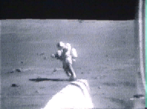
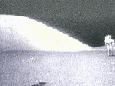
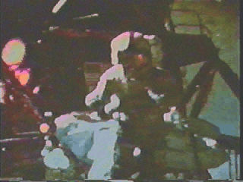
Weight on other planets
By experimentation: the Moon

Slide 19
Your weight on another planet depends on:
The atmosphere of the planet
The distance the planet is from the Sun
The mass of the planet
The mass AND size of the planet
The size of the planet

Slide 20
Weight on other planets
Since weight is a measure of how strong gravity is pulling us, it can change if we were to go to another planet
Force = G M m / d²
  Our mass, m, doesn’t change when we go somewhere else (it measures how much stuff is in us), but the mass of the planet, M, and the distance between us and the center of the planet, d, will be different if we go to another planet!
  Note that BOTH the mass AND the size of the other planet matter, because gravity depends on both the mass of the pulling object AND how far you are from the center of it

Slide 21
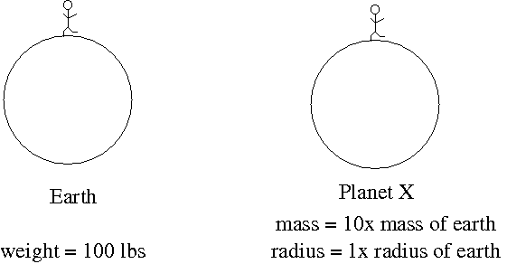
Imagine another planet, planet X, that has 10 times the mass of Earth, but the same size as Earth. If a 100 lb (on Earth) person went to visit, how much would they weigh?
force = G M m / d²
10 lbs
100 lbs
1000 lbs
10000 lbs
Can’t tell from information given

Slide 22
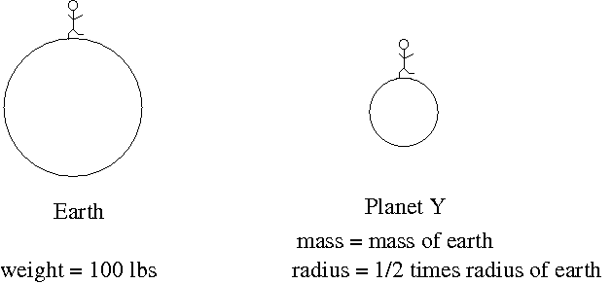
Imagine another planet, planet Y, that has the same mass as Earth, but has half the radius. If a 100 lb person went to visit, how much would they weigh?
force = G M m / d²
25 lbs
100 lbs
200 lbs
400 lbs
Can’t tell from information given

Slide 23
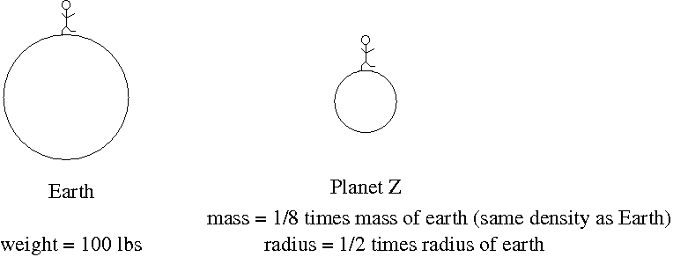
Imagine another planet, planet Z, that has 1/8th the mass of the Earth and has half the radius. If a 100 lb person went to visit, how much would they weigh?
force = G M m / d²
12.5 lbs
50 lbs
100 lbs
400 lbs
Can’t tell from information given

Slide 24
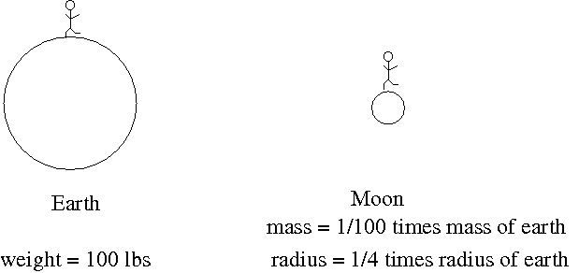
The Moon has about 1/100th the mass of Earth and about 1/4 the radius. If a 100 lb person went to visit, how much would they weigh?
force = G M m / d²
1 lbs
4 lbs
16 lbs
1600 lbs
Can’t tell from information given

Slide 25
Mars has about 1/10th the mass of Earth and about 1/2 the radius. If a 100 lb person went to visit, how much would they weigh?
force = G M m / d²
10 lbs
40 lbs
100 lbs
400 lbs
Can’t tell from information give

Slide 26
Imagine another planet, planet X, around some other star. Planet X has a mass that is 100 times the mass of Earth. If a 100lb person went to visit, how much would they weigh?
force = G M m / d²
10 lbs
10000 lbs
Can’t tell because we don’t know mass of the star
Can’t tell because we don’t know mass of the planet
Can’t tell because we don’t know the size of the planet

Slide 27
Weight on other planets
Other planets, weight calculator:
http://btc.montana.edu/ceres/html/Weight/weight.html

