Slide 1
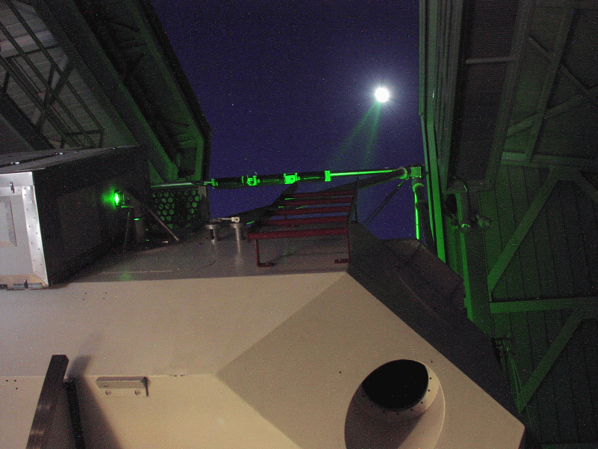
Distances to Astronomical Objects

Slide 2
Recap
Distances in astronomy
  Measuring distances directly with light travel time
  Measuring distances geometrically with parallax
  Measuring distances using brightnesses

Slide 3
Distances using brightnesses
Apparent brightness depends on intrinsic brightness and on distance
If we measure apparent brightness and know intrinsic brightness, we can get the distance!
How does this work?

Slide 4
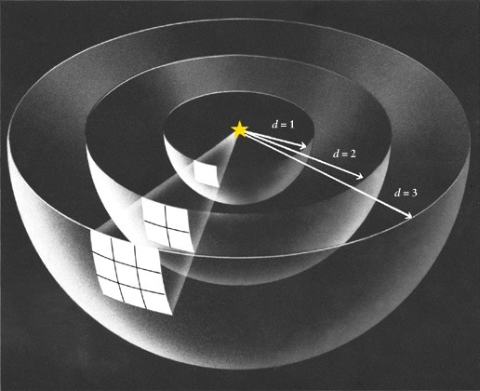
The “inverse-square” law of brightnesses
As an object gets more distant, its light is spread out over the area of a larger sphere.
The amount of light measured by one detector gets less by an amount corresponding to the area of the sphere
Since surface area goes as radius squared, brightness goes as inverse of radius squared
  Twice the distance, four times the surface area, one fourth the brightness
  Ten times the distance, 100 times the surface area, one hundredth the brightness

Slide 5
How can we use this?
If we know intrinsic brightness and measure apparent brightness, we can measure distance
But how do we know intrinsic brightness of astronomical objects?
  Conversely, if you know distance and measure apparent brightness you can measure intrinsic brightness
Use parallax for nearby objects to measure distances
With these independent distances, we can convert apparent brightnesses to intrinsic brightnesses
Now look for more distant objects that appear similar to the nearby ones, make the assumption that they have the same intrinsic brightness, measure apparent brightness and determine the distance!

Slide 6
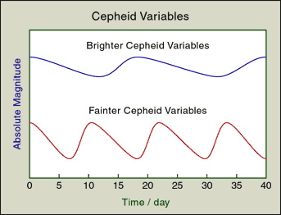
Standard candles
What sort of objects can we recognize as being the “same”?
Stars of similar temperatures and sizes
  We can measure something about temperatures and sizes from studying the color and the type of light emitted, independent of knowing the distance or intrinsic brightness
Certain types of variable stars
  Variable stars are stars that change in brightness from night to night. Some of these change with very regular patterns.
  For one kind of variable star, called Cepheid variables, one finds from nearby objects with parallax, that there is relation between variation period and intrinsic brightness
  The nice thing about Cepheids is they are intrinsically very bright, so they can be seen a long way away …. Even in other nearby galaxies!

Slide 7
Imagine I find a Cepheid variable star in the Andromeda galaxy that has a light curve that looks identical to one seen in a Milky Way cluster that is 1000 light years away. However, the Andromeda Cepheid is a million (10^6) times fainter. If the Milky way cluster is 1000 light years away, how far away is the Andromeda galaxy?
10000 light years (ten times farther than cluster)
100,000 light years (100x farther)
1,000,000 light years (1000x farther)
10,000,000 light years (10,000x farther)
1,000,000,000 light years (a million times farther)

Slide 8
Units of distance in astronomy
Astronomical units
  One astronomical unit is the average distance between the Earth and the Sun
  Used in the solar system
Light years
  Distance that light travels in one year
  Unit of distance, not time!
  Can also talk about light seconds, light minutes, etc.
Parsecs
  Natural unit used when measuring parallax: a motion of one arcsecond from opposite sides of the Earth’s orbit occurs for an object at one parsec
  kiloparsecs (1000 parsecs; kpc) and megaparsecs (1 million parsecs; Mpc) used for sizes of galaxies and distances to galaxies

Slide 9
Distances in Astronomy
Solar system
  Light minutes to light hours
Milky Way galaxy
  Nearest stars: light years
  Galaxy center: tens of thousands of light years
Galaxies
  Nearest big Galaxy: few million light years
  Most distant galaxies: billions of light years
  Microwave background: >13 billion light years

Slide 10
Introduction: Astronomy and Science
Motions in the Sky: Astronomy by Eye
Overview of the Universe
The Physical Basis of Astronomy: Gravity and Light
Interesting Questions in Astronomy

Slide 11
Basic question/idea
Why do astronomical objects move?
  GRAVITY
What does an understanding of gravity allow you to do?
  Understand motions
  Measure MASSES of objects

Slide 12
Motions: definitions
Motion of an object is specified by describing how fast an object is moving (speed), and also by what direction it is moving in
Combination of speed and direction is called the velocity of an object
If the velocity of an object is changing (either speed or direction), the object is said to be accelerating. Acceleration is a change in velocity.
  Deceleration (slowing down) is just considered as negative acceleration

Slide 13
Some examples
Is the object accelerating?

Slide 14
Imagine we discover a planet with a perfectly circular orbit. Which is true?
The planet will not be accelerating
The planet will be accelerating, changing both speed and direction
The planet will be accelerating, changing only speed
The planet will be accelerating, changing only direction
A planet cannot be in a circular orbt

Slide 15
Newton’s Laws of Motion (1)
Law of inertia: the velocity of an object will not change unless there is a force acting on it
  An object at rest stays at rest unless something pushes on it
  An object that is moving will continue to move at the same speed in the same direction unless something pushes on it
  If an object is accelerating, there must be a force acting on it

Slide 16
Newton’s Laws of Motion (2)
Force law: if a force is applied to an object, the object will accelerate
  Change in velocity can be a change in speed, change in direction, or both
  Acceleration is larger if force is larger
  For a given force, the acceleration is larger on a less massive object than on a more massive object.
  Mathematically
    acceleration = force / mass

Slide 17
If you apply a force to (push on) an object, how does the motion change?
A ) the object will always speed up
B) the object will either speed up or slow down
C) the speed of the object might increase or decrease, but it also might stay the same
D) the motion of the object won't change

Slide 18
Newton’s laws of motion (3)
Action / reaction law
  For every applied force, a force of equal strength but opposite direction arises
  Explains how many things on Earth move
  Has an important consequence called conservation of momentum
    Momentum is defined as mass times velocity
    When there are no other forces, the total momentum of a a set of objects is unchanged (conserved)
    Principle behind rocket/jet propulsion
    Recoil is another familiar application

Slide 19
If the Sun pulls on the Earth, what does Newton’s 3rd law say about the pull of the Earth on the Sun?
The Earth does not pull on the Sun
The Earth pulls on the Sun but this pull is much weaker than the pull of the Sun on the Earth
The Earth pulls on the Sun with an equal force to that with which the Sun pulls on the Earth
The pull of the Earth on the Sun is stronger than the pull of the Sun on the Earth

Slide 20
Newton’s 2nd law (force law) says that if a force acts on an object, the object accelerates. If the Earth pulls on the Sun with the same force as the Sun pulls on the Earth, then
The acceleration of the Sun must be the same as the acceleration of the Earth
The acceleration of the Sun must be stronger than the acceleration of the Earth, because the Sun is more massive
The acceleration on the Sun must be weaker than the acceleration of Earth, because the Sun is more massive
The acceleration of the Sun must be stronger than the acceleration of the Earth, because the Earth is more massive
The acceleration of the Sun must be weather than the acceleration of the Earth, because the Earth is more massive

Slide 21
Forces in nature
Newton’s laws tell us how objects will move in the presence or absence of forces. But where do forces come from?
So far, only four basic forces have been discovered
  Gravity: force between objects that have mass
  Electromagnetic force: force between objects that have electric charge
  Strong force: force that is important within atomic nucleii
  Weak force: also only important within atoms
Of these forces, only gravity is important for understanding the motion of most astronomical objects

