Slide 1
Distances to Astronomical Objects

Slide 2
Recap
Canvas homework due Wednesday
Lab this week: Parallax
Overview of the Universe
Solar System, Galaxy, Universe
Largest scales
Expanding Universe
Evidence for a Big Bang
Evidence for an accelerating Universe → dark energy
Recurring themes
We don’t live in the center of anything
Distances between astronomical objects are LARGE, generally much larger than the objects themselves: universe is mostly empty
But how do we measure such large distances?

Slide 3
Direct distance measurements
On Earth, we often measure distances directly
Clearly impractical for astronomical objects!
Actually, a form of direct distance measurement is made for the moon and some nearby planets
Basic idea: if you send something somewhere, knowing exactly how fast it travels, you can see how long it takes to get there and back and then determine how far away the object is

Slide 4
If you set off driving to Albuquerque, keep your speed precisely at 100 km/hr, and it takes you 6 hours to get there and back again, how far away is Albuquerque?
100 km
300 km
600 km
1200 km
No clue

Slide 5
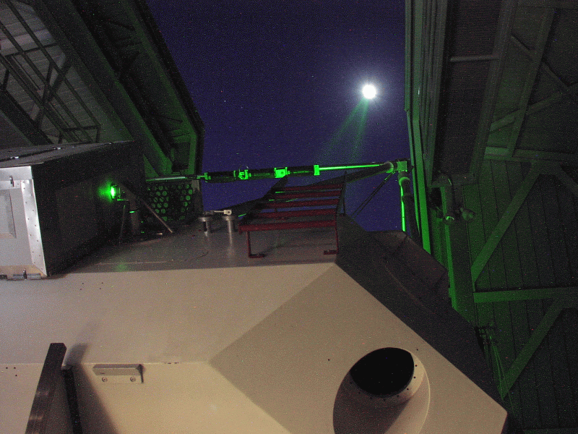
Direct distance measurements
On Earth, we often measure distances directly
Clearly impractical for astronomical objects!
Actually, a form of direct distance measurement is made for the moon and some nearby planets
Basic idea: if you send something somewhere, knowing exactly how fast it travels, you can see how long it takes to get there and back and then determine how far away the object is
What can we use that we know the speed of? LIGHT
Radar and/or laser ranging experiments

Slide 6
If you send a light pulse to the Moon, travelling at 300,000 km/s, and it takes about 2.5 seconds for the light to come back, about how far away is the Moon?
300,000 km
375,000 km
600,000 km
750,000 km
No clue

Slide 7
Distances using angles
Even using light ranging, we can’t measure distances very far!
Too long
Too faint for large distances
Fundamental method for measuring distances has to do with measuring angles, just like surveying on Earth is used to measure distances
Basic idea: an object of fixed length will look smaller as it is placed farther away.
True size: how long the object really is
Apparent size: angle it appears to take up
If you know the true size, and measure the apparent angle, you can determine the distance!
It is an inverse relation: the smaller the angle, the larger the distance.
distance is proportional to 1/angle
half the angle --> twice the distance! One tenth the angle --> ten times the distance!

Slide 8
Distances using angles
Let’s say a meter stick at a distance of 6 meters takes up an angle of about 10 degrees (= one “fist” at arms length).
1 fist → 6 meters
2 fists → ? meters
0.5 fists → ? meters
Look at the meterstick, and measure its angular size (how many fists?) Using this, about how far away is the front of the classroom?
5 meters
10 meters
15 meters
20 meters
25 meters

Slide 9
Distances using angles
But how can we use this for astronomical objects? We can’t send a ruler to them and don’t know beforehand how big they really are!
Use the technique “in reverse”

Slide 10
Distances using angles
O
A
ruler
B
ruler
O
Which is the bigger angle: A or B?
How can we measure these angles?
1. Look at two ends of a ruler from O
2. Look at O from two ends of a ruler!

Slide 11
Distances using parallax
Look at an object from two different vantage points
Measure the change in angle from the two different points
If you know how far apart your vantage points are, you can determine the distance!

Slide 12
Parallax in practice
Parallax is used by the human brain all of the time!
Consider your two eyes!
For astronomical objects, distances are so large that the angular shift is VERY small
To be able to measure it, want to choose vantage points that are VERY far apart
What’s the maximum practical distance?
Earth on either side of its orbit!

Slide 13
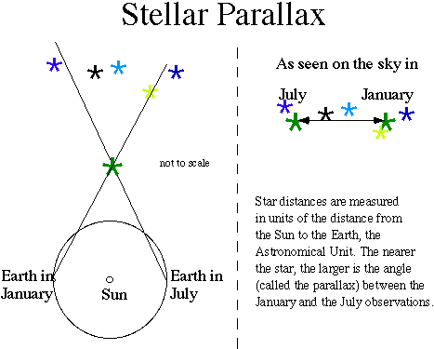

Slide 14
How far can you use parallax?
Parallax is the fundamental method used to measure distances in astronomy
However, even from the very wide vantage points of opposite sides of the Earth’s orbit, our best angle measurements are only good enough to measure distances to relatively nearby stars, just in our neighborhood in the Milky Way!
How can we measure more distant objects?
Improve our ability to measure angles: new satellites (European GAIA mission, US SIM mission)
Use alternative distance indicators, taking advantage of parallax for nearby objects

Slide 15
Distances using brightnesses
Apparent brightness depends on intrinsic brightness and on distance
If we measure apparent brightness and know intrinsic brightness, we can get the distance!
How does this work?

Slide 16
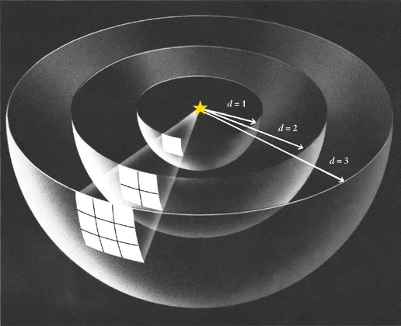
Imagine you flick on a light bulb for a fraction of a second. The light starts rushing out away from the bulb, like an rapidly expanding sphere. Imagine our eyes are little square sensors 1 cm on a side.
As the light gets farther away from the bulb, you need
A. the same number of eyes to collect it all
B. more eyes to collect it all
C. less eyes to collect it all
D. sunglasses!

Slide 17
The “inverse-square” law of brightnesses
As an object gets more distant, its light is spread out over the area of a larger sphere.
The amount of light measured by one detector gets less by an amount corresponding to the area of the sphere
Since surface area goes as radius squared, brightness goes as inverse of radius squared
Twice the distance, four times the surface area, one fourth the brightness
Ten times the distance, 100 times the surface area, one hundredth the brightness

Slide 18
Imagine you measure the brightness of a lightbulb when it is at a distance of 100 meters. You then have someone move the lightbulb: when you look at it after it has been moved, you see that it appears one quarter as bright. How far away has the bulb been moved to?
25 meters
50 meters
100 meters
200 meters
400 meters

Slide 19
How can we use this?
If we know intrinsic brightness and measure apparent brightness, we can measure distance
But how do we know intrinsic brightness of astronomical objects?
Conversely, if you know distance and measure apparent brightness you can measure intrinsic brightness
Use parallax for nearby objects to measure distances
With these independent distances, we can convert apparent brightnesses to intrinsic brightnesses
Now look for more distant objects that appear similar to the nearby ones, make the assumption that they have the same intrinsic brightness, measure apparent brightness and determine the distance!

Slide 20
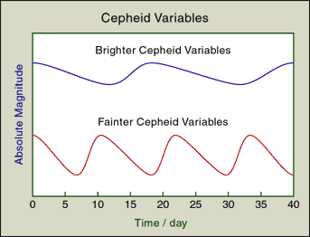
Standard candles
What sort of objects can we recognize as being the “same”?
Stars of similar temperatures and sizes
We can measure something about temperatures and sizes from studying the color and the type of light emitted, independent of knowing the distance or intrinsic brightness
Certain types of variable stars
From nearby objects with parallax, see there is relation between variation period and intrinsic brightness

Slide 21
Units of distance in astronomy
Astronomical units
One astronomical unit is the average distance between the Earth and the Sun
Used in the solar system
Light years
Distance that light travels in one year
Unit of distance, not time!
Can also talk about light seconds, light minutes, etc.
Parsecs
Natural unit used when measuring parallax: a motion of one arcsecond from opposite sides of the Earth’s orbit occurs for an object at one parsec
kiloparsecs (1000 parsecs; kpc) and megaparsecs (1 million parsecs; Mpc) used for sizes of galaxies and distances to galaxies

Slide 22
Distances in Astronomy
Solar system
Light minutes to light hours
Milky Way galaxay
Nearest stars: light years
Galaxy center: tens of thousands of light years
Galaxies
Nearest big Galaxy: few million light years
Most distant galaxies: billions of light years
Microwave background: >13 billion light years

