Slide 1
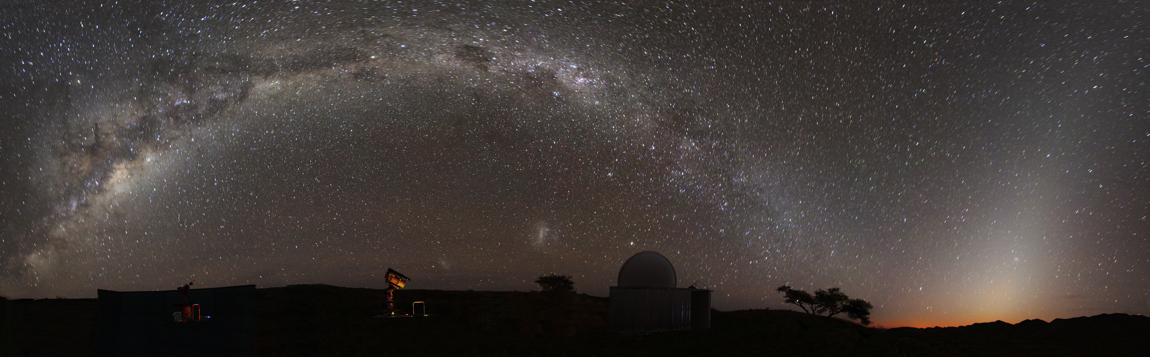
The Milky Way and Other Galaxies

Slide 2
Recap
Canvas homework: due on Wednesday
Lab this week: Galaxy Morphology
Campus Observatory
Milky Way galaxy
  Stars: brightnesses, masses, sizes, compositions, evolution
  Interstellar matter: gas, dust
  Relation between stars and interstellar matter
  Shape of the Milky Way as inferred from observations within it

Slide 3
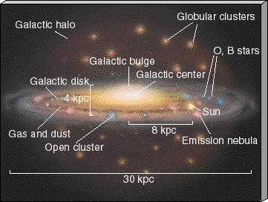
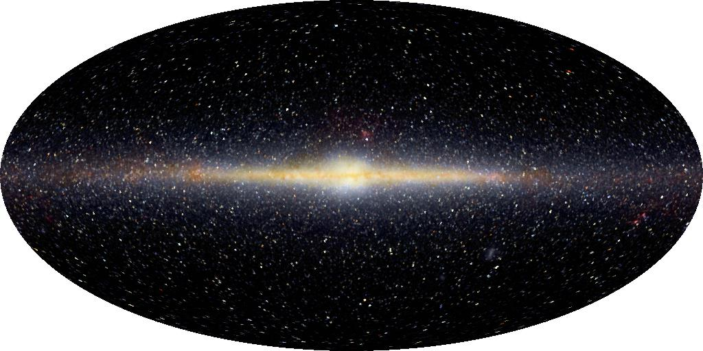

Slide 4
Both Solar System and Milky Way are FLAT

Slide 5
Scale of the Milky Way
OBJECT | DISTANCE FROM SUN
Solar system “size” (Pluto distance) | 6x10¹⁴ cm
Nearby stars | 6x10¹⁸ cm
Center of galaxy | 2x10²² cm
We found that, in a scale model where the Solar System is a disk 25cm in diameter, the nearest stars would be about 2500 m away.
Considering data, about how far would the center of the galaxy be in this scale model?
A. 75 meters
B. 750 meters
C. 7,500 meters
D. 7,500,000 meters
E. totally lost
2x10²² cm / 6x10¹⁴ cm = 0.3x10⁸ = 3x10⁷ =30 million times bigger
So if Solar System is 25cm across in model, nearest stars are 75x10⁷ cm = 7500 km away!
If SS is a frisbee, center of galaxy is in Europe!

Slide 6
Motions in the Milky Way
Objects in the Milky Way move
  In the disk, stars and interstellar matter revolve around the center of the galaxy in roughly circular orbits, all in the same direction
  In the halo, stars and globular clusters move around in higgledy-piggledy orbits, all different shapes and directions!
  Periods of orbits are very long: hundreds of millions of years!
    Because stars are so far away, over the course of our lifetime, it is very hard to see anything move at all!

Slide 7
Leaving the Milky Way: lots of questions
How do we measure masses, sizes, temperatures, and compositions of stars?
How does the star/gas relationship work? What makes stars form?
Why is the galaxy flat? Why is there a small fraction of the galaxy that is in a halo?
How do we measure motions of stars? Why do the stars move as they do?
Shape and motions provide clues about how the Milky Way formed and evolved

Slide 8
Galaxies in the Universe
The Milky Way is one of billions of galaxies in the Universe
All galaxies are not identical to the Milky Way

Slide 9
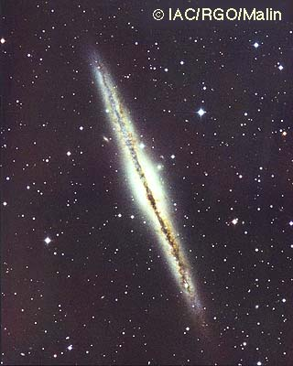
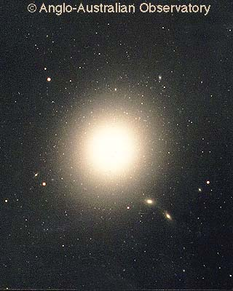
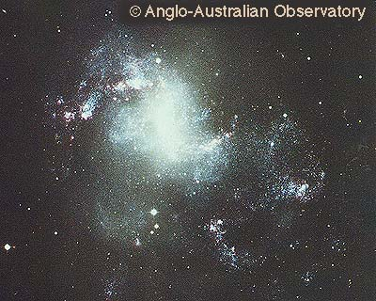
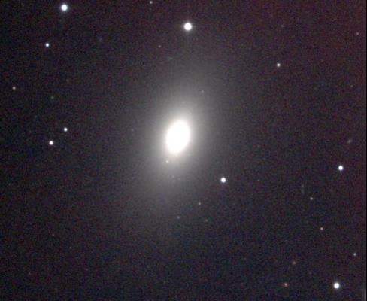
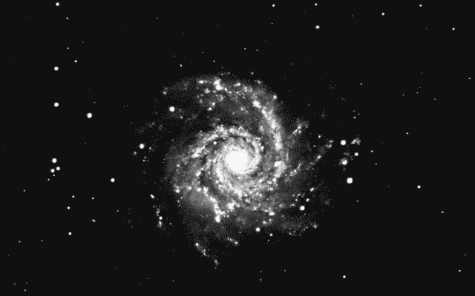
Galaxy shapes
Galaxies come in two basic shapes
  Spiral galaxies
    Milky Way is a spiral galaxy
    Spirals are flat, so what they look like depends on how they are oriented
    Like the Milky Way, other spiral galaxies have stars and lots of interstellar matter. Stars are continuously forming and dying
  Elliptical galaxies
    Elliptical galaxies are not flat, they are big balls of stars
    Sometimes the balls are a little squashed, but they’re never flat like spirals
    Elliptical galaxies don’t seem to have very much interstellar matter, so new stars are not forming, so most of the stars are old.
Some galaxies don’t fit nicely into either of these two categories, and are called irregular galaxies
Another spiral galaxy: not the Milky Way!

Slide 10
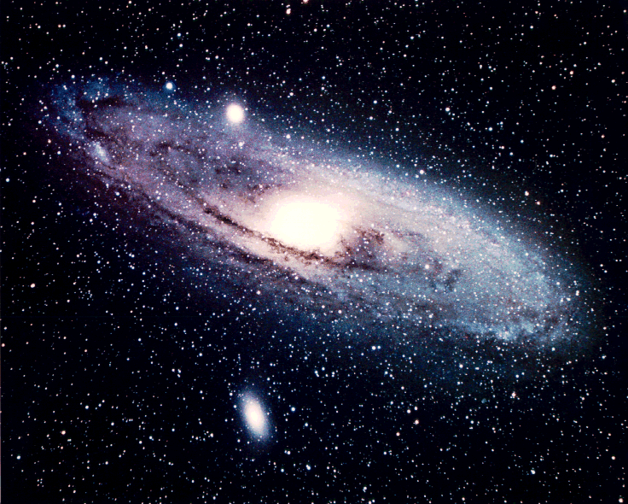
Other galaxy properties
Masses and sizes
  Galaxies come in a wide range of masses and sizes
Motions of stars
  In spiral galaxies, stars orbit the centers in nearly circular orbits, like the Milky Way disk
  In elliptical galaxies, stars orbit the centers in all different directions and different shaped orbits (like the Milky Way halo)

Slide 11
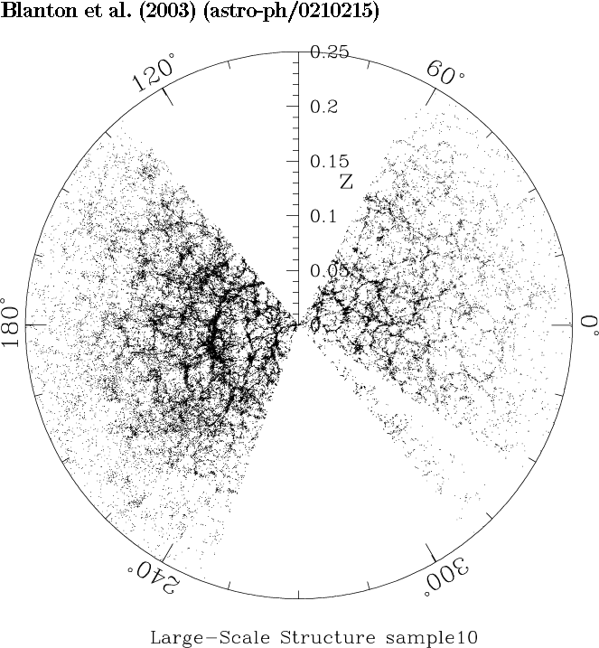
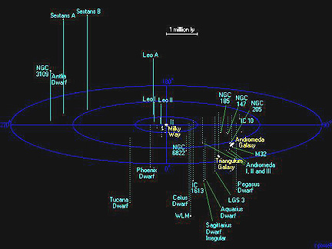
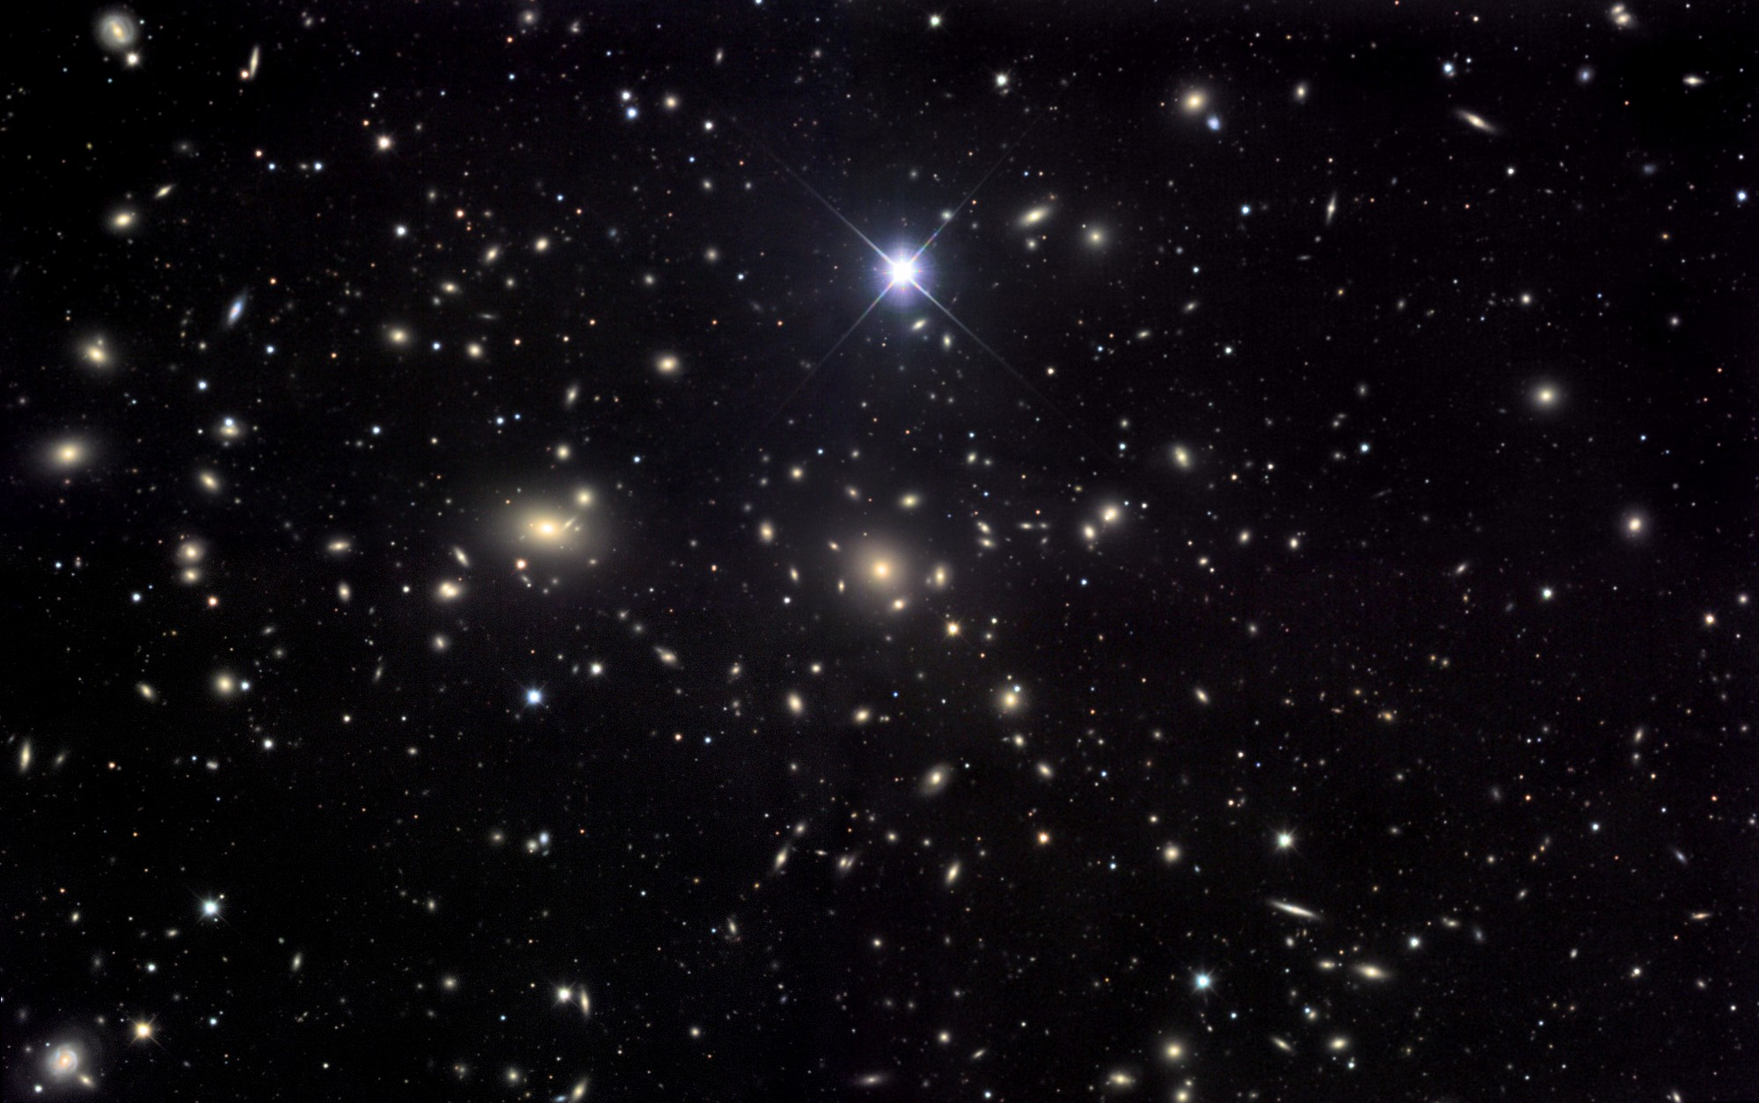
Distribution of galaxies in space
Galaxies are not spread uniformly through space
The Milky Way is in a small group of galaxies called the Local Group
  The Local Group has 2 big galaxies, the Milky Way and Andromeda, and a couple of dozen small galaxies
Away from the Milky Way, galaxies are sometimes found as isolated objects, sometimes in small groups (like the Milky Way), and sometimes in large clusters of galaxies
On largest scales, galaxies are located in a “frothy” distribution

Slide 12
What about motions of galaxies?
Despite large distances, we can get some information about motions of galaxies
Motion of objects can be split into components:
  Sideways, or transverse, motion
  Radial motion: part of motion towards or away from us
Transverse motion very hard to measure for distant objects, impossible for galaxies
Radial motion can be measured using a phenomenon called the Doppler shift

Slide 13
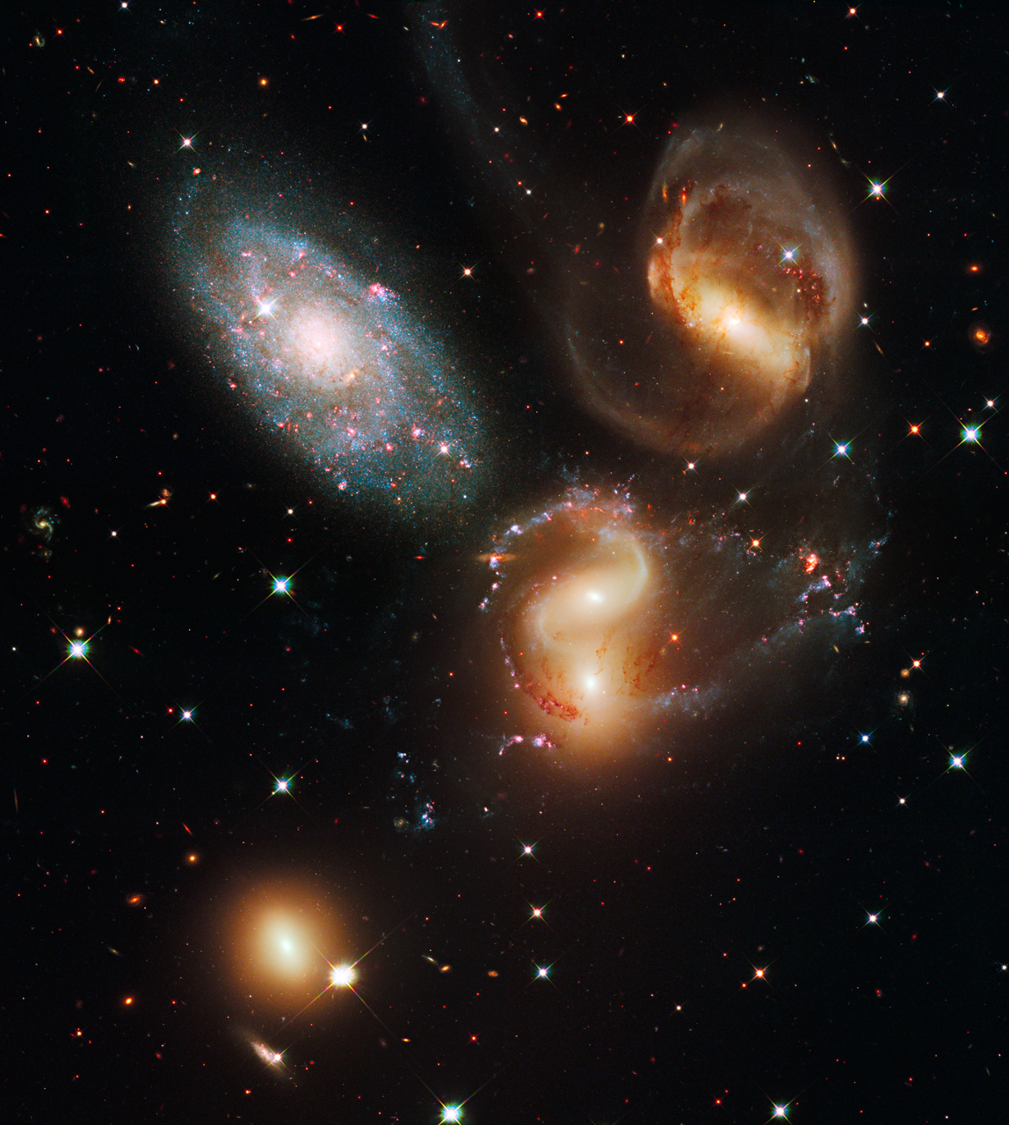
Motions of galaxies
Galaxies move around in space
  They sometimes collide!

Slide 14
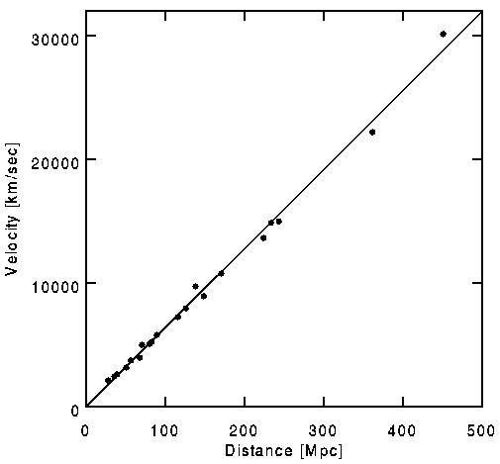
Expansion of the Universe
Essentially all galaxies appear to be moving away from us
The speed of recession is proportional to the distance of the galaxy
  A galaxy twice as far away is moving twice as fast; three times as far away is moving three times as fast; ten times as far away, ten times as fast, etc.
  This pattern of galaxy expansion is often called Hubble’s law

Slide 15
What does this mean?
Let’s set up a simulation, with 5 galaxies (ABCDE) spaced at 3 feet apart: VOLUNTEERS?
Imagine we live in Galaxy A
Let’s look at Galaxy B and say it is moving away from us at 1 foot/second
Galaxy C is twice as far as galaxy A: how fast is it moving?
Galaxy D is three times as far: how fast?
Galaxy E is four times as far: how fast?
Let’s do it!

Slide 16
How far in 5 seconds?
Let’s do things a bit more carefully
Galaxy B: 1 foot/sec, in 5 seconds: ?
Galaxy C: 2 feet/sec, in 5 seconds: ?
Galaxy D: 3 feet/sec, in 5 seconds: ?
Galaxy E: 4 feet/sec, in 5 seconds: ?

Slide 17
What does this look like?
Consider the view from our galaxy (A)
Galaxy | Start distance | End distance | Speed = distance change / time
A | 0 | 0
B | 3
C | 6
D | 9
E | 12

Slide 18
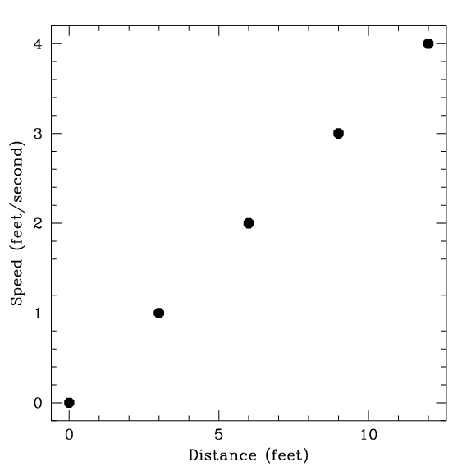
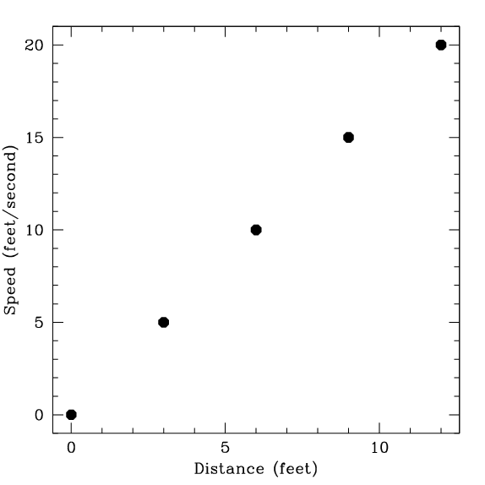
Graph it

Slide 19
What about from other galaxies?
Make the same table from the point of view of another galaxy: choose B, C, D, or E
Galaxy | Start distance | End distance | Speed = distance change / time
A
B
C
D
E

Slide 20
What does this mean?
Galaxies all appear to be flying away from us!!
Are we at the center of the Universe? …………NO!!!!!!…………
  No matter what galaxy you live on, all other galaxies appear to be flying away from you!
  Everything is moving apart from everything else --- NO CENTER!!
  What’s the key observation? --> speed is proportional to distance
Alternative way of thinking about things: all galaxies stay still, but space between them is expanding

Slide 21
To Do
Homework for Wednesday, reading and questions
Review material…

