Slide 1
Stars
Interstellar matter
Shape of the Galaxy

Slide 2
Recap
Canvas assignment for next Wednesday will be posted soon
Relative sizes and distances between objects in Solar System
Scale models
The Solar System in the Milky Way galaxy
Distances to nearby stars relative to size of Solar System
Looking at stars
Brightness: apparent brightness depends on intrinsic brightness AND distance
Color: depends on temperature at surface of star (and perhaps, on intervening material)

Slide 3
Stars
Stars come in a range of masses
Sun is intermediate: most massive stars about 100x mass of Sun, least massive stars about 1/10th mass of Sun
Stars come in range of sizes
Again, Sun is intermediate. Some larger stars are called giant stars, smaller ones are called dwarfs
However, measuring size is tricky! Even with biggest telescopes you don’t see stars as “circles”, they are just points because they are so far away!
Most stars have similar compositions to each other
Measuring mass, size, and composition requires some extra observations and understanding! Can’t get these from looking at a single picture!

Slide 4
Stars live and die
Stars evolve:
they are born, live their lives, and die
Properties of stars (temperatures and sizes in particular) evolve over their lifetimes
Lifetimes are long: millions to billions of years. So we don’t usually directly see too much of the evolution! But we do see lots of stars at different stages of evolution!

Slide 5
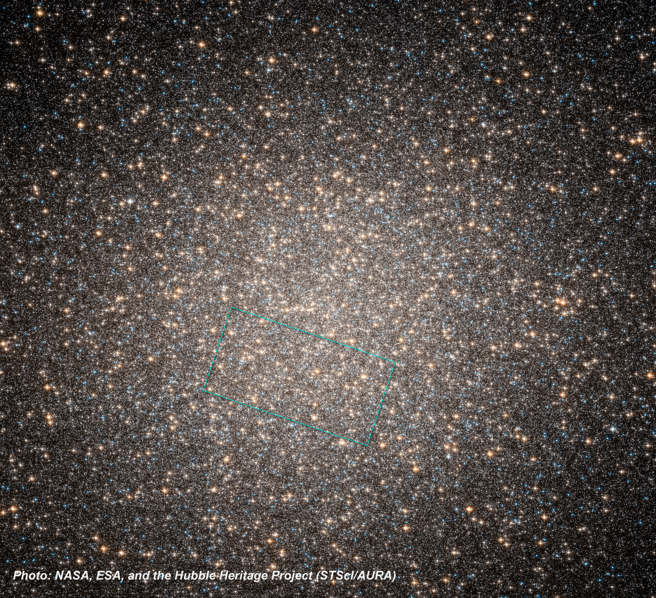
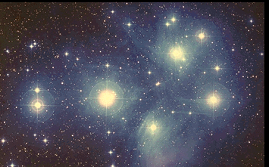
Stars in space
Not all stars are isolated from each other, like the Sun is
Many stars exist as binary stars, two stars that orbit each other
Binary stars are very important to astronomy, as they are how we measure masses of stars
Some stars come as triples, quadruples, or more
Some stars come in clusters, with hundreds to millions of stars grouped together in space
Two general types of clusters
Open clusters have fewer stars (hundreds to thousands) and are more spread out
Globular clusters have more stars (thousands to millions) and the stars are more closely packed
Clusters are very important to astronomy, because they allow us to measure relative intrinsic brightnesses of stars, since all stars in a cluster are at the same distance from us. They are also important because it turns out that all stars in a given cluster have the same age

Slide 6
This is a star cluster (the Pleiades). Let’s say all of these stars are in the cluster (most of them are!)
Which star is intrinsically the brightest?
A. Star A
B. Star B
C. Star C
D. All same brightness
E. Can’t tell
B
A
C

Slide 7
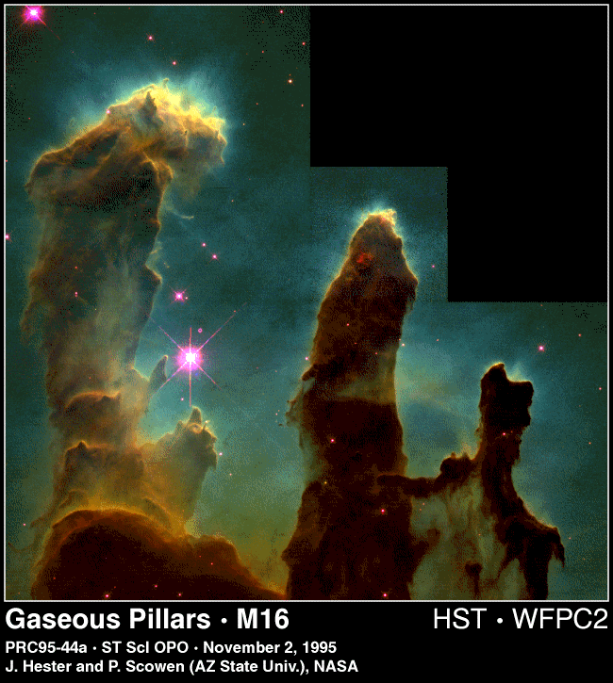
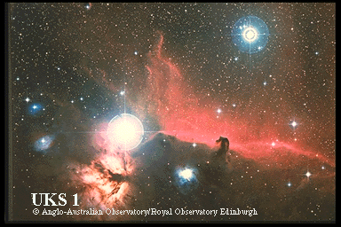
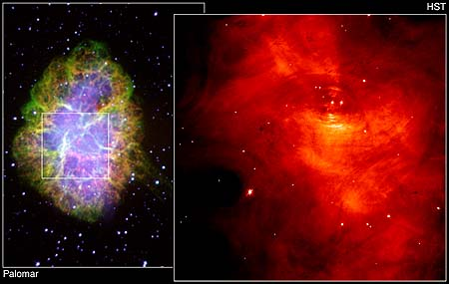
Stuff between the stars
In the Milky Way, there is also stuff between the stars, often called interstellar matter
Two main components: gas and dust
Interstellar clouds are often called nebulae
Interstellar clouds have symbiotic relation with the stars of the galaxy
Stars form from interstellar clouds
When stars die, they eject some or all of their material back into the interstellar medium

Slide 8
Shape of the Milky Way
The Sun is a member of a very large group of stars (over a billion!) that make up the Milky Way Galaxy
Determining the shape of the Milky Way galaxy is a bit tricky because we live inside of it
The Milky Way is so large that we can’t come close to sending something out to look back!
How can you figure out the shape of something from inside of it?

Slide 9
Shape of the Solar System
Even though most of the solar system is empty, we can consider the shape that the objects within it take up as they move around the Sun. Given the animations you’ve seen, what’s the shape of the Solar System (not the shape of the planets!), considering only the planets out to Neptune?
A. Spherical (like a ball)
B. Cubical (like a dice)
C. Flat and square (like a baseball base)
D. Flat and round (like a frisbee)
E. Irregular

Slide 10
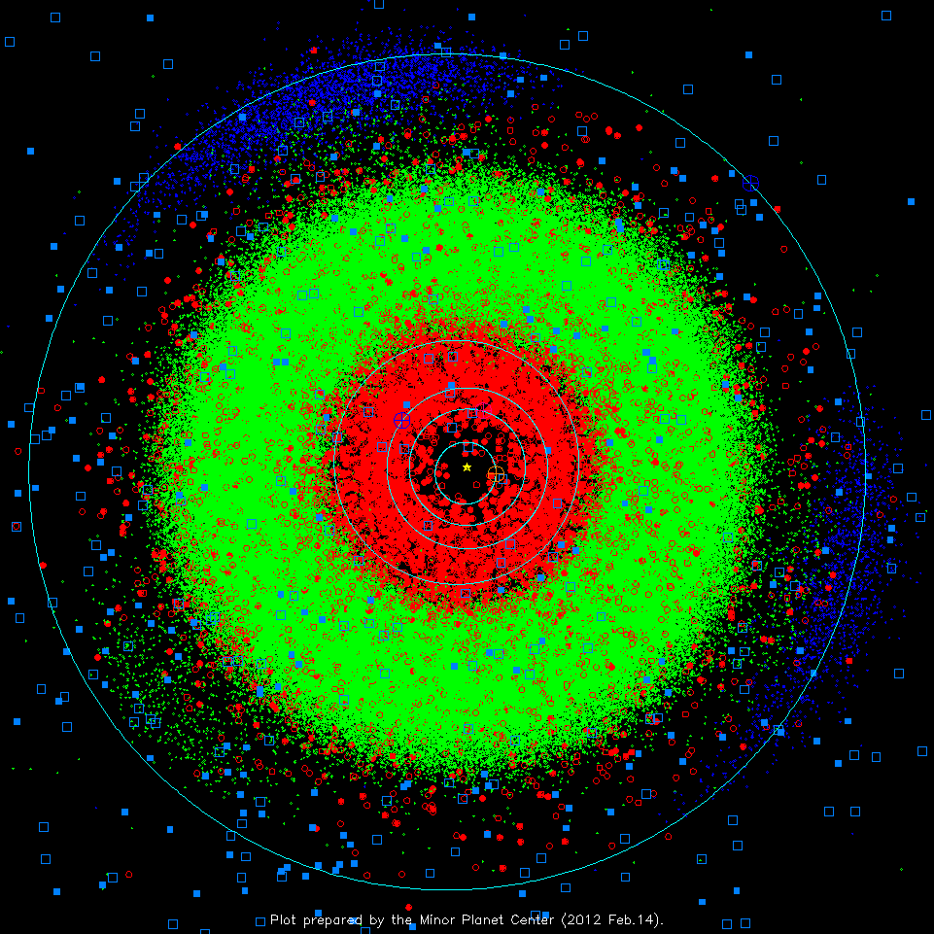
Shape of the Solar System
We’ve learned that there are a LOT of asteroids in the main asteroid belt (between Mars and Jupiter), and that these asteroids orbit in nearly circular orbits with near-zero inclination. Since they are small, they are rather faint; however, let’s imagine:
If all of the asteroids in the Solar System glowed brightly and we looked at them at night, where would we see them?
All across the sky
In a line around the sky
In two clumps in the sky
In a circle in the night sky
Don’t know

Slide 11
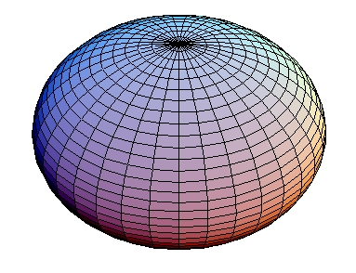
Thought experiment
Imagine we lived in a galaxy that was shaped like a sphere, with stars distributed all throughout the sphere. If we lived in the middle of the sphere and looked out at all of the other stars, what would we see?
A. equal number of stars in all directions
B. more stars in one half of the sky and less in the other
C. stars located mostly along a line in the sky
D. stars located mostly in two directions

Slide 12
Imagine we lived in a galaxy that was shaped like a flattened disk, with stars distributed all throughout the disk. If we lived in the middle of the disk and looked out at all of the other stars, what would we see?
A. equal number of stars in all directions
B. more stars in one half of the sky and less in the other
C. stars located mostly along a line in the sky
D. stars located mostly in two directions

Slide 13
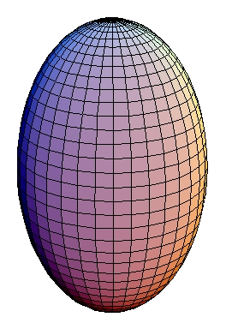
Imagine we lived in a galaxy that was shaped like a cigar, with stars distributed all throughout the cigar. If we lived in the middle of the cigar and looked out at all of the other stars, what would we see?
A. equal number of stars in all directions
B. more stars in one half of the sky and less in the other
C. stars located mostly along a line in the sky
D. stars located mostly in two directions

Slide 14
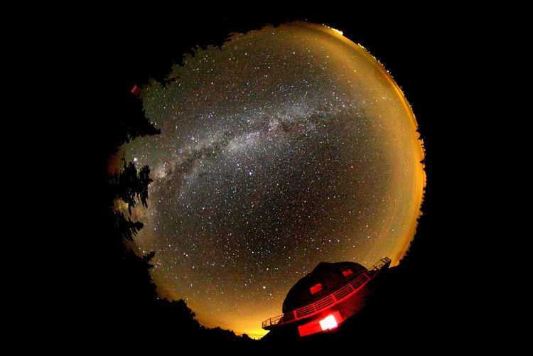
Given this picture of the night sky, what shape do you think our Galaxy is?
A. sphere
B. flattened disk
C. cigar
D. beats me!

Slide 15
Shape of the Milky Way
Most stars in Milky Way found in a thin disk of stars. Sun is located about 2/3rds of the way out
Almost all of the gas and dust are also found in the disk
Open star clusters are found in the disk
A small fraction of stars are found in a roughly spherical halo around the disk.
For some reason, globular clusters are found in the halo

Slide 16
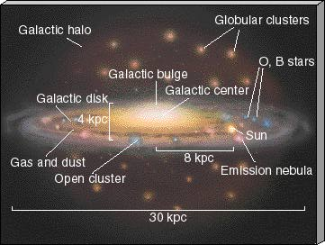
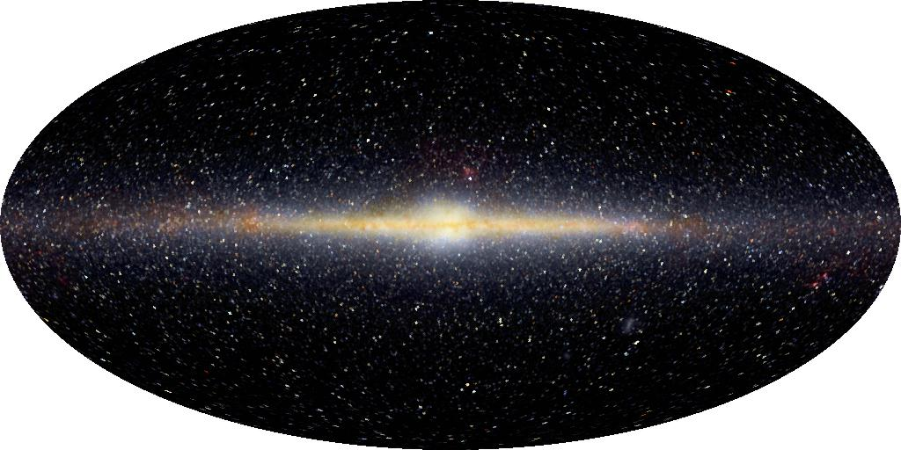

Slide 17
Both Solar System and Milky Way are FLAT

Slide 18
Scale of the Milky Way
OBJECT | DISTANCE FROM SUN
Solar system “size” (Pluto distance) | 6x10¹⁴ cm
Nearby stars | 6x10¹⁸ cm
Center of galaxy | 2x10²² cm
We found that, in a scale model where the Solar System is a disk 25cm in diameter, the nearest stars would be about 2500 m away.
Considering data, about how far would the center of the galaxy be in this scale model?
A. 75 meters
B. 750 meters
C. 7,500 meters
D. 7,500,000 meters
E. totally lost
2x10²² cm / 6x10¹⁴ cm = 0.3x10⁸ = 3x10⁷ =30 million times bigger
So if Solar System is 25cm across in model, center of Galaxy is 75x10⁷ cm = 7500 km away!
If SS is a frisbee, center of galaxy is in Europe!

Slide 19
Motions in the Milky Way
Objects in the Milky Way move
In the disk, stars and interstellar matter revolve around the center of the galaxy in roughly circular orbits, all in the same direction
In the halo, stars and globular clusters move around in higgledy-piggledy orbits, all different shapes and directions!
Periods of orbits are very long: hundreds of millions of years!
Because stars are so far away, over the course of our lifetime, it is very hard to see anything move at all!

Slide 20
Leaving the Milky Way: lots of questions
How do we measure masses, sizes, temperatures, and compositions of stars?
How does the star/gas relationship work? What makes stars form?
Why is the galaxy flat? Why is there a small fraction of the galaxy that is in a halo?
How do we measure motions of stars? Why do the stars move as they do?
Shape and motions provide clues about how the Milky Way formed and evolved

Slide 21
Galaxies in the Universe
The Milky Way is one of billions of galaxies in the Universe
All galaxies are not identical to the Milky Way

Slide 22
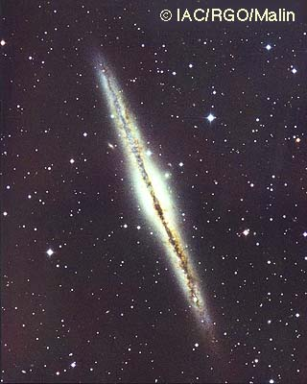
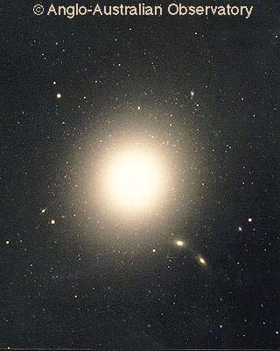
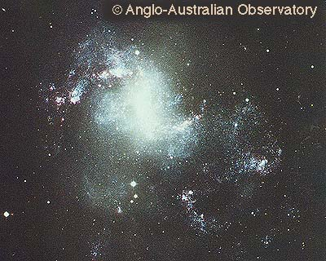
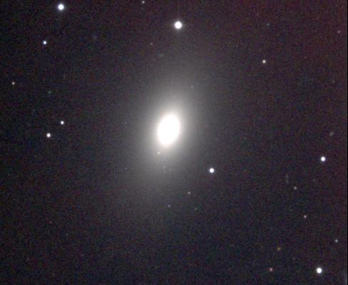
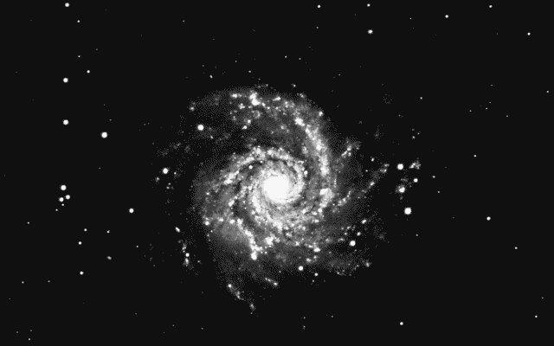
Galaxy shapes
Galaxies come in two basic shapes
Spiral galaxies
Milky Way is a spiral galaxy
Spirals are flat, so what they look like depends on how they are oriented
Like the Milky Way, other spiral galaxies have stars and lots of interstellar matter. Stars are continuously forming and dying
Elliptical galaxies
Elliptical galaxies are not flat, they are big balls of stars
Sometimes the balls are a little squashed, but they’re never flat like spirals
Elliptical galaxies don’t seem to have very much interstellar matter, so new stars are not forming, so most of the stars are old.
Some galaxies don’t fit nicely into either of these two categories, and are called irregular galaxies
Another spiral galaxy: not the Milky Way!

Slide 23
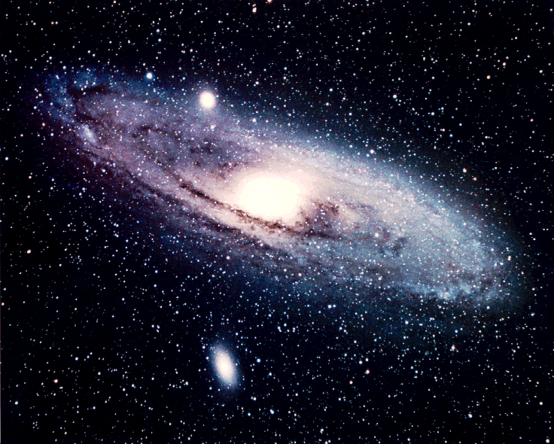
Other galaxy properties
Masses and sizes
Galaxies come in a wide range of masses and sizes
Motions of stars
In spiral galaxies, stars orbit the centers in nearly circular orbits, like the Milky Way disk
In elliptical galaxies, stars orbit the centers in all different directions and different shaped orbits (like the Milky Way halo)

Slide 24
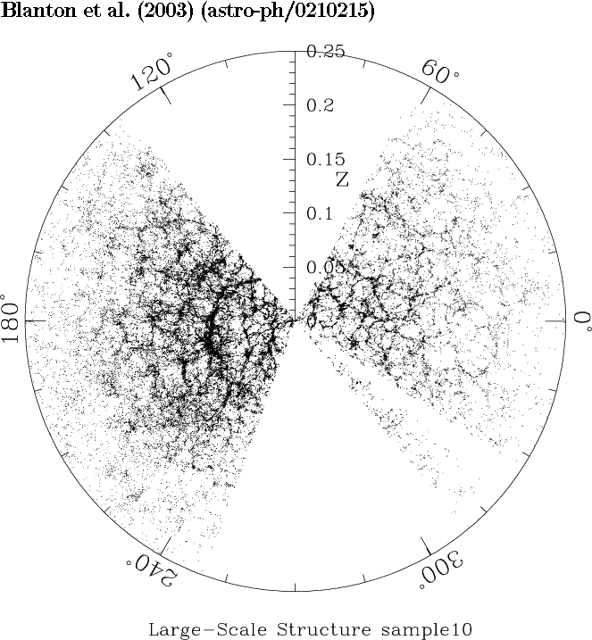
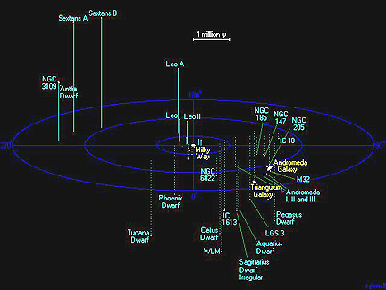
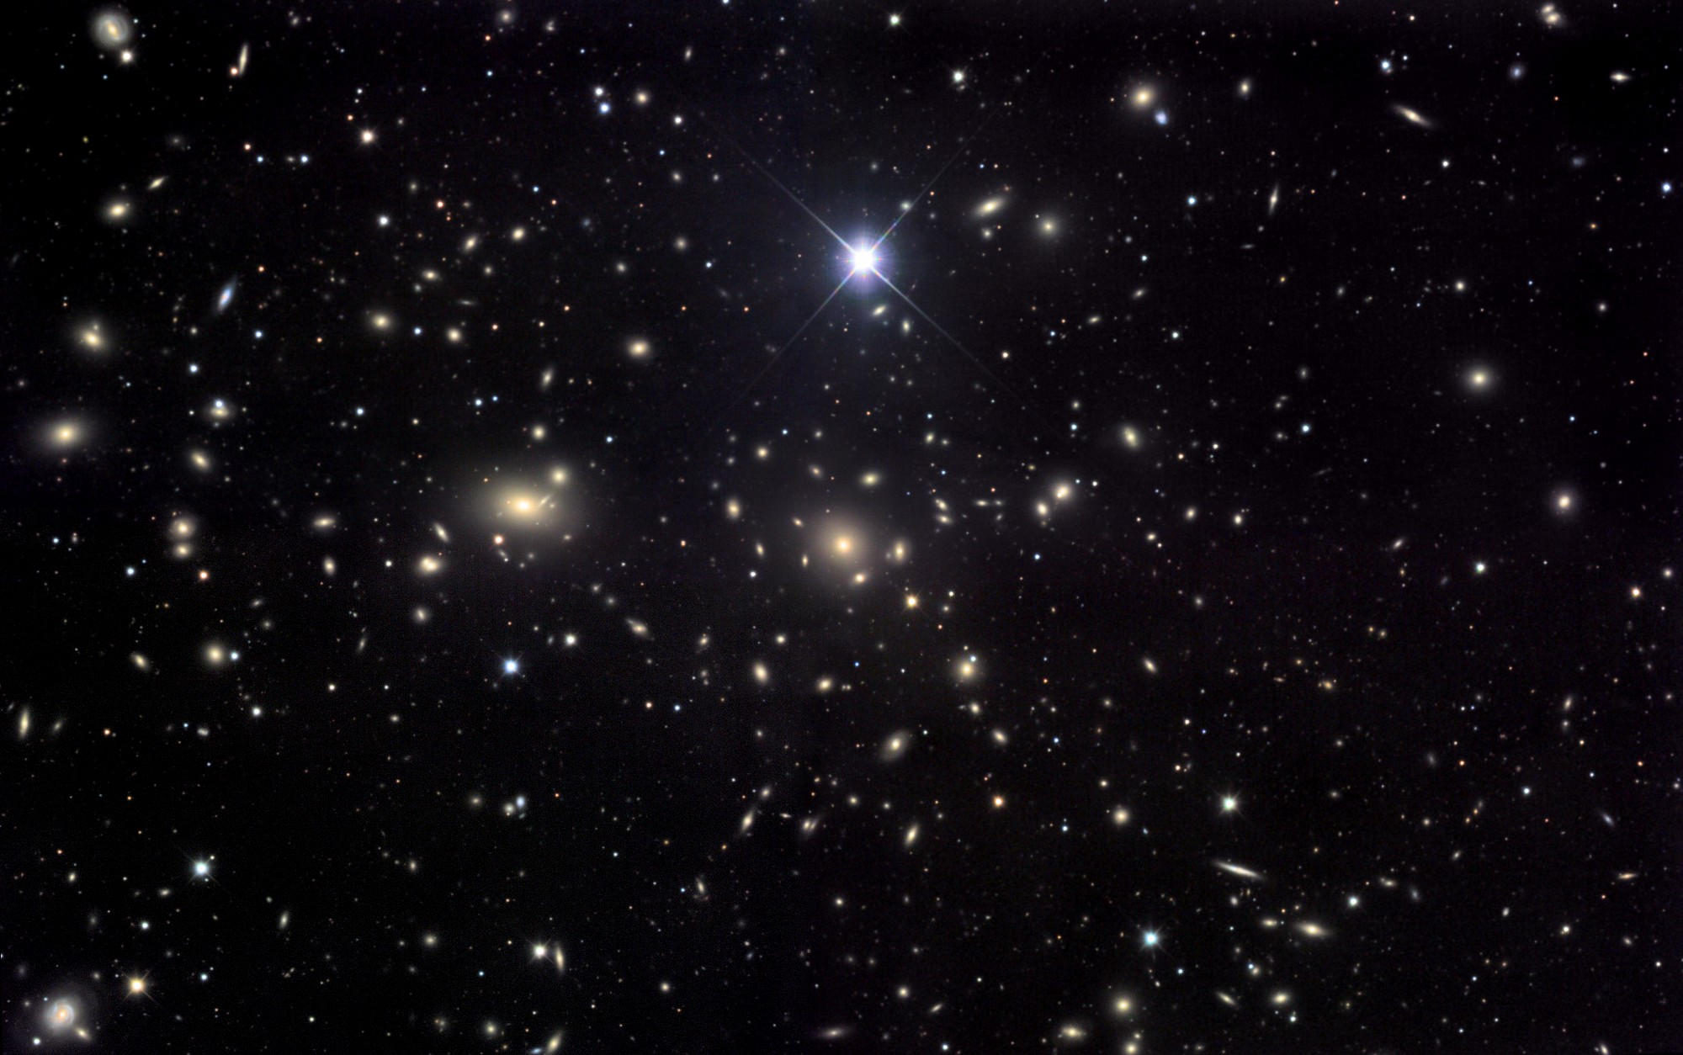
Distribution of galaxies in space
Galaxies are not spread uniformly through space
The Milky Way is in a small group of galaxies called the Local Group
The Local Group has 2 big galaxies, the Milky Way and Andromeda, and a couple of dozen small galaxies
Away from the Milky Way, galaxies are sometimes found as isolated objects, sometimes in small groups (like the Milky Way), and sometimes in large clusters of galaxies
On largest scales, galaxies are located in a “frothy” distribution

Slide 25
To do
Look at the sky!
Can you find the Milky Way?
Star clusters: find the Pleiades
Intrinsically bright stars vs nearby stars: Deneb, Vega, and Altair
Find and read information about the Milky Way

