Slide 1
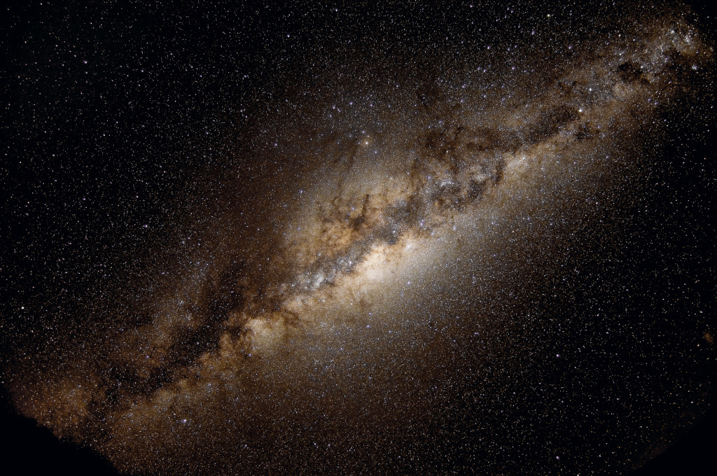
Distances in the Solar System
Solar System in the Milky Way
Stars
Interstellar matter
Shape of the Galaxy

Slide 2
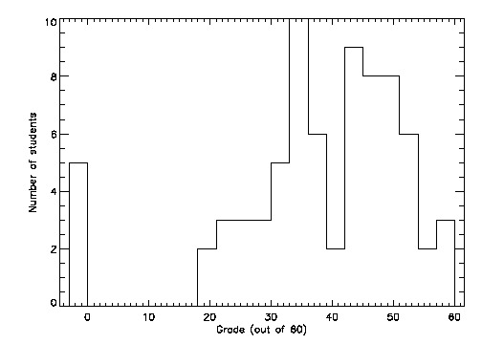
Recap
Midterm results
  Grade histogram
  Course feedback
  Strategies for better grades: class, assignments, resources, read/research
Remember campus observatory!
Solar System
  Masses and sizes of the planets
    Planets come in range of masses and sizes with no super clear relation between location, mass, and size
  Using masses and sizes to learn something about compositions of planets without visiting!
    Two types of planets
      Higher density: rocky, terrestrrial: Mercury, Venus, Earth, Mars
      Lower density: gasieous, Jovian: Jupiter, Saturn, Uranus, Neptune
  Relative sizes of planets

Slide 3
How are the orbits of the planets arranged in our solar system?
The planets are evenly spaced throughout our solar system.
The inner planets are spaced close together while the outer planets are far apart.
C. The inner planets are spaced far apart while the outer planets are close together
There is no trend in the spacing of the planets.
Don’t know
(animation of orbits)

Slide 4
Which of the following statements is FALSE?
All of the eight major planets orbit in the same plane
B. All of the planets orbit around the Sun in the same direction as Earth.
All of the eight planets have orbits that are close (although not perfectly) to circular (although not perfectly)
All of the above statements are true
All of the above statements are false
(animation of orbits)

Slide 5
Today
Compositions and nature of planets
Relative sizes and distances between planets
The Solar System as a member of the Milky Way Galaxy
  Relative distances to nearby stars
  Properties of other stars
  Stuff between the stars
  Shape of the Milky Way

Slide 6
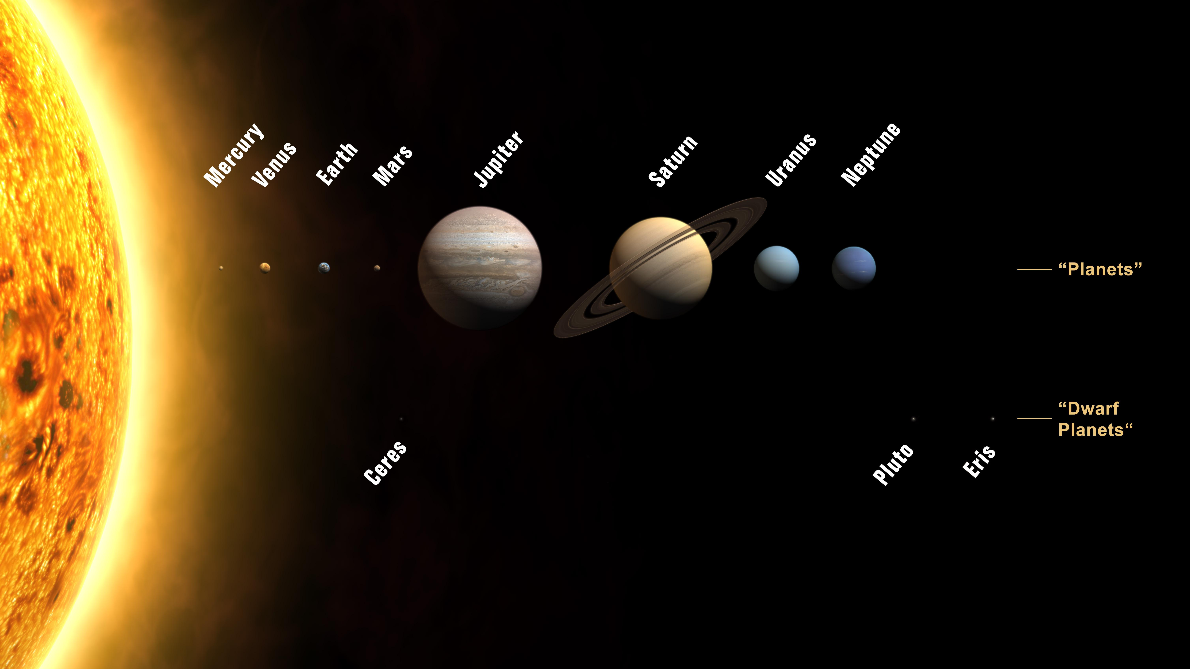
Scale models
To work out a scale model, calculate the relative sizes of two objects by dividing the actual sizes, then multiply model size of one by the relative sizes
In scale model where Sun is a 1m diameter ball, Jupiter and Saturn are about 10cm diameter (softballs), Earth and Venus about 1 cm (marbles), Mercury and Mars (pebbles), Pluto et al (grains of sand to dust)
Can use this to think about distances between objects as well

Slide 7
Relative distances between planets
Sun Diameter | 1.5x10¹¹ cm | 1 m
OBJECT | DISTANCE FROM SUN | Model
Earth | 1.5x10¹³ cm
Jupiter | 8x10¹³ cm
Pluto | 6x10¹⁴ cm
Nearest star | 4x10¹⁸ cm
Considering data, how far would Earth be from the Sun in a scale model where the Sun is a beachball 1m in diameter?
A.10 meters
B.100 meters
C. 200 meters
D. 1000 meters
E. totally lost
1.5x10¹³ cm / 1.5x10¹¹ cm = 10² = 100 x bigger
So if Sun is 1m diameter, earth is 100m away!

Slide 8
Scale model of the Solar System
Sun is beachball 1m in diameter
  Jupiter, Saturn: softballs
  Uranus, Neptune: baseballs
  Earth, Venus: marbles
  Mercury, Mars: pebbles
Distances: put model Sun at the stadium goal line
  Mercury: 40 yd line
  Venus: 70 yd line
  Earth: 100 yds (opposing goal line)
  Mars: 150 yds (1 1/2 football fields)
  Jupiter: 500 yds (5 football fields, Pan Am center)
  Neptune: 3000 yds (~2 miles, Mesilla Valley Mall)
Inner planets are really concentrated near the Sun compared with outer planets: not at all uniform spacing!
The Solar System is mostly empty!!

Slide 9
Leaving the Solar System: still lots of questions!
Why are there eight planets? Why are they spaced the way they are?
Why do planets come in different groups? What determines masses, sizes, and densities?
Why do planets orbit as they do? Why is the Solar System flat?
Answers to these may be framed in the general question: how did the Solar System form and evolve?
  We have theories that address some of these questions, but not all of them!
Perhaps some key clues could come from understanding the properties of other Solar Systems …

Slide 10
The Solar System in the Milky Way
The Solar System is the system of objects associated with the Sun
The Sun is one of billions of other stars in the Milky Way galaxy
Many other stars may have planetary systems, perhaps like ours
Distance to nearest star is MUCH larger than size of the solar system!

Slide 11
Scale model: nearest stars
Considering data, how far would nearest star be in a scale model where the Solar System is a frisbee 25 cm in diameter?
A. 25 meters (1/4 football field)
B. 250 meters (2.5 football fields)
C. 2500 meters (25 football fields)
D. 25000 meters (250 football fields)
E. totally lost
OBJECT | DISTANCE FROM SUN
Solar system “size” (Neptune distance) | 6x10¹⁴ cm
Nearby stars | 6x10¹⁸ cm
6x10¹⁸ cm / 6x10¹⁴ cm = 10⁴ = 10000 x bigger
So if Solar System is 25cm across in model, nearest stars are 25x10⁴ cm = 2500 m = 2.5 km
If entire Solar System is a frisbee,nearest stars are a couple of miles away!
Space is MOSTLY EMPTY!

Slide 12
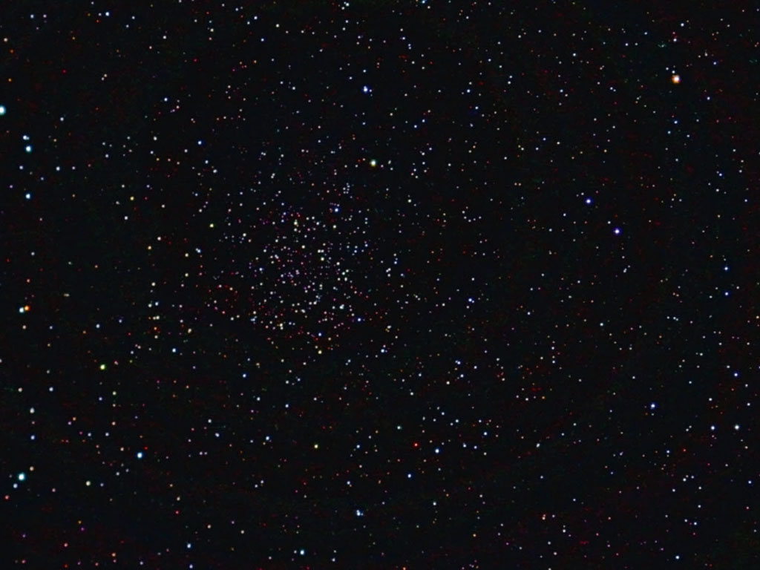
Stars
All of the stars we see in the sky are in the Milky Way galaxy, relatively nearby to us
All stars are NOT the same: looking at a picture, what are some apparent differences?
Stars come in a wide range of brightnesses
  We see stars because they shine (energy from nuclear reactions in their centers, just like the Sun – the Sun is a star!)
  The apparent brightness (how bright it appears to us) depends on how bright the star really shines AND how far away it is
  The intrinsic brightness is how bright the star is really shining. All stars do not have the same intrinsic brightness

Slide 13
A
Which star is the closest?
A. Star A
B. Star B
C. Star C
D. All same distance
E. Can’t tell
B
C

Slide 14
Stars
You can’t tell how far away a star is just by looking at a single picture!
  As a result, you can’t tell about intrinsic brightnesses so easily!
  When you look at bright stars in the sky, you can’t tell if they are bright because they are close, or bright because they are intrinsically very bright!
Stars come in a range of colors
  Color is related to the temperature of the surface of the star: hotter stars are bluer, cooler stars are redder
  Color can also be related to presence of stuff between the stars and us

Slide 15
Stars
Stars come in a range of masses
  Sun is intermediate: most massive stars about 100x mass of Sun, least massive stars about 1/10th mass of Sun
Stars come in range of sizes
  Again, Sun is intermediate. Some larger stars are called giant stars, smaller ones are called dwarfs
  However, measuring size is tricky! Even with biggest telescopes you don’t see stars as “circles”, they are just points because they are so far away!
Most stars have similar compositions to each other
Measuring mass, size, and composition requires some extra observations and understanding! Can’t get these from looking at a single picture!

Slide 16
Stars live and die
Stars evolve:
  they are born, live their lives, and die
  Properties of stars (temperatures and sizes in particular) evolve over their lifetimes
  Lifetimes are long: millions to billions of years. So we don’t usually directly see too much of the evolution! But we do see lots of stars at different stages of evolution!

Slide 17
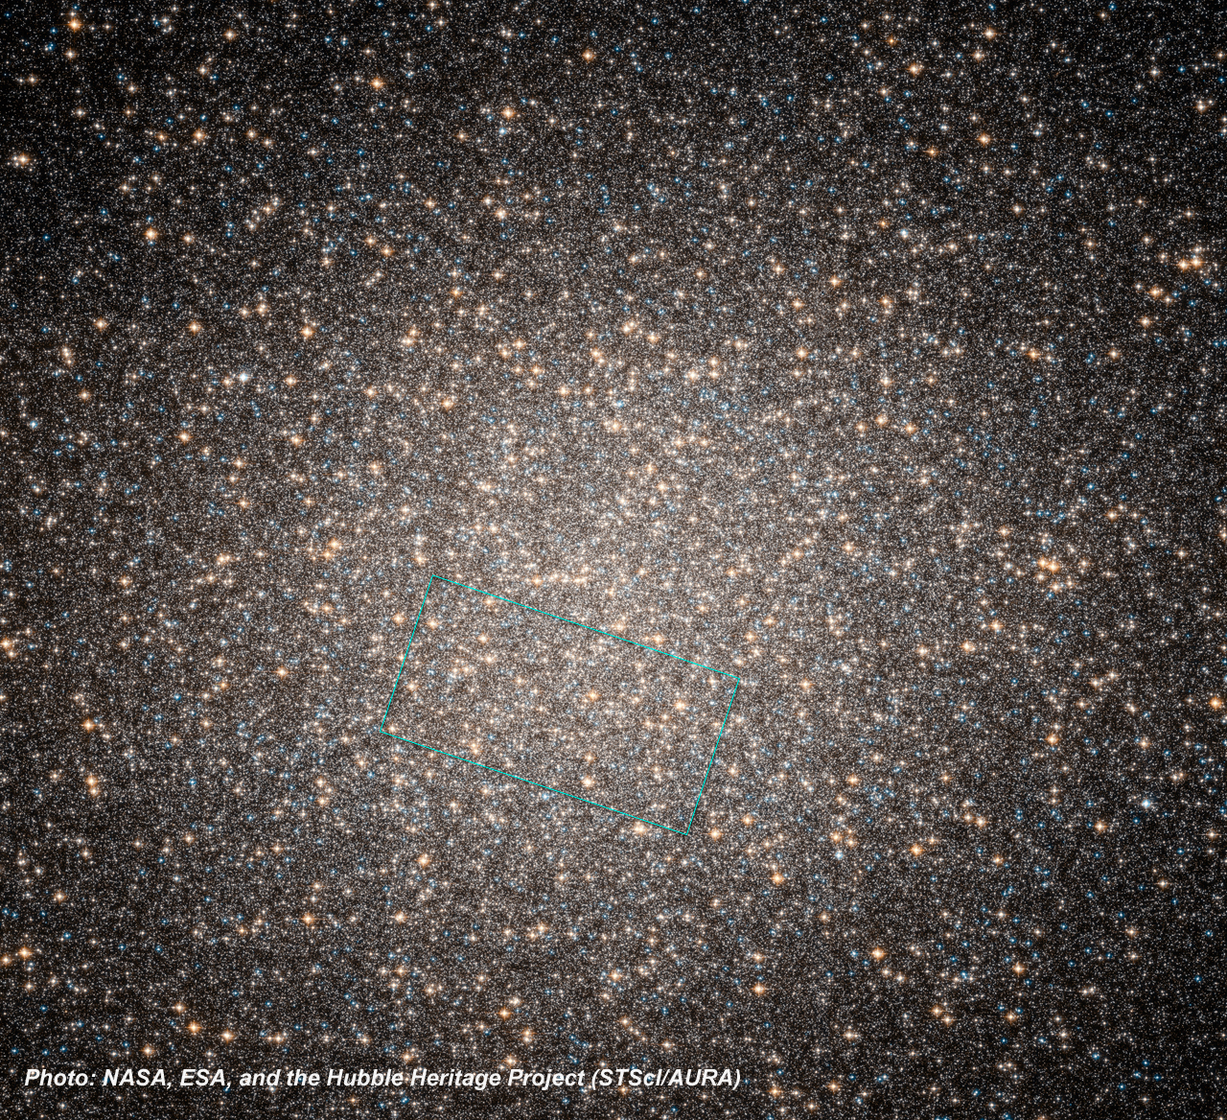
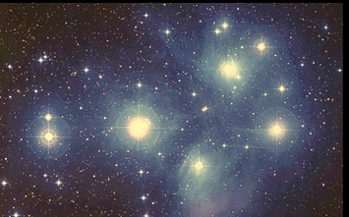
Stars in space
Not all stars are isolated from each other, like the Sun is
Many stars exist as binary stars, two stars that orbit each other
  Binary stars are very important to astronomy, as they are how we measure masses of stars
Some stars come as triples, quadruples, or more
Some stars come in clusters, with hundreds to millions of stars grouped together in space
  Two general types of clusters
  Open clusters have fewer stars (hundreds to thousands) and are more spread out
  Globular clusters have more stars (thousands to millions) and the stars are more closely packed
  Clusters are very important to astronomy, because they allow us to measure relative intrinsic brightnesses of stars, since all stars in a cluster are at the same distance from us. They are also important because it turns out that all stars in a given cluster have the same age

Slide 18
This is a star cluster (the Pleiades). Let’s say all of these stars are in the cluster (most of them are!)
Which star is intrinsically the brightest?
A. Star A
B. Star B
C. Star C
D. All same brightness
E. Can’t tell
B
A
C

Slide 19
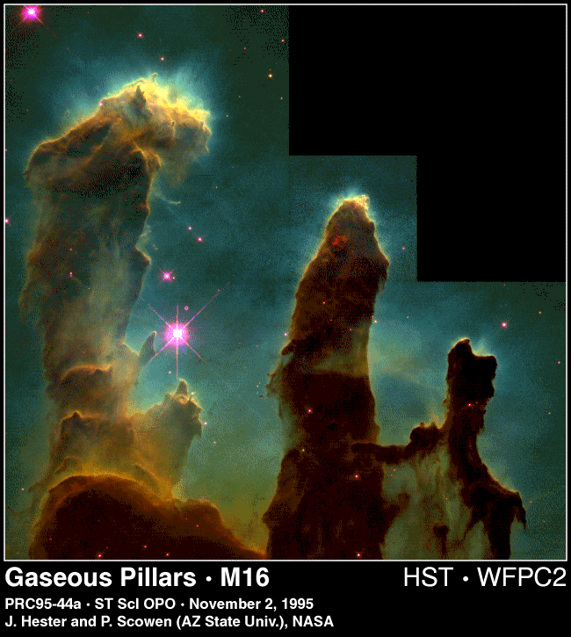
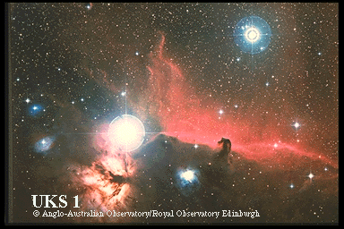
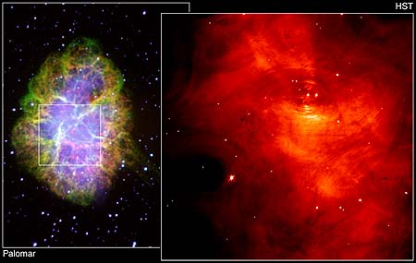
Stuff between the stars
In the Milky Way, there is also stuff between the stars, often called interstellar matter
  Two main components: gas and dust
  Interstellar clouds are often called nebulae
Interstellar clouds have symbiotic relation with the stars of the galaxy
  Stars form from interstellar clouds
  When stars die, they eject some or all of their material back into the interstellar medium

Slide 20
The Milky Way
The Sun is a member of a very large group of stars (over a billion!) that make up the Milky Way Galaxy
What is the shape of the Milky Way?
Tricky to get the shape of the Milky Way, because we live inside it, and it’s WAY too big to send something outside to look back at it!

Slide 21
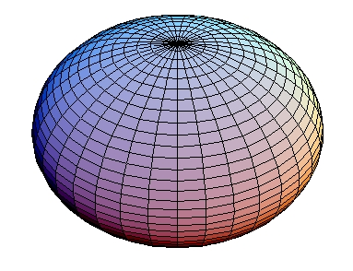
Thought experiment
Imagine we lived in a galaxy that was shaped like a sphere, with stars distributed all throughout the sphere. If we lived in the middle of the sphere and looked out at all of the other stars, what would we see?
A. equal number of stars in all directions
B. more stars in one half of the sky and less in the other
C. stars located mostly along a line in the sky
D. stars located mostly in two directions

Slide 22
Imagine we lived in a galaxy that was shaped like a flattened disk, with stars distributed all throughout the disk. If we lived in the middle of the disk and looked out at all of the other stars, what would we see?
A. equal number of stars in all directions
B. more stars in one half of the sky and less in the other
C. stars located mostly along a line in the sky
D. stars located mostly in two directions

Slide 23
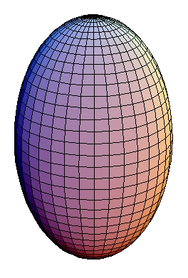
Imagine we lived in a galaxy that was shaped like a cigar, with stars distributed all throughout the cigar. If we lived in the middle of the cigar and looked out at all of the other stars, what would we see?
A. equal number of stars in all directions
B. more stars in one half of the sky and less in the other
C. stars located mostly along a line in the sky
D. stars located mostly in two directions

Slide 24
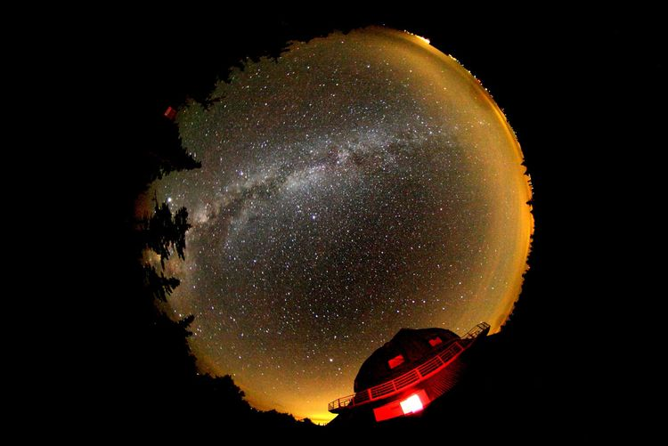
Given this picture of the night sky, what shape do you think our Galaxy is?
A. sphere
B. flattened disk
C. cigar
D. beats me!

Slide 25
Shape of the Milky Way
Most stars in Milky Way found in a thin disk of stars. Sun is located about 2/3rds of the way out
  Almost all of the gas and dust are also found in the disk
  Open star clusters are found in the disk
A small fraction of stars are found in a roughly spherical halo around the disk.
  For some reason, globular clusters are found in the halo

Slide 26
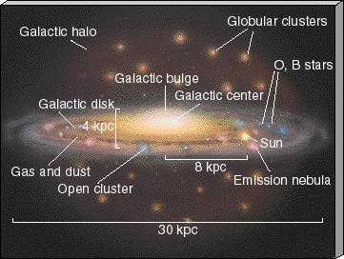
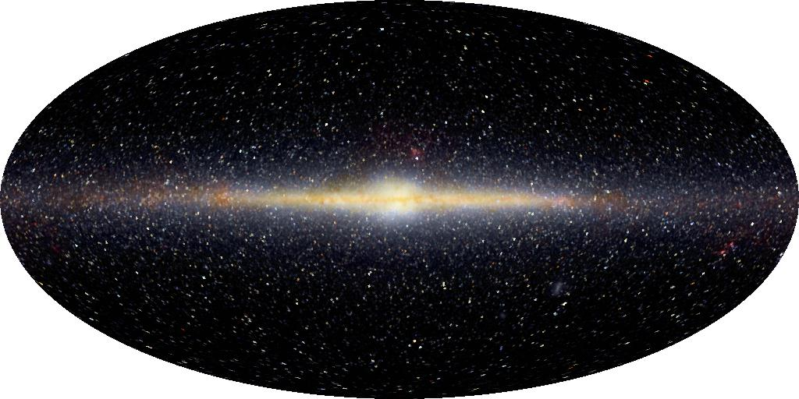

Slide 27
To do
Find and read information about the shape and contents of the Milky Way

