Slide 1
Solar System: Types of planets Sizes and distances in the Solar System

Slide 2
Recap
The Solar System
Finding faint solar system objects: moving objects
The “new” Solar System: many objects, especially objects past Neptune
Pluto appears to be one of these
Collisions between objects
“shooting stars”
Collisions as important events on Earth
Lab this week: shaping surfaces in the Solar System

Slide 3
Properties of planets: Masses, sizes and compositions
Difference between mass and size
Mass measures how much of something there is: on Earth, we often use mass and weight interchangeably, but they’re not quite the same thing
Size measures how big it is across
Sun is by far most massive and biggest of solar system objects!
Both masses and sizes can be measured by observing planets (masses if they have something orbiting them, like moons)

Slide 4
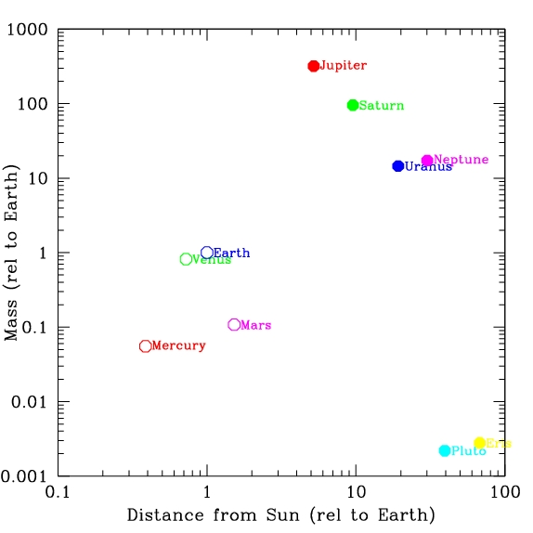
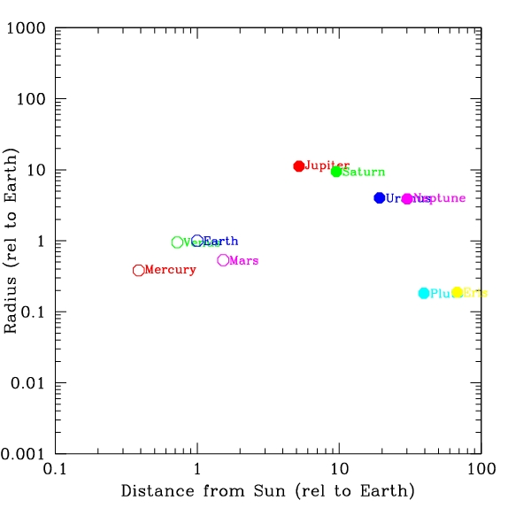
Data on masses and sizes
Planet | Mass (rel to Earth) | Size (rel to Earth)
Mercury | 0.055 | .0.382
Venus | 0.815 | .949
Earth | 1.00 | 1.0
Mars | 0.1.07 | 0.533
Jupiter | 317.9 | 11.19
Saturn | 95.18 | 9.46
Uranus | 14.54 | 3.98
Neptune | 17.13 | 3.81
Pluto | 0.0022 | 0.18
Eris | 0.0028 | 0.22
Are there any clear patterns?

Slide 5
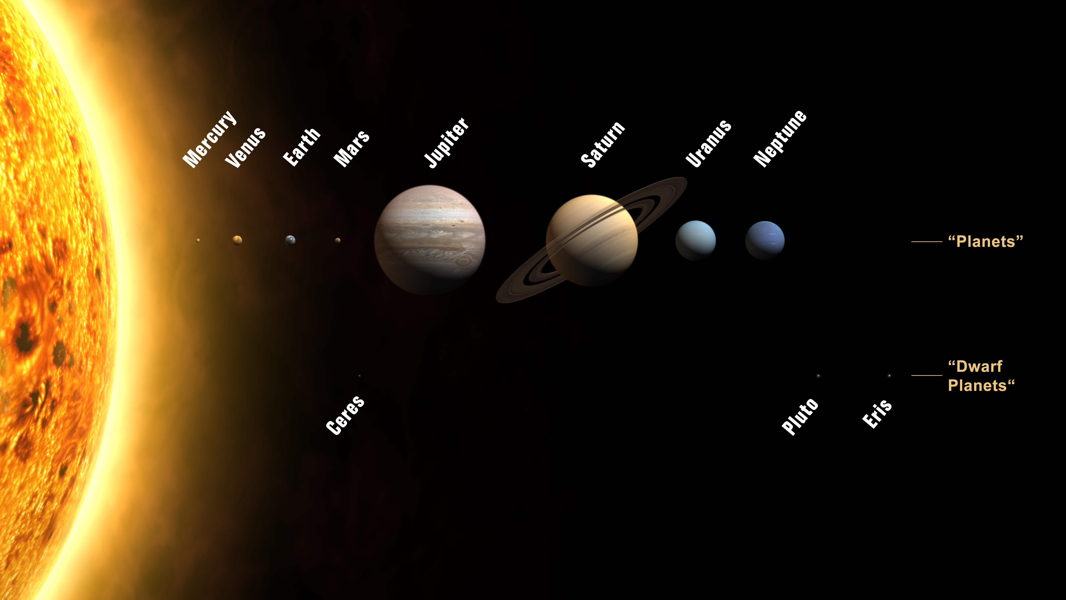
Compositions of planets: quick checks
Is there an easy way to tell if planets are all made of about the same stuff?
Consider a cube. As it gets bigger, how much more stuff is in it?
If two objects are made of the same stuff, the mass is related to the size
How about a planet, which have spherical shapes?
Imagine two planets, A and B, that are made of the same type of material. Planet A has twice the radius of planet B (and so has more material). How would you expect their masses to compare?
A. if the radius of planet A is twice as big as B, the mass would be twice as big
B. if the radius of planet A is twice as big as B, the mass would be 2² = 4 times as big, because the surface area goes as the radius squared (4 π R²)
C. if the radius of planet A is twice as big as B, the mass would be 2³ = 8 times as big, because the volume goes as the radius cubed (4/3 π R³⁾
D. they would have the same mass
E. totally lost

Slide 6
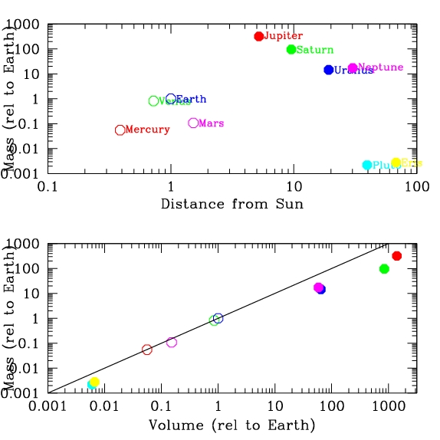
Are planets made of the same stuff?
Top plot shows the masses of the planets as a function of their distance from the Sun. Bottom plot shows the masses of the planets as a function of their volume; note that the points are no longer ordered by distance from the Sun, but the color coding is the same as in the top plot. The line shows where objects would fall if their masses were directly proportional to their volumes.
Considering the bottom plot, do you think all of the planets are made of the same material? If not, which planets appear to have the most different compositions?
A. seems like all planets are made of the same material
B. seems like the outer planets are more massive than you'd expect given their size/volume
C. seems like the outer planets are less massive than you'd expect given their volume
D. can't tell at all from information given
E. no idea what you’re talking about

Slide 7
Density
The combination of mass and volume of an object gives the density of the object, which is a measure of how “compact” material is
density = mass / volume
Density is useful because it’s relatively easy to calculate and because it can be used to get a rough idea about compositions:
Objects made of similar material should have similar density, so if objects differ significantly in density, they are most likely made of different material
Different materials can have similar densities, so if objects have the same density, you can’t know for sure what they are made of

Slide 8
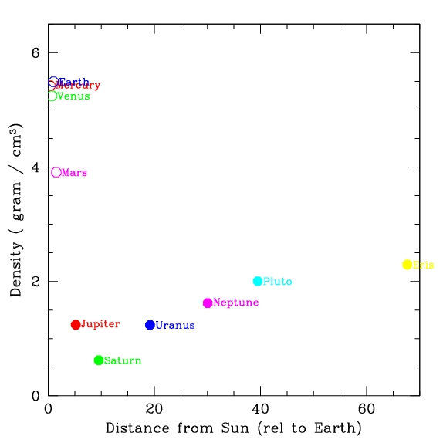
Different types of planets!
Mercury, Venus, Earth, Mars
higher density
rocky composition
“terrestrial” planets
Jupiter, Saturn, Uranus, Neptune
lower density
gaseous composition: no hard surface!
“Jovian” planets
Pluto, Eris, other TNOs?
intermediate density
rock/ice composition

Slide 9
Sizes and distances in the Solar System: Scale models
Useful way to get good feeling of relative sizes and distances of objects is to consider a “scale model”
Imagine a model solar system where the Sun is a beach ball, 1 meter in diameter
How big would the Earth be in this model?
A. basketball
B. softball
C. marble
D. grain of sand
E. totally lost!
OBJECT | RADIUS
Sun | 7x10¹⁰ cm
Earth | 6x10⁸ cm
Jupiter | 7x10⁹ cm
Pluto | 1x10⁸ cm
Sun relative to Earth:
(7x10¹⁰) / (6x10⁸) ~ 10² = 100 times bigger
So if Sun is 1m (=100cm), Earth is 1 cm!

Slide 10
Scale models
To work out a scale model, calculate the relative sizes of two objects by dividing the actual sizes, then multiply model size of one by the relative sizes
In scale model where Sun is a 1m diameter ball, Jupiter and Saturn are about 10cm diameter (softballs), Earth and Venus about 1 cm (marbles), Mercury and Mars (pebbles), Pluto et al (grains of sand to dust)
Can use this to think about distances between objects as well

Slide 11
Relative distances between planets
Considering data, how far would Earth be from the Sun in a scale model where the Sun is a beachball 1m in diameter?
A.10 meters
B.100 meters
C. 200 meters
D. 1000 meters
E. totally lost
Sun diameter: 1.5x10¹¹ cm
OBJECT | DISTANCE FROM SUN
Earth | 1.5x10¹³ cm
Jupiter | 8x10¹³ cm
Pluto | 6x10¹⁴ cm
Nearest star | 4x10¹⁸ cm
1.5x10¹³ cm / 1.5x10¹¹ cm = 10² = 100 x bigger
So if Sun is 1m diameter, earth is 100m away!

Slide 12
Scale model of the Solar System
Sun is beachball 1m in diameter
Jupiter, Saturn: softballs
Uranus, Neptune: baseballs
Earth, Venus: marbles
Mercury, Mars: pebbles
Distances: put model Sun at the stadium goal line
Mercury: 40 yd line
Venus: 70 yd line
Earth: 100 yds (opposing goal line)
Mars: 150 yds (1 1/2 football fields)
Jupiter: 500 yds (5 football fields, Pan Am center)
Neptune: 3000 yds (~2 miles, Mesilla Valley Mall)
The Solar System is mostly empty!!

Slide 13
Leaving the Solar System: still lots of questions!
How do we measure masses, sizes, and distances?
Why are there eight planets? Why are they spaced the way they are?
Why do planets come in different groups? What determines masses, sizes, and densities?
Why do planets orbit as they do? Why is the Solar System flat?
Answers to these may be framed in the general question: how did the Solar System form and evolve?

Slide 14
How are the orbits of the planets arranged in our solar system?
The planets are evenly spaced throughout our solar system.
The inner planets are spaced close together while the outer planets are far apart.
C. The inner planets are spaced far apart while the outer planets are close together
There is no trend in the spacing of the planets.
Don’t know
(animation of orbits)

Slide 15
Which of the following statements is FALSE?
All of the eight major planets orbit in the same plane
B. All of the planets orbit around the Sun in the same direction as Earth.
All of the eight planets have orbits that are close (although not perfectly) to circular (although not perfectly)
All of the above statements are true
All of the above statements are false
(animation of orbits)

Slide 16
The Solar System in the Milky Way
The Solar System is the system of objects associated with the Sun
The Sun is one of billions of other stars in the Milky Way galaxy
Many other stars may have planetary systems, perhaps like ours
Distance to nearest star is MUCH larger than size of the solar system!

Slide 17
Scale model: nearest stars
Considering data, how far would nearest star be in a scale model where the Solar System is a frisbee 25 cm in diameter?
A. 25 meters (1/4 football field)
B. 250 meters (2.5 football fields)
C. 2500 meters (25 football fields)
D. 25000 meters (250 football fields)
E. totally lost
OBJECT | DISTANCE FROM SUN
Solar system “size” (Neptune distance) | 6x10¹⁴ cm
Nearby stars | 6x10¹⁸ cm
6x10¹⁸ cm / 6x10¹⁴ cm = 10⁴ = 10000 x bigger
So if Solar System is 25cm across in model, nearest stars are 25x10⁴ cm = 2500 m = 2.5 km
If entire Solar System is a frisbee,nearest stars are a couple of miles away!
Space is MOSTLY EMPTY!

Slide 18
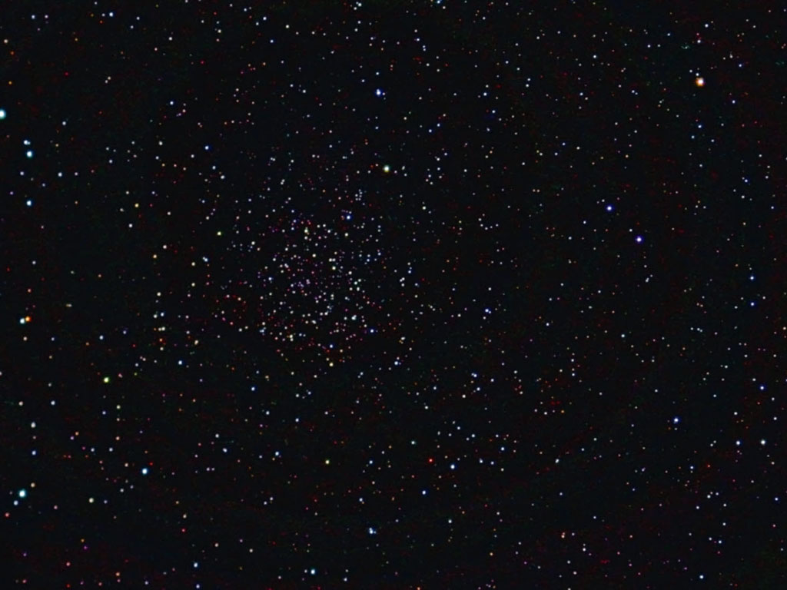
Stars
All of the stars we see in the sky are in the Milky Way galaxy, relatively nearby to us
All stars are NOT the same: looking at a picture, what are some apparent differences?
Stars come in a wide range of brightnesses
We see stars because they shine (energy from nuclear reactions in their centers, just like the Sun – the Sun is a star!)
The apparent brightness (how bright it appears to us) depends on how bright the star really shines AND how far away it is
The intrinsic brightness is how bright the star is really shining. All stars do not have the same intrinsic brightness

Slide 19
A
Which star is the closest?
A. Star A
B. Star B
C. Star C
D. All same distance
E. Can’t tell
B
C

Slide 20
Stars
You can’t tell how far away a star is just by looking at a single picture!
As a result, you can’t tell about intrinsic brightnesses so easily!
When you look at bright stars in the sky, you can’t tell if they are bright because they are close, or bright because they are intrinsically very bright!
Stars come in a range of colors
Color is related to the temperature of the surface of the star: hotter stars are bluer, cooler stars are redder
Color can also be related to presence of stuff between the stars and us

Slide 21
Stars
Stars come in a range of masses
Sun is intermediate: most massive stars about 100x mass of Sun, least massive stars about 1/10th mass of Sun
Stars come in range of sizes
Again, Sun is intermediate. Some larger stars are called giant stars, smaller ones are called dwarfs
However, measuring size is tricky! Even with biggest telescopes you don’t see stars as “circles”, they are just points because they are so far away!
Most stars have similar compositions to each other
Measure mass, size, and composition requires some extra observations and understanding! Can’t get these from looking at a single picture!

Slide 22
To do

