Slide 1
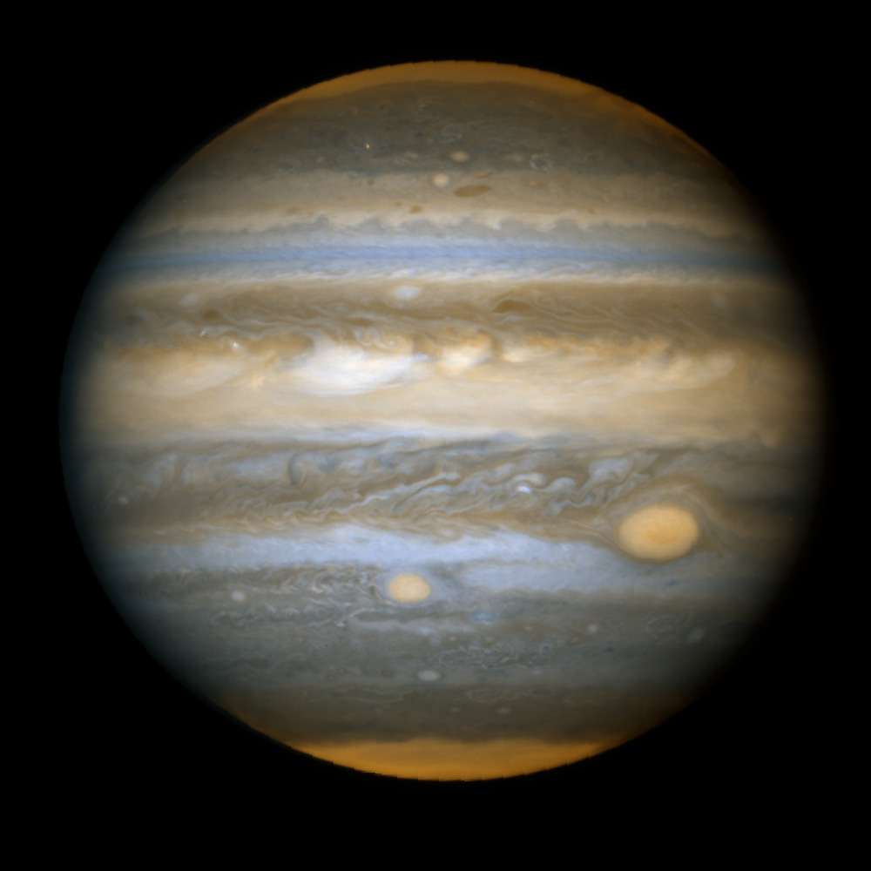
Solar System

Slide 2
Recap
Canvas assignment due
MIDTERM on Friday
III. Overview of the Universe
Our place in the Universe: our universal “address”
The Solar System
  Contents: Sun, planets, moons, asteroids, comets
  How we see Solar System objects and factors that affect their brightness of Solar Systems objects
  Challenges in finding new Solar System objects: apparent brightnesses and sizes of objects

Slide 3
Which of the following lists of objects is sorted correctly from smallest to largest object?
A. Jupiter, Earth, Solar System, Milky Way Galaxy, galaxy clusters
B. Earth, Jupiter, Milky Way Galaxy, Solar System, galaxy clusters
C. Earth, Jupiter, Solar System, galaxy clusters, Milky Way Galaxy
D. Earth, Jupiter, Solar System, Milky Way Galaxy, galaxy clusters
E. Earth, Jupiter, Milky Way Galaxy, galaxy clusters, Solar System

Slide 4
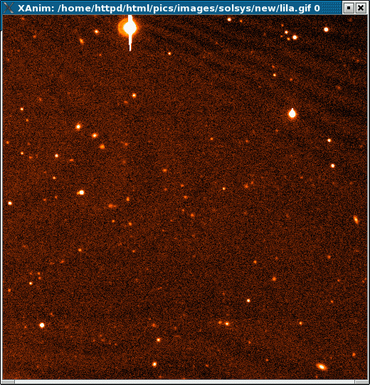
How can we find new Solar System objects?

Slide 5
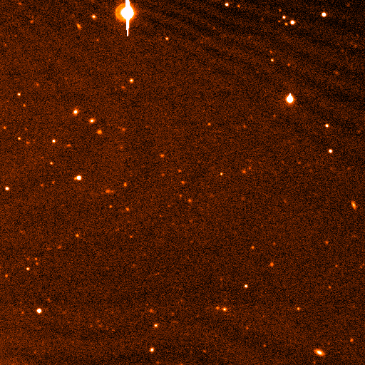
Motions of astronomical objects
Astronomical objects move through space
  The rate at which they appear to move depends on how fast they are actually moving but also on how far away they are
  It also depends on what direction they are moving (hard to tell if something is coming directly towards you or going directly away from you by looking for motion!)
Almost all objects are so far away that we can only barely, if at all, detect this motion over the course of our lifetime
Solar system objects are an exception: planets go around the Sun on timescales of years or decades!
Which is the new dwarf planet?

Slide 6
Solar system objects can be detected because they move relative to distant objects
These are discovery pictures for a distant dwarf planet, called Eris!

Slide 7
Today
The Solar System
Motions/orbits
Shape of the solar system
Properties of planets: masses and sizes
Are planets all made of the same stuff?
Scale models: size and distances in the Solar System
Lab this week: Shaping Surfaces in the Solar System : Comets, Asteroids, and Craters

Slide 8
Orbits of solar system objects
Detecting motions of faint objects has allowed us to discover many objects in orbit around the Sun!
Objects are found at ranges of different distances from the Sun
Many orbits are close to circular, but some aren’t!
See animated map of solar system object
  Note “Main belt” asteroids between Mars and Jupiter
  Many objects outside the orbit of Neptune

Slide 9
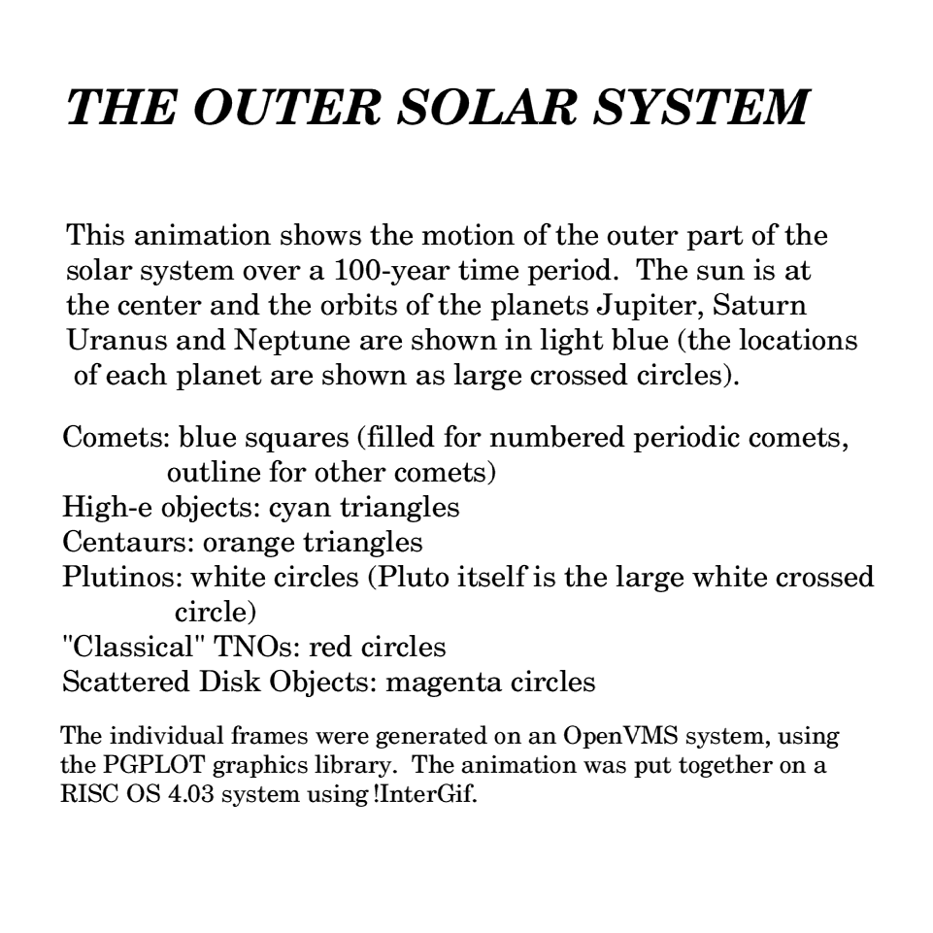
Orbital periods
Is there a relation between the time it takes an object to go around the Sun (its period) and the distance it is from the Sun? If so, why?
Looking at the animation, which statement best fits the observed data?
A. all solar system objects take about the same time to orbit the Sun
B. objects that are farther from the Sun take longer because they have farther to go, but they move at about the same speed as closer objects
C. Objects that are farther from the Sun take longer to go around, both because they have farther to go and because they move slower
D. different objects take different amounts of time to go around, but there’s no correlation with distance from the Sun

Slide 10
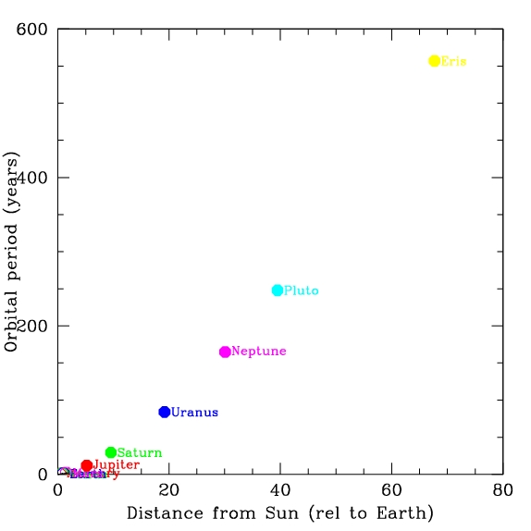
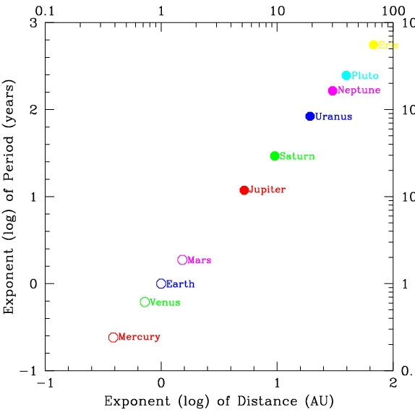
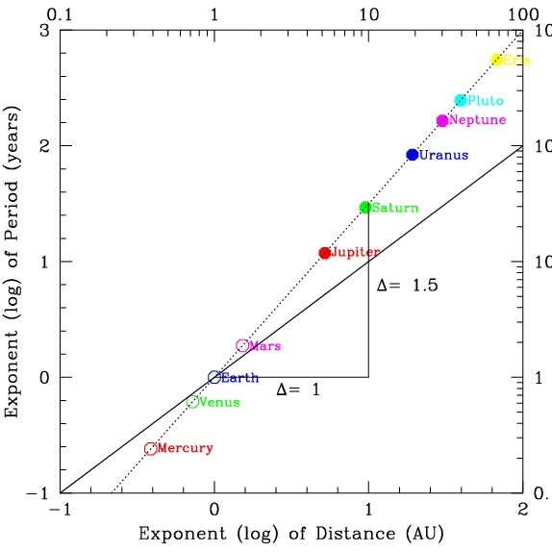
Orbital period data
Can we make a model for the relation between period and distance?
Let’s graph the data
  Note that uncertainties in period and distance are very small!
  Hard to see all data, but note that relation is NOT linear
Linear (additive) graphs vs. logarithmic (multiplicative) graphs
  There is a clear relation!
In a logarithmic plot, a straight line represents a kind of relation called a power law
  y = A x^{n}
  where the slope of the line gives
  the exponent n, so here:
  Period = A (distance) ^{1.5}
  The constant A just depends on what units you use, so is perhaps less “interesting”, so we might say: Period is proportional to distance to the 1.5 power
  P α d ^{1.5}

Slide 11
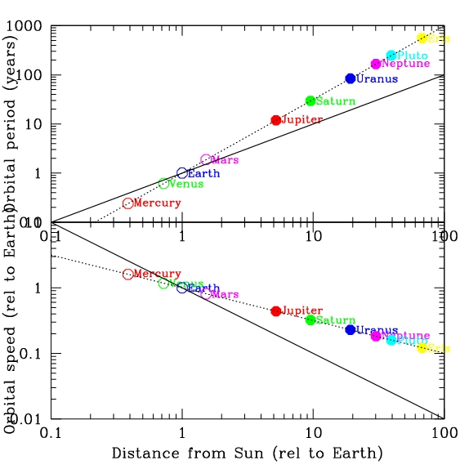
Using a model to make predictions
What is the typical distance of main belt asteroids from the Sun? The distance from the Earth to the Sun is defined as one astronomical unit (a.u.)
1 a.u.
2 a.u.
3 a.u.
5 a.u.
10 a.u.
How long would you predict it takes a main belt asteroid to orbit the Sun?
A. 1 year
B. 3 years
C. 5 years
D. 10 years
E. 20 years
Orbital period of Ceres (largest main belt asteroid) is 4.6 years

Slide 12
Orbital period data
There is a very tight relation between average distance from the Sun, orbital period, and orbital speed
While there is a clear relation, it is not a “linear” relation, I.e. at twice the distance from the Sun, it is not twice the period
Clearly, you could make a good model from this, and make predictions for periods of newly discovered solar system objects
  Period proportional to d^{1.5}
  Speed proportional to d^{-0.5}
Kepler’s laws apply to ALL solar system objects (not just planets)
Is there a theory that explains why?
  YES! GRAVITY!

Slide 13
Shapes and inclinations of orbits
See animation of planetary orbits
Most planetary orbits are close to circles (but not quite, note Mars and Mercury in particular)
Pluto and Eris are distinctly non-circular
Most objects orbit in the same plane
  Again, Pluto and Eris stand apart

Slide 14
Shape of the solar system
Even though most of the solar system is empty, we can consider the shape that the objects within it take up as they move around the Sun. Given the animations you’ve seen, what’s the shape of the Solar System (not the shape of the planets!), considering only the planets out to Neptune?
A. Spherical (like a ball)
B. Cubical (like a dice)
C. Flat and square (like a baseball base)
D. Flat and round (like a frisbee)
E. Irregular
The solar system is largely flat. Raises the question: Why?

Slide 15
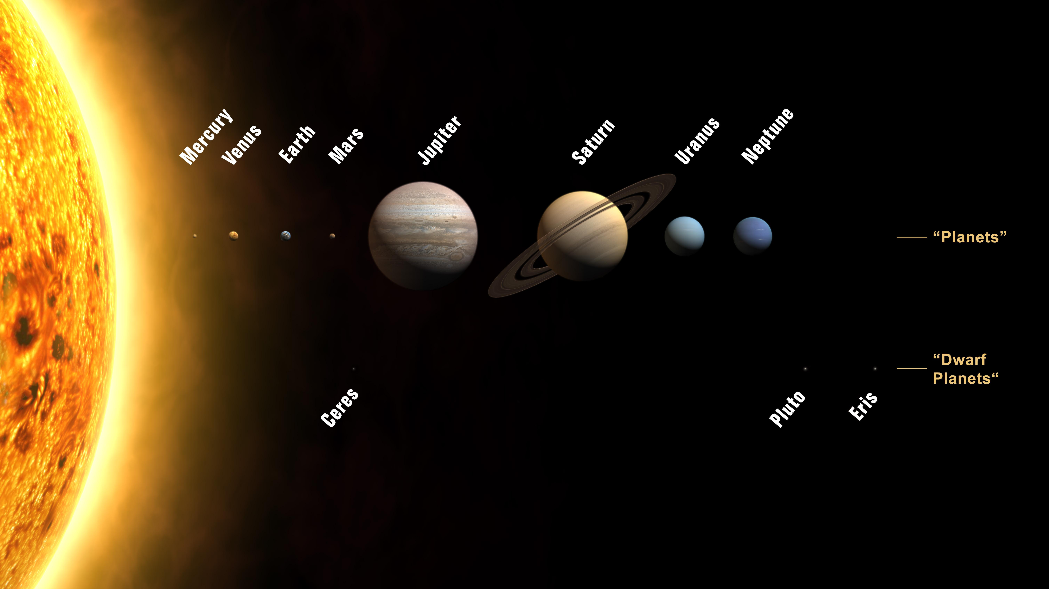
The New Solar System
With bigger telescopes and improved technology, we’ve continued to discover more solar system objects. Not suprisingly, we’re finding fainter ones that hadn’t been seen before. These are mostly far out in the Solar System, beyond the orbit of Neptune
Many of the new objects have orbits that have a lot of similarities to Pluto, like Eris
This previously undiscovered class of objects are called Kuiper belt objects (after someone who predicted their existence) or trans-Neptunian objects (TNOs). Their compositions appear to be more like comets than like the other planets
Based on these discoveries, it appears that Pluto is one of this group of objects.
People wonder about how the different groups of objects form in the solar system, and it’s possible that the bigger planets form in a different way than the TNOs
This had led some people to want to change the classification of Pluto from a planet to something else, to help use classification to understand things about the Solar System
  Some people object to this!
  In any case, Pluto is still there, with the same properties we’ve always known about! At some level, the debate about whether we should call it a “planet” isn’t really part of science, it’s just a name! The science is in understanding the nature of objects and how and why they got there

Slide 16
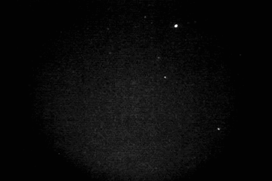
Collisions in the Solar Systemq
Given that there’s a lot of small objects in the Solar System (asteroids, comets, Kuiper belt objects) and that all orbits aren’t perfect circles, different orbits can intersect, leading to collisions between objects
Most of the collisions that a planet experiences are with very small objects, since they are by far the most common
When small asteroids (meteoroids) hit the Earth, the friction as they move through the Earth’s atmosphere causes them to burn up
  We see these as “shooting stars” (but that’s a pretty bad name for them!)
  Bigger meteoroids can survive down to the Earth’s surface, and be found as meteorites
  Biggest ones over the history of the Earth may have had major impact on Earth’s history!
Impacts are an important phenomenon that effect surfaces of Solar System objects, especially those without atmospheres
  Impacts were probably much more common shortly after the Solar System was formed, when there was more material around
  Craters can be used to estimate relative ages of some surfaces

Slide 17
Properties of planets:
Masses, sizes and compositions
Difference between mass and size
  Mass measures how much of something there is: on Earth, we often use mass and weight interchangeably, but they’re not quite the same thing
  Size measures how big it is across
  Sun is by far most massive and biggest of solar system objects!
Both masses and sizes can be measured by observing planets (masses if they have something orbiting them, like moons)

Slide 18
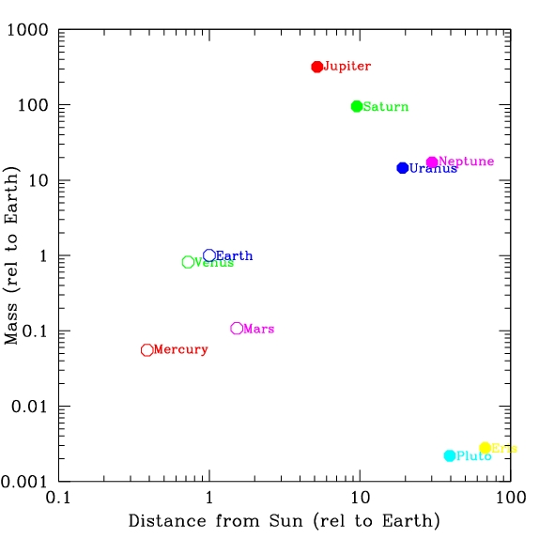
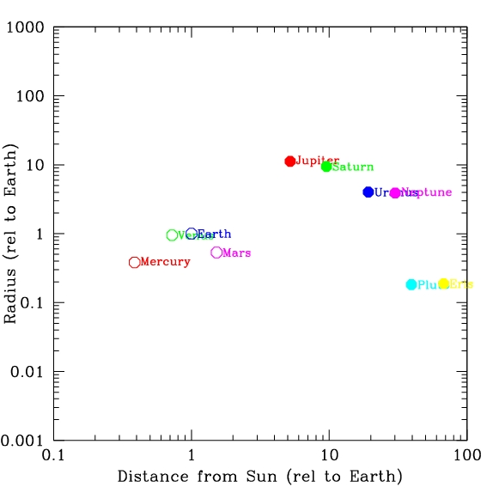
Data on masses and sizes
Planet | Mass (rel to Earth) | Size (rel to Earth)
Mercury | 0.055 | .0.382
Venus | 0.815 | .949
Earth | 1.00 | 1.0
Mars | 0.1.07 | 0.533
Jupiter | 317.9 | 11.19
Saturn | 95.18 | 9.46
Uranus | 14.54 | 3.98
Neptune | 17.13 | 3.81
Pluto | 0.0022 | 0.18
Eris | 0.0028 | 0.22
Are there any clear patterns?

Slide 19
Compositions of planets: quick checks
Is there an easy way to tell if planets are all made of about the same stuff?
Consider a cube. As it gets bigger, how much more stuff is in it?
  If two objects are made of the same stuff, the mass is related to the size
How about a planet, which have spherical shapes?
Imagine two planets, A and B, that are made of the same type of material. Planet A has twice the radius of planet B (and so has more material). How would you expect their masses to compare?
A. if the radius of planet A is twice as big as B, the mass would be twice as big
B. if the radius of planet A is twice as big as B, the mass would be 2² = 4 times as big, because the surface area goes as the radius squared (4 π R²)
C. if the radius of planet A is twice as big as B, the mass would be 2³ = 8 times as big, because the volume goes as the radius cubed (4/3 π R³⁾
D. they would have the same mass
E. totally lost

Slide 20
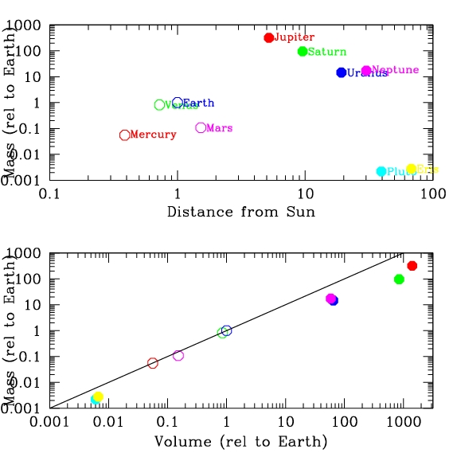
Are planets made of the same stuff?
Top plot shows the masses of the planets as a function of their distance from the Sun. Bottom plot shows the masses of the planets as a function of their volume; note that the points are no longer ordered by distance from the Sun, but the color coding is the same as in the top plot. The line shows where objects would fall if their masses were directly proportional to their volumes.
Considering the bottom plot, do you think all of the planets are made of the same material? If not, which planets appear to have the most different compositions?
A. seems like all planets are made of the same material
B. seems like the outer planets are more massive than you'd expect given their size/volume
C. seems like the outer planets are less massive than you'd expect given their volume
D. can't tell at all from information given
E. no idea what you’re talking about

Slide 21
Density
The combination of mass and volume of an object gives the density of the object, which is a measure of how “compact” material is
  density = mass / volume
Density is useful because it’s relatively easy to calculate and because it can be used to get a rough idea about compositions:
  Objects made of similar material should have similar density, so if objects differ significantly in density, they are most likely made of different material
  Different materials can have similar densities, so if objects have the same density, you can’t know for sure what they are made of

Slide 22
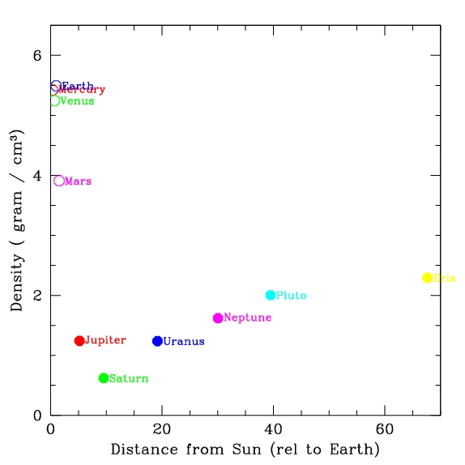
Different types of planets!
Mercury, Venus, Earth, Mars
  higher density
  rocky composition
  “terrestrial” planets
Jupiter, Saturn, Uranus, Neptune
  lower density
  gaseous composition: no hard surface!
  “Jovian” planets
Pluto, Eris, other TNOs?
  intermediate density
  rock/ice composition

Slide 23
Sizes and distances in the Solar System: Scale models
Useful way to get good feeling of relative sizes and distances of objects is to consider a “scale model”
Imagine a model solar system where the Sun is a beach ball, 1 meter in diameter
How big would the Earth be in this model?
A. basketball
B. softball
C. marble
D. grain of sand
E. totally lost!
OBJECT | RADIUS
Sun | 7x10¹⁰ cm
Earth | 6x10⁸ cm
Jupiter | 7x10⁹ cm
Pluto | 1x10⁸ cm
Sun relative to Earth:
(7x10¹⁰) / (6x10⁸) ~ 10² = 100 times bigger
So if Sun is 1m (=100cm), Earth is 1 cm!

Slide 24
Scale models
To work out a scale model, calculate the relative sizes of two objects by dividing the actual sizes, then multiply model size of one by the relative sizes
In scale model where Sun is a 1m diameter ball, Jupiter and Saturn are about 10cm diameter (softballs), Earth and Venus about 1 cm (marbles), Mercury and Mars (pebbles), Pluto et al (grains of sand to dust)
Can use this to think about distances between objects as well

Slide 25
Relative distances between planets
Considering data, how far would Earth be from the Sun in a scale model where the Sun is a beachball 1m in diameter?
A.10 meters
B.100 meters
C. 200 meters
D. 1000 meters
E. totally lost
Sun diameter: 1.5x10¹¹ cm
OBJECT | DISTANCE FROM SUN
Earth | 1.5x10¹³ cm
Jupiter | 8x10¹³ cm
Pluto | 6x10¹⁴ cm
Nearest star | 4x10¹⁸ cm
1.5x10¹³ cm / 1.5x10¹¹ cm = 10² = 100 x bigger
So if Sun is 1m diameter, earth is 100m away!

Slide 26
Scale model of the Solar System
Sun is beachball 1m in diameter
  Jupiter, Saturn: softballs
  Uranus, Neptune: baseballs
  Earth, Venus: marbles
  Mercury, Mars: pebbles
Distances: put model Sun at the stadium goal line
  Mercury: 40 yd line
  Venus: 70 yd line
  Earth: 100 yds (opposing goal line)
  Mars: 150 yds (1 1/2 football fields)
  Jupiter: 500 yds (5 football fields, Pan Am center)
  Neptune: 3000 yds (~2 miles, Mesilla Valley Mall)
The Solar System is mostly empty!!

Slide 27
Leaving the Solar System: still lots of questions!
How do we measure masses, sizes, and distances?
Why are there eight planets? Why are they spaced the way they are?
Why do planets come in different groups? What determines masses, sizes, and densities?
Why do planets orbit as they do? Why is the Solar System flat?
Answers to these may be framed in the general question: how did the Solar System form and evolve?

Slide 28
To do
Midterm Friday

