Slide 1
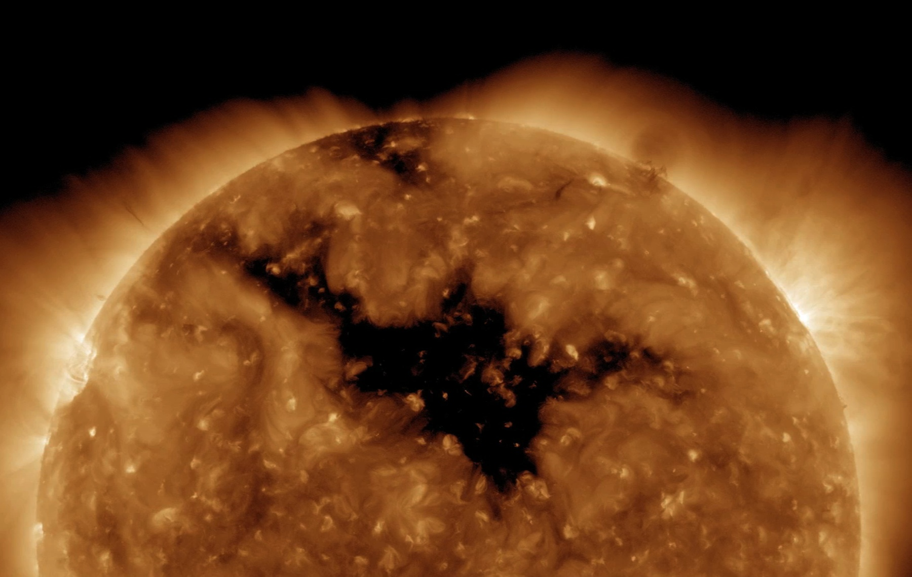
PART III: OVERVIEW OF THE UNIVERSE

Slide 2
Recap
Lab today: measurement & how many galaxies
Midterm Friday: review sheet, etc.
Canvas assignment due Wednesday
Historical understanding of the Solar System
  Kepler’s laws

Slide 3
Today
III. Overview of the Universe
Our place in the Universe
The Solar System
  Contents
  Discovery
  Properties

Slide 4
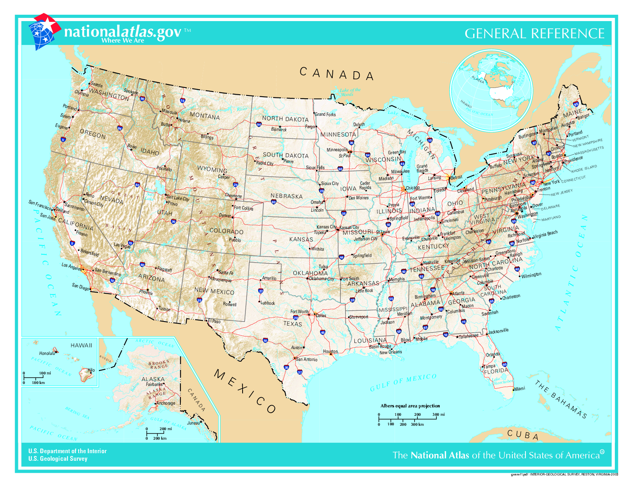
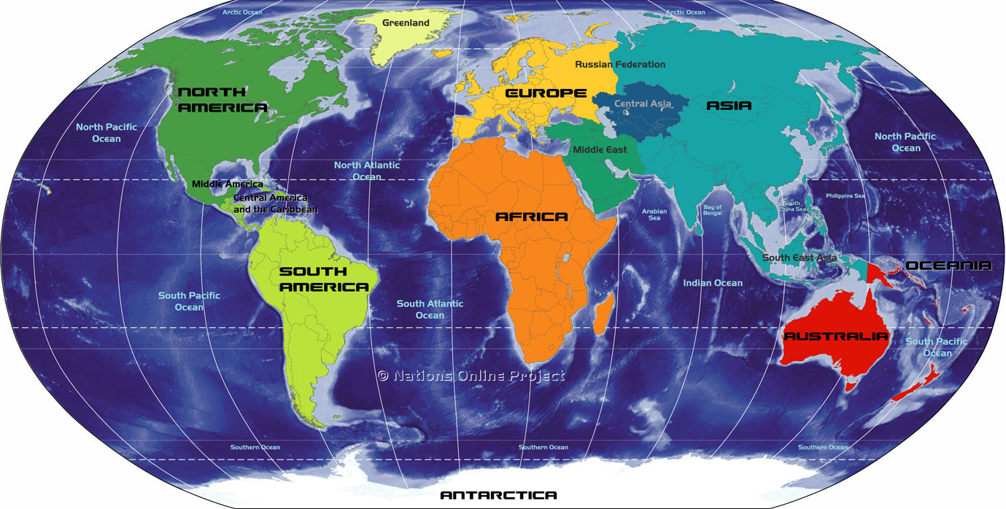
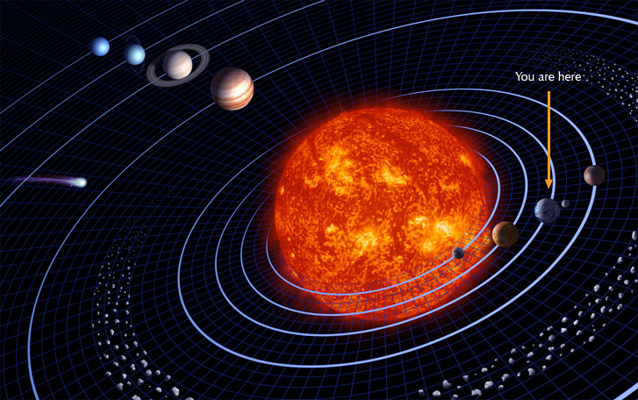
Our place in the Universe
Our cosmic Address:
  Las Cruces, NM, USA
  North America (one of seven continents)
  Earth (one of eight planets)
  Solar System (one of ?? planetary systems)
    Zooming out
  Milky Way galaxy (one star of billions of stars)
  Universe (one galaxy of billions of galaxies)

Slide 5
Which of the following best describes what you think about the Earth's location in the Universe?
Earth goes around the Sun, which is located near the center of the Milky Way galaxy.
Earth goes around the Sun, which located in the outer regions of the Milky Way galaxy.
Earth goes around the the Sun, which is not located in any galaxy.
The Sun goes around the Earth, which is located in the Milky Way galaxy.
I don't know

Slide 6
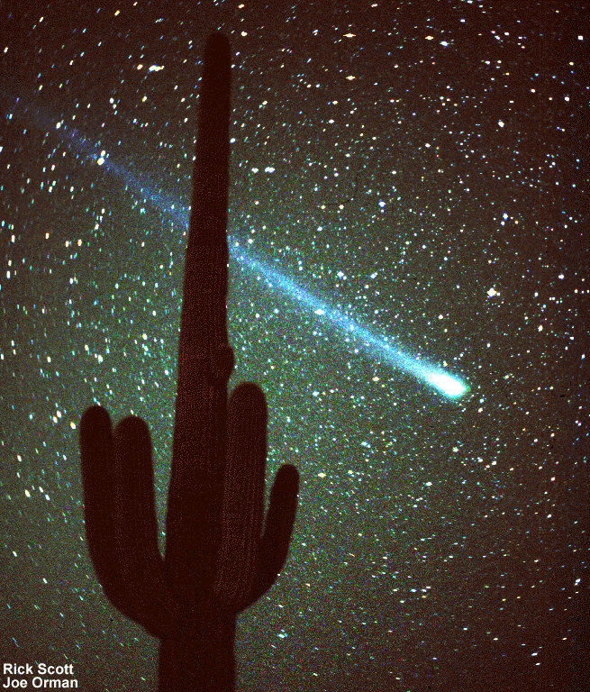
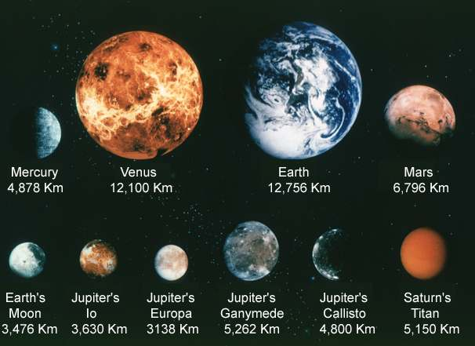
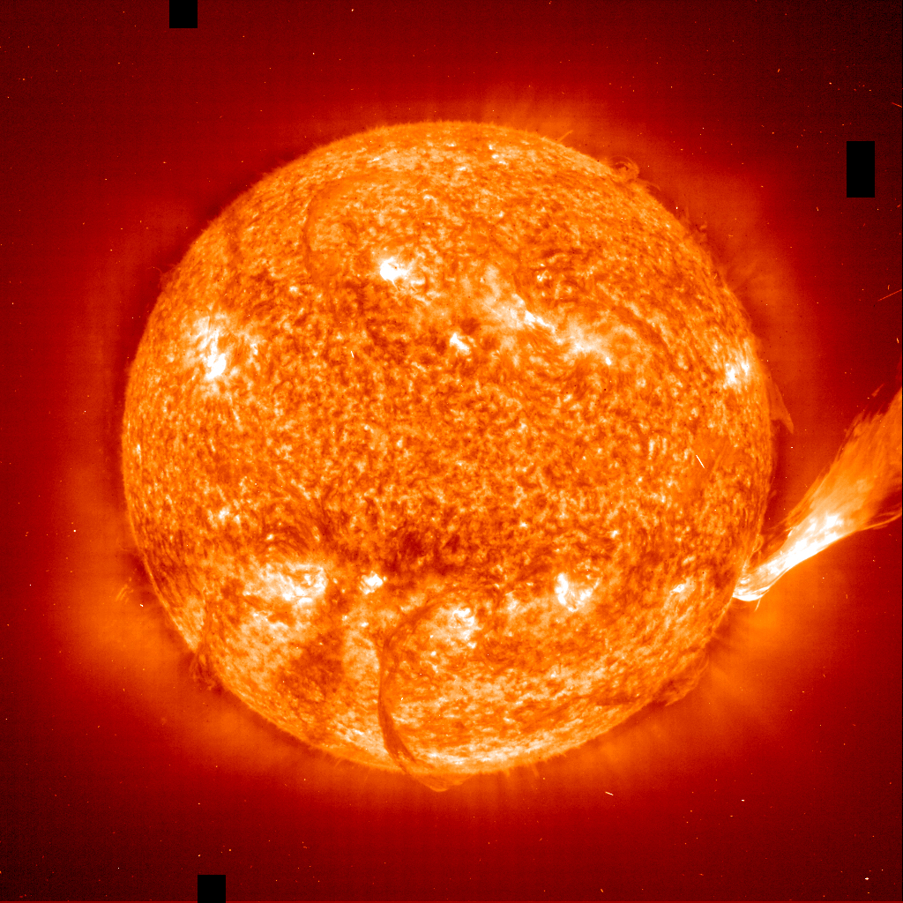
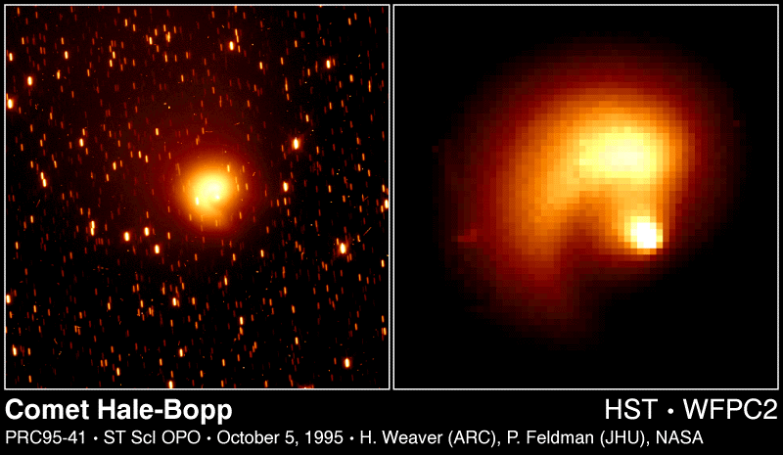
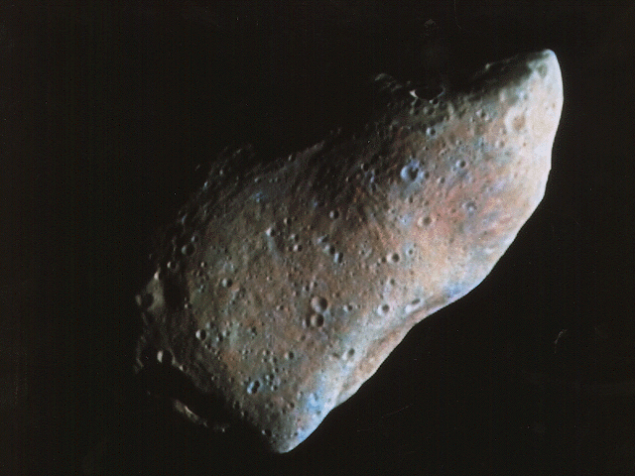
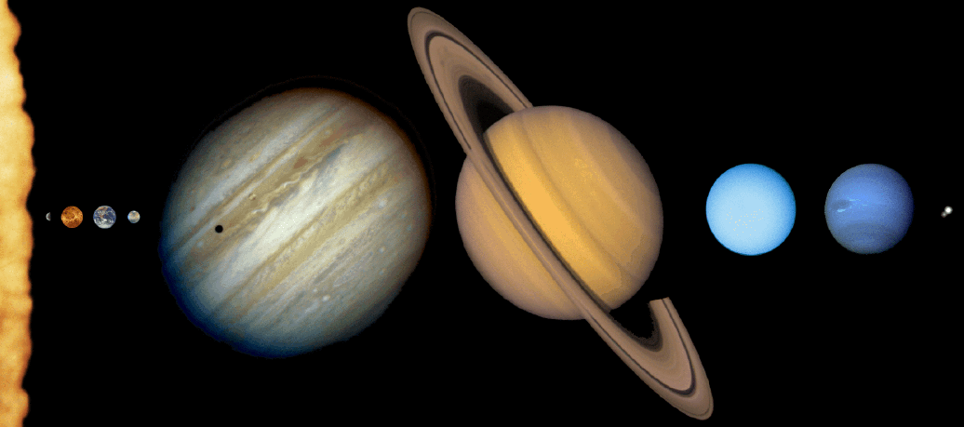
Solar system
What is the solar system?
  Collection of objects associated with the Sun by gravity
Contents of the solar system
  Sun: by far most massive. Only object in SS producing energy (by nuclear reactions in its core)
  Planets: larger objects orbiting the Sun. Traditionally, there were 9 (Mercury, Venus, Earth, Mars, Jupiter, Saturn, Uranus, Neptune, Pluto), now usually considered eight
  Moons: objects orbiting planets. Inner planets have few, outer planets have lots
  Asteroids: smaller rocky objects orbiting the Sun. Most are very small! Small ones often called meteoroids
  Comets: smaller icy objects orbiting the Sun

Slide 7
Why do we see the Sun?
  It reflects light from other stars
  It produces light at its surface that travels directly to our eyes
  It produces light at its center that travels directly to our eyes
  It reflects light coming from the Earth
  None of the above
We see the Sun because it produces light at its surface. The source of the energy for this light production is nuclear reactions that occur in the core of the Sun.

Slide 8
Why do we see the other planets?
  They reflect light coming from the Sun
  They reflect light coming from other stars
  They produce light at their surface that travels directly to our eyes
  They produce light at their center that travels directly to our eyes
  They reflect light coming from the Earth
In visible light, we see planets because they reflect sunlight. Apart from reflected light, planets actually do glow with their own light, but it is a type of light called infrared light, that our eyes cannot see. The source of energy for this comes primarily from the planets being heated by the Sun.

Slide 9
Seeing objects in the solar system
Planets reflect visible light from the Sun
The apparent brightness of a planet depends on
  Distance of planet from Sun (how much light does it get?)
  Distance of planet from Earth (how much of the reflected light do we receive?)
  Size of planet (how much light gets reflected?)
  Surface composition of planet (what fraction of light gets reflected?)

Slide 10
If we had a colony on Neptune, and were looking at Pluto, it would
A. look about the same brightness as it does when we look at it from Earth
B. look fainter than it looks from Earth, because Neptune is farther from the Sun than Earth is
C. look brighter than it looks from Earth, because Neptune’s orbit is bigger than Earth’s orbit
D. sometimes look brighter than from Earth, sometimes fainter, depending on the position of Neptune and Pluto in their orbits
E. be impossible to see at all

Slide 11
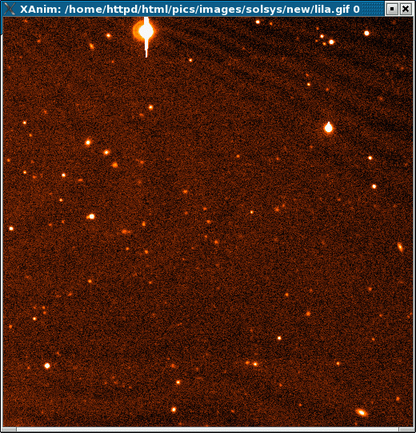
Data/observations:
Finding solar system objects
New solar system objects are continually being found. How?
Which is the new dwarf planet?
The brightest object in the picture
The faintest object in the picture
The biggest object in the picture
The smallest object in the picture
Can’t tell!

Slide 12
Sizes of astronomical objects
The apparent, or angular size of an object depends on how far away it: the farther away an object is, the smaller it looks
The apparent size also (obviously) depends on how big the object is!
Most astronomical objects are so far away, they just look like points when seen from Earth
  Exceptions are: Sun, nearby planets, large planets, galaxies
  The “size” that one measures from pictures of stars and small solar system objects has nothing to do with the size of the objects themselves: it has to do with the quality of the telescope and the quality of the observing site (Earth’s atmosphere blurs objects)
Small solar system objects appear similar to stars!

Slide 13
Brightnesses of astronomical objects
Brightnesses of astronomical object:
  The apparent brightness of an object depends on how far away it is: the farther away an object is, the fainter it looks
  The apparent brightness also (obviously) depends on how much light it is really emitting or reflecting (its luminosity, or intrinsic brightness)
  Stars are much much much more luminous than solar system objects, but they are also much much much farther away, so there is overlap in the apparent brightness
  Small solar system objects look similar to stars!
Solar system objects are much much much closer than stars, but you can’t tell anything about the distance from looking at a single picture!

Slide 14
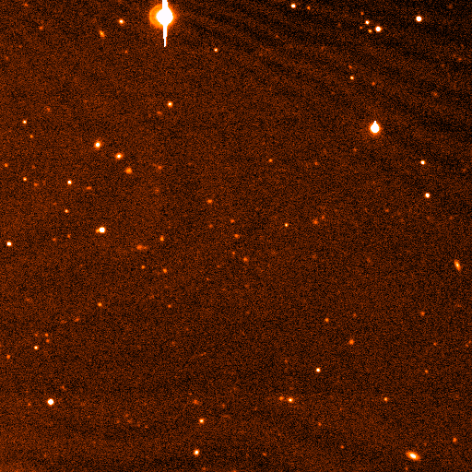
Motions of astronomical objects
Astronomical objects move through space
  The rate at which they appear to move depends on how fast they are actually moving but also on how far away they are
  It also depends on what direction they are moving (hard to tell if something is coming directly towards you or going directly away from you by looking for motion!)
Almost all objects are so far away that we can only barely, if at all, detect this motion over the course of our lifetime
Solar system objects are an exception: planets go around the Sun on timescales of years or decades!
Which is the new dwarf planet?

Slide 15
Orbits of solar system objects
Detecting motions of faint objects has allowed us to discover many objects in orbit around the Sun!
Objects are found at ranges of different distances from the Sun
Many orbits are close to circular, but some aren’t!
See animated map of solar system object

Slide 16
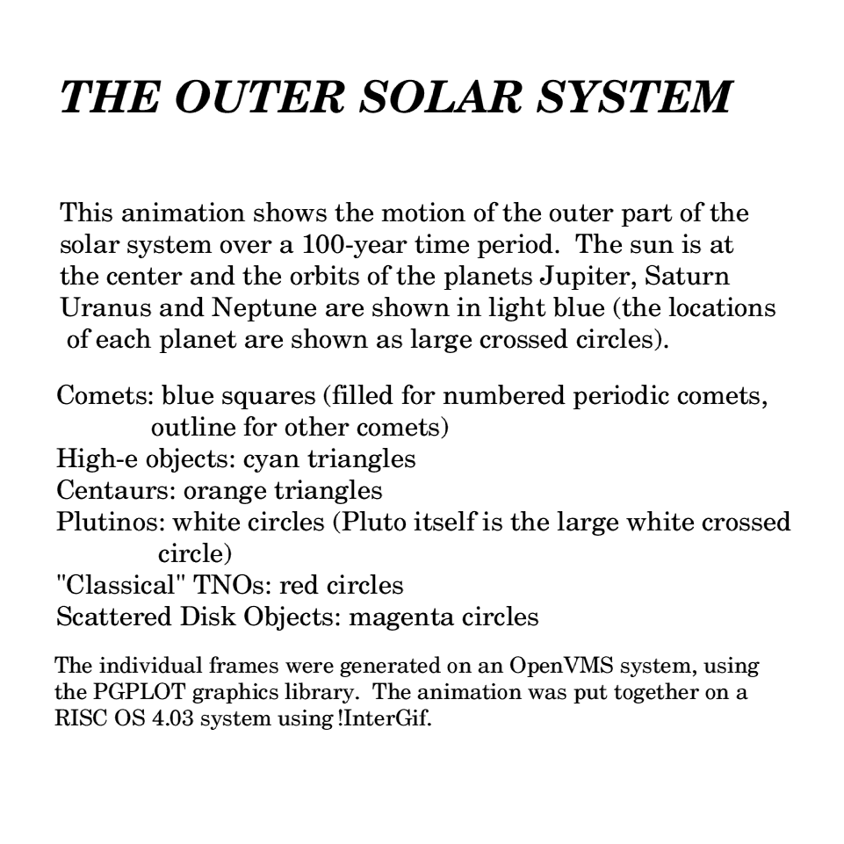
Orbital periods
Looking at the animation, which statement best fits the observed data?
A. all solar system objects take about the same time to orbit the Sun
B. objects that are farther from the Sun take longer because they have farther to go, but they move at about the same speed as closer objects
C. Objects that are farther from the Sun take longer to go around, both because they have farther to go and because they move slower
D. different objects take different amounts of time to go around, but there’s no correlation with distance from the Sun
(animations are a bit slow!)

Slide 17
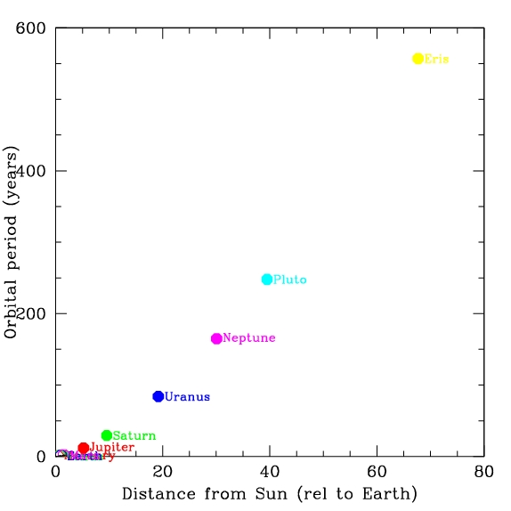
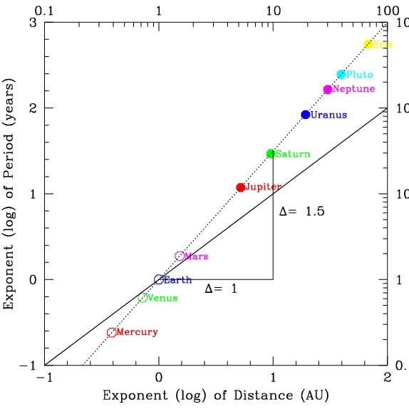
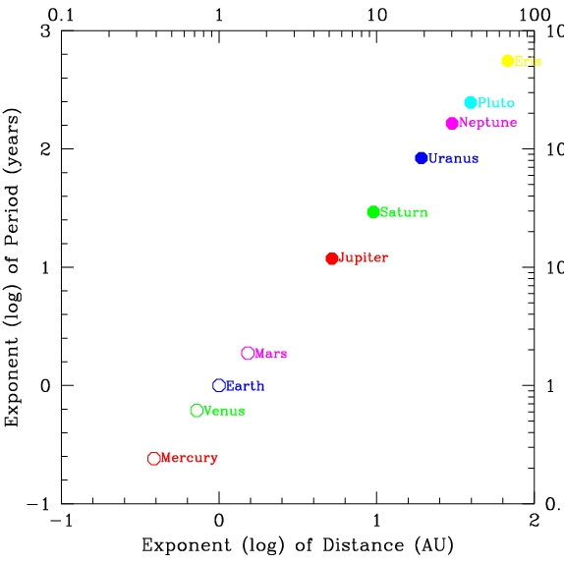
Orbital period data
“linear” graphs: a graph where moving a fixed distance along an axis represents adding an amount more to the last tick mark.
  These are the graphs you normally make
  Problem: if there’s a big range in objects being plotted, some are hard to see!
“logarithmic” graphs: a graph where moving a fixed distance along an axis represents multiplying the amount of the last tick mark by a certain amount
  In this kind of plot, a straight line represents a kind of relation called a power law
  y = A x^{n}
  where the slope of the line gives
  the exponent n, so here:
  Period = A (distance) ^{1.5}
  The constant A just depends on what units you use, so is perhaps less “interesting”, so we might say: Period is proportional to distance to the 1.5 power
  P α d ^{1.5}

Slide 18
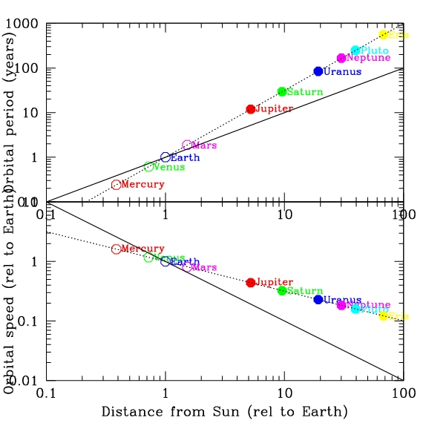
Orbital period data
There is a very tight relation between average distance from the Sun, orbital period, and orbital speed
While there is a clear relation, it is not a “linear” relation, I.e. at twice the distance from the Sun, it is not twice the period
Clearly, you could make a good model from this, and make predictions for periods of newly discovered solar system objects

Slide 19
Orbital period data
What is the typical distance of main belt asteroids from the Sun? The distance from the Earth to the Sun is defined as one astronomical unit (a.u.)
1 a.u.
2 a.u.
3 a.u.
5 a.u.
10 a.u.
How long would you predict it takes a main belt asteroid to orbit the Sun?
A. 1 year
B. 3 years
C. 5 years
D. 10 years
E. 20 years

Slide 20
Orbital period data
There is a very tight relation between average distance from the Sun, orbital period, and orbital speed
While there is a clear relation, it is not a “linear” relation, I.e. at twice the distance from the Sun, it is not twice the period
Clearly, you could make a good model from this, and make predictions for periods of newly discovered solar system objects
You might also ask: why? And see if there is a theory that explains this. There is: GRAVITY

Slide 21
Shapes and inclinations of orbits
See animation of planetary orbits
Most planetary orbits are close to circles (but not quite, note Mars and Mercury in particular)
Pluto and Eris are distinctly non-circular
Most objects orbit in the same plane
  Again, Pluto and Eris stand apart

Slide 22
Shape of the solar system
Even though most of the solar system is empty, we can consider the shape that the objects within it take up as they move around the Sun. Given the animations you’ve seen, what’s the shape of the Solar System, consider only the planets out to Neptune?
A. Spherical (like a ball)
B. Cubical (like a dice)
C. Flat and square (like a baseball base)
D. Flat and round (like a frisbee)
E. Irregular
The solar system is largely flat. Raises the question: Why?

Slide 23
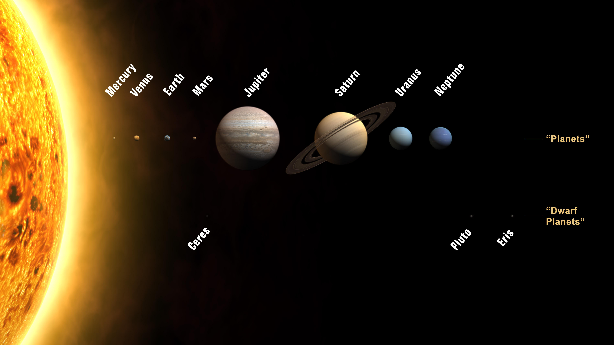
The New Solar System
With bigger telescopes and improved technology, we’ve continued to discover more solar system objects. Not suprisingly, we’re finding fainter ones that hadn’t been seen before. These are mostly far out in the Solar System, beyond the orbit of Neptune
Many of the new objects have orbits that have a lot of similarities to Pluto, like Eris
This previously undiscovered class of objects are called Kuiper belt objects (after someone who predicted their existence) or trans-Neptunian objects (TNOs). Their compositions appear to be more like comets than like the other planets
Based on these discoveries, it appears that Pluto is one of this group of objects.
People wonder about how the different groups of objects form in the solar system, and it’s possible that the bigger planets form in a different way than the TNOs
This had led some people to want to change the classification of Pluto from a planet to something else, to help use classification to understand things about the Solar System
  Some people object to this!
  In any case, Pluto is still there, with the same properties we’ve always known about! At some level, the debate about whether we should call it a “planet” isn’t really part of science, it’s just a name! The science is in understanding the nature of objects and how and why they got there

Slide 24
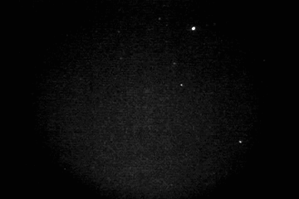
Collisions in the Solar System
Given that there’s a lot of small objects in the Solar System (asteroids, comets, Kuiper belt objects) and that all orbits aren’t perfect circles, different orbits can intersect, leading to collisions between objects
Most of the collisions that a planet experiences are with very small objects, since they are by far the most common
When small asteroids (meteoroids) hit the Earth, the friction as they move through the Earth’s atmosphere causes them to burn up
  We see these as “shooting stars” (but that’s a pretty bad name for them!)
  Bigger meteoroids can survive down to the Earth’s surface, and be found as meteorites
  Biggest ones over the history of the Earth may have had major impact on Earth’s history!
Impacts are an important phenomenon that affect surfaces of Solar System objects, especially those without atmospheres
  Impacts were probably much more common shortly after the Solar System was formed, when there was more material around

Slide 25
To do

