Slide 1
History of Solar System Understanding
Kepler’s laws

Slide 2
Recap/Announcements
Moon motions in the sky due Monday
Midterm next Friday 9/27
Historical development of our model of the Solar System
Original geocentric model, model of Ptolemy
Development of heliocentric models
Importance of new data: telescopes and the phases of Venus

Slide 3
The value of accurate data
Despite the evidence against the geocentric model,, there was still the problem that the heliocentric model of Copernicus failed to predict locations of planets perfectly
Tycho Brahe was an astronomer who realized that getting the most precise measurements of planetary positions would be of great value to constrain theories about how the Solar System is laid out
He spent several years in the late 1500's collecting precise data on planetary positions, and made these available for others to think about
Many people (including Tycho) tried to devise models to reproduce the observations
Finally, one succeeded ….. Johannes Kepler

Slide 4
Kepler's model of the Solar System
Kepler came up with a model that was able to fit the observations perfectly, and predict locations of planets.
Key points:
model was tied to reproducing observations: data is what it is!
had to release preconceptions:
Earth is not at the center
orbits aren't circles!
Kepler's model was characterized by his 3 Laws of Planetary Motion

Slide 5
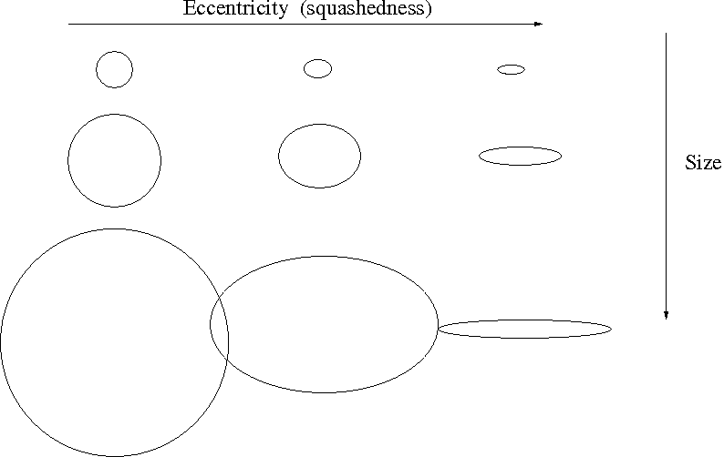
Kepler's first law
Planets travel in elliptical orbits with the Sun located at one of the focii of the ellipse
What is an ellipse?
Compare to a circle, which is described by ONE thing: size (radius or diameter) and a center
Described by TWO things: size and squashedness (eccentricy)
How do you draw one? Instead of one center, there are TWO focii. Separation of focii related to eccentricity.
Size of an ellipse is specified by the length of its semimajor axis (analogous to radius of circle)

Slide 6
Law of ellipses in the Solar System
Kepler first law (correctly) states that planets travel in elliptical orbits around the Sun, with the Sun at one focus of the ellipse
In fact, ALL objects (e.g., comets and asteroids) orbit in elliptical orbits
Most planetary orbits, while elliptical, are only slightly elongated, so they are close to circles
Many comets, however, orbit in very eccentric orbits

Slide 7
Which of the orbit configurations is not possible given Kepler’s law of ellipses?
A
B
C
D
All are possible

Slide 8
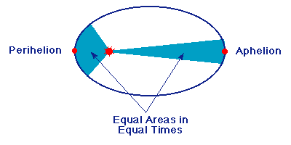
Kepler's 2nd law
In their elliptical orbits, planets travel faster when they are closer to the Sun, and slower when they are farther from it
More specifically, law of equal areas: planetary orbits sweep out equal areas (between Sun and planet) in equal times

Slide 9
If we discovered a planet that had a perfectly circular orbit, with the Sun at the center of the circle
It would contradict Kepler’s laws
The planet would not move
The planet would change its speed as it went around in its orbit
The planet would orbit at the same speed through the entire orbit
The world as we know it would come to an end

Slide 10
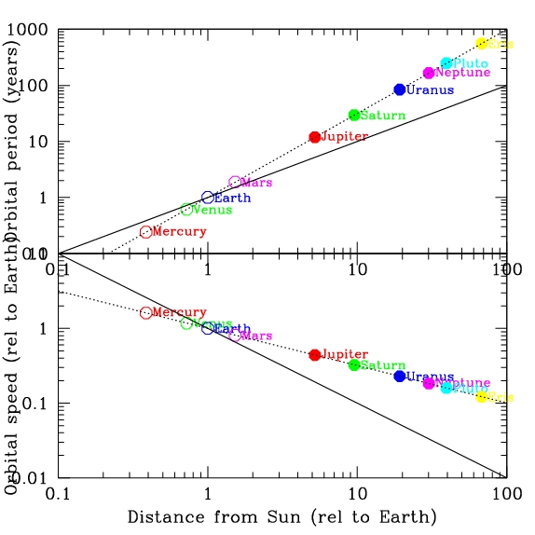
Kepler’s 3rd law: the Harmonic Law
The time it takes for a planet to go around the Sun is related to the size of its orbit; more distant planets take longer to go around.
Mathematically
(Period in years)² = (semimajoraxis in a.u.)³
An astronomical unit is the average distance between the Earth and the Sun. It is a unit of distance used within the Solar System

Slide 11
Which planet takes longer to orbit?
Planet A
Planet B
Both take the same amount of time
Can’t tell from information given
No clue

Slide 12
P² = a³
If we found a planet that orbited the Sun every 8 years, how big would the semimajor axis of its orbit be?
A. 4 au
B. 8 au
C. 16 au
D. 64 au
E. no clue

Slide 13
P² = a³
Jupiter orbits about 5 times farther from the Sun than the Earth does. How long does it take Jupiter to go around the Sun?
A. about 5 years
B. about 11 years
C. about 25 years
D. about 100 years
E. no clue

Slide 14
Why do Kepler's laws work?
Kepler's model correctly describes the Solar System and motions within it
However, it does NOT explain WHY the planets orbit according to Kepler's law
The understanding of WHY the planets move as they do was developed in the late 1600's by Isaac Newton, who introduced the concept of gravity

Slide 15
To Do
Read about Kepler’s laws
Moon motions in the sky
Campus observatory

