Slide 1
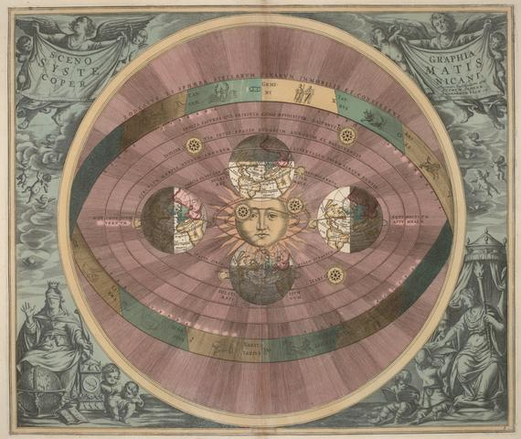
History of Solar System Understanding
How do we know the Earth goes around the Sun?

Slide 2
Recap/Announcements
Canvas assignment due today
Moon motions in the sky due
Campus observatory
Midterm 9/27
Appearance and motions of objects in the sky:
  Motions of planets: retrograde motion
  Appearance of planets: phases
  Appearance of planets: time of day they can be seen

Slide 3
Figuring out the Solar System
We’ve talked about how objects appear to move in the sky given our understanding of how objects move in the Solar System
In reality, people looked at the sky, saw how objects moved, and figured out the Solar System!
Following the development of this understanding provides a great example of how the process of science works, in particular how models are modifying and rejected in the light of new measurements

Slide 4
Basic observations
Sun goes around in the sky
Stars go around, but you see different stars over the course of a year
Moon goes around, but also moves around in the sky once per month
Planets are objects with more complicated motion in the sky
  Retrograde motion
  Some, like Venus, are only visible at certain times of day (near sunrise and sunset)

Slide 5
The model from ancient Greece
Earth is located at the center of the Universe, and stands still
  Partly motivated by preconception (we don’t feel like we are moving)
  Partly motivated by lack of observed parallax of stars
  Some Greeks, in particular, Aristarchus, did think about the possibility of the Earth revolving around the Sun
Objects move in circular orbits around the Earth
  Circles preferred because of simplicity (pre-conception?)
Sun moves around once per day, stars move around a bit slower, Moon slower, etc

Slide 6
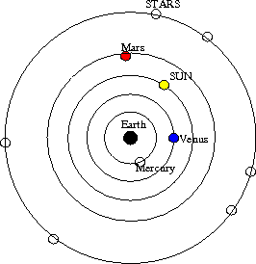
Rejecting a theory
All objects go in circular orbits around earth. All orbits are independent of each other, with different periods.
Which of the following observations does this simple geocentric model fail to explain?
Rising and setting of the Sun
Motion of the stars around the sky
Retrograde motion of the planets
All of the above
None of the above

Slide 7
The model from ancient Greece
  Motions of planets (retrograde motion) can't be explained in simplest picture!
  What did they do? Modify the model!
  Introduction of epicycles to explain retrograde motion

Slide 8
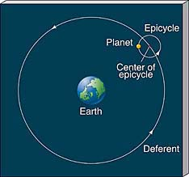
Epicycles

Slide 9
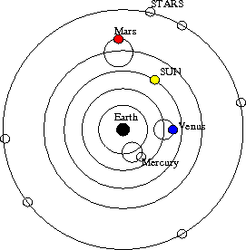
Rejecting a theory
All objects go in circular orbits around earth, with planets in epicycles. All orbits are independent of each other, with different periods.
Which of the following observations does this model fail to explain?
Retrograde motion of Mars
Retrograde motion of Venus
Time of day we can see Mars (all times over course of a few years)
Time of day we can see Venus (only near sunrise and sunset, plus daytime)
All of the above

Slide 10
Geocentric model of Ptolemy
Most elaborate geocentric model was developed by the astronomer Ptolemy around 150 AD
  Fixed Mercury and Venus to the Sun to account for when they are seen
  Used model to predict positions of planets on subsequent nights --> didn’t work so well!
Ptolemy made lots of small adjustments to the basic picture to try to better match the observed position of planets
Always preserved Earth at center (geocentric) and circular orbits, but had some orbits off center, some orbits tied to other orbits, etc. --> complicated
Even with complications, model didn't perfectly predict planetary positions
Still, this was the main model of the Solar System for ~1500 years!

Slide 11
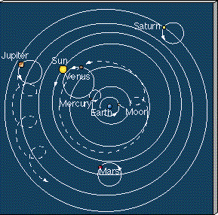
Ptolemaic model

Slide 12
The Renaissance and birth of heliocentric models
In the 1500s and 1600s, Europe went through Renaissance, where many ideas were reconsidered
Copernicus, a Polish astronomer, suggested a dramatically different model of the Solar System, a heliocentric model, with the Sun at the center
Copernicus preserved the idea that planets orbited in circular orbits around the Sun
  Explained retrograde motion as we now understand it
However, used model to predict location of planets, unfortunately, these didn’t turn out so well!
Big debate ensued, between geocentric and heliocentric models
  Debate was partly scientific, based on how well each model did in predicted where planets would be observed. Unfortunately, neither made perfect predictions!
  Debate was partly philosophical, as some people/institutions had strong opinions about Earth being centrally located

Slide 13
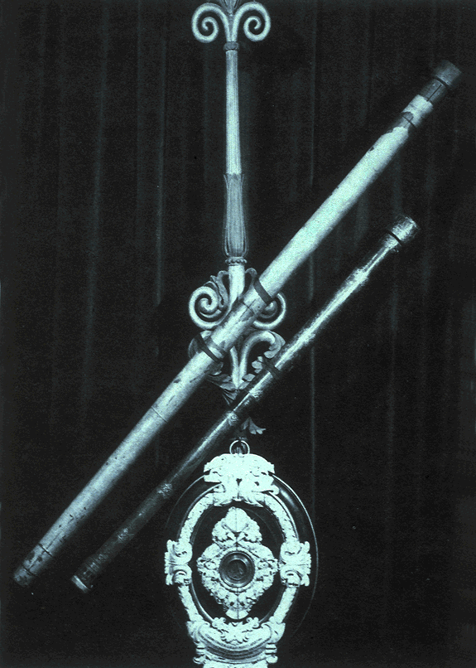
The impact of new technology
At the same time, new technology started to be used for astronomical observations
Galileo used optics to make telescopes to look at the sky
  Discovered moons around planets (Jupiter in particular) that clearly moved in orbit around the parent planet --> strong philosophical implication that there are objects that orbit something beside the Earth!
  Discovered that planets are resolved disks. This allowed him to observe phases of planets!
    Of particular interest was Venus….

Slide 14
In the heliocentric model, both Venus and Earth orbit the Sun (at different speeds). If you looked at Venus through a telescope (so you could see the disk), you would expect to see:
A ) always a full Venus
B) always a half Venus
C) always a crescent Venus
D) different phases at different times
E) Venus would still look like a point

Slide 15
In the geocentric model, both Venus and the Sun orbit the Earth. To explain retrograde motion, Venus orbits in an epicycle. To explain the fact that Venus is only seen near sunrise and sunset, the orbit of Venus is "tied" to the orbit of the Sun. In this model, if you looked at Venus through a telescope (so you could see the disk), you would expect to see:
A. always a full Venus
B. always a half Venus
C. either a crescent or new Venus
D. all different phases at different times
E. Venus would only look like a point

Slide 16
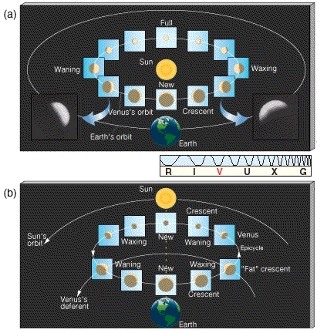
The phases of Venus
All phases observed → Strong evidence for heliocentric model over geocentric model!!

Slide 17
The value of accurate data
Despite the evidence for a heliocentric model, there was still the problem that the model of Copernicus failed to predict locations of planets perfectly
Tycho Brahe was an astronomer who realized that getting the most precise measurements of planetary positions would be of great value to constrain theories about how the Solar System is laid out
  He spent several years in the late 1500's collecting precise data on planetary positions, and made these available for others to think about
Many people (including Tycho) tried to devise models to reproduce the observations
Finally, one succeeded ….. Johannes Kepler

Slide 18
Kepler's model of the Solar System
Kepler came up with a model that was able to fit the observations perfectly, and predict locations of planets.
Key points:
  model was tied to reproducing observations: data is what it is!
  had to release preconceptions:
    Earth is not at the center
    orbits aren't circles!
Kepler's model was characterized by his 3 Laws of Planetary Motion

Slide 19
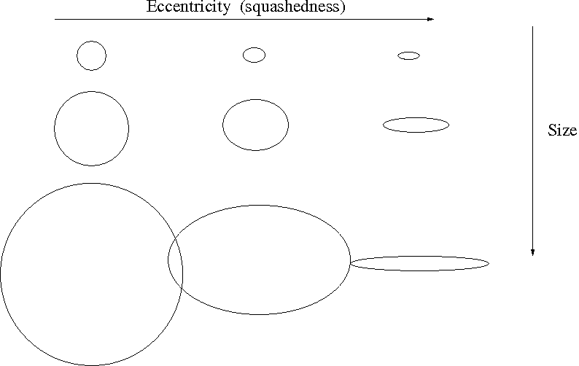
Kepler's first law
Planets travel in elliptical orbits with the Sun located at one of the focii of the ellipse
  What is an ellipse?
    Compare to a circle, which is described by ONE thing: size (radius or diameter) and a center
    Described by TWO things: size and squashedness (eccentricy)
    How do you draw one? Instead of one center, there are TWO focii. Separation of focii related to eccentricity.
    Size of an ellipse is specified by the length of its semimajor axis (analogous to radius of circle)

Slide 20
Law of ellipses in the Solar System
Kepler's laws correctly state that planets travel in elliptical orbits around the Sun, with the Sun at one focus of the ellipse
In fact, ALL objects (e.g., comets and asteroids) orbit in elliptical orbits
Most planetary orbits, while elliptical, are only slightly elongated, so they are close to circles
Many comets, however, orbit in very eccentric orbits

Slide 21
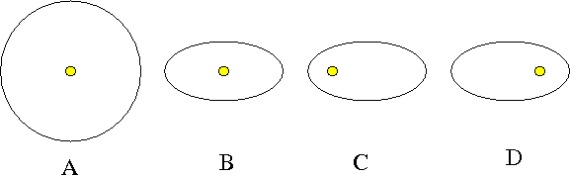
Which of the orbit configurations is not possible given Kepler’s law of ellipses?
A
B
C
D
All are possible

Slide 22
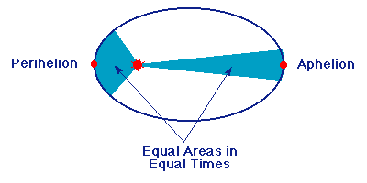
Kepler's 2nd law
In their elliptical orbits, planets travel faster when they are closer to the Sun, and slower when they are farther from it
More specifically, law of equal areas: planetary orbits sweep out equal areas (between Sun and planet) in equal times

Slide 23
If we discovered a planet that had a perfectly circular orbit, with the Sun at the center of the circle
It would contradict Kepler’s laws
The planet would not move
The planet would change its speed as it went around in its orbit
The planet would orbit at the same speed through the entire orbit
The world as we know it would come to an end

Slide 24
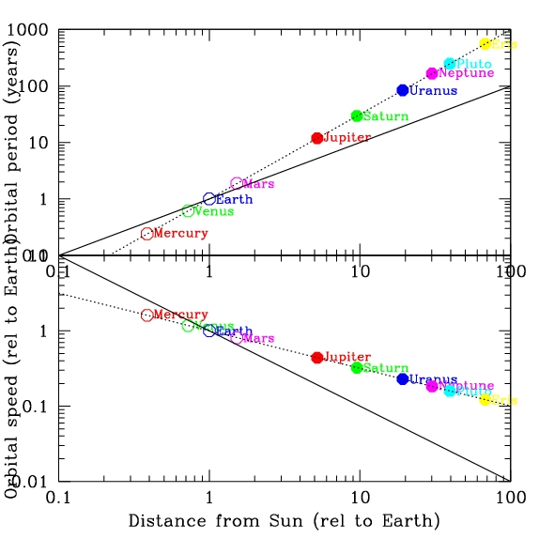
Kepler’s 3rd law: the Harmonic Law
The time it takes for a planet to go around the Sun is related to the size of its orbit; more distant planets take longer to go around.
Mathematically
(Period in years)² = (semimajoraxis in a.u.)³
Remember, an astronomical unit is the average distance between the Earth and the Sun. It is a unit of distance used within the Solar System

Slide 25
P² = a³
If we found a planet that orbited the Sun every 8 years, how big would the semimajor axis of its orbit be?
A. 4 au
B. 8 au
C. 16 au
D. 64 au
E. no clue

Slide 26
P² = a³
Jupiter orbits about 5 times farther from the Sun than the Earth does. How long does it take Jupiter to go around the Sun?
A. about 5 years
B. about 11 years
C. about 25 years
D. about 100 years
E. no clue

Slide 27
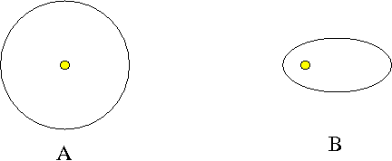
Which planet takes longer to orbit?
Planet A
Planet B
Both take the same amount of time
Can’t tell from information given
No clue

Slide 28
Why do Kepler's laws work?
Kepler's model correctly describes the Solar System and motions within it
However, it does NOT explain WHY the planets orbit according to Kepler's law
The understanding of WHY the planets move as they do was developed in the late 1600's by Isaac Newton, who introduced the concept of gravity

Slide 29
To Do
Read about Kepler’s laws
Moon motions in the sky
Campus observatory

