Slide 1
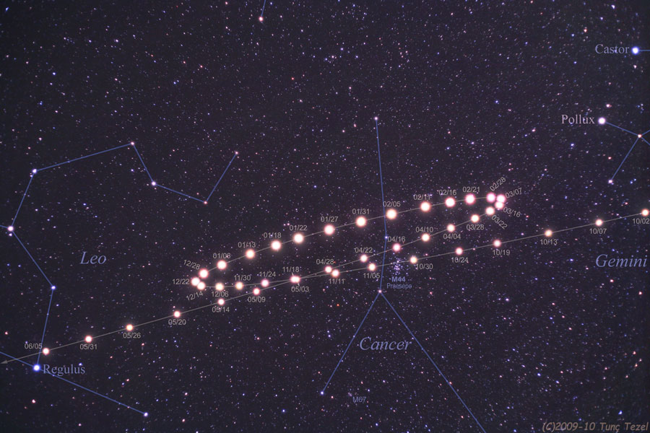
Planets in the sky
Motions, times of day, phases

Slide 2
Recap
Canvas assignment due Wed
Sky observation due Monday; also, campus observatory
Lab this week: Moon lab
Midterm Friday 9/27
Moon
  Orbit of the Moon and changing time of day when you can see it: motion of Moon in the sky
  Phases of the Moon: related to location of Moon in its orbit because of relative configuration of Sun, Moon, and Earth
    Phase of moon is correlated with time of day when Moon is above the horizon
  Eclipses: shadows of Moon and Earth
    Infrequent because of tilt of Moon’s orbit
    Appearance of lunar and solar eclipses

Slide 3
Motion of planets in the sky
More complicated than motion of Sun, stars, or Moon, because apparent motion is combination of:
  Reflex motion of Earth’s rotation
  Reflex motion of Earth’s revolution
  Intrinsic motion of planet around Sun
Motion of planets very important in historical context of how we came to figure out the nature of the Solar System

Slide 4
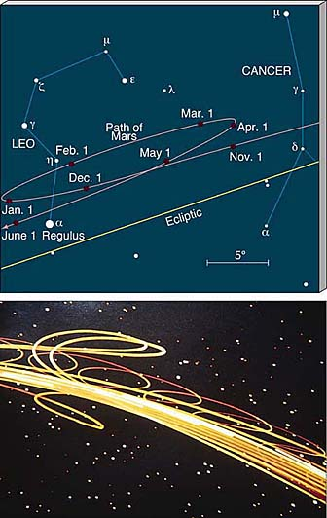
Retrograde motion
Because of combination of intrinsic and reflex motion, apparent motion of planets can be complex
Planets don’t always appear to move the same direction over the course of a year
  Different from stars, Sun, and Moon
  People have recognized this for a long time and knew that the planets were somehow different!
The “backing up” of the planets is known as retrograde motion
  Outer planets show retrograde motion because they are moving slower than us, so when the Earth “passes” them, they appear to back up
  Inner planets show retrograde motion because they are orbiting Sun faster than us and we view their motion from outside their orbits

Slide 5
Planets: appearance
When you look at planets through even a small telescope, you see that they are close enough so that you can actually see the disk of the planet
  Even without a telescope, because their apparent size is bigger than that of stars, they often don’t twinkle as much
When you use a telescope, you can see that planets, like the Moon, have phases
  Makes sense, because we see planets because they reflect light from the Sun: phases occur when things are seen in reflected sunlight, because the position of THREE things matter: Sun, Earth, and object

Slide 6
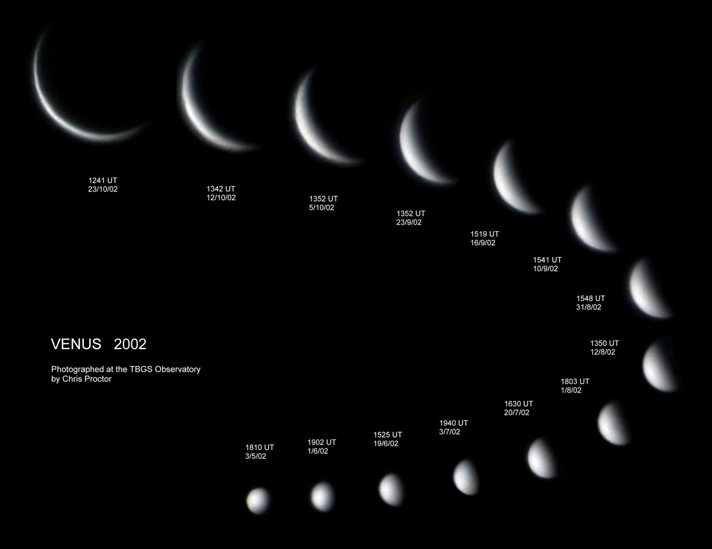
Imagine we looked at Venus over the time it took Venus to make a complete orbit around the Sun. We see Venus because it is reflecting light from the Sun. If we looked at Venus through a telescope, we would see
A. that Venus always looks "full", i.e. we would always see the fully illuminated half of Venus
B. that the part of Venus that we could see from Earth wasn't fully illuminated, and always looked like it was in "crescent phase"
C. that the part of Venus that we could see from Earth was sometimes fully illuminated, but sometimes looked like it was in "gibbous phase"
D. that Venus went through the full set of different phases over the course of its year

Slide 7
Imagine we looked at Jupiter over the time it took Jupiter to make a complete orbit around the Sun. We see Jupiter because it is reflecting light from the Sun. If we looked at Jupiter through a telescope, we would see
A. that Jupiter always looks "full", i.e. we would always see the fully illuminated half of Jupiter
B. that the part of Jupiter that we could see from Earth wasn't fully illuminated, and always looked like it was in "crescent phase"
C. that the part of Jupiter that we could see from Earth was sometimes fully illuminated, but sometimes looked like it was in "gibbous phase"
D. that Jupiter went through the full set of different phases over the course of its year

Slide 8
Planets: phases
When you look at planets through a telescope, you see they have phases
  Planets closer to Sun than Earth (Mercury and Venus) have all phases
  Planets farther from Sun than Earth only have phases full or close to it
Without a telescope, you can’t see the phases!

Slide 9
Planets: time of day
Not all planets can be seen at all times of day!

Slide 10
If you watch over the course of several years, at what times of day can you see Venus (imagining that it was possible to see it even during daytime)?
A. At all times of day
B. Only during the middle of the night
C. Only during the middle of the day
D. Only in daytime, and shortly before or after sunrise/sunset
E. never

Slide 11
If you watch over the course of several years, at what times of day can you see Jupiter (again, imagining that it was possible to see even during daytime)?
A. At all times of day
B. Only during the middle of the night
C. Only during the middle of the day
D. Only in daytime, and shortly before or after sunrise/sunset
E. never

Slide 12
Planets: time of day
When can you see Mercury and Venus?
  Always seen “near” the Sun, so always during daytime or close to it
  The “evening” or “morning” star
When can you see planets that orbit farther from the Sun than Earth?
  Depends on their location in their orbit
  Over time, can be seen anytime of day

Slide 13
Figuring out the Solar System
We’ve talked about how objects appear to move in the sky given our understanding of how objects move in the Solar System
In reality, people looked at the sky, saw how objects moved, and figured out the Solar System!
Following the development of this understanding provides a great example of how the process of science works

Slide 14
The development of scientific models
Scientific models are based on data
  - While easy to say, cultural world view, or preconceptions about how the world is laid out, can also play a role!
Since data is key, so is ability of people to make measurements
  - How accurately can things like the positions of stars and planets be measured?
Development of new technology is often a key factor in advancing models

Slide 15
Basic observations
Sun goes around in the sky once per day
Stars go around once per day, but you see different stars over the course of a year
Moon goes around once per day, but also moves around in the sky once per month
Planets are objects with irregular motion in the sky
  Retrograde motion
  Some, like Venus, are only visible at certain times of day (near sunrise and sunset)

Slide 16
The model from ancient Greece
Earth is located at the center of the Universe, and stands still
  Partly motivated by preconception (we don’t feel like we are moving)
  Partly motivated by lack of observed parallax of stars
  Some Greeks, in particular, Aristarchus, did think about the possibility of the Earth revolving around the Sun
Objects move in circular orbits around the Earth
  Circles preferred because of simplicity (pre-conception?)
Sun moves around once per day, stars move around a bit slower, Moon slower, etc

Slide 17
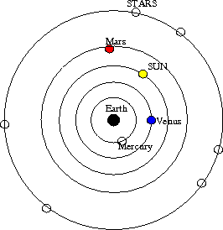
Rejecting a theory
Which of the following observations does this simple geocentric model fail to explain?
Rising and setting of the Sun
Motion of the stars around the sky
Retrograde motion of the planets
All of the above
None of the above

Slide 18
The model from ancient Greece
  Motions of planets (retrograde motion) can't be explained in simplest picture!
  What did they do? Modify the model!
  Introduction of epicycles to explain retrograde motion

Slide 19
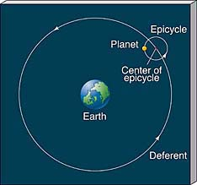
Epicycles

Slide 20
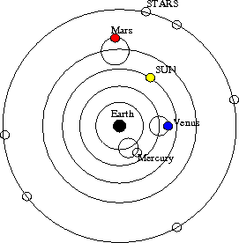
Rejecting a theory
Which of the following observations does this model fail to explain?
Retrograde motion of Mars
Retrograde motion of Venus
Time of day we can see Mars
Time of day we can see Venus
All of the above

Slide 21
Geocentric model of Ptolemy
Most elaborate geocentric model was developed by the astronomer Ptolemy
  Fixed Mercury and Venus to the Sun to account for when they are seen
  Used model to predict positions of planets on subsequent nights --> didn’t work so well!
Ptolemy made lots of small adjustments to the basic picture to try to better match the observed position of planets
Always preserved Earth at center (geocentric) and circular orbits, but had some orbits off center, some orbits tied to other orbits, etc. --> complicated
Even with complications, model didn't perfectly predict planetary positions
Still, this was the main model of the Solar System for ~1700 years!

Slide 22
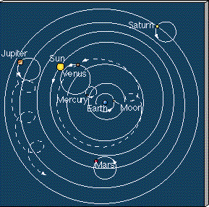
Ptolemaic model

Slide 23
The Renaissance and birth of heliocentric models
In the 1500s and 1600s, Europe went through Renaissance, where many ideas were reconsidered
Copernicus, a Polish astronomer, suggested a dramatically different model of the Solar System, a heliocentric model, with the Sun at the center
Copernicus preserved the idea that planets orbited in circular orbits around the Sun, however
  Used model to predict location of planets, unfortunately, these didn’t turn out so well!
Big debate ensued, between geocentric and heliocentric models
  Debate was partly scientific, based on how well each model did in predicted where planets would be observed. Unfortunately, neither made perfect predictions!
  Debate was partly philosophical, as some people/institutions had strong opinions about Earth being centrally located

Slide 24
The impact of new technology
At the same time, new technology started to be used for astronomical observations
Galileo used optics to make telescopes to look at the sky
  Discovered moons around planets (Jupiter in particular) that clearly moved in orbit around the parent planet --> strong philosophical implication that there are objects that orbit something beside the Earth!
  Discovered that planets are resolved disks. Observed that Venus went through phases, which could be explained by the heliocentric model, but not by the geocentric model

Slide 25
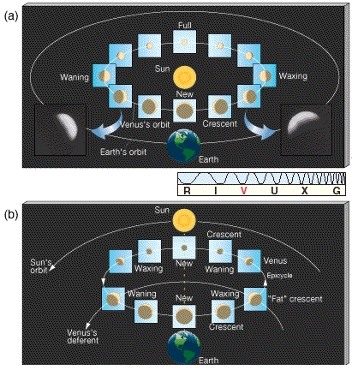
The phases of Venus

Slide 26
The value of accurate data
Despite the evidence for a heliocentric model, there was still the problem that the model of Copernicus failed to predict locations of planets perfectly
Tycho Brahe was an astronomer who realized that getting the most precise measurements of planetary positions would be of great value to constrain theories about how the Solar System is laid out
  He spent several years in the late 1500's collecting precise data on planetary positions, and made these available for others to think about
Many people (including Tycho) tried to devise models to reproduce the observations
Finally, one succeeded ….. Johannes Kepler

Slide 27
To do
Lab this week: Moon lab
Canvas assignment due Wednesday
Observing the sky assignment due Monday

