Slide 1
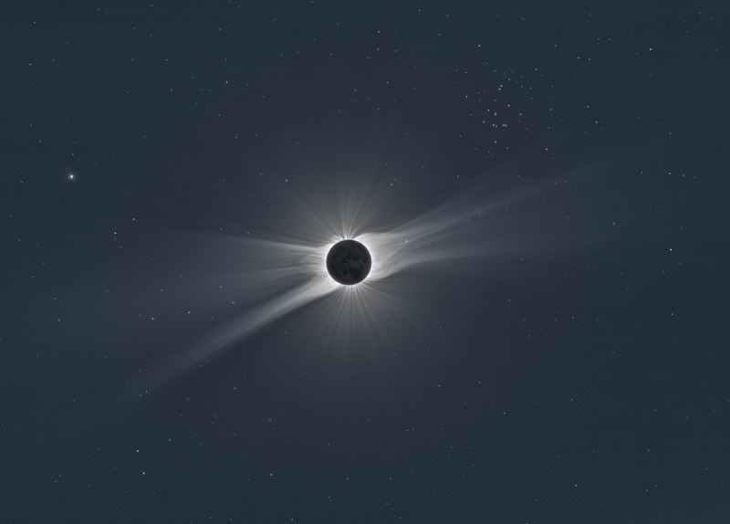
Moon
Phases and eclipses

Slide 2
Recap
New Canvas homework to be posted due next Wednesday
Midterm 2 weeks from today: 9/27
Moon
  Orbit of the Moon and changing time of day when you can see it: motion of Moon in the sky
  Phases of the Moon: related to location of Moon in its orbit because of relative configuration of Sun, Moon, and Earth
    Phase of moon is correlated with time of day when Moon is above the horizon

Slide 3
What phase of the Moon is being shown?
A. New
B. Crescent
C. Quarter
D. Gibbous
E. Full

Slide 4
You see the full moon rising over the eastern horizon. What time is it?
A. Noon
B. Sunset
C. Midnight
D. Sunrise
E. It depends on the time of year

Slide 5
You see the first quarter moon rising over the eastern horizon. What time is it?
A. Noon
B. Sunset
C. Midnight
D. Sunrise
E. Can’t tell for sure

Slide 6
You see the third quarter moon passing nearly directly overhead. What time is it?
A. Noon
B. Sunset
C. Midnight
D. Sunrise
E. Can’t tell for sure

Slide 7
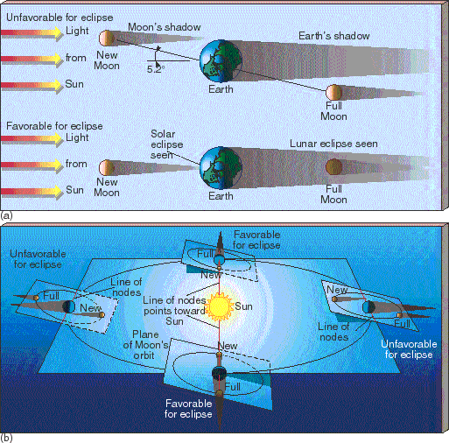
Eclipses
Eclipses occur when the Earth, Moon, and Sun are directly in line, so that the Earth blocks light from reaching the Moon, or the Moon blocks light from reaching the Earth
  Solar eclipse: Moon between Earth and Sun
  Lunar eclipse: Earth between Moon and Sun
  Note these can only occur at particular phases of the Moon!
Eclipses do not happen frequently because of the tilt of the Moon’s orbit relative to the plane in which the Earth revolves around the Sun
  Since tilt is constant as Earth orbits the Moon, there are two times during the year when eclipses are possible -- if Moon is at the right phase during these times!

Slide 8
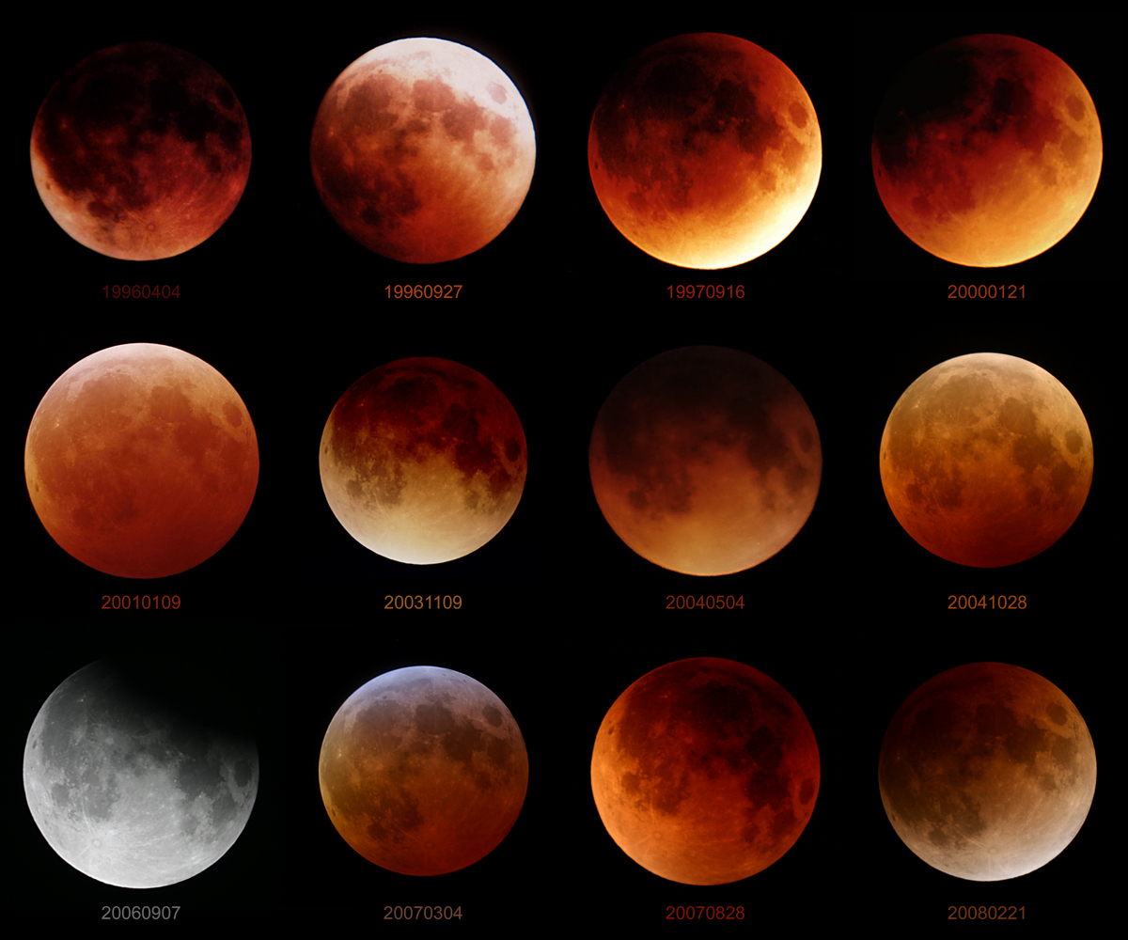
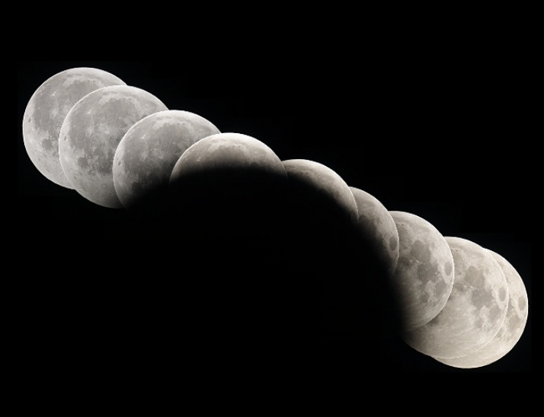
Lunar eclipses: appearance
Earth is bigger than Moon, so it casts a larger shadow: entire Moon fits inside of this
  When there is a lunar eclipse, it can be seen from anywhere on Earth
  Lunar eclipses last for several hours
  During a lunar eclipse, Earth’s atmosphere refracts some sunlight, so Moon can still be faintly seen

Slide 9
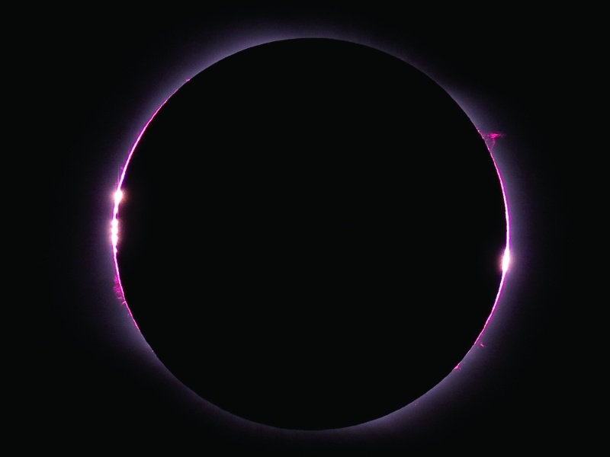
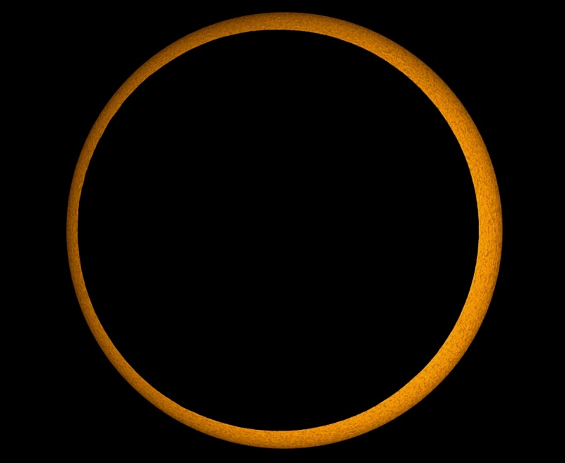
Solar eclipses: appearance
Moon is smaller than Earth, so it casts a smaller shadow, and the full shadow only hits a small piece of Earth
  When there is a solar eclipse, it can only be seen from a small strip on Earth
  Solar eclipse only lasts several minutes, before a given location on Earth rotates out of the shadow
  Coincidence: apparent size of Moon is about the same as apparent size of Sun! But there is some variation since orbit of Moon is slightly elliptical

Slide 10
Say I told you that there was going to be a lunar eclipse in one week. What would be the phase of the Moon today?
New
First quarter
Full
Third quarter
Waning crescent

Slide 11
Motion of planets in the sky
More complicated than motion of Sun, stars, or Moon, because apparent motion is combination of:
  Reflex motion of Earth’s rotation
  Reflex motion of Earth’s revolution
  Intrinsic motion of planet around Sun
Motion of planets very important in historical context of how we came to figure out the nature of the Solar System

Slide 12
Planetary orbits
All planets go around the Sun in the same direction
All major planets go around the Sun in approximately the same plane
Planets nearer the Sun move faster than those further out

Slide 13
Imagine the Earth stood perfectly still (no rotation, no revolution), and we were watching Mars as it orbited the Sun. How would Mars appear to move in the sky?
A. Mars would move in a big circle around the sky once every 24 hours
B. Mars would move in a big circle around the sky once every year
C. Mars would move in a big circle around the sky over the time period in which Mars makes one full revolution around the Sun (almost 2 years)
D. Mars would travel back and forth along a line in the sky
E. Mars would not appear to move at all

Slide 14
Imagine Mars stood perfectly still (no rotation, no revolution), and we were watching Mars as Earth rotated around its axis, imagining for the time being that rotation was the only motion. How would Mars appear to move in the sky?
A. Mars would move in a big circle around the sky once every 24 hours
B. Mars would move in a big circle around the sky once every year
C. Mars would move in a big circle around the sky over the time period where Mars makes one full revolution around the Sun
D. Mars would travel back and forth along a line in the sky
E. Mars would not appear to move at all

Slide 15
Imagine Mars stood perfectly still (no rotation, no revolution), and we were watching Mars as Earth revolved around the Sun, imagining for the time being that revolution was the only motion. How would Mars appear to move in the sky?
A. Mars would move in a big circle around the sky once every 24 hours
B. Mars would move in a big circle around the sky once every year
C. Mars would move in a big circle around the sky over the time period where Mars makes one full revolution around the Sun
D. Mars would travel back and forth along a line in the sky
E. Mars would not appear to move at all

Slide 16
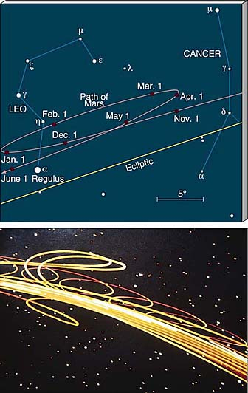
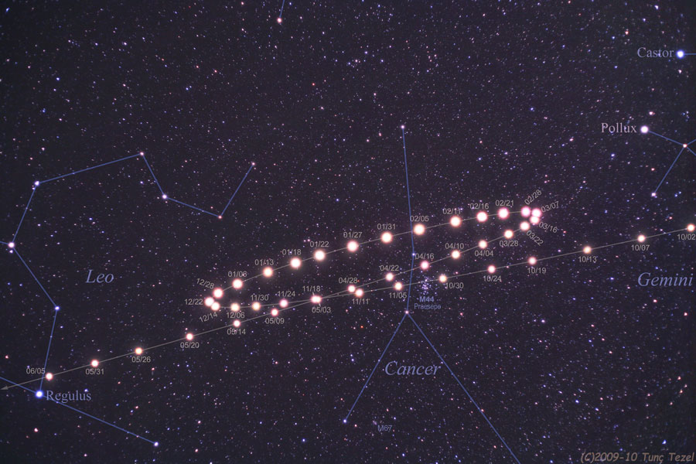
Retrograde motion
Because of combination of intrinsic and reflex motion, apparent motion of planets can be complex
Planets don’t always appear to move the same direction over the course of a year
  Different from stars, Sun, and Moon
  People have recognized this for a long time and knew that the planets were somehow different!
The “backing up” of the planets is known as retrograde motion
  Outer planets show retrograde motion because they are moving slower than us, so when the Earth “passes” them, they appear to back up
  Inner planets show retrograde motion because they are orbiting Sun faster than us and we view their motion from outside their orbits

Slide 17
Planets: appearance
When you look at planets through even a small telescope, you see that they are close enough so that you can actually see the disk of the planet
  Even without a telescope, because their apparent size is bigger than that of stars, they often don’t twinkle as much
When you use a telescope, you can see that planets, like the Moon, have phases
  Makes sense, because we see planets because they reflect light from the Sun: phases occur when things are seen in reflected sunlight, because the position of THREE things matter: Sun, Earth, and object

Slide 18
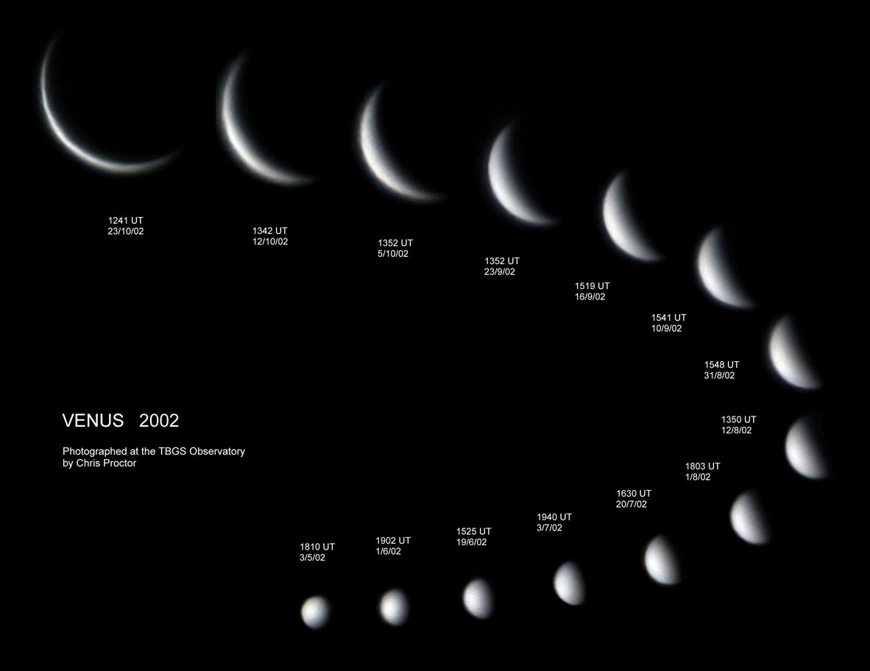
Imagine we looked at Venus over the time it took Venus to make a complete orbit around the Sun. We see Venus because it is reflecting light from the Sun. If we looked at Venus through a telescope, we would see
A. that Venus always looks "full", i.e. we would always see the fully illuminated half of Venus
B. that the part of Venus that we could see from Earth wasn't fully illuminated, and always looked like it was in "crescent phase"
C. that the part of Venus that we could see from Earth was sometimes fully illuminated, but sometimes looked like it was in "gibbous phase"
D. that Venus went through the full set of different phases over the course of its year

Slide 19
Imagine we looked at Jupiter over the time it took Jupiter to make a complete orbit around the Sun. We see Jupiter because it is reflecting light from the Sun. If we looked at Jupiter through a telescope, we would see
A. that Jupiter always looks "full", i.e. we would always see the fully illuminated half of Jupiter
B. that the part of Jupiter that we could see from Earth wasn't fully illuminated, and always looked like it was in "crescent phase"
C. that the part of Jupiter that we could see from Earth was sometimes fully illuminated, but sometimes looked like it was in "gibbous phase"
D. that Jupiter went through the full set of different phases over the course of its year

Slide 20
Planets: phases
When you look at planets through a telescope, you see they have phases
  Planets closer to Sun than Earth (Mercury and Venus) have all phases
  Planets farther from Sun than Earth only have phases full or close to it
Without a telescope, you can’t see the phases!

Slide 21
Planets: time of day
Not all planets can be seen at all times of day!

Slide 22
If you watch over the course of several years, at what times of day can you see Venus (imagining that it was possible to see it even during daytime)?
A. At all times of day
B. Only during the middle of the night
C. Only during the middle of the day
D. Only in daytime, and shortly before or after sunrise/sunset
E. never

Slide 23
If you watch over the course of several years, at what times of day can you see Jupiter (again, imagining that it was possible to see even during daytime)?
A. At all times of day
B. Only during the middle of the night
C. Only during the middle of the day
D. Only in daytime, and shortly before or after sunrise/sunset
E. never

Slide 24
Planets: time of day
When can you see Mercury and Venus?
  Always seen “near” the Sun, so always during daytime or close to it
  The “evening” or “morning” star
When can you see planets that orbit farther from the Sun than Earth?
  Depends on their location in their orbit
  Over time, can be seen anytime of day

Slide 25
To do
Canvas homework on seasons and moon
Next week lab: Moon
Next motions in the sky assignment?

