Slide 1
Moon
Phases and eclipses

Slide 2
Recap
Seasons: arise from tilt of Earth’s rotation axis
Path of Sun across sky changes over the course of year, sometimes higher, sometimes lower
Concentration of sunlight
Length of day
Seasons on other planets

Slide 3
Reflex motion of stars from Earth’s revolution
We talked about reflex motion of stars and Sun from Earth’s rotation (circles in the sky)
We talked about reflex motion of Sun from Earth’s revolution (different constellations at different times of year, seasons)
What about reflex motion of stars from Earth’s revolution?
Stars are very far away compared to distance between Earth and Sun
Nonetheless, there is a very small effect, detectable for the nearest stars, arising from viewing them from different sides of the Sun; this is called parallax
Parallax is very important from the respect of measuring distances to astronomical objects, as we’ll discuss later

Slide 4
The rising and setting of the Sun each day is caused by:
A. intrinsic motion of the Sun around the Earth
B. reflex motion from Earth rotating on its axis
C. the 23.5 degree tilt of the Earth’s axis
C. reflex motion from Earth revolving around the Sun
D. intrinsic motion of the Sun around the center of the Milky Way

Slide 5
The circular motion of the stars around the North Star is caused by:
A. intrinsic motion of the stars around the North Star
B. reflex motion from Earth rotating on its axis
C. the 23.5 degree tilt of the Earth’s axis
D. reflex motion from Earth revolving around the Sun
E. intrinsic motion of the stars around the center of the Milky Way

Slide 6
The changing of constellations that can be seen at different times of year is caused by:
A. intrinsic motion of the stars around the Earth
B. motion of Earth rotating on its axis
C. the 23.5 degree tilt of the Earth’s axis
D. motion of Earth revolving around the Sun
E. intrinsic motion of the stars around the center of the Milky Way

Slide 7
Parallax occurs as a result of:
A. intrinsic motion of the Sun around the center of the Milky Way
B. reflex motion from Earth rotating on its axis
C. the 23.5 degree tilt of the Earth’s axis
D. reflex motion from Earth revolving around the Sun
E. intrinsic motion of the stars around the center of the Milky Way

Slide 8
Seasons occur as a result of:
A. the rotation of Earth on its axis
B. the changing distance of the Sun from the Earth as the Earth revolves around the Sun
C. the 23.5 degree tilt of the Earth’s rotation axis relative to the plane in which it revolves around the Sun
D. variation in the temperature of the Sun at different times of year
E. the fact that one hemisphere of Earth is closer to the Sun than the other hemisphere

Slide 9
Today
Moon
Lab next week: Moon lab

Slide 10
Orbit of the Moon
Moon orbits around the Earth, once every 29 days or so
Plane of Moon’s orbit is close (but not identical) to plane of Earth’s orbit around Sun
Time of day Moon can be seen depends on where it is in its orbit relative to Sun

Slide 11
Motion of Moon & Time of Day
Moon’s declination changes like the Sun’s does, but over the course of a month, not a year!
Path of Moon through the sky changes over the course of a month
Each day/night, Moon moves across sky because of reflex motion of Earth’s rotation
On top of this, intrinsic motion of Moon, from W to E, is visible from night to night

Slide 12
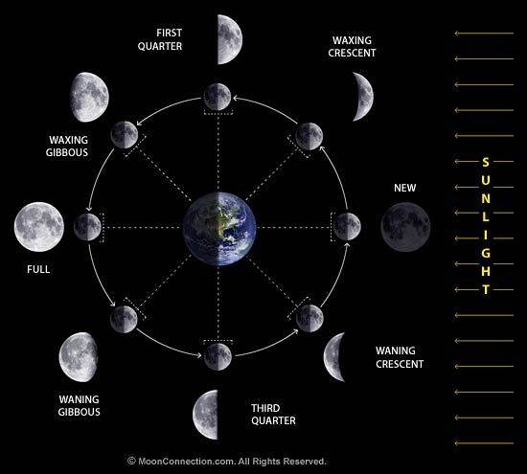
Phases of the Moon
We see moon because it reflects sunlight
Appearance of Moon depends on relative locations of Sun, Earth, and Moon --> phases of the moon
Half of the Moon is always lit up -- the half facing the Sun
We see different fractions of this half depending on where the Moon is in its orbit

Slide 13
Moon phases AND time of day
Both time of day when Moon can be seen and phase of Moon depend on where Moon is in its orbit
As a result, a given phase always rises and sets about the same time
Animation: http://astro.unl.edu/naap/lps/animations/lps.html

Slide 14
What phase of the Moon is being shown?
A. New
B. Crescent
C. Quarter
D. Full

Slide 15
You see the full moon rising over the eastern horizon. What time is it?
A. Noon
B. Sunset
C. Midnight
D. Sunrise
E. Can’t tell for sure

Slide 16
You see the first quarter moon rising over the eastern horizon. What time is it?
A. Noon
B. Sunset
C. Midnight
D. Sunrise
E. Can’t tell for sure

Slide 17
You see the third quarter moon passing nearly directly overhead. What time is it?
A. Noon
B. Sunset
C. Midnight
D. Sunrise
E. Can’t tell for sure

Slide 18
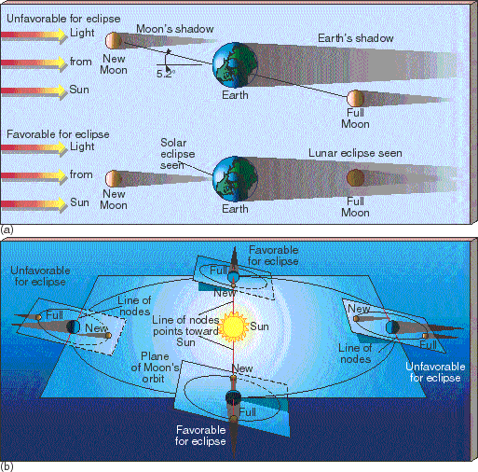
Eclipses
Eclipses occur when the Earth, Moon, and Sun are directly in line, so that the Earth blocks light from reaching the Moon, or the Moon blocks light from reaching the Earth
Solar eclipse: Moon between Earth and Sun
Lunar eclipse: Earth between Moon and Sun
Note these can only occur at particular phases of the Moon!
Eclipses do not happen frequently because of the tilt of the Moon’s orbit relative to the plane in which the Earth revolves around the Sun
Since tilt is constant as Earth orbits the Moon, there are two times during the year when eclipses are possible -- if Moon is at the right phase during these times!

Slide 19
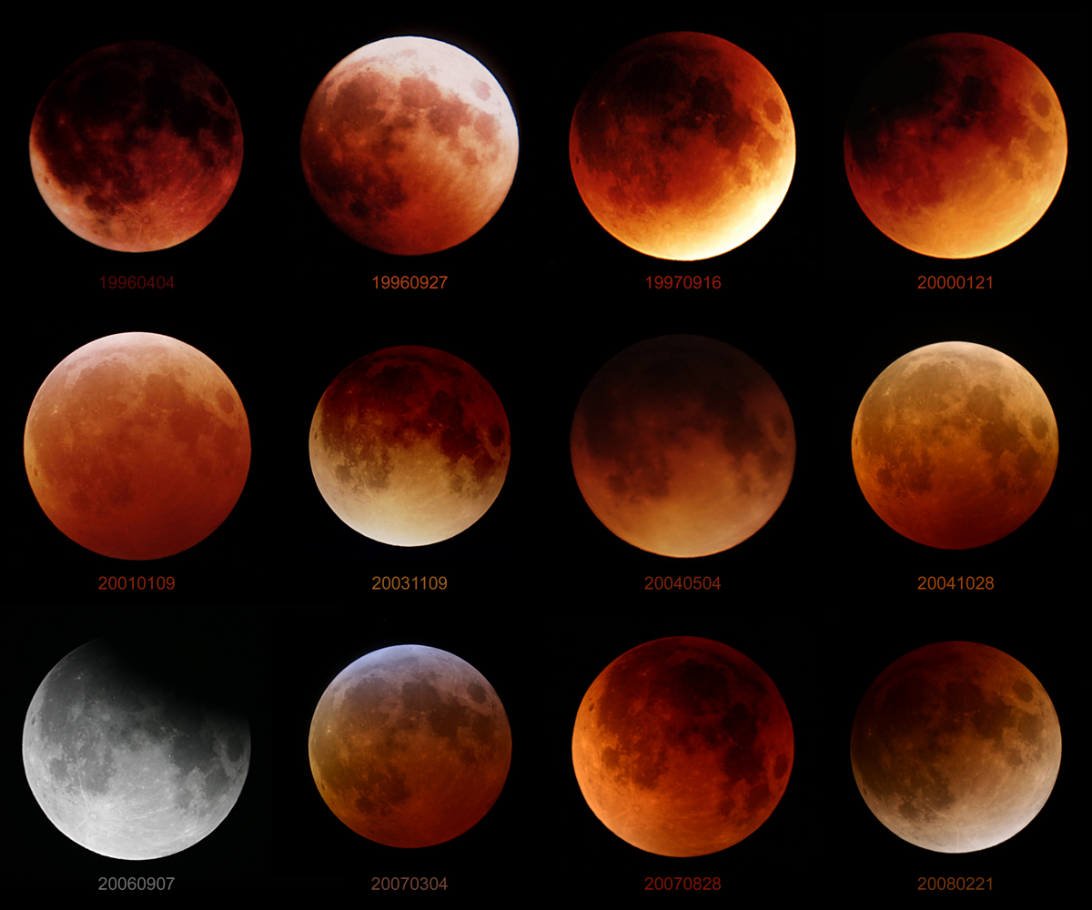
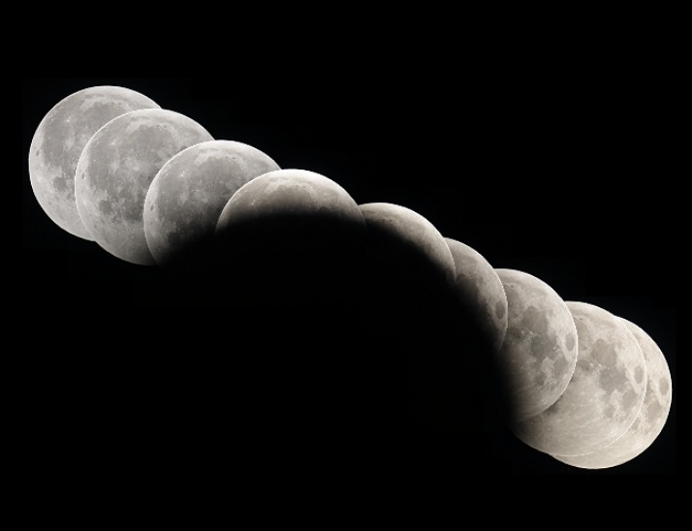
Lunar eclipses: appearance
Earth is bigger than Moon, so it casts a larger shadow: entire Moon fits inside of this
When there is a lunar eclipse, it can be seen from anywhere on Earth
Lunar eclipses last for several hours
During a lunar eclipse, Earth’s atmosphere refracts some sunlight, so Moon can still be faintly seen

Slide 20
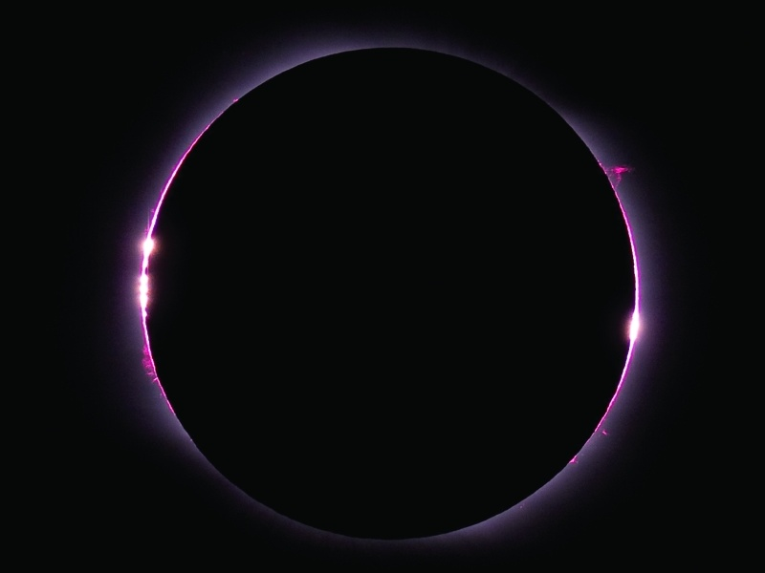
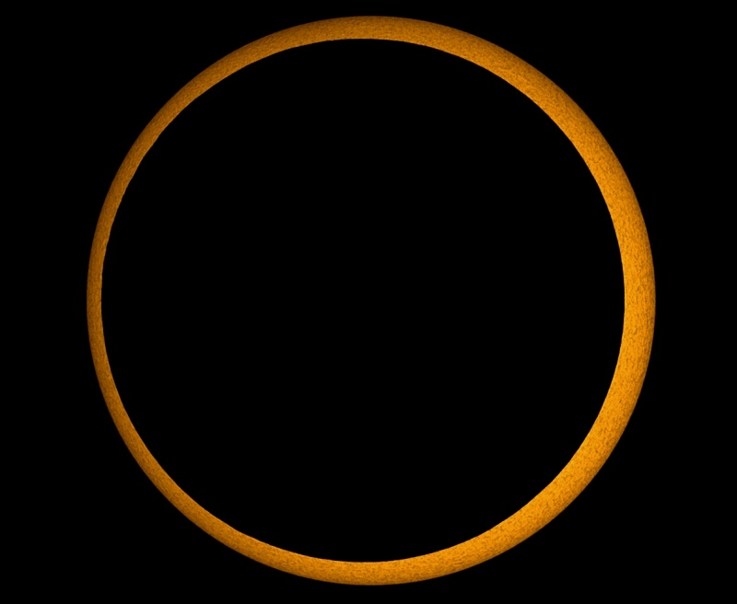
Solar eclipses: appearance
Moon is smaller than Earth, so it casts a smaller shadow, and the full shadow only hits a small piece of Earth
When there is a solar eclipse, it can only be seen from a small strip on Earth
Solar eclipse only lasts several minutes, before a given location on Earth rotates out of the shadow
Coincidence: apparent size of Moon is about the same as apparent size of Sun! But there is some variation since orbit of Moon is slightly elliptical

Slide 21
To do
Lab this week and next
Next motions in the sky assignment

