Slide 1
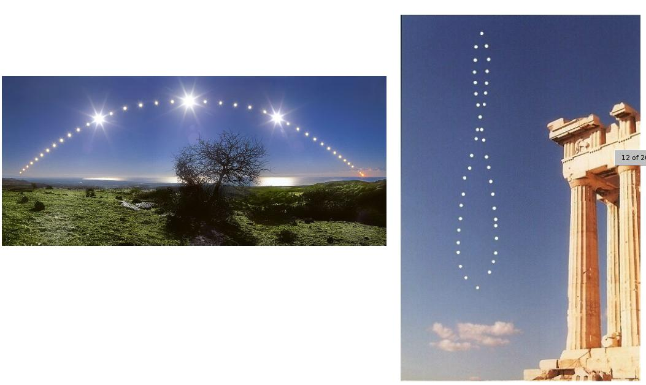
Astronomy by eye: motions in the Sky
Effects from Earth’s revolution around Sun
Seasons

Slide 2
Recap
Canvas assignment: science and pseudo science due WEDNESDAY: includes reading!
Previous assignment on motions in the sky
Lab this week: Seasons
Remember: campus observatory
Astronomy by eye: motions in the sky
  Objects can appear to move because of intrinsic motion and/or reflex motion
  Reflex motion from Earth’s rotation: celestial sphere appears to spin around once per day
    Apparent motion in sky depends on declination of object and where on Earth you’re looking from
  Reflex motion from Earth’s revolution around Sun

Slide 3
Reflex motion from Earth’s revolution
In addition to rotating on its axis, the Earth revolves around the Sun, once a year
As a result, the Sun appears to move with respect to the stars
  it passes through the constellations of the zodiac
  Of course, we don’t really see this because we can’t see the constellations when the Sun is up!
Because of the Earth’s revolution, we see different stars at night over the course of the year

Slide 4
Tilt of Earth’s axis
The Earth’s revolution around the Sun defines a plane
The Earth’s rotation axis is tilted, by 23.5 degrees, relative to the plane in which the Earth revolves around the Sun
The direction of the tilt is fixed in space, so it defines some special places in the Earth’s orbit:
  Solstices when the north pole is pointed towards or away from the Sun (although it never points directly at the Sun)
  Equinoxes when then the rotation axis is pointed perpendicular to the direction of the Sun

Slide 5
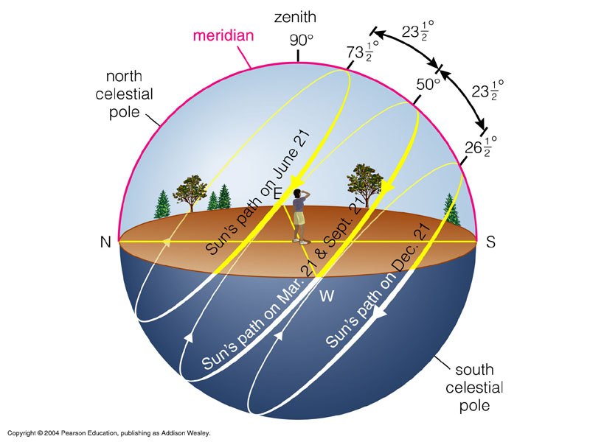
Path of the Sun in the Sky
Because of this tilt, the latitude (declination) of the Sun changes over the course of a year
Since the motion of an object across the sky depends on its declination, the motion of the Sun across the sky changes over the course of a year

Slide 6
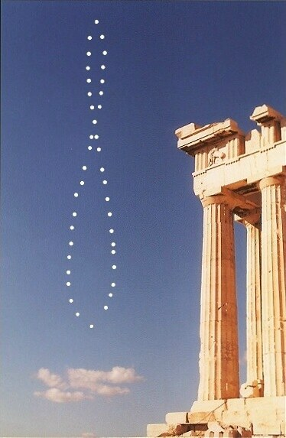
Sun’s position over the course of a year at the same time each day: the Analemma

Slide 7
Seasons
Because of the change of the Sun’s path across the sky over the course of a year, we have seasons: the temperature is different at different times of the year
Why?

Slide 8
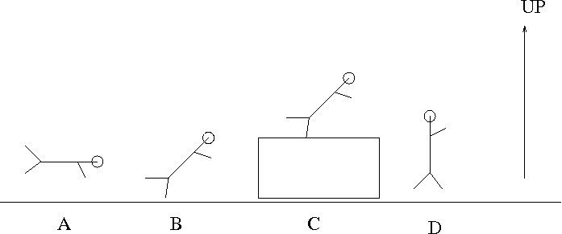
Imagine you are outside at the pool with the Sun overhead and you want to maximize the tan you get on your back. Which of the following positions would you choose? Why?

Slide 9
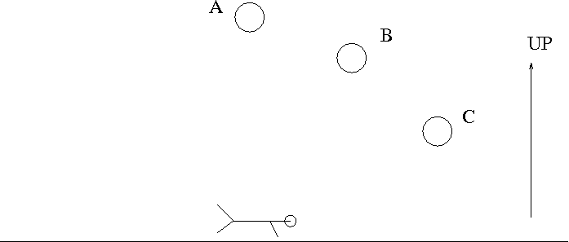
Imagine you are at at tanning salon and want to maximize the tan you get on your back. Which of the following positions would you choose to put the light? Note that all positions have the light at the same distance from your back.

Slide 10
Seasons: concentration of sunlight
When the Sun is higher in the sky, its light is more concentrated on the Earth, so it is warmer
  Also explains why it is warmer at lower latitudes on Earth than at higher latitudes
  Concentration of sunlight has nothing to do with the distance of the Earth from the Sun

Slide 11
Seasons: length of day
When the Sun is higher in the sky, it stays above the horizon for longer, contributing to making it warmer
  Concentration is more important, however: during summer at the North Pole, the Sun is up for 24 hours, but it’s still colder up there because the Sun is low in the sky the entire time!
  Useful animation? http://www.edumedia-share.com/media.php?id=964

Slide 12
Seasons: location on Earth
Because of the tilt of the Earth’s rotation axis, the latitude (declination) of the Sun changes over the year
When the Sun is at northern declinations, it is higher in the sky in the northern hemisphere, but lower in the sky in the southern hemisphere!
When the Sun is at southern declinations, it is lower in the sky in the northern hemisphere, but higher in the sky in the southern hemisphere!
As a result, seasons are reversed between the two hemispheres: summer in north is winter in south, and vice versa

Slide 13
Seasons: distance of Earth from Sun
Seasons on Earth have NOTHING TO DO with changing distance of Earth from Sun
  The Earth’s orbit is almost a perfect circle, the small deviations from this have only a tiny effect on the temperature. In fact, the Earth is slightly closer to the Sun during northern winter!
  While the tilt of the Earth’s axis causes some portions of the Earth to be ever so slightly closer to the Sun, this has a negligible effect on the temperature. Remember, the size of the Earth is tiny compared to the distance from the Sun!

Slide 14
Seasons on other planets
Seasons result from the tilt of the rotation axis relative to the plane of revolution around the Sun
Different planets have different tilts, hence different seasons!
Jupiter: tilt is nearly zero!
Uranus: tilt is nearly 90 degrees
Mars: tilt is about 23 degrees, just like Earth
  But Mars is more complicated, because its orbit is actually significantly non-circular, which is different from the Earth!

Slide 15
Reflex motion of stars from Earth’s revolution
We talked about reflex motion of stars and Sun from Earth’s rotation (circles in the sky)
We talked about reflex motion of Sun from Earth’s revolution (different constellations at different times of year, seasons)
What about reflex motion of stars from Earth’s revolution?
  Stars are very far away compared to distance between Earth and Sun
  Nonetheless, there is a very small effect, detectable for the nearest stars, arising from viewing them from different sides of the Sun; this is called parallax
  Parallax is very important from the respect of measuring distances to astronomical objects, as we’ll discuss later

Slide 16
The rising and setting of the Sun each day is caused by:
A. intrinsic motion of the Sun around the Earth
B. reflex motion from Earth rotating on its axis
C. reflex motion from Earth revolving around the Sun
D. intrinsic motion of the Sun around the center of the Milky Way

Slide 17
The circular motion of the stars around the North Star is caused by:
A. intrinsic motion of the stars around the North Star
B. reflex motion from Earth rotating on its axis
C. reflex motion from Earth revolving around the Sun
D. intrinsic motion of the stars around the center of the Milky Way

Slide 18
The changing of constellations that can be seen at different times of year is caused by:
A. intrinsic motion of the stars around the Earth
B. motion of Earth rotating on its axis
C. motion of Earth revolving around the Sun
D. intrinsic motion of the stars around the center of the Milky Way

Slide 19
Parallax occurs as a result of:
A. intrinsic motion of the Sun around the center of the Milky Way
B. reflex motion from Earth rotating on its axis
C. reflex motion from Earth revolving around the Sun
D. intrinsic motion of the stars around the center of the Milky Way

Slide 20
Seasons occur as a result of:
A. the rotation of Earth on its axis
B. the changing distance of the Sun from the Earth as the Earth revolves around the Sun
C. the tilt of the Earth’s rotation axis relative to the plane in which it revolves around the Sun
D. variation in the temperature of the Sun at different times of year

Slide 21
To do
Lab this week: Seasons!
Canvas assignment – includes reading!

