Slide 1
Observing the night sky Science issues in the world Pseudoscience /astrology

Slide 2
Recap
Class photos / roster
No lab next week: next class Wed
Observing sky project due Wednesday
Astronomy and Science
Models and theories
The scientific process
Observing the night sky
Testing models that explain the motion of the Sun across the sky

Slide 3
Observing the night sky
How many of the following objects were you able to identify in the sky: Jupiter, Orion, North Star, Venus?
0
1
2
3
4

Slide 4
Observing the night sky
Which best describes your observations?
I was unable to detect any motion of any objects across the sky
I was able to detect the motion of objects, but was unable to judge whether they were all moving at the same rate
I was able to detect the motion of objects, and found they all moved at the same rate
I was able to detect the motion of objects, and found that they moved at different rates
I was unable to measure anything or did not complete the assignment

Slide 5
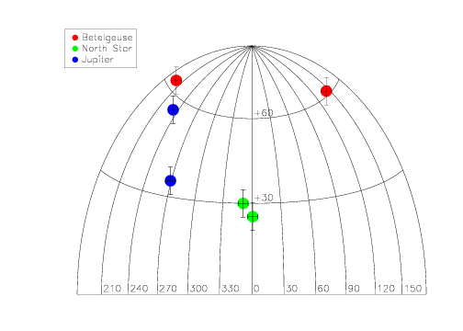
Observing the night sky
Which best describes the observations?
The data suggest there is no motion of any objects across the sky
The data suggest that objects move, but we are unable to judge whether they were all moving at the same rate
The data suggest that all obects move at the same rate
The data suggest that objects moved at different rates
We cannot understand these data
Data obtained from measurements taken two hours apart.
Note the “wrap” of the map

Slide 6
Testing the model
Observing that stars move across the sky during the course of a night
Proves that the Earth rotates on its axis
Proves that the Earth revolves around the Sun
Proves that the Sun revolves around the Earth
Rejects the model that the Sun is the only object that is moving in space
Rejects the model that the Earth rotates on its axis

Slide 7
Today
Observing the sky
Science and science issues in the world
Good and bad science
Pseudoscience
Astrology

Slide 8
Directions and Distances in the Sky
North, South, East and West don’t really give enough information when looking at the sky. What direction is straight up?
To describe a location in the sky, you need to give two pieces of information: for example, which direction (NSEW) and then how far above the horizon
What’s the best unit to measure how far above horizon?
A. Inches
B. Feet
C. Light Years
D. Degrees
E. No idea what you’re talking about

Slide 9
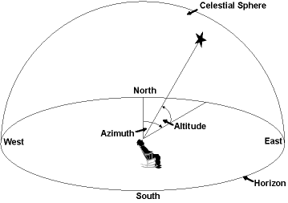
Angles in the Sky
Distances in the sky are best measured by angles: 360 degrees in a circle, 90 degrees from horizon to zenith
A convenient, approximate way to measure angles is using your fist held at arms length
How many degrees in one fist? (hint: how many fists from horizon to zenith?)
A. About 1 degree
B. About 10 degrees
C. About 20 degrees
D. About 45 degrees
E. No idea what you’re talking about
You might be able to come up with a better measuring device, something like a big protractor …. a sextant.

Slide 10
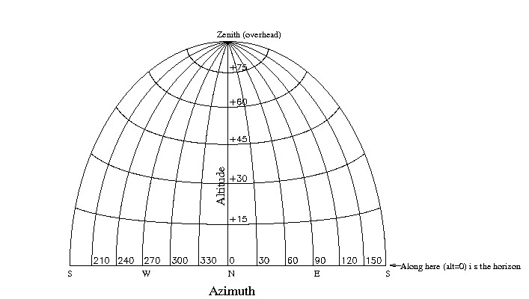
Assignment
Identify an object in the sky
Measure its position: two angles
Estimate the uncertainty in the position
Do it for several different objects
Wait a while (how long?)
Measure the positions again
Tabulate and plot your data …. With uncertainties
Using your data, has the object moved?
If so, can you calculate how fast?
Compare motions of different objects in the sky
See link on Canvas page

Slide 11
What to look for in the sky now
What you see in the sky depends on when you look: time of year and time of night!
For fall 2013, can find:
Planets: Venus, Saturn
Bright stars: summer triangle, Arcturus, Big Dipper
Moon (when it is up)
Milky Way (when Moon is not up)
Let’s look at some charts!

Slide 12
Finding and identifying objects in the sky: Useful resources
Astroviewer: http://www.astroviewer.com/interactive-night-sky-map.php)
UK National Schools Observatory (http://www.schoolsobservatory.org.uk/)
SkyMaps (http://www.skymaps.com/)
Numerous apps for cell phones!

Slide 13
Science in the real world
Although the process is well defined, in practice things can still be hard to figure out
Measurement uncertainties sometimes make it hard to know whether new data are inconsistent with a model/theory
People are reluctant to give up long-held beliefs. Many things we now think are self-evident were not always believed, and the transitions to newer ideas were not instantaneous!
Science is often applied to complex systems, e.g. weather, human body, where we don’t know enough to understand how things work from basic physical laws

Slide 14
Science issues today
Question: come up with at least one important issue in the world today than involves science, and develop a scientific question related to this issue. Remember, science is an evidence-based process for learning about the physical world
Climate change: is the climate changing? Why?
Energy: are energy resources finite? Are there different ways by which energy can be generated?
Medicine: are different drugs effective? Always? Sometimes?
Genetic engineering: is genetically engineered food healthy?
Environment: what are the effects of human activity on the environment?
Species preservation and extinction: is the number and diversity of species being affected by human activity?
Many others…

Slide 15
Opportunities and challenges of current science issues
There’s an interface between science and human activity: science can inform policy
Challenges
Some issues require decisions or actions before complete knowledge is obtained, e.g., climate change
Science and journalism: given lots of people, there are often multiple opinions. Are they all equally valid? What is “balanced” coverage?
Science and politics: many people have strongly held opinions based on political principles or associations
Do we really need to deal with these issues?--> YES, they impact your lives! Science is a powerful process that has improved our lives immensely, and has the potential to continue to do so -- if we stick with the process and not try to subvert it!

Slide 16
How do you decide?
You are often presented with multiple points of view about an issue where scientific data is relevant. What do you do?
A. think about which position “seems” right based on personal experience or personal consideration of the issues
B. Look at credentials of people presenting different points of view and believe the view of people with the “better” credentials
C. See how many “experts” believe each point of view and go with the point of view that more experts believe (“democracy” of experts).
D. See how many non-experts (i.e. general public) believe each point of view and go with the point of view that seems to be more popular (“democratic” approach)
E. Feel like it’s impossible to know for sure what’s going on, so don’t care

Slide 17
Hallmarks of good science
Useful to be able to assess reliability of scientific presentations of an issue. Some hallmarks of good science:
Credentials of people presenting the ideas
Reasonable assessment of uncertainties
Skepticism and qualification of opinions
States not only what is known, but also what is not known
Ironically, this qualification is often interpreted as indicating invalidity of conclusions
Although skepticism is good, skepticism must eventually be backed up by measurement; skepticism can be a way to hide unwillingness to accept new data
Peer review, publication of data
Reproducibility of results/measurements, especially by others
Lack of vested interest in the results
Willingness to reconsider

Slide 18
Problem: bad/misleading science
Problem of fraudulent science: fairly rare (e.g., fake/fudged data, etc.)
Problem of self-proclaimed scientists
Information age (Mars as big as the Moon?), organizational names
An example
Problem of vested interests: common!
Often, indirect influences, e.g., funding, or publication of results
Pseudoscience
Be aware!

Slide 19
Astrology
Which of the following applies to you?
I think astronomy and astrology are the same thing
I know the difference between astronomy and astrology
I know there’s a difference between astronomy and astrology, but I’m not sure what it is
Do you know your astrological sign?
Yes
No
Which of the following best applies to you?
A. I read horoscopes frequently, and think that they apply to me pretty accurately
B. I read horoscope frequently, but don't think they really mean much
C. I rarely or never read horoscopes

Slide 20
Pseudoscience
Pseudosciences are ideas about scientific topics, or topics that “sound scientific”, that have been rejected by studies using scientific methodology, but whose proponents persist in promoting them
Some examples:
“paranormal” phenomena, psychics, astrology
For some reason, there have become increasingly popular, not less so!
Can be an issue if people have a hard time distinguishing between science and pseudoscience
Can also be an issue because people get “fleeced”! (snake oil!)
Hallmarks of pseudoscience:
Unwillingness to relinquish theory, even after observation does not support it
Not peer reviewed

Slide 21
Astrology
What is astrology?
Astrology is something which purports that the position of the planets and the stars at the time of your birth determines the course of your future life
Is wondering about this idea in the first place non-scientific?
Yes
No
Given the hypothesis of astrology, what would be the next step in analyzing it scientifically?

Slide 22
Observations/data relevant to astrology
There is no evidence that astrology actually works.
Note that the predictions of astrology may work sometimes; almost certainly, some of these predictions will work sometimes by chance! Certainly, astrology is not a fully deterministic theory; if it claimed to be so, even a single example of a failed astrological prediction would invalidate the theory.
Even as a statistical theory, astrology fails to be validated by experiment.
A link to some studies on the predictions of astrology: http://www.astrosociety.org/education/resources/pseudobib.html#1

Slide 23
Theoretical basis for astrology?
Is it surprising that astrology doesn’t work? Are there successful scientific theories that make predictions about astrology?
Current theoretical understanding, which has been well supported by observation, says there are four basic forces in nature:
Gravity
Electromagnetic force
Strong force
Weak force
When quantitatively calculated, the force arising from planets and stars at the moment of your birth from any of these sources is much smaller than the force contribution from many other objects! So in no way would it be expected that the position of astronomical objects would have an impact

Slide 24
To do
Night sky assignment: look at the sky!
Look up on web information about motion of stars in the sky and the concept of the celestial sphere

