Slide 1
Science: methods and scientific models/theory

Slide 2
Recap
I. Astronomy and Science
Science is an evidence-based way of looking at the world; we are compelled to only consider ideas that are consistent with measurements (observations, data)
Most measurements have uncertainties
sometimes make interpretation more challenging
Understanding of uncertainties is important
Sometimes scientists call uncertainties “errors”

Slide 3
Today
Process of science: models and theories
Observing the night sky: collecting your own data!
Science in the world today

Slide 4
Process of science
Observations lead scientists to construct models about what is going on that are consistent with the observations
A model tries to fit observations into a description of what is going on
Example: weight gain
Example: Data shows that planets more distant from Sun take longer to go around Sun than closer ones
Scientific theories address the question “Why?” and often explain multiple observations or models with a single idea
Example: Why do more distant planets take longer to go around? Theory: gravity
In science, theory means a very well tested idea! (in contrast to other common uses of the word)

Slide 5
Testing scientific models and theories: what is true?
Hard to prove that a model or theory is absolutely true
Easier to prove that a model or theory is false!
Just find one well-measured example where it fails
A good theory is one that has not been proved false, despite many efforts
A good theory will make predictions for things to observe that weren’t observed before the theory was developed
A good theory is often simpler: given two acceptable theories, the simpler one, or the one that explains more phenomena, is preferred
Models that are backed up by a theory are preferred to those that are not
Models / theories can only be rejected based on evidence, not on opinion

Slide 6
The scientific process
Idea/
Curiousity
Observation/
Measurement
No, wrong, new model!
Model/Theory
OK?
Yes
Prediction
Test by
measurement

Slide 7
Example: Earth / Sun motion
Do we see the same stars/constellations at different times of the year?
We observe that we see different stars at different times of the year
Why?
Model 1: Sun goes around Earth

Slide 8
Scientific analysis question
The idea that the Sun goes around the Earth is:
A. wrong because of the philosophical principle that it is unlikely that humans would exist on something that was at the center of something
B. correct because of the philosophical principle that humans are so special that they must be located at the center of the Solar System
C. interesting but untestable
D. proved wrong because we see the Sun moving across the sky
E. none of the above

Slide 9
Example: Earth / Sun motion
We observe that we see different stars at different times of the year
Model 1: Sun goes around Earth
Model 2: Earth goes around Sun
Can you come up with a prediction of one model that differs from the prediction of the other?

Slide 10
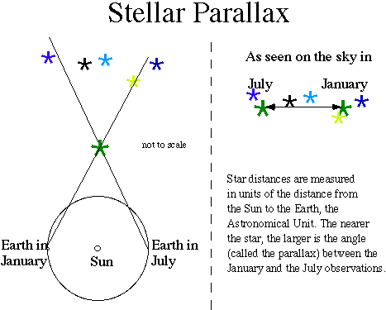
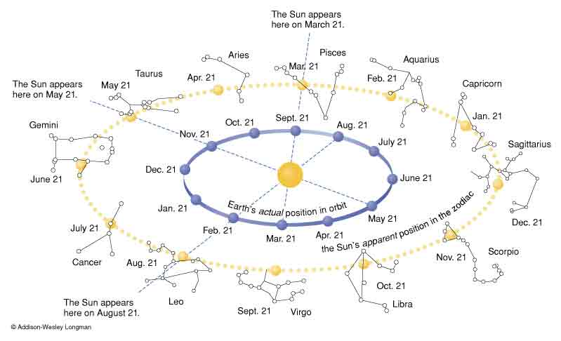
Astronomical example
Observation:
different stars are seen at different times of year
Model:
Earth goes around the Sun once a year
Prediction
Stars will appear in different directions at opposite points of orbit (parallax)
Observation
Originally, not seen! --> MODEL REJECTED!
With advances in technology, seen! --> NOT REJECTED AFTER ALL!

Slide 11
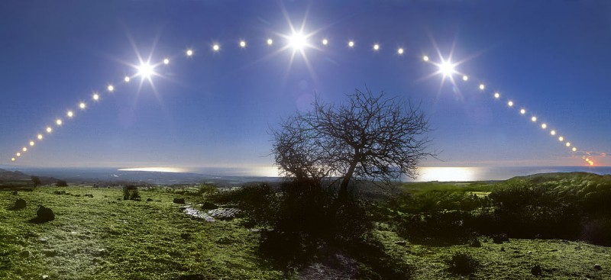
What is moving?
Picture shows the position of the Sun in the sky over the course of a day (at the winter solstice)
Can you develop a model that explains this observation?
Can you come up with an alternative model?
How might you decide between them?
One idea: what about other objects in the sky aside from the Sun?

Slide 12
Earth/Sun motion
This one is actually not so easy!
Not widely accepted that Earth was moving, not Sun, until about 500 years ago
New technology makes issue fairly clear, but again, the correct model was known before this new technology was available

Slide 13
Let’s do it!
Do stars appear to move across the sky?
Can you measure how fast they are moving? Are they all moving at the same rate?
Do planets and stars appear to move at the same rate?
Assignment:
At night, measure the location of several objects at several different times.
See if data are consistent with the model
Remember to include errors on your measurements!

Slide 14
Viewing the night sky
Find a good location: relatively dark, no tall buildings or trees
Orient yourself: find the directions
Which direction is the front of the classroom?
North
East
South
West

Slide 15
Directions and Distances in the Sky
North, South, East and West don’t really give enough information when looking at the sky. What direction is straight up?
To describe a location in the sky, you need to give two pieces of information: for example, which direction (NSEW) and then how far above the horizon
What’s the best unit to measure how far above horizon?
A. Inches
B. Feet
C. Light Years
D. Degrees
E. No idea what you’re talking about

Slide 16
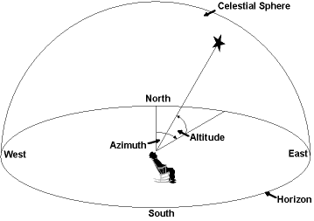
Angles in the Sky
Distances in the sky are best measured by angles: 360 degrees in a circle, 90 degrees from horizon to zenith
A convenient, approximate way to measure angles is using your fist held at arms length
How many degrees in one fist? (hint: how many fists from horizon to zenith?)
A. About 1 degree
B. About 10 degrees
C. About 20 degrees
D. About 45 degrees
E. No idea what you’re talking about
You might be able to come up with a better measuring device, something like a big protractor …. a sextant.

Slide 17
What to look for in the sky now
What you see in the sky depends on when you look: time of year and time of night!
For fall 2013, can find:
Planets: Venus, Saturn
Bright stars: summer triangle, Arcturus, Big Dipper
Moon (when it is up)
Milky Way (when Moon is not up)
Let’s look at some charts!

Slide 18
Finding and identifying objects in the sky: Useful resources
Astroviewer: http://www.astroviewer.com/interactive-night-sky-map.php)
UK National Schools Observatory (http://www.schoolsobservatory.org.uk/)
SkyMaps (http://www.skymaps.com/)
Numerous apps for cell phones!

Slide 19
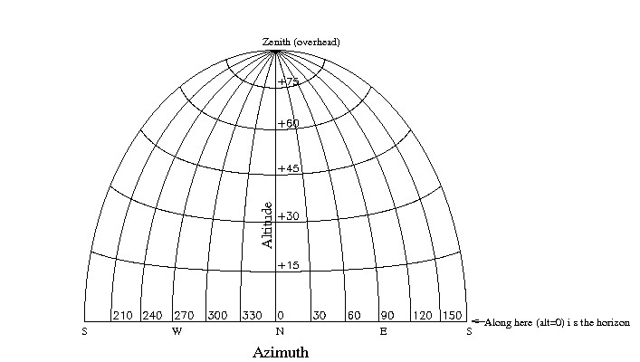
Assignment
Identify an object in the sky
Measure its position: two angles
Estimate the uncertainty in the position
Do it for several different objects
Wait a while (how long?)
Measure the positions again
Using your data, has the object moved?
If so, can you calculate how fast?
Compare motions of different objects in the sky
See link on Canvas page

Slide 20
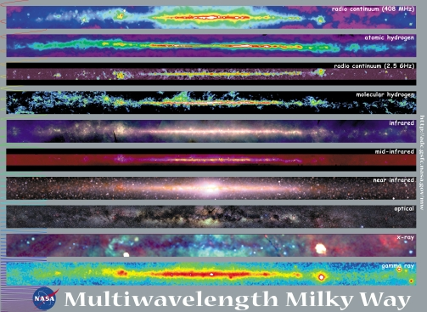
Another example: location of Solar System in the Galaxy
Question
Is the Solar System in the middle of the Milky Way galaxy?
Model/hypothesis
Sun is in the middle of a big ball of stars
Prediction:
Equal number of stars in different directions
Observation:
More stars spread around a line in the sky
Modified model:
Sun in in the middle of a big disk of stars
Prediction:
Equal numbers of stars in different directions in the disk
Observation:
Roughly equal numbers of stars in different directions in the disk --> MODEL OK
Many more clusters of stars in one direction than in others --> MODEL NOT OK
Modified model:
Sun in the outer regions of disk, dust prevent more stars being seen in central direction

Slide 21
Science in the real world
Although the process is well defined, in practice things can still be hard to figure out
Measurement errors sometimes make it hard to know whether new data are inconsistent with a model/theory
People are reluctant to give up long-held beliefs. Many things we now think are self-evident were not always believed, and the transitions to newer ideas were not instantaneous!
Science is often applied to complex systems, e.g. weather, human body, where we don’t know enough to understand how things work from basic physical laws

Slide 22
Science issues today
Question: come up with at least one important issue in the world today than involves science. Remember, science is a process for learning about the physical world
Climate change: is the climate changing? Why?
Energy: are energy resource finite? Are there different ways by which energy can be generated?
Medicine: are different drugs effective? Always? Sometimes?
Genetic engineering: is genetically engineered food healthy?
Environment: what are the effects of human activity on the environment?
Species preservation and extinction: is the number and diversity of species being affected by human activity?
Many others…

Slide 23
Opportunities and challenges of current science issues
There’s an interface between science and human activity: science can inform policy
Some issues require decisions or actions before complete knowledge is obtained, e.g., climate change
Science and journalism: given lots of people, there are often multiple opinions. Are they all equally valid? What is “balanced” coverage?
Science and politics: many people have strongly held opinions based on political principles or associations
Do we really need to deal with these issues?--> YES, they impact your lives! Science is a powerful process that has improved our lives immensely, and has the potential to continue to do so -- if we stick with the process and not try to subvert it!

Slide 24
How do you decide?
You are often presented with multiple points of view about an issue where scientific data is relevant. What do you do?
A. think about which position “seems” right based on personal experience or personal consideration of the issues
B. Look at credentials of people presenting different points of view and believe the view of people with the “better” credentials
C. See how many “experts” believe each point of view and go with the point of view that more experts believe (“democracy” of experts).
D. See how many non-experts (i.e. general public) believe each point of view and go with the point of view that seems to be more popular (“democratic” approach)
E. Feel like it’s impossible to know for sure what’s going on, so don’t care

Slide 25
Hallmarks of good science
Useful to be able to assess reliability of scientific presentations of an issue. Some hallmarks of good science:
Credentials of people presenting the ideas
Reasonable assessment of errors
Skepticism and qualification of opinions
States not only what is known, but also what is not known
Ironically, this qualification is often interpreted as indicating invalidity of conclusions
Although skepticism is good, skepticism must eventually be backed up by measurement; skepticism can be a way to hide unwillingness to accept new data
Peer review, publication of data
Reproducibility of results/measurements, especially by others
Lack of vested interest in the results
Willingness to reconsider

Slide 26
Problem: bad/misleading science
Problem of fraudulent science: fairly rare (e.g., fake/fudged data, etc.)
Problem of self-proclaimed scientists
Information age (Mars as big as the Moon?), organizational names
An example
Problem of vested interests: common!
Often, indirect influences, e.g., funding, or publication of results
Pseudoscience
Be aware!

Slide 27
Astrology
Which of the following applies to you?
I think astronomy and astrology are the same thing
I know the difference between astronomy and astrology
I know there’s a difference between astronomy and astrology, but I’m not sure what it is
Do you know your astrological sign?
Yes
No
Which of the following best applies to you?
A. I read horoscopes frequently, and think that they apply to me pretty accurately
B. I read horoscope frequently, but don't think they really mean much
C. I rarely or never read horoscopes

Slide 28
Pseudoscience
Pseudosciences are ideas about scientific topics, or topics that “sound scientific”, that have been rejected by studies using scientific methodology, but whose proponents persist in promoting them
Some examples:
“paranormal” phenomena, psychics, astrology
For some reason, there have become increasingly popular, not less so!
Can be an issue if people have a hard time distinguishing between science and pseudoscience
Can also be an issue because people get “fleeced”! (snake oil!)
Hallmarks of pseudoscience:
Unwillingness to relinquish theory, even after observation does not support it
Not peer reviewed

Slide 29
Astrology
What is astrology?
Astrology is something which purports that the position of the planets and the stars at the time of your birth determines the course of your future life
Is wondering about this idea in the first place non-scientific?
Given the hypothesis of astrology, what would be the next step in analyzing it scientifically?

Slide 30
Observations/data relevant to astrology
There is no evidence that astrology actually works.
Note that the predictions of astrology may work sometimes; almost certainly, some of these predictions will work sometimes by chance! Certainly, astrology is not a fully deterministic theory; if it claimed to be so, even a single example of a failed astrological prediction would invalidate the theory.
Even as a statistical theory, astrology fails to be validated by experiment.
A link to some studies on the predictions of astrology: http://www.astrosociety.org/education/resources/pseudobib.html#1

Slide 31
Theoretical basis for astrology?
Is it surprising that astrology doesn’t work? Are there successful scientific theories that make predictions about astrology?
Current theoretical understanding, which has been well supported by observationsays there are four basic forces in nature:
Gravity
Electromagnetic force
Strong force
Weak force
When quantitatively calculated, the force arising from planets and stars at the moment of your birth from any of these sources is much smaller than the force contribution from many other objects! So in no way would it be expected that the position of astronomical objects would have an impact

Slide 32
Discussion question:
Why do you think that astrology, and other pseudosciences, are so widespread?
Searching for simplicity in a complex world?
Driven by media?
Driven by profit?
Increasing frequency of “coincidences”, perhaps because populations grow?

Slide 33
To do
Pre-course assessment on Canvas due TODAY
If not already done in lab, get a clicker from me and register it
Night sky observations: motions of objects in the sky
See details in Canvas link

