Slide 1
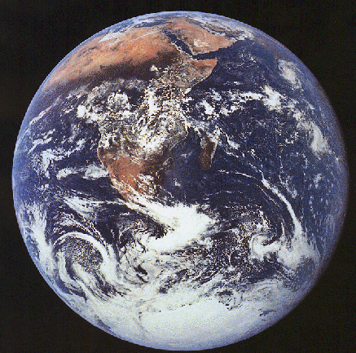
Science: observation, measurement, models

Slide 2
Class outline: whole semester
I. Introduction: Astronomy and Science
II. Motions in the Sky: Astronomy By Eye
III. Overview of the Universe
IV. The Physical Basis of Astronomy: Gravity and Light
V. Some interesting astronomy questions

Slide 3
What is science?
Science is a process by which we learn about the world
Science is not a collection of facts
Can be driven by curiosity or a need to know
Science relies on observations, i.e. measurements, also known as DATA
If an idea can’t be backed up with supporting data, and potentially refutable, it is not a scientific idea
Measurements almost always have some uncertainty associated with them
Understanding the quality of a measurement is often critical to being able to interpret it
Scientific progress often is related to breakthroughs in ability to collect data, or to reductions in the uncertainties associated with the data

Slide 4
Measurement accuracy/error
Very difficult, if not impossible, to interpret data without understanding how accurate it is! Uncertainties can come from
Tools used for measurement
Variation in thing being measured
Variation between different objects
(example: mean weight of a population)
Sometimes uncertainties are small compared with things being measured, sometimes not!
You can’t really interpret data without understanding the measurement uncertainties
Good skill: when someone presents you with data, understand or ask about the uncertainties. Without uncertainties, presentation of data is incomplete
Sometimes scientists use the word “errors” as a synonym for “uncertainties”. Don’t be misled.

Slide 5
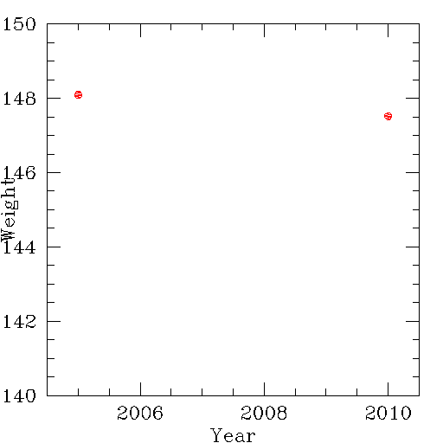
Example: Am I gaining weight?
A Yes
B No
C Information is incomplete

Slide 6
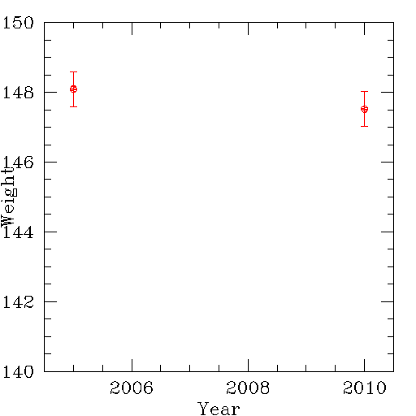
Example: Am I gaining weight?
A Yes
B No
C Can’t tell from these measurements: need more, or better, data
D Information is incomplete
Conventionally, error bars represent the range where the true measurement is likely to fall 2/3rds of the time; 95% of the time, the true measurement should be within double the length of the error bars.

Slide 7
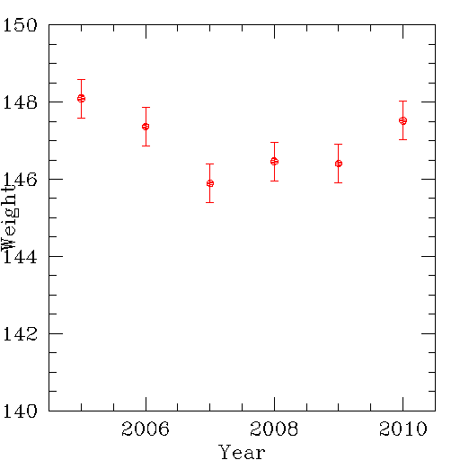
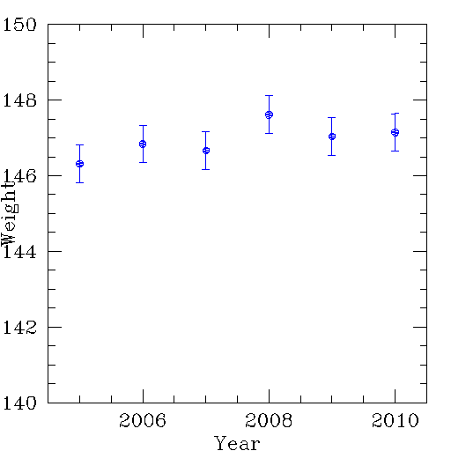
How to improve?
More data: fill in the time sequence
Repeat measurements: use different scales

Slide 8
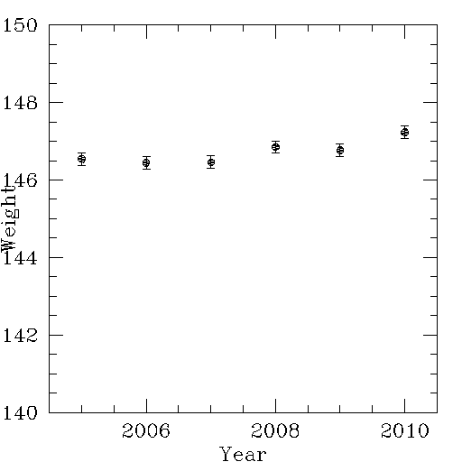
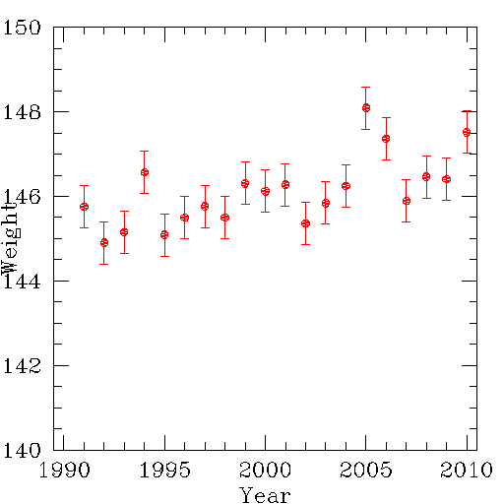
How to make things better?
Try to reduce measurement error: use a better scale, average together more measurements
When looking for a trend, try to extend the baseline: look over a longer period of time

Slide 9
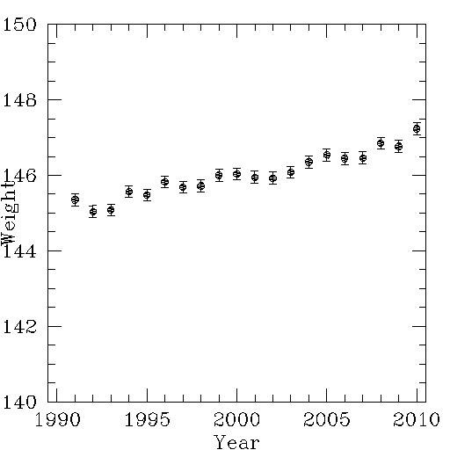
Even better data: six scales over more time
NOTE:
These are simulated data where the input was a constant weight gain per year
Even so, data that has some measurement error show some years with no apparent gain
Statistics, with well defined errors, can say how probable an interpretation of the data is
A Yes
B No
C Can’t tell from these measurements
D Information is incomplete

Slide 10
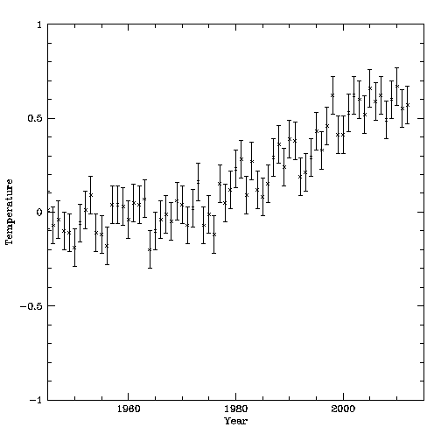
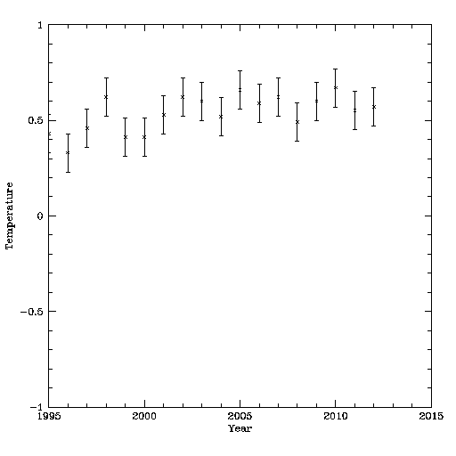
Real example: global temperatures

Slide 11
Measurement uncertainties
Just because there are measurement uncertainties doesn’t mean you can’t believe measurements: if trends are larger than errors, they are believable!
Ironically, if someone doesn’t give you uncertainties, it perhaps makes results less believable!
Data don’t always come in the form of numbers, but it can be helpful if you can figure out how to represent it with numbers, so you can have quantitative error estimates

Slide 12
Sum up: observations/measurements/errors
Science is based on observations / measurements. Which of the following is true?
A any measurement that can be represented by numbers gives a perfect assessment of what is going on with the object you are observing
B all measurements have associated uncertainties, but since you can’t do anything about them, you just interpret the results from the measurements you have without worrying about the uncertainties
C you need to understand the size of the expected uncertainties so you can decide whether the interpretation of the measurements is valid
D if you have measurements that have uncertainties, you cannot draw any conclusions from the data

Slide 13
Science: making progress
Improvements in the ability to measure things, or clever new ways to measure things, often leads to advances in understanding

Slide 14
What is the shape of the Earth?
The horizon at the ocean
A Flat (except for mountains)
B Spherical
C Cubical
D Depends on where you’re looking from
How do you know? How is your knowledge consistent with the data shown in the picture? Is there new data that makes the situation clearer?

Slide 15
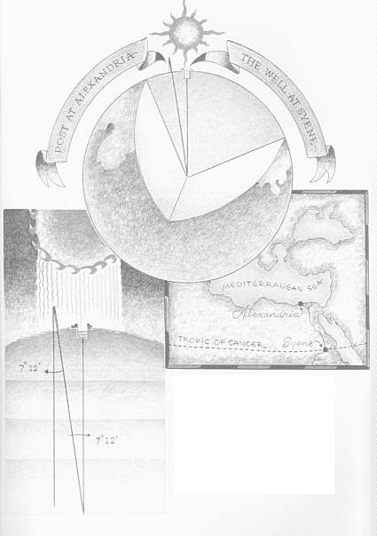
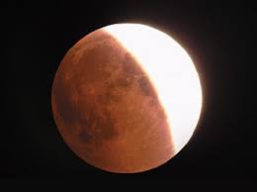
Shape of the Earth
Shape of the earth was known long before external images, and even before circumnavigation!
Shadows and eclipses
Clever measurement ideas can be powerful! Some people are very good at this, and often concentrate on experiments/observations

Slide 16
Scientific models
Data by itself is only a part of science: science generally tries to put data into a context of understanding what is being measured
Observations/measurements often lead to scientific models, or interpretations/hypotheses
Sometimes, multiple models may be consistent with observed data
New, or better, data, can sometimes resolve the issue

Slide 17
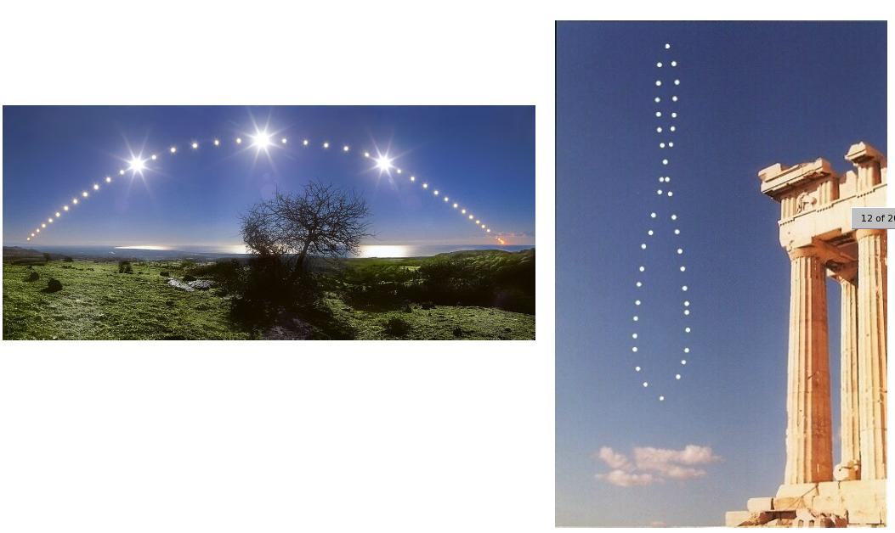
What is moving?
Location of Sun over course of a year, at the same time each day
Location of Sun over course of a day
Two models:
Sun is moving
Earth is moving
Which is correct? How do we know?

Slide 18
Earth/Sun motion
This one is actually a lot harder!
Not widely accepted that Earth was moving, not Sun, until about 500 years ago
New technology makes issue fairly clear, but again, the correct model was known before this new technology was available

Slide 19
To do
By next class:
Complete online assessment on Canvas: guaranteed 100% for first homework!
Bring $10 to lab for lab manual
We will set up using iClickers in lab. If you have one that you want to try to use, bring it to labs
Continue to master your directions!
Start to look at the sky
Useful resources: see class home page
If you don’t already know, look up how to find the Big Dipper
Go out at night and find it
What direction do you have to look to find it?

Slide 20
Viewing the night sky
Find a good location: relatively dark, no tall buildings or trees
Orient yourself: find the directions
Which direction is the front of the classroom?
North
East
South
West

Slide 21
Directions and Distances in the Sky
North, South, East and West don’t really give enough information when looking at the sky. What direction is straight up?
To describe a location in the sky, you need to give two pieces of information: for example, which direction (NSEW) and then how far above the horizon
What’s the best unit to measure how far above horizon?
A. Inches
B. Feet
C. Light Years
D. Degrees

Slide 22
Angles in the Sky
Distances in the sky are best measured by angles: 360 degrees in a circle, 180 degrees from horizon to horizon, 90 degrees from horizon to zenith
A convenient, approximate way to measure angles is using your fist held at arms length
How many degrees in one fist? (hint: how many fists from horizon to zenith?)
A. About 1 degree
B. About 10 degrees
C. About 20 degrees
D. About 45 degrees

Slide 23
Useful resources
Astroviewer: (http://www.astroviewer.com/interactive-night-sky-map.php)
UK National Schools Observatory (http://www.schoolsobservatory.org.uk/)
SkyMaps (http://www.skymaps.com/)
Numerous apps for cell phones!

Slide 24
What to look for in the sky now
What you see in the sky depends on when you look: time of year and time of night!
For late summer 2013, just after it gets dark, can find:
Planets: Venus, Saturn
Bright stars: the Summer Triangle
Moon (when it is up)
Milky Way (when Moon is not up)
Let’s look at some charts!

Slide 25
To do
Start looking at the sky
Look west (early!) for Venus, Mars(?), Saturn(?
Look south and up for summer triangle
Look east for Moon and Jupiter

