Slide 1
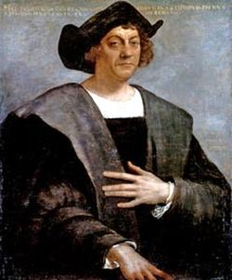
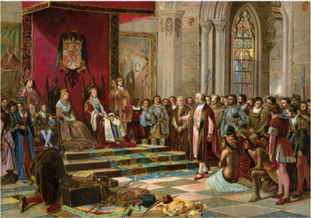

Slide 2
Feasibility rested on 2 things:
Surface of the planet was 6/7th land
Long eastward extent of Asia and small circumference of earth

Slide 3
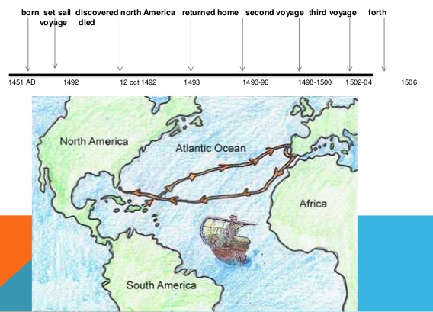

Slide 4
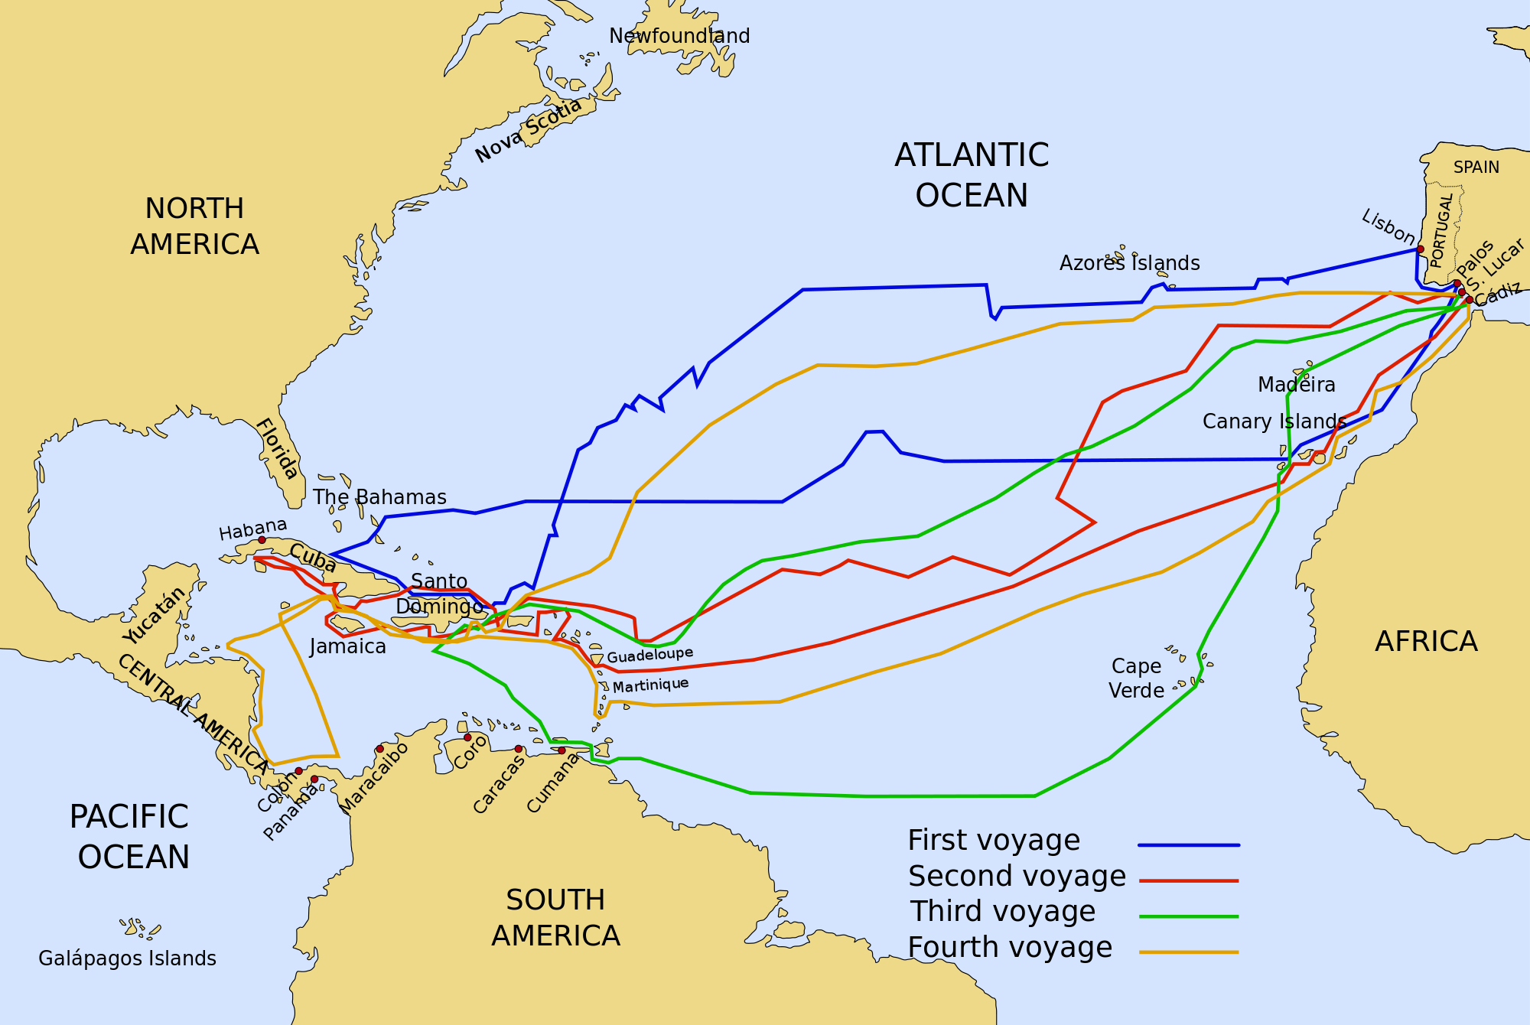

Slide 5
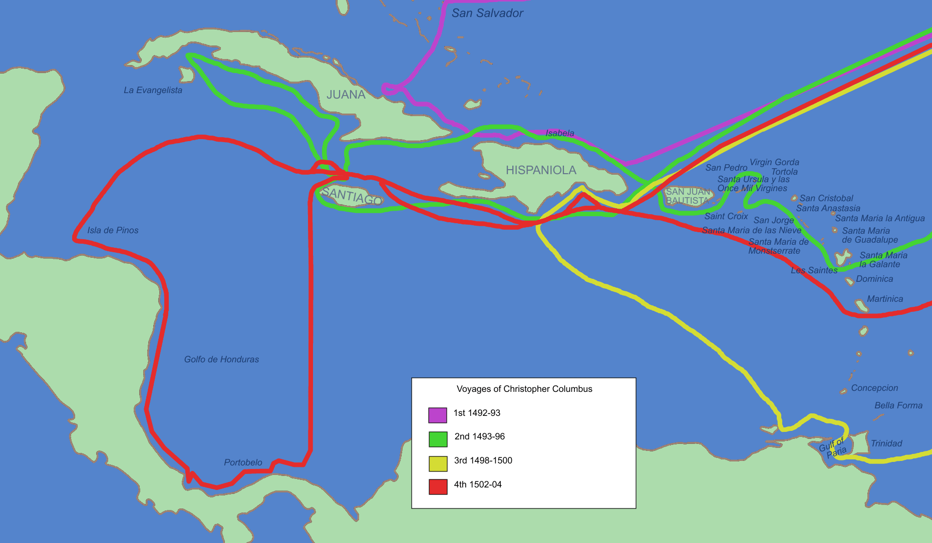

Slide 6
3 Discoveries:
Discovered lands not known to Europe before
Found best westward path from Europe to North America
Found best eastward path from North America to Europe

